Slide 1
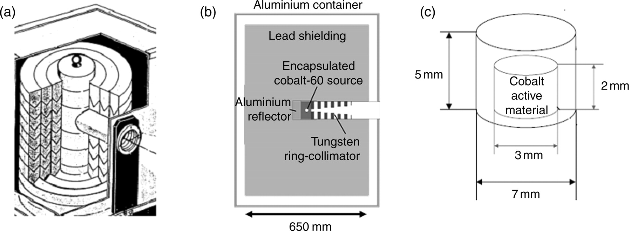
Figure 1. (a) Isometric view of the ⁶⁰Co source with the lead cylinder, the ring-collimator and the ...
Notes:
Figure 1. (a) Isometric view of the 60Co source with the lead cylinder, the ring-collimator and the aluminium container. (b) Cross section of the MCNPX geometry of the 60Co source. (c) The source stainless steel capsule and the cobalt active material.
Unless provided in the caption above, the following copyright applies to the content of this slide: © The Author 2007. Published by Oxford University Press. All rights reserved. For Permissions, please email: journals.permissions@oxfordjournals.org

Slide 2
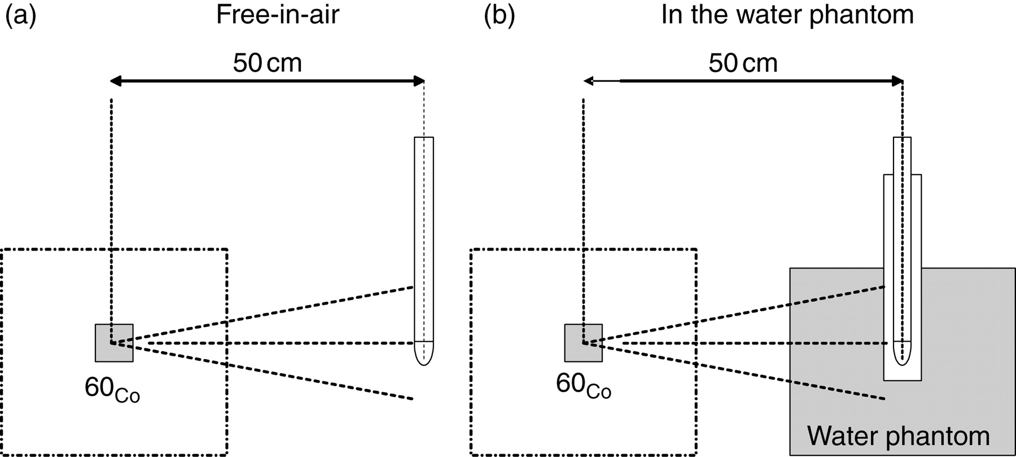
Figure 2. Sketch of the experimental setup. (a) Free-in-air. (b) In the water phantom.
Notes:
Figure 2. Sketch of the experimental setup. (a) Free-in-air. (b) In the water phantom.
Unless provided in the caption above, the following copyright applies to the content of this slide: © The Author 2007. Published by Oxford University Press. All rights reserved. For Permissions, please email: journals.permissions@oxfordjournals.org

Slide 3
Figure 3. Cross-section of the drawing of the ionisation chamber as supplied by the manufacturer and of the detailed ...
Notes:
Figure 3. Cross-section of the drawing of the ionisation chamber as supplied by the manufacturer and of the detailed MCNPX model (not to scale).
Unless provided in the caption above, the following copyright applies to the content of this slide: © The Author 2007. Published by Oxford University Press. All rights reserved. For Permissions, please email: journals.permissions@oxfordjournals.org

Slide 4
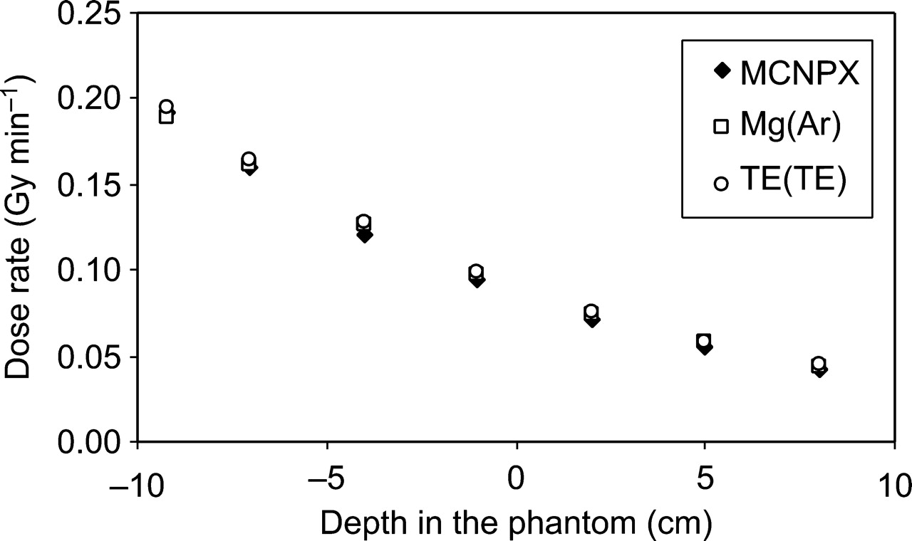
Figure 4. Absorbed dose in the water phantom in the ⁶⁰Co gamma-ray beam obtained using Mg(Ar), TE(TE) ion ...
Notes:
Figure 4. Absorbed dose in the water phantom in the 60Co gamma-ray beam obtained using Mg(Ar), TE(TE) ion chamber and from MCNPX calculation.
Unless provided in the caption above, the following copyright applies to the content of this slide: © The Author 2007. Published by Oxford University Press. All rights reserved. For Permissions, please email: journals.permissions@oxfordjournals.org

Slide 5
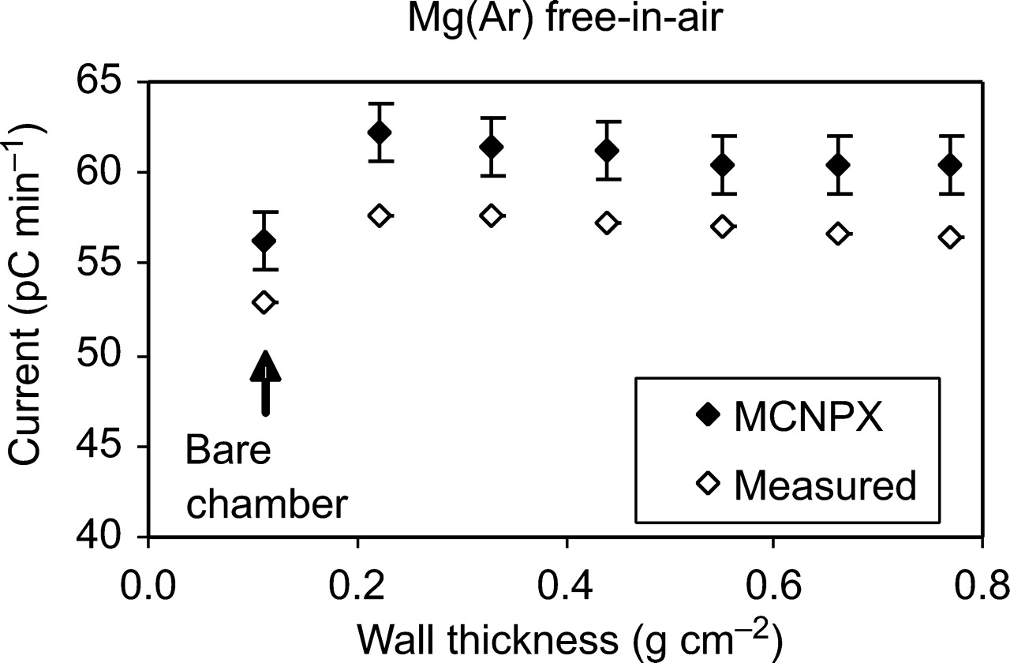
Figure 5. The measured and the calculated charge per unit of minute produced in the gas of the Mg(Ar) ionisation ...
Notes:
Figure 5. The measured and the calculated charge per unit of minute produced in the gas of the Mg(Ar) ionisation chamber with Mg build-up caps in a 60Co gamma-ray beam.
Unless provided in the caption above, the following copyright applies to the content of this slide: © The Author 2007. Published by Oxford University Press. All rights reserved. For Permissions, please email: journals.permissions@oxfordjournals.org

Slide 6
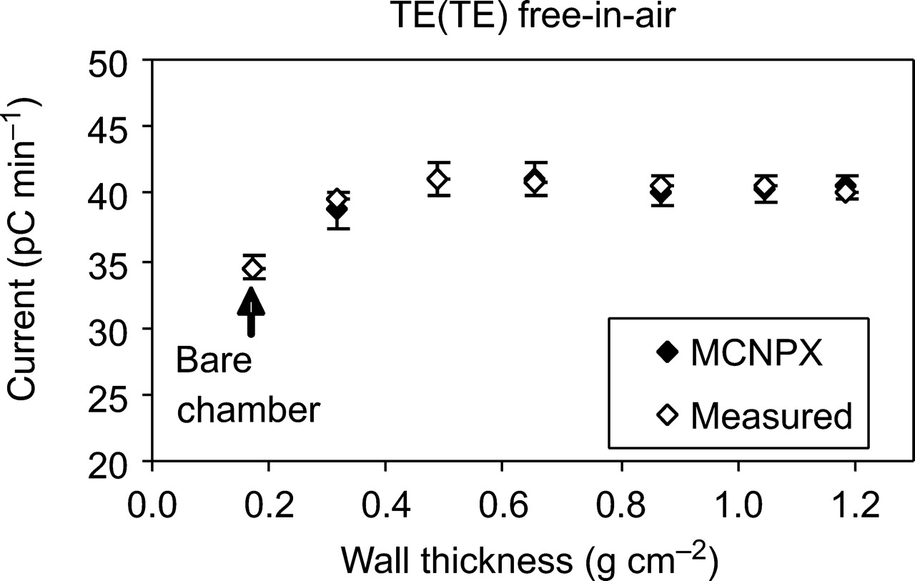
Figure 6. The measured and the calculated charge per unit of minute produced in the gas of the TE(TE) ionisation ...
Notes:
Figure 6. The measured and the calculated charge per unit of minute produced in the gas of the TE(TE) ionisation chamber with TE build-up caps in a 60Co gamma-ray beam.
Unless provided in the caption above, the following copyright applies to the content of this slide: © The Author 2007. Published by Oxford University Press. All rights reserved. For Permissions, please email: journals.permissions@oxfordjournals.org

Slide 7
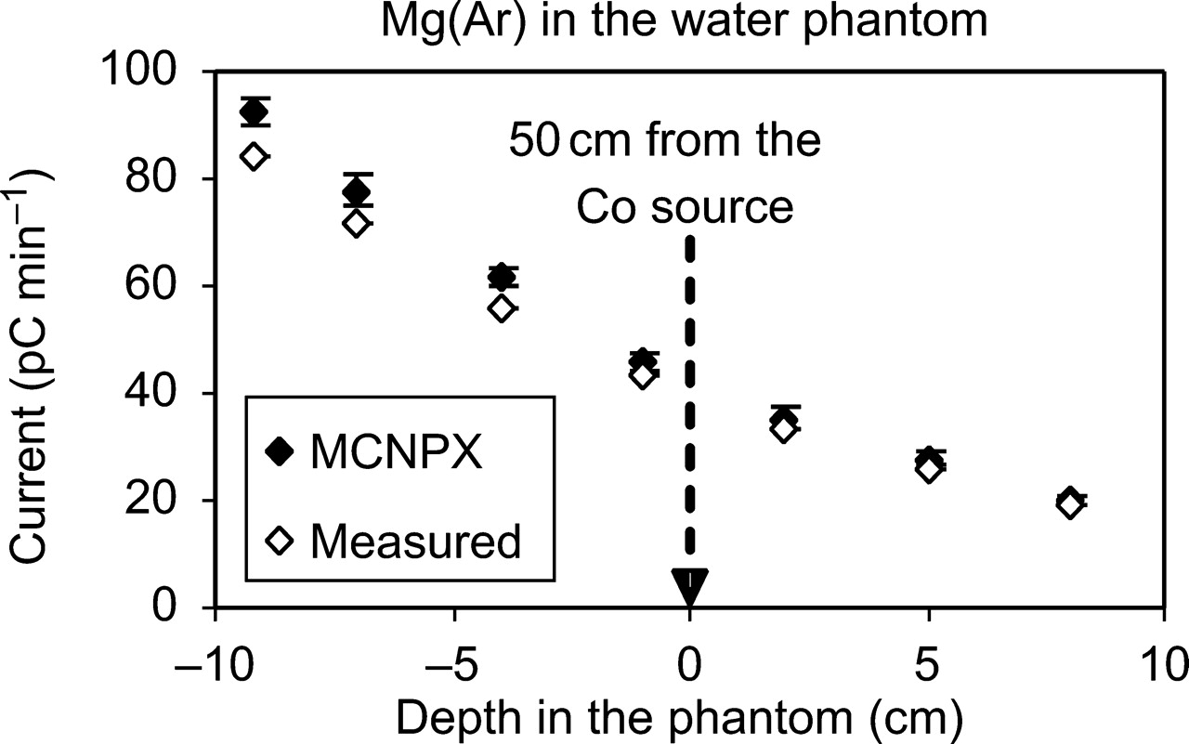
Figure 7. Comparison of measured and calculated charges per unit of minute in the water phantom for Mg(Ar) ionisation ...
Notes:
Figure 7. Comparison of measured and calculated charges per unit of minute in the water phantom for Mg(Ar) ionisation chamber exposed to a 60Co gamma-ray beam.
Unless provided in the caption above, the following copyright applies to the content of this slide: © The Author 2007. Published by Oxford University Press. All rights reserved. For Permissions, please email: journals.permissions@oxfordjournals.org

Slide 8
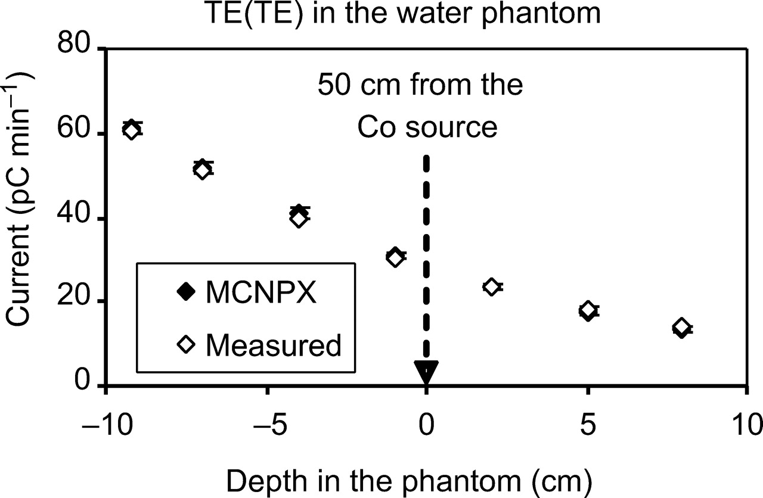
Figure 8. Comparison of measured and calculated charges per unit of minute in the water phantom for TE(TE) ionisation ...
Notes:
Figure 8. Comparison of measured and calculated charges per unit of minute in the water phantom for TE(TE) ionisation chamber exposed to a 60Co gamma-ray beam.
Unless provided in the caption above, the following copyright applies to the content of this slide: © The Author 2007. Published by Oxford University Press. All rights reserved. For Permissions, please email: journals.permissions@oxfordjournals.org

