Slide 1
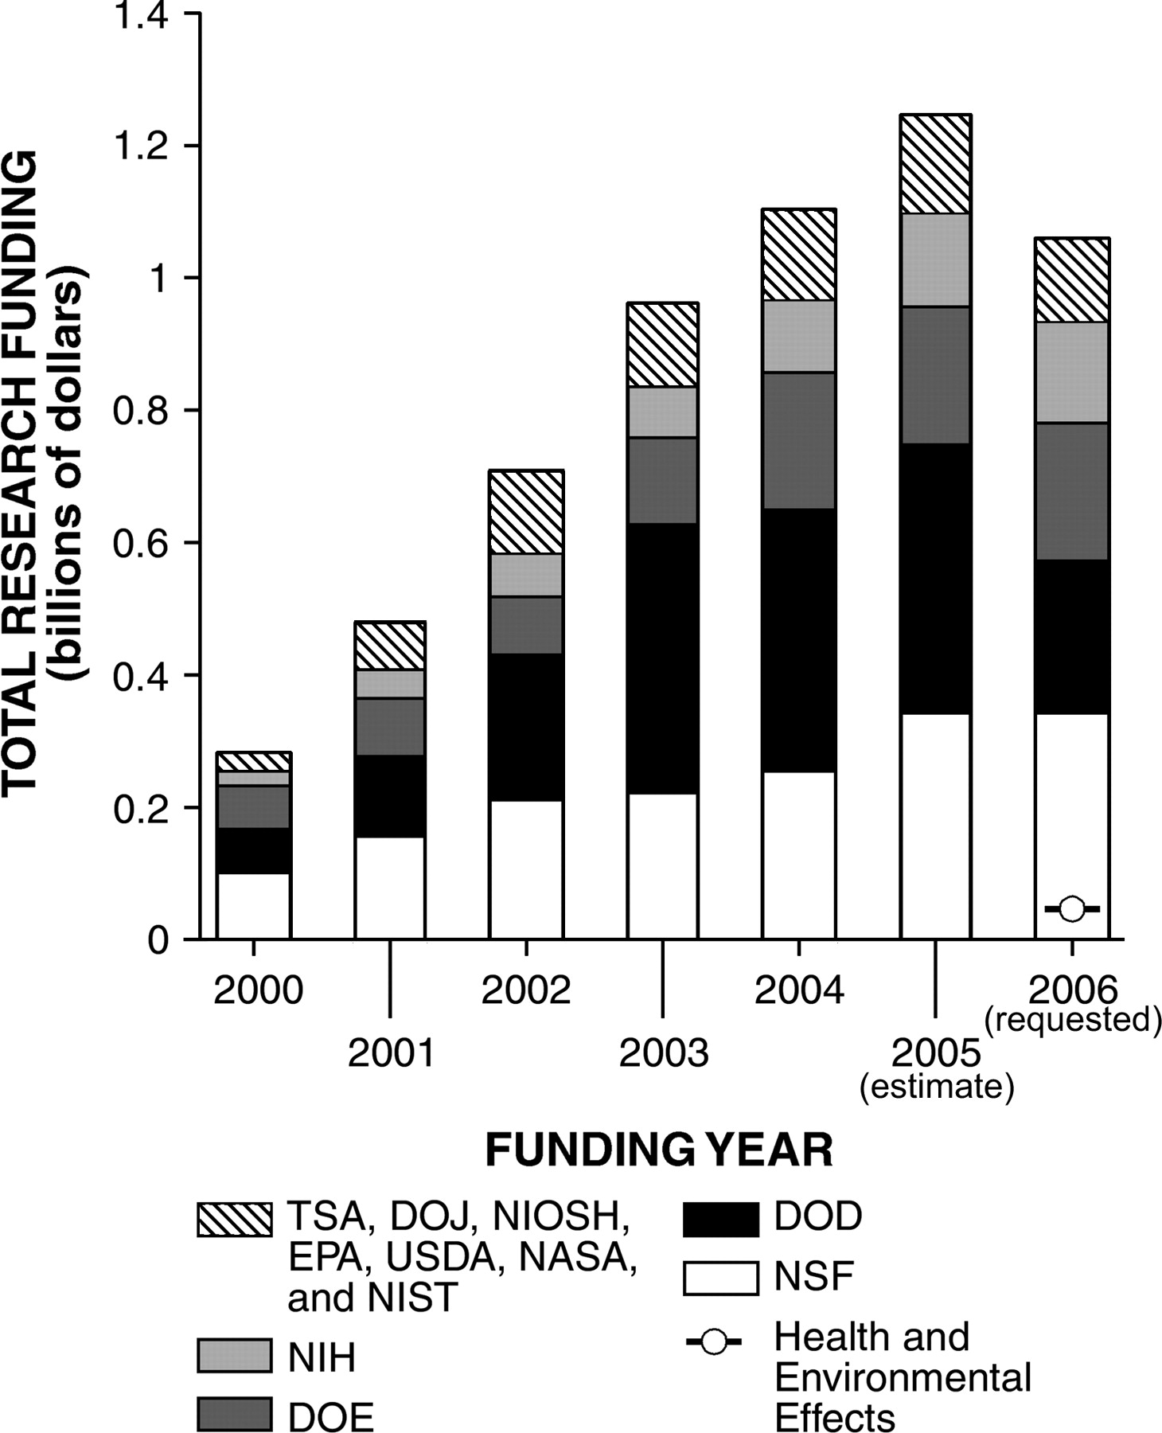
FIG. 1. National Nanotechnology Initiative total annual budget for various sectors. Federal funding for environment, ...
Notes:
FIG. 1. National Nanotechnology Initiative total annual budget for various sectors. Federal funding for environment, health, and safety is about 4% of the total budget. Additional funding is also occurring secondarily through other research (e.g., NIH); however, total funding for implications is still likely less than 10% based on the NIH budget. Source: www.nano.gov.
Unless provided in the caption above, the following copyright applies to the content of this slide: © The Author 2005. Published by Oxford University Press on behalf of the Society of Toxicology. All rights reserved. For Permissions, please email: journals.permissions@oxfordjournals.org

Slide 2
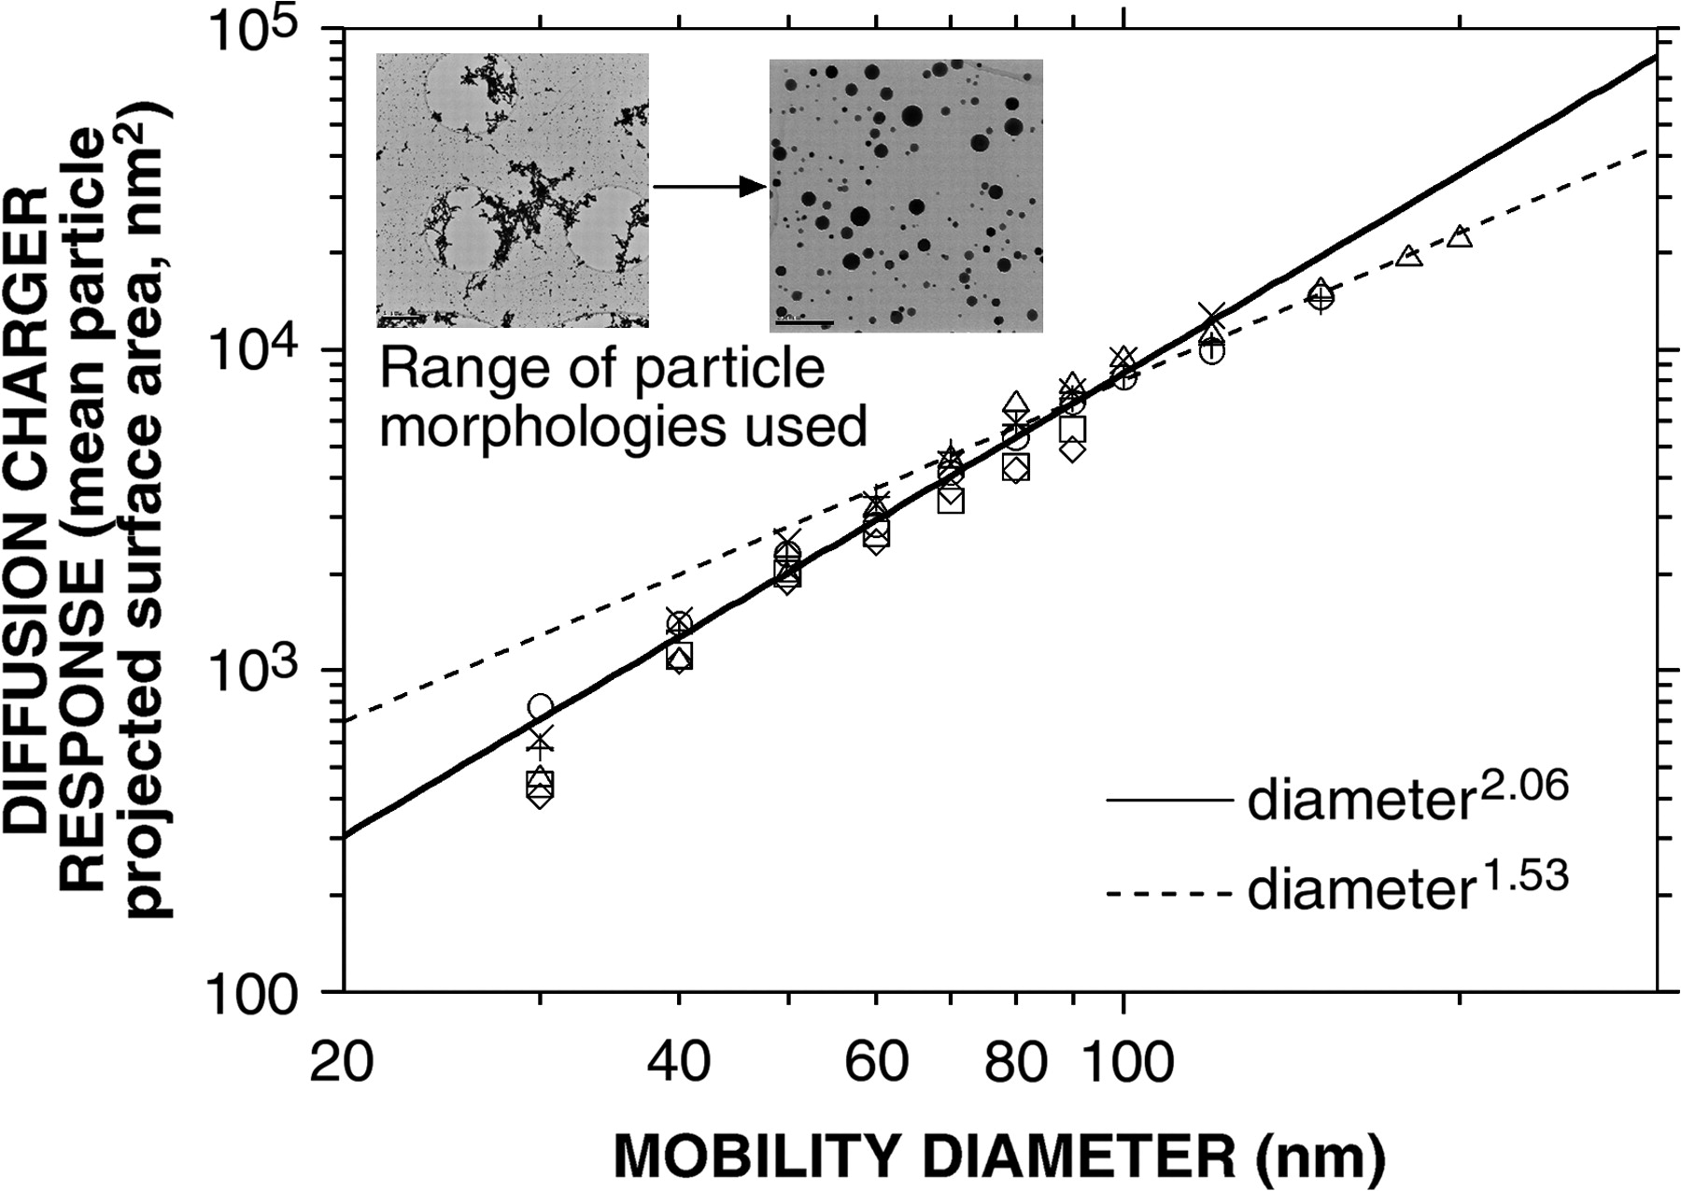
FIG. 2. Measured diffusion charger response to monodisperse aerosols with a range of particle morphologies (denoted ...
Notes:
FIG. 2. Measured diffusion charger response to monodisperse aerosols with a range of particle morphologies (denoted by different symbols) (Ku and Maynard, 2005). Mobility diameter refers to particle diameter as characterized using differential mobility analysis.
Unless provided in the caption above, the following copyright applies to the content of this slide: © The Author 2005. Published by Oxford University Press on behalf of the Society of Toxicology. All rights reserved. For Permissions, please email: journals.permissions@oxfordjournals.org

Slide 3
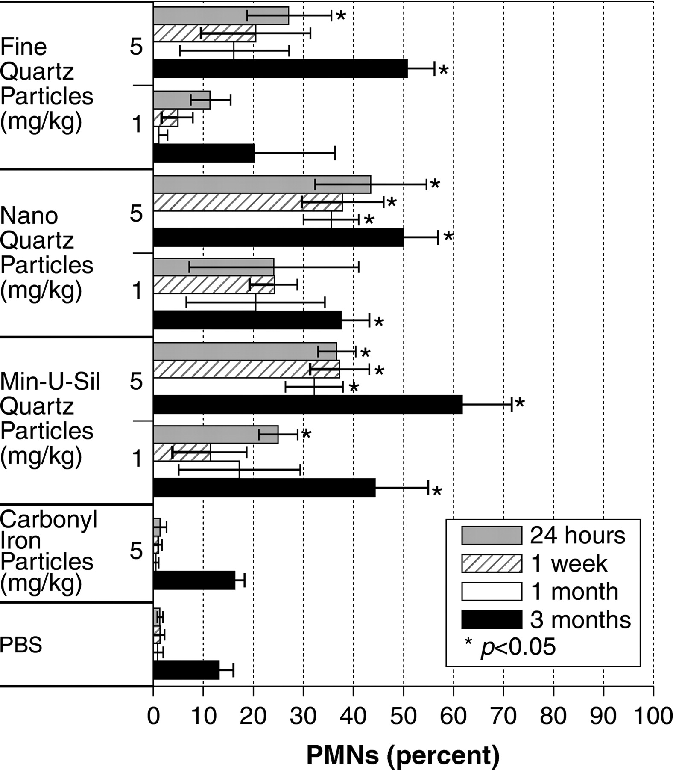
FIG. 3. Pulmonary inflammation in Min-U-Sil quartz, nanoscale quartz, fine-sized quartz, or iron particle-exposed ...
Notes:
FIG. 3. Pulmonary inflammation in Min-U-Sil quartz, nanoscale quartz, fine-sized quartz, or iron particle-exposed rats and controls as evidenced by percent neutrophils (PMN) in BAL fluids at 24 h, 1 week, 1 month, and 3 months postexposure. Values given are means ± SD. Exposures to Min-U-Sil or nanoscale quartz particles produced sustained, significant pulmonary inflammatory responses at all time points, as measured through 3 months postexposure. Exposures to fine-sized (400 nm) quartz particles also produced lung inflammatory responses, but were not as potent as with the Min-U-Sil and nanoscale quartz particles.
Unless provided in the caption above, the following copyright applies to the content of this slide: © The Author 2005. Published by Oxford University Press on behalf of the Society of Toxicology. All rights reserved. For Permissions, please email: journals.permissions@oxfordjournals.org

Slide 4
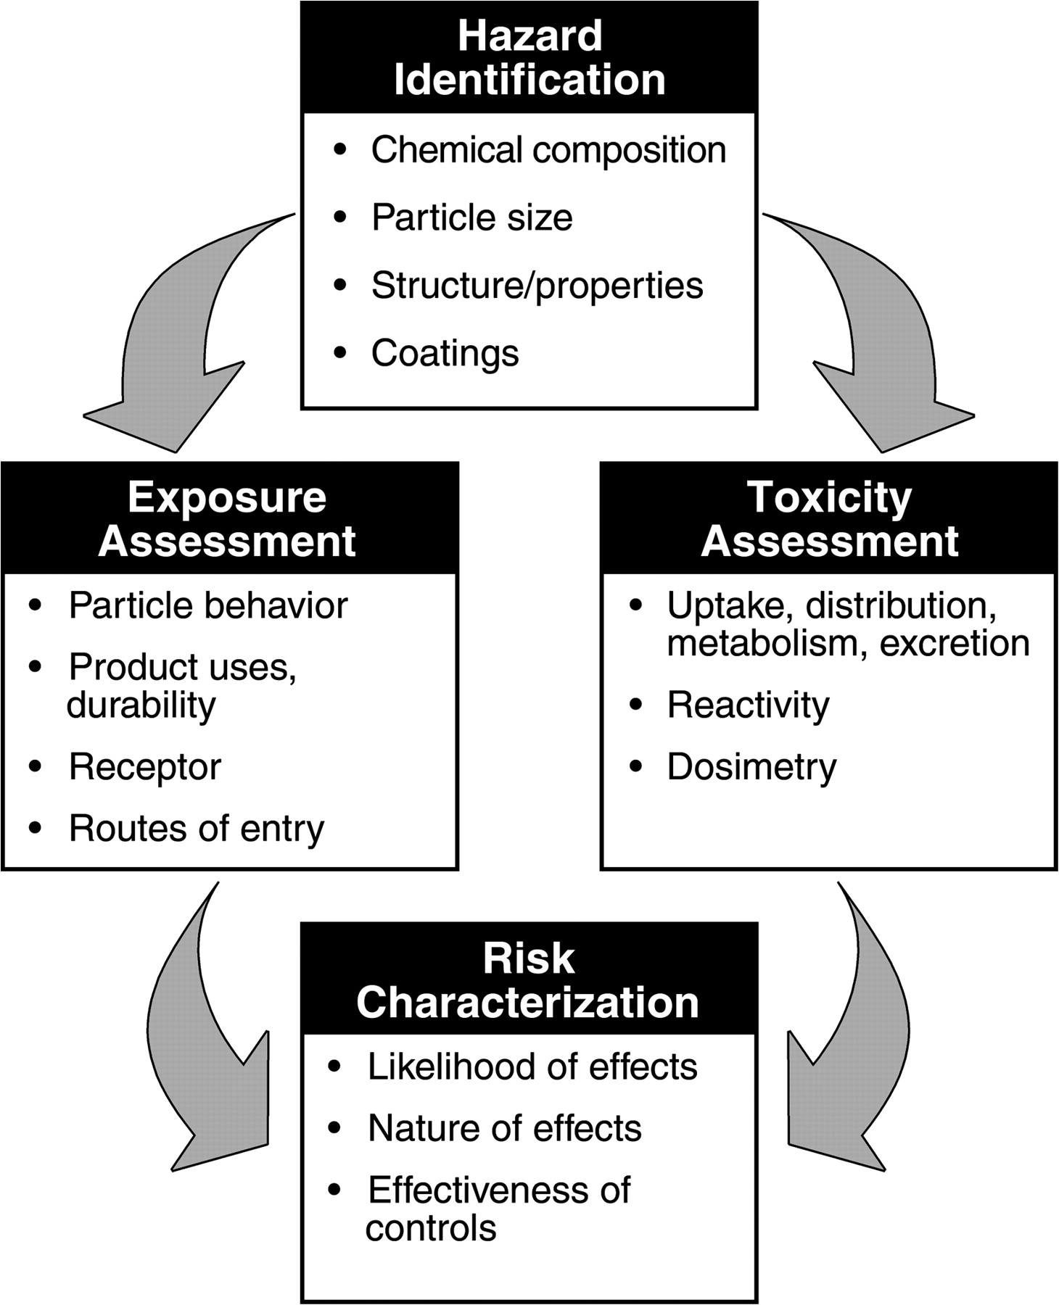
FIG. 4. Risk assessment framework for nanomaterials.
Notes:
FIG. 4. Risk assessment framework for nanomaterials.
Unless provided in the caption above, the following copyright applies to the content of this slide: © The Author 2005. Published by Oxford University Press on behalf of the Society of Toxicology. All rights reserved. For Permissions, please email: journals.permissions@oxfordjournals.org

Slide 5
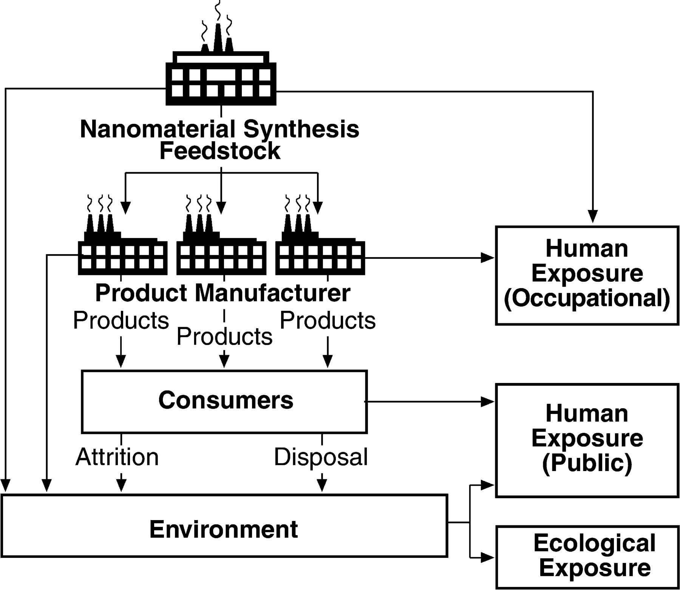
FIG. 5. Potential for release and exposure to nanoscale substances.
Notes:
FIG. 5. Potential for release and exposure to nanoscale substances.
Unless provided in the caption above, the following copyright applies to the content of this slide: © The Author 2005. Published by Oxford University Press on behalf of the Society of Toxicology. All rights reserved. For Permissions, please email: journals.permissions@oxfordjournals.org

