Slide 1
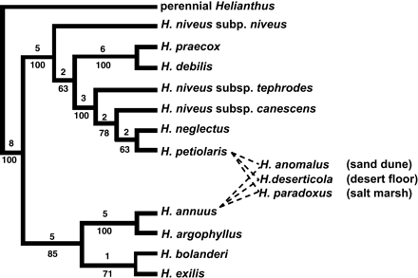
Figure 1. Example of a phylogenetic tree showing reticulation due to homoploid hybrid speciation. Phylogenetic tree for ...
Notes:
Figure 1. Example of a phylogenetic tree showing reticulation due to homoploid hybrid speciation. Phylogenetic tree for Helianthus section, Helianthus based on combined chloroplast DNA and nuclear ribosomal DNA data (Rieseberg 1991). The number of mutations are given above and bootstrap percentages below each branch. Dashed lines indicate parentage of homoploid hybrid species.
Unless provided in the caption above, the following copyright applies to the content of this slide: © 2005 The American Genetic Association

