Slide 1
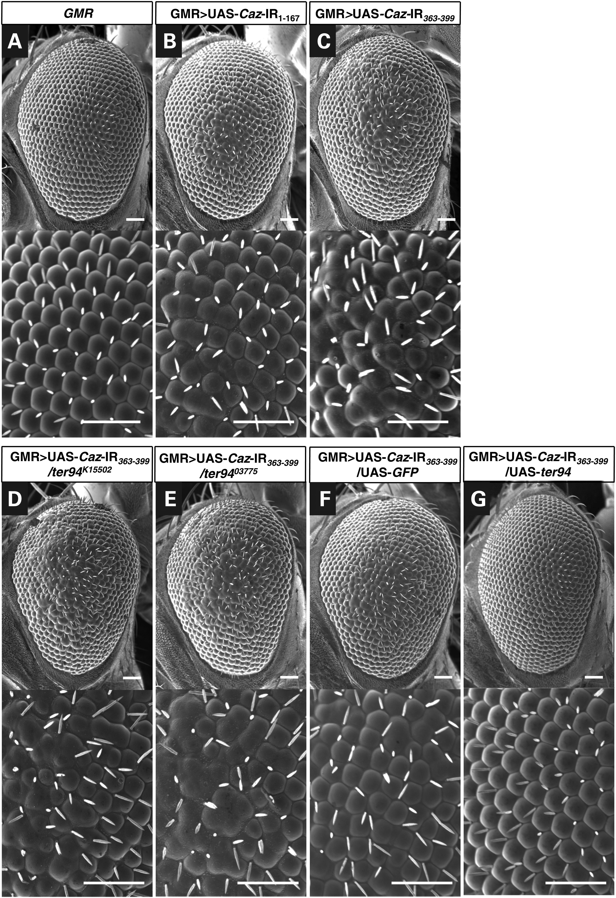
Figure 1. The rough-eye phenotype induced by Caz-knockdown is modified by genetic changes in ter94. Each panel shows a ...
Notes:
Figure 1. The rough-eye phenotype induced by Caz-knockdown is modified by genetic changes in ter94. Each panel shows a scanning electron micrograph of the compound eye of a 3-day-old adult fly. Each lower panel is a higher magnification image of the corresponding upper panel. Specific knockdown of Caz in eye imaginal discs was achieved by crossing the transgenic flies that carried UAS-Caz-IR with the GMR-GAL4 driver. (A) The eyes of a control fly carrying GMR-GAL4; +; + (GMR) exhibit apparently normal eye morphology having an organized ommatidial architecture. (B and C) Adult eyes from two independent fly lines with eye-specific Caz-knockdown. Flies from line with UAS-Caz-IR1–167 (strain 4, Table 1) or from the line with UAS-Caz-IR363–399 were crossed with flies from the GMR-GAL4 driver strain. Resultant flies carrying GMR>UAS-Caz-IR1–167 (B) or GMR>UAS-Caz-IR363–399 (C) have essentially the same rough-eye phenotype and exhibit ommatidial degeneration. (D and E) Adult eyes from two independent fly lines; each line has eye-specific Caz-knockdown and a distinct loss-of-function mutation in ter94. The eye-specific Caz-knockdown fly line (GMR>UAS-Caz-IR363–399/UAS-Caz-IR363–399) was crossed with flies carrying the strongest (ter94K15502) or a strong (ter9403775) loss-of-function ter94 mutation. The resultant flies carrying GMR>UAS-Caz-IR363–399/ter94K15502 (D) or GMR>UAS-Caz-IR363–399/ter9403775 (E) show rough-eye phenotypes that is enhanced relative to that observed in flies with GMR>UAS-Caz-IR363–399 alone (C). Adult eyes from fly lines resulting from crosses of eye-specific Caz-knockdown flies with UAS-GFP (GMR>UAS-Caz-IR363–399/UAS-GFP, a responder control, F) or UAS-ter94 (GMR>UAS-Caz-IR363–399/UAS-ter94, G). The rough-eye phenotype induced by eye-specific Caz-knockdown is obviously less severe in the presence of UAS-ter94 (G) than in the presence of UAS-GFP (F). Posterior is to the right, and dorsal is to the top. The flies were developed at 28°C. Scale bars indicate 50 µm.
Unless provided in the caption above, the following copyright applies to the content of this slide: © The Author 2014. Published by Oxford University Press. All rights reserved. For Permissions, please email: journals.permissions@oup.com

Slide 2
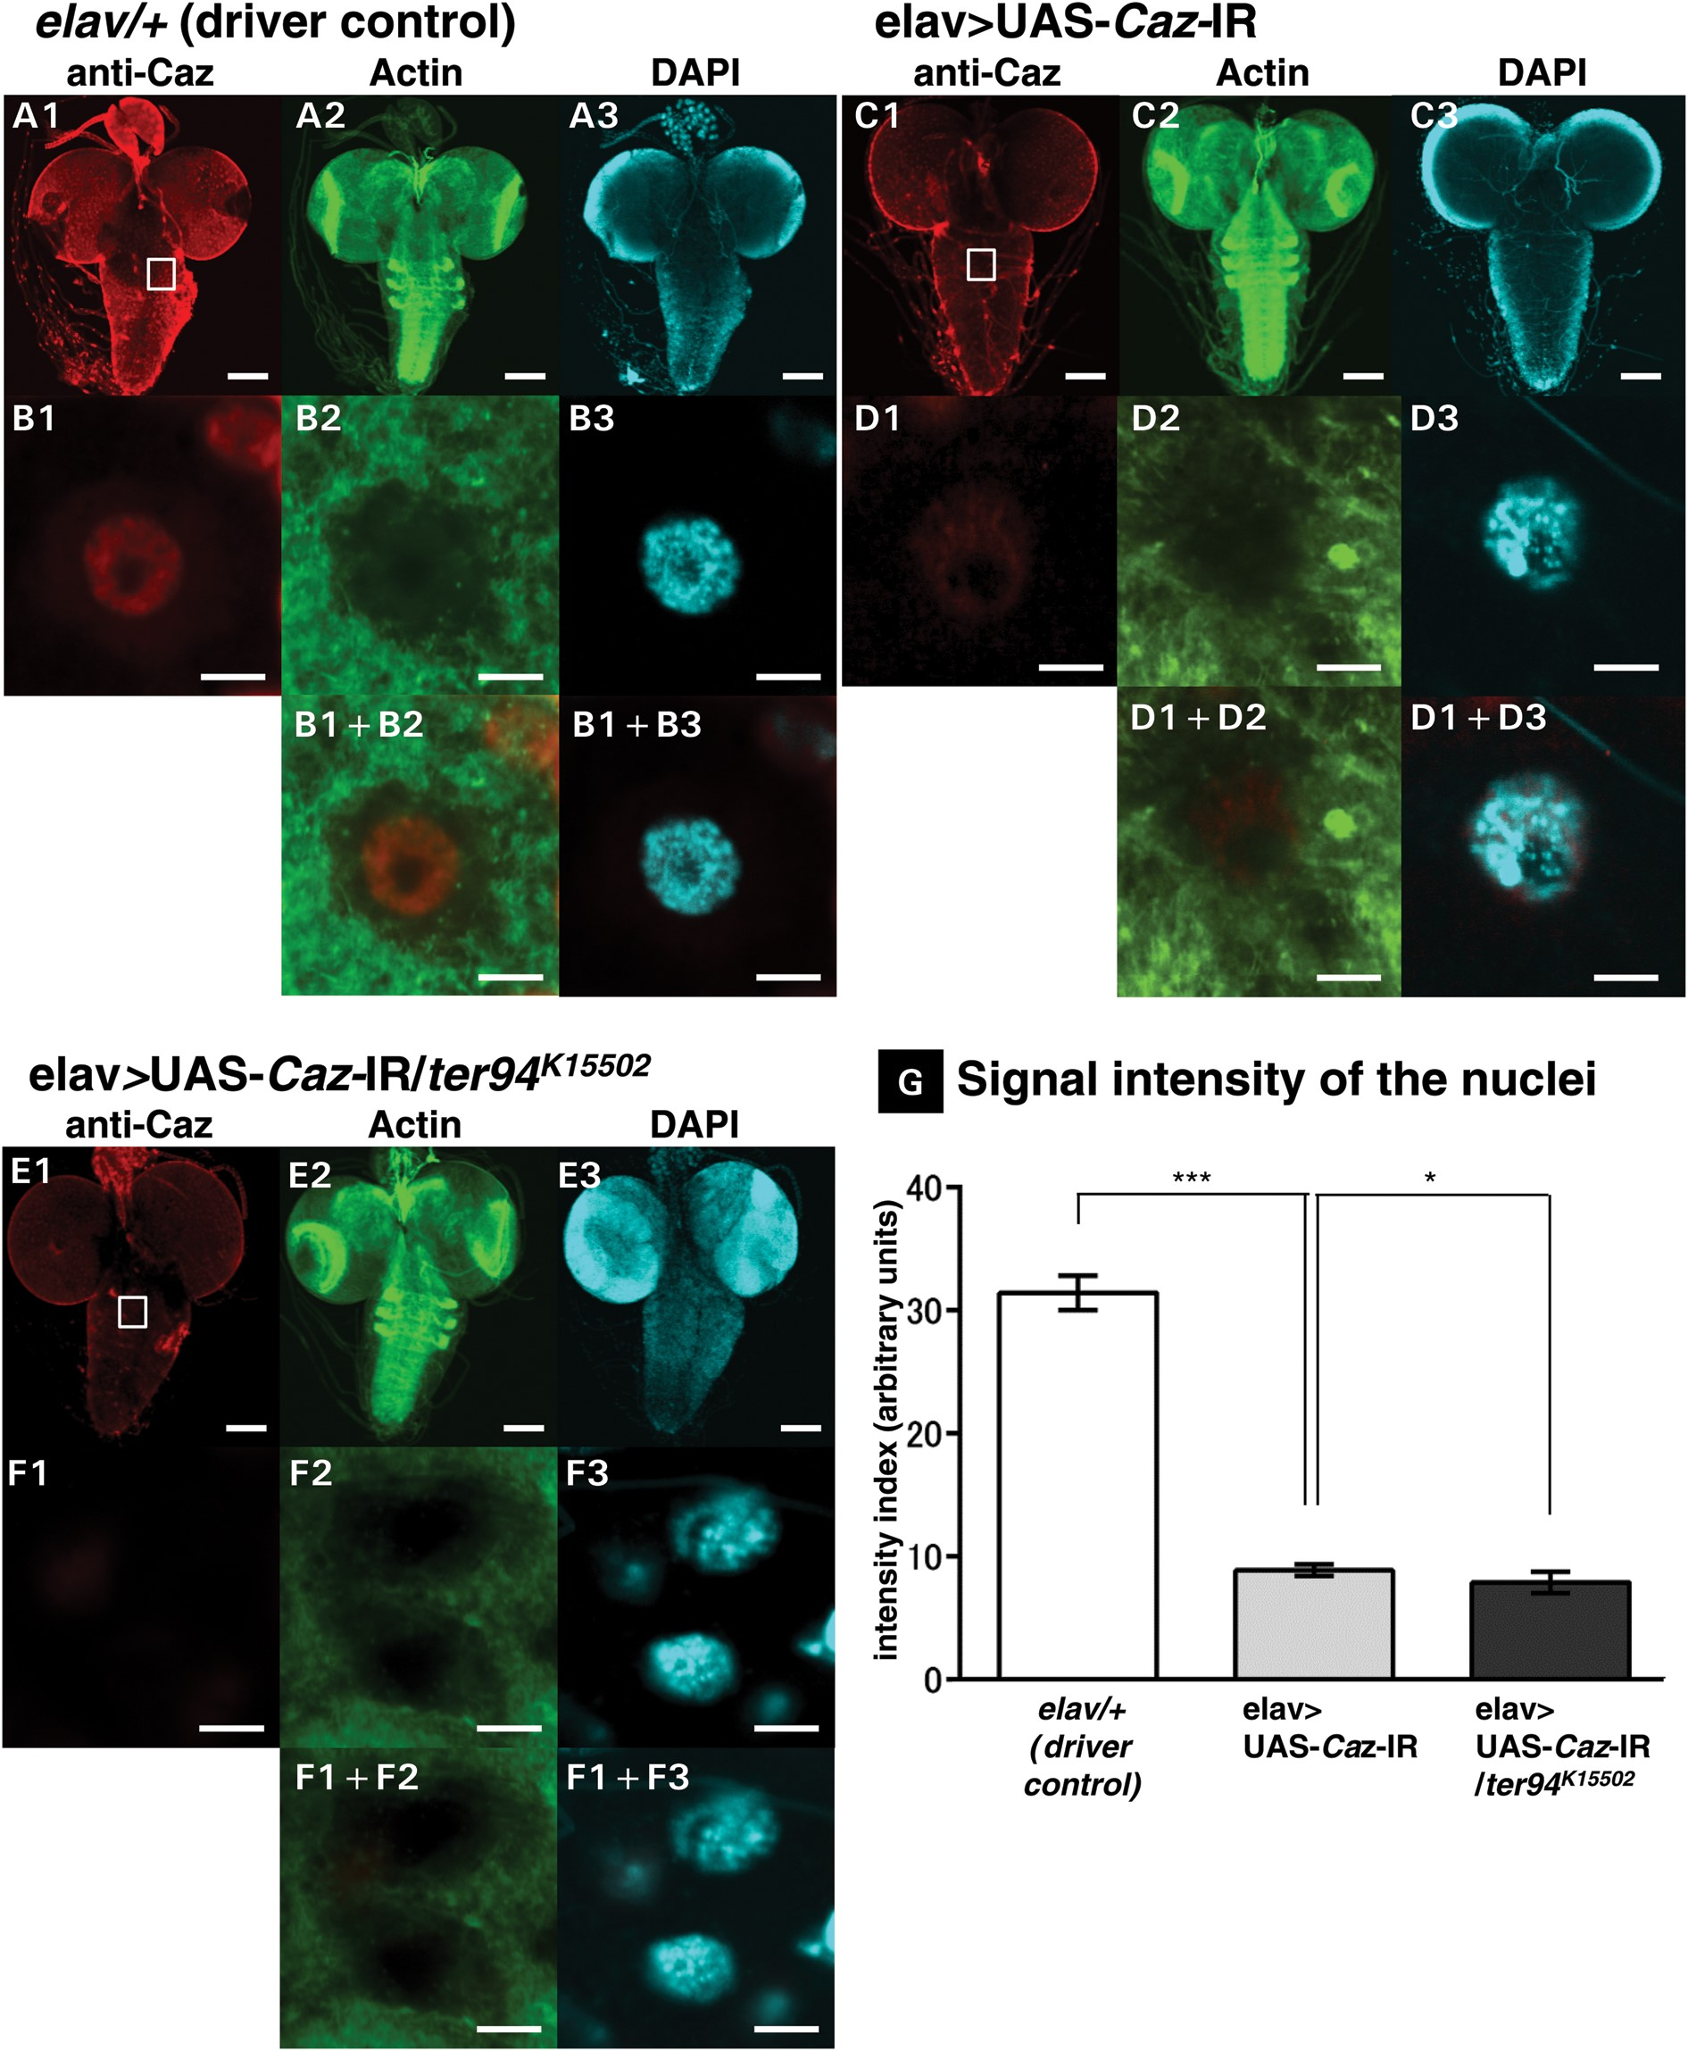
Figure 2. Neuron-specific Caz-knockdown reduces Caz signal in nuclei within larval CNS, and this reduction is ...
Notes:
Figure 2. Neuron-specific Caz-knockdown reduces Caz signal in nuclei within larval CNS, and this reduction is significantly exacerbated by a loss-of-function ter94 mutation. (A)–(F) are representative images of corresponding genotypes. (A1)–(A3) are immunofluorescent images of larval CNS, which comprises BVGC, taken from a driver control larva carrying elav/+. (C1)­–(C3) are the BVGCs of a Caz-knockdown larva carrying UAS-Caz-IR. (E1)–(E3) are the BVGCs of a larva co-expressed with ter94K15502 in the background of Caz-knockdown carrying elav>UAS-Caz-IR/ter94K15502. (B1)–(B3), (D1)–(D3) and (F1)–(F3) are higher magnification images of the boxed area in (A1), (C1) and (E1), respectively. (B1+B2), (B1+B3), (D1+D2), (D1+D3), (F1+F2) and (F1+F3) are merged images. The indirect immunofluorescence in A1, B1, C1, D1, E1 and F1 is signal from the polyclonal anti-Caz antibody. The fluorescence in A2, B2, C2, D2, E2 and F2 is from phalloidin, which labels actin; the fluorescence in A3, B3, C3, D3, E3 and F3 is from DAPI, which labels DNA. The BVGC of driver control larvae carrying elav/+ show ubiquitous signals from endogenous Caz (A1), but the signal intensity from endogenous Caz in the BVGC is remarkably reduced in larvae carrying elav>UAS-Caz-IR (C1). Anti-Caz antibody immunoreactivity is evident in the nuclei of neuronal cells (B1) and does not colocalize with phalloidin-stained actin filaments (B2, B1+B2). Caz does not colocalize with DAPI (B3, B1+B3). The intensity of nuclear Caz signal is significantly reduced in the BVGCs of larvae carrying elav>UAS-Caz-IR (D1) compared with that of driver control larvae (B1) (P UAS-Caz-IR/ter94K15502) (E1) also show remarkably reduced Caz signals in the BVGCs. The intensity of the nuclear Caz signal is significantly reduced in these larvae with the strongest loss-of-function allele of ter94 and Caz-knockdown (F1), even compared with that of the Caz-knockdown larvae (D1) (P < 0.05, G). The scale bars indicate 100 μm (A1–A3, C1–C3 and E1–E3) and 5 μm (B1–B3, D1–D3 and F1–F3). (G) This graph plots the mean (± SE) of the intensity of the nuclear Caz signal in BVGCs from third instar larvae as fluorescence emission in arbitrary units with respect to the genotype; Columns and horizontal bars show the mean and SE of 15 nuclei, respectively. ***P < 0.001, *P < 0.05.
Unless provided in the caption above, the following copyright applies to the content of this slide: © The Author 2014. Published by Oxford University Press. All rights reserved. For Permissions, please email: journals.permissions@oup.com

Slide 3
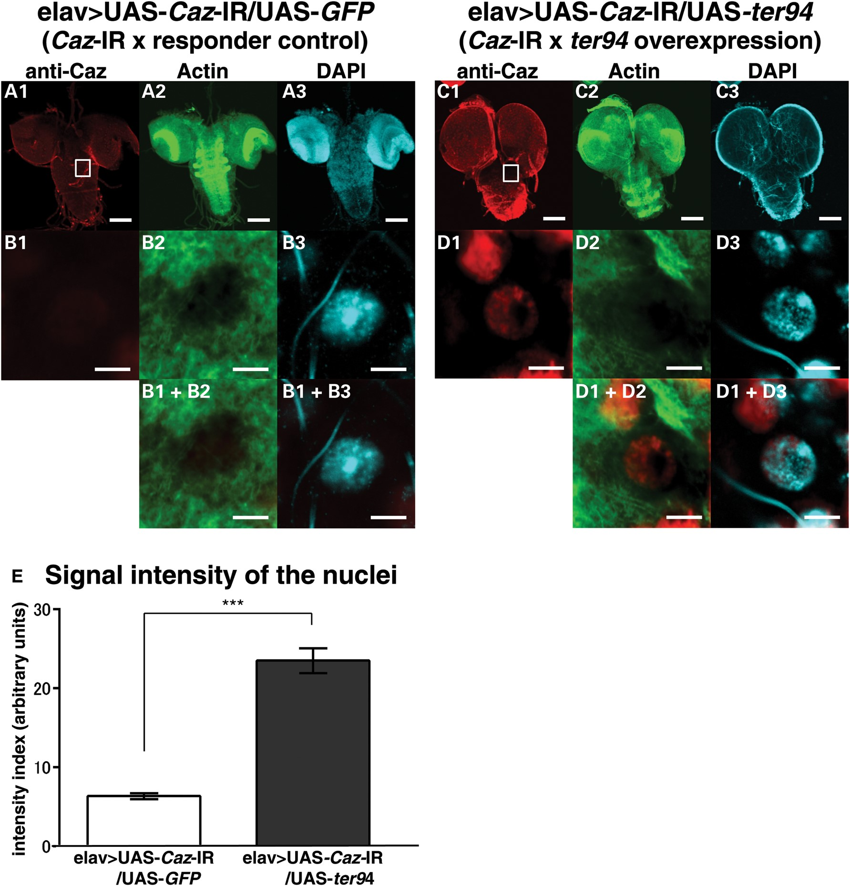
Figure 3. Overexpression of wild-type ter94 restores Caz signal in nuclei in the CNS of larvae with neuron-specific ...
Notes:
Figure 3. Overexpression of wild-type ter94 restores Caz signal in nuclei in the CNS of larvae with neuron-specific Caz-knockdown. (A)–(D) are representative images of corresponding genotypes. (A1)–(A3) are the BVGCs of a Caz-knockdown larva carrying elav>UAS-Caz-IR/UAS-GFP. (C1)–(C3) are the BVGCs of a larva that overexpressed wild-type ter94 in the background of Caz-knockdown carrying elav>UAS-Caz-IR/UAS-ter94. (B1)–(B3) and (D1)–(D3) are higher magnification images of the boxed area in A1 and C1, respectively. (B1+B2), (B1+B3), (D1+D2) and (D1+D3) are merged images. The indirect immunofluorescence in A1, B1, C1 and D1 is the signal from the polyclonal anti-Caz antibody. The fluorescence in A2, B2, C2 and D2 and that in A3, B3, C3 and D3 are from phalloidin and DAPI, respectively. (E) shows the mean (±SE) of the intensity of the nuclear Caz signal in the BVGC tissues from the third instar larvae as fluorescence emission in arbitrary units. Columns and horizontal bars show the mean and SE of 15 nuclei, respectively. ***P UAS-Caz-IR/UAS-GFP (A1), Caz signals are remarkably stronger in the BVGCs of the larvae carrying elav>UAS-Caz-IR/UAS-ter94 (C1). The intensity of the nuclear Caz signal is significantly higher in these larvae due to the overexpression of ter94 (D1) than in the larvae carrying elav>UAS-Caz-IR/UAS-GFP (B1) (P < 0.001, E). The scale bars indicate 100 μm (A1–A3 and C1–C3) and 5 μm (B1–B3 and D1–D3).
Unless provided in the caption above, the following copyright applies to the content of this slide: © The Author 2014. Published by Oxford University Press. All rights reserved. For Permissions, please email: journals.permissions@oup.com

Slide 4
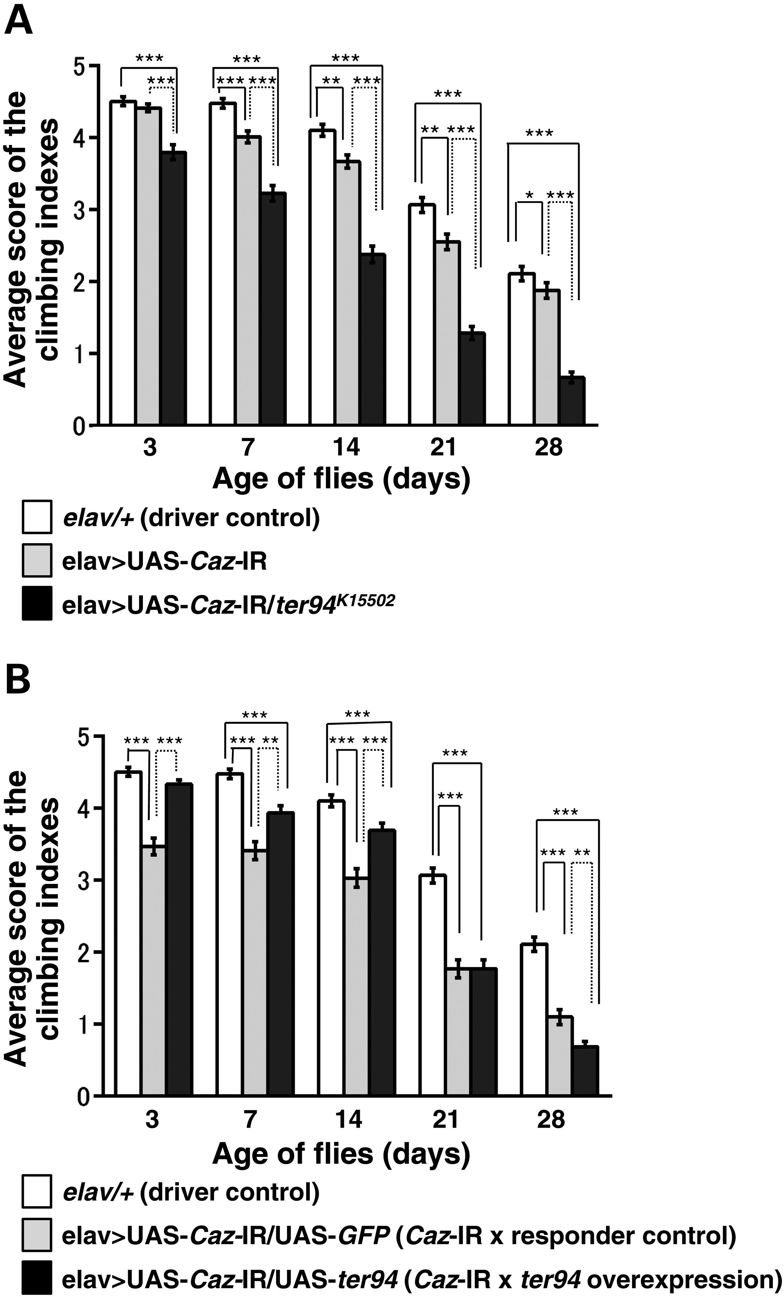
Figure 4. A loss-of-function ter94 mutation and wild-type ter94 overexpression have opposite effects on the climbing ...
Notes:
Figure 4. A loss-of-function ter94 mutation and wild-type ter94 overexpression have opposite effects on the climbing ability of neuron-specific Caz-knockdown flies. (A) The locomotive ability of driver control flies, which carrying elav/+ (n = 366, white columns), is significantly better than that of neuron-specific Caz-knockdown flies, which carrying elav>UAS-Caz-IR (n = 296, gray columns) for every age examined other than day 3. On each day after eclosion that was monitored, adult flies carrying elav>UAS-Caz-IR/ter94K15502 (n = 210, black columns) exhibited significantly worse climbing ability than flies carrying neuron-specific Caz-knockdown alone. (B) Conversely, adult flies carrying elav>UAS-Caz-IR/UAS-ter94 (n = 215, black columns) have significantly better climbing ability than flies carrying elav>UAS-Caz-IR/UAS-GFP (n = 190, gray columns) on days 3, 7 and 14, but not after day 14. The climbing ability of flies carrying elav/+ (n = 366, white columns) is significantly better than those carrying elav>UAS-Caz-IR/UAS-GFP for every age examined, same as those in (A). Until day 3, the climbing ability of flies carrying elav>UAS-Caz-IR/UAS-ter94 is recovered almost as well as that of flies carrying elav/+. However, that of the flies carrying elav>UAS-Caz-IR/UAS-ter94 is significantly less than that of flies carrying elav/+ after day 3. Columns and horizontal bars show the mean and SE of the measurements, respectively. ***P < 0.001, **P < 0.01 and *P < 0.05.
Unless provided in the caption above, the following copyright applies to the content of this slide: © The Author 2014. Published by Oxford University Press. All rights reserved. For Permissions, please email: journals.permissions@oup.com

Slide 5
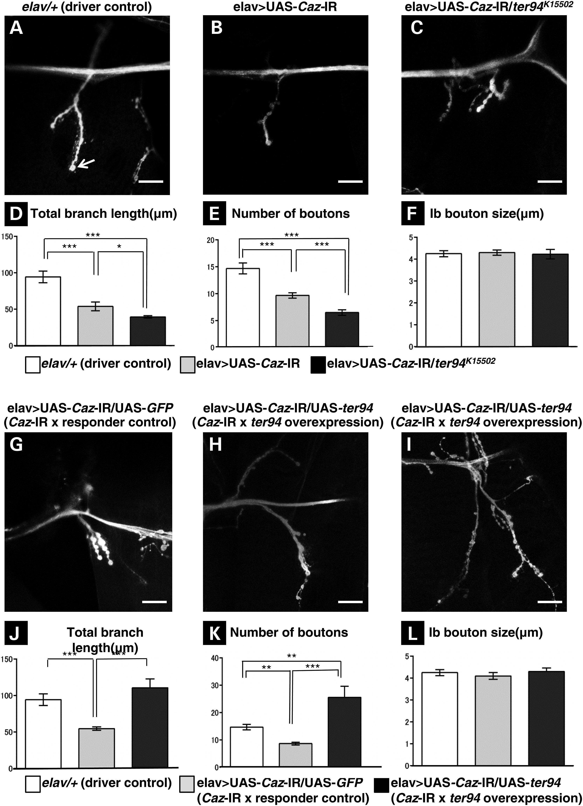
Figure 5. A loss-of-function ter94 mutation and wild-type ter94 overexpression change the morphology of MN presynaptic ...
Notes:
Figure 5. A loss-of-function ter94 mutation and wild-type ter94 overexpression change the morphology of MN presynaptic terminals in the NMJ of MN4 in neuron-specific Caz-knockdown larvae in opposite ways. A representative image of anti-horseradish peroxidase staining of muscle 4 synapses in third instar larvae with elav/+ (A; a driver control), neuron-specific Caz-knockdown (B; elav>UAS-Caz-IR), neuron-specific Caz-knockdown crossed with the strongest loss-of-function mutation of ter94 (C; elav>UAS-Caz-IR/ter94K15502), neuron-specific Caz-knockdown crossed with UAS-GFP (G; elav>UAS-Caz-IR/UAS-GFP; a responder control) or neuron-specific Caz-knockdown crossed with UAS-ter94 (H and I; different larvae with the same genotype, elav>UAS-Caz-IR/UAS-ter94). (D and J) Total branch length of the NMJ from muscle 4 for each of the indicated genotypes. Compared with the total length of synaptic branches of MNs in driver control larvae (A), that in neuron-specific Caz-knockdown larvae (B) is significantly decreased (P < 0.001, n = 10, D). This decrease in branch length observed in the neuron-specific Caz-knockdown larvae (B) is significantly worsened in larvae carrying the strongest loss-of-function allele of ter94 and neuron-specific Caz-knockdown (C) (P UAS-Caz-IR/UAS-GFP (G) (P UAS-Caz-IR/UAS-ter94 was highly variable among individual flies (H and I). The total branch length of synaptic branches of MNs in the larvae carrying elav>UAS-Caz-IR/UAS-GFP is significantly decreased compared with that of larvae carrying elav/+ (P < 0.001, n = 12, J). (E and K) The number of synaptic boutons for each of the indicated genotypes. The number of synaptic boutons of MNs in neuron-specific Caz-knockdown larvae (B) is also significantly decreased compared with driver control larvae (A) (P < 0.001, n = 10, E). This decrease in the number of synaptic boutons in the neuron-specific Caz-knockdown larvae is significantly worsened in larvae carrying the strongest loss-of-function allele of ter94 and neuron-specific Caz-knockdown (C) (P < 0.001, n = 10, E). Conversely, the number of synaptic boutons in the larvae carrying wild-type ter94 overexpression in the background of neuron-specific Caz-knockdown (H and I) is significantly higher than that in responder control larvae (G) (P UAS-Caz-IR/UAS-GFP (P UAS-Caz-IR/UAS-ter94 (P UAS-Caz-IR, n = 31 for elav>UAS-Caz-IR/ter94K15502, n = 30 for elav>UAS-Caz-IR/UAS-GFP and n = 32 for elav>UAS-Caz-IR/UAS-ter94). There are no significant differences in the size of synaptic boutons among driver control larvae, either larvae with elav>UAS-Caz-IR and those with elav>UAS-Caz-IR/ter94K15502(F) or among driver control larvae, either larvae with elav>UAS-Caz-IR/UAS-GFP and elav>UAS-Caz-IR/UAS-ter94 (L). The scale bar indicates 20 μm (A–C and G–I). Columns and horizontal bars show the mean and SE of the measurements, respectively (D–F and J–L). ***P < 0.001, **P < 0.01 and *P < 0.05.
Unless provided in the caption above, the following copyright applies to the content of this slide: © The Author 2014. Published by Oxford University Press. All rights reserved. For Permissions, please email: journals.permissions@oup.com

Slide 6
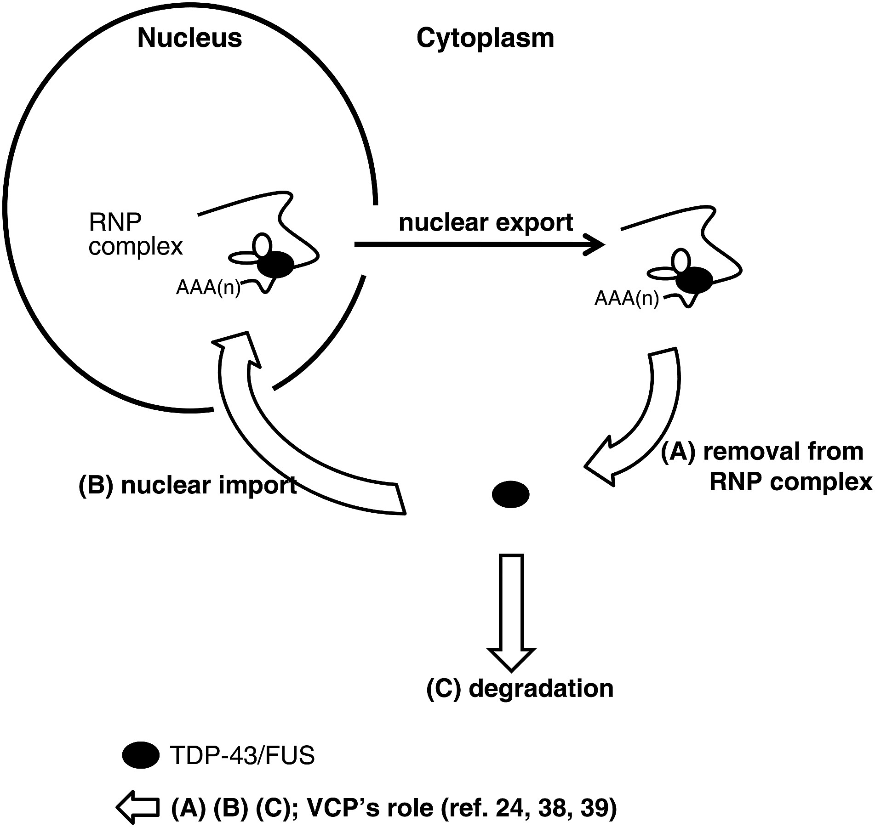
Figure 6. Hypothetical roles of VCP in the nucleoplasmic balance of TDP-43 and FUS referring to the paper by Ritson et ...
Notes:
Figure 6. Hypothetical roles of VCP in the nucleoplasmic balance of TDP-43 and FUS referring to the paper by Ritson et al. (24). VCP, human ortholog of ter94, may act during removal of TDP-43/FUS from RNP complexes in the cytoplasm (A), nuclear import of TDP-43/FUS (B) and degradation of TDP-43/FUS by the autophagic pathway (C). FUS, the human ortholog of Caz, might translocate from cytoplasm to nucleus when VCP is overexpressed because the nuclear-import function of VCP (B) would be dominantly induced under conditions of FUS deficiency in nuclei. Conversely, loss-of-function alleles of VCP may exacerbate the FUS deficiency in nuclei because FUS is not being properly imported into nuclei by VCP.
Unless provided in the caption above, the following copyright applies to the content of this slide: © The Author 2014. Published by Oxford University Press. All rights reserved. For Permissions, please email: journals.permissions@oup.com

