Slide 1
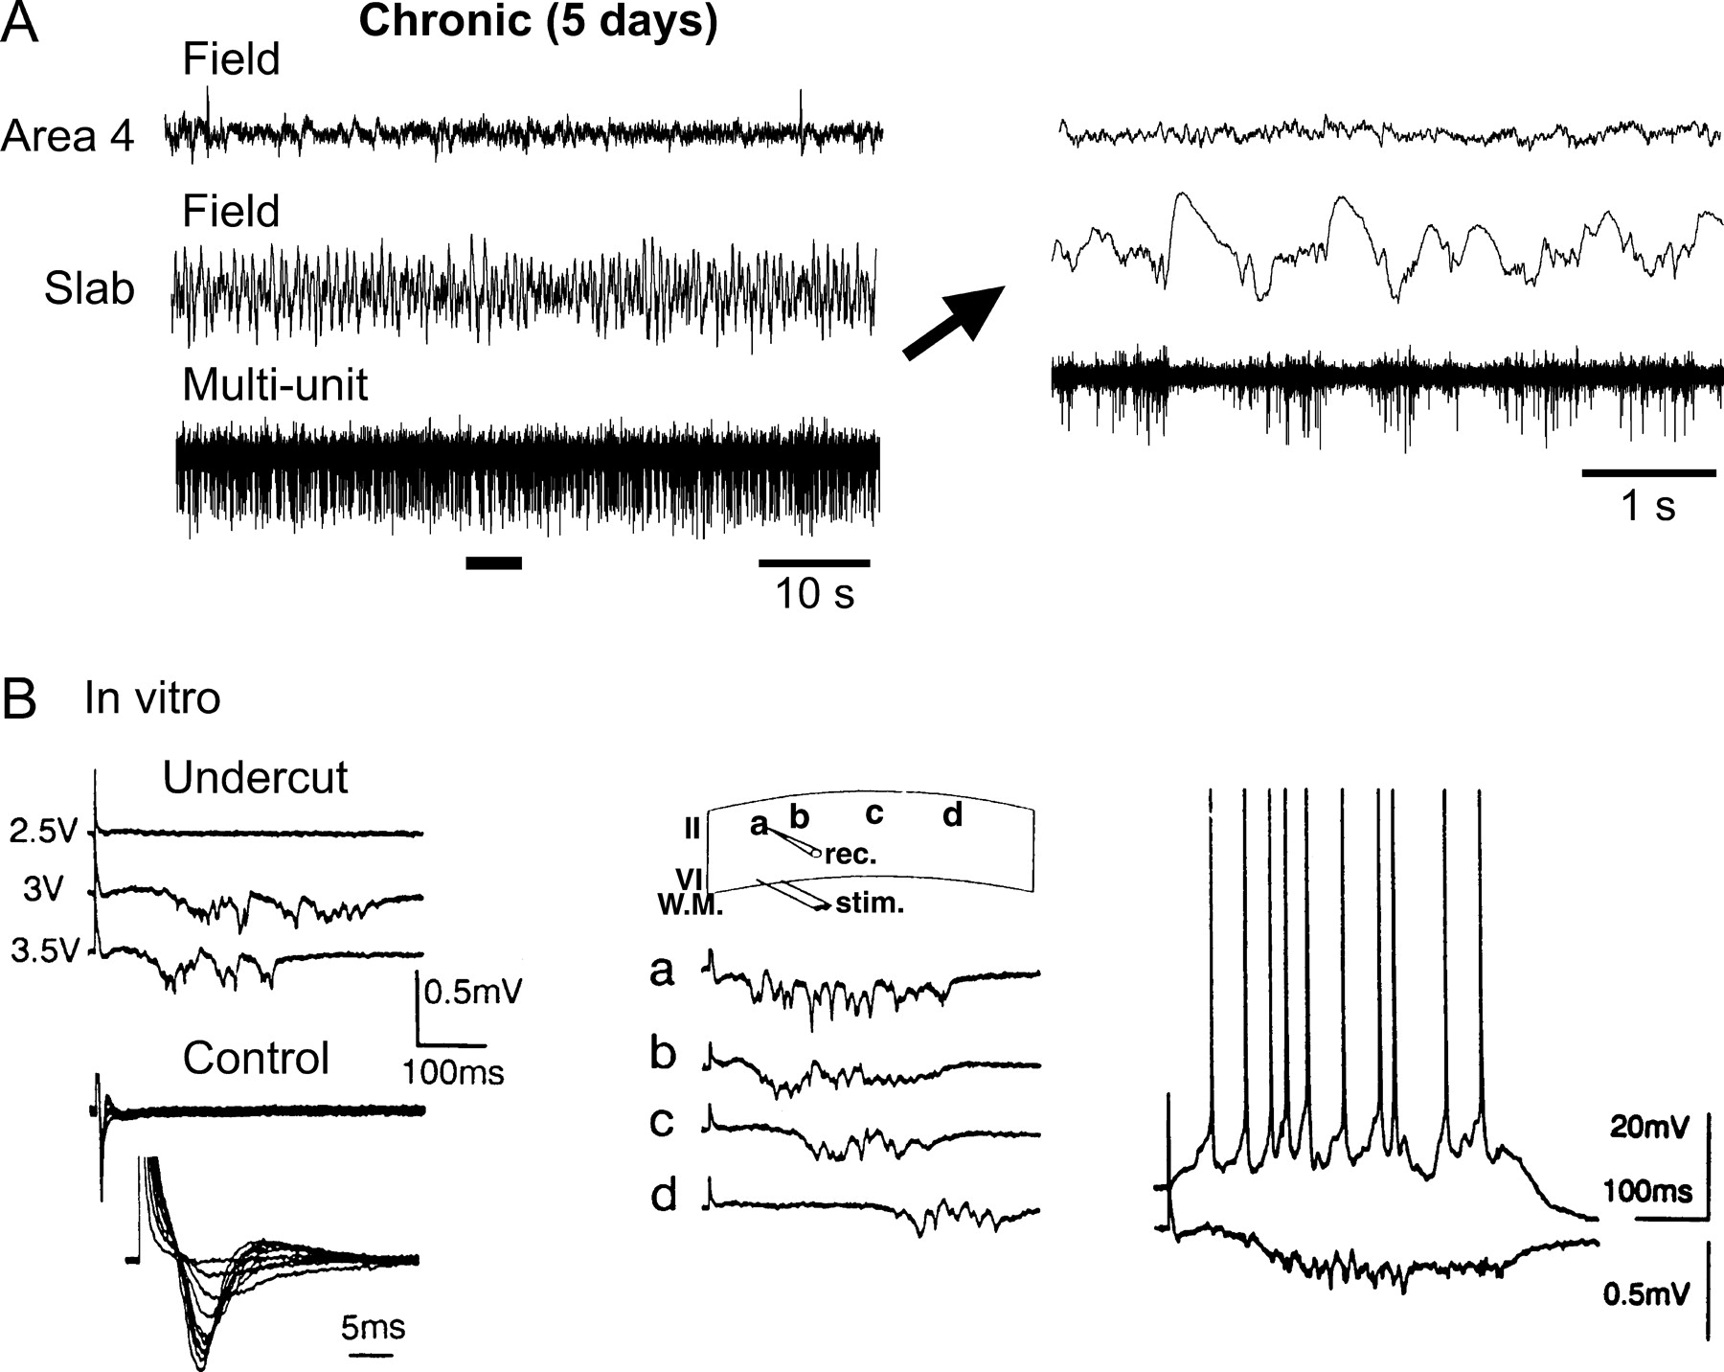
Figure 1. Spontaneous and evoked activities in chronically isolated cortex. (A) Field potentials and multi-unit ...
Notes:
Figure 1. Spontaneous and evoked activities in chronically isolated cortex. (A) Field potentials and multi-unit recordings from the unanesthetized intact cortex and the chronically isolated slab on the fifth day after isolation during a period of REM sleep. The fragment indicated by the horizontal bar is expanded on the right as indicated by the arrow. The chronically isolated slab was characterized by slow waves and clustered neuronal firing. (B) Characteristics of epileptiform events recorded in slices of chronically isolated (‘undercut’) cortex [modified from Prince and Tseng (1993), used with permission]. Electrical stimulation evoked all-or-none polyphasic epileptiform field potentials in undercut cortex (left panel), but only short-latency responses in slices of contralateral control cortex. Burst discharges propagated across cortex at an average speed of 1–4 cm/s (middle panel). The distance between positions a–d was ∼5 mm. Intracellular recording of a layer 2 pyramidal cell during an evoked epileptiform event (right panel).
Unless provided in the caption above, the following copyright applies to the content of this slide: Cerebral Cortex V 15 N 6 © Oxford University Press 2004; all rights reserved

Slide 2
Figure 4. Only nearly complete deafferentation leads to network bursting activity. Amount of HSP that was required to ...
Notes:
Figure 4. Only nearly complete deafferentation leads to network bursting activity. Amount of HSP that was required to restore the average PY cell firing rate to 5 Hz in networks that were partially deprived of afferents (left). The middle panel plots the average power of the LNPs computed for 10 contiguous blocks of 100 PY cells, normalized with respect to that of intact cortex. LNPs computed over all PY cells are shown on the right. Homeostatic synaptic plasticity restored a low-amplitude irregular LNP after partial (<80%) deafferentation. The simulations in partially deafferented cortex were performed in networks with 1000 PY and 250 IN cells and dense local synaptic connectivity.
Unless provided in the caption above, the following copyright applies to the content of this slide: Cerebral Cortex V 15 N 6 © Oxford University Press 2004; all rights reserved

Slide 3
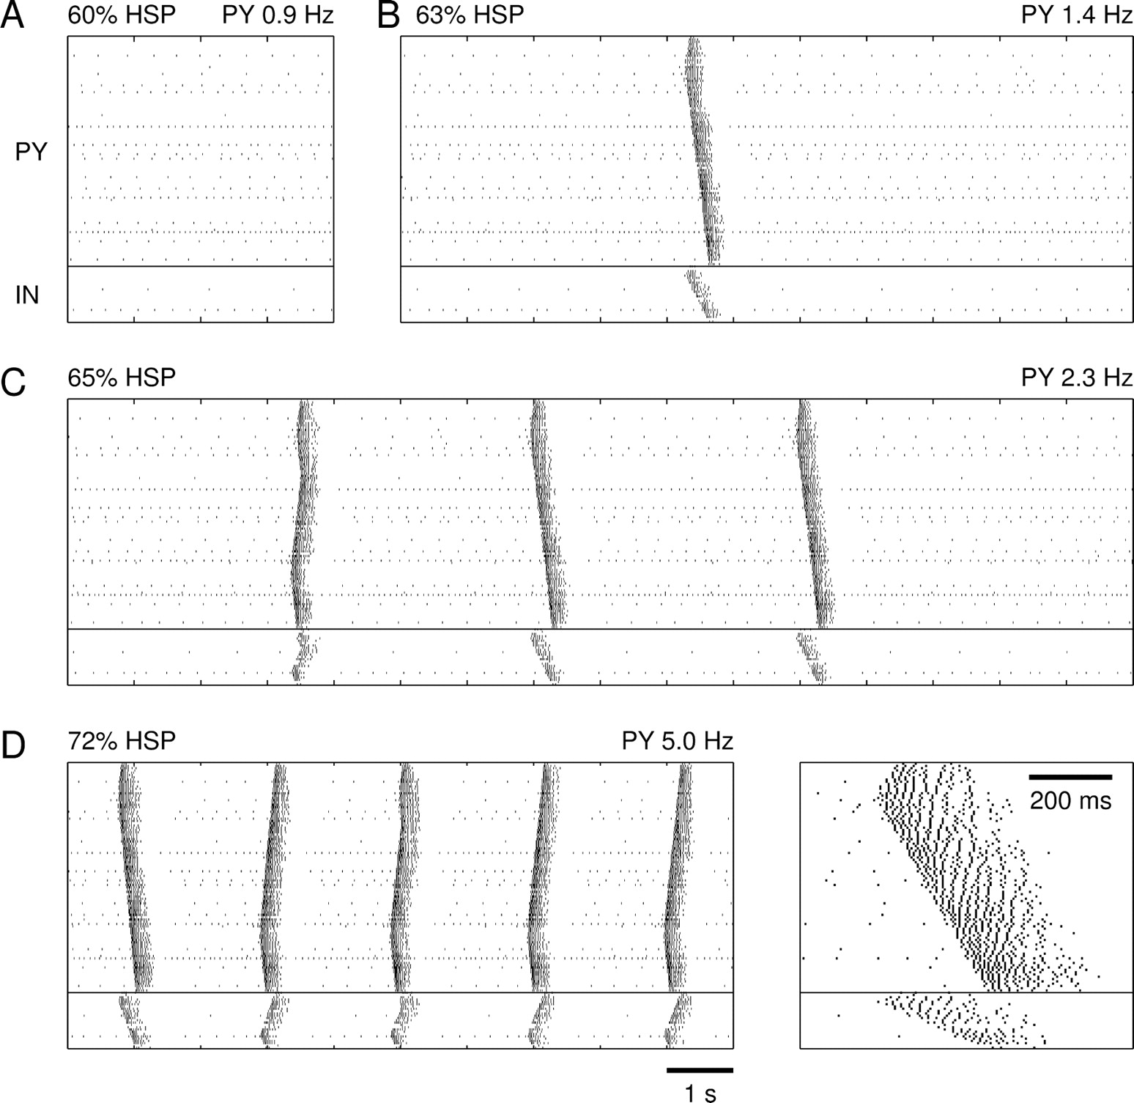
Figure 3. Emergence of propagating burst discharges in deafferented cortex after homeostatic synaptic plasticity. Spike ...
Notes:
Figure 3. Emergence of propagating burst discharges in deafferented cortex after homeostatic synaptic plasticity. Spike rasterplots of network activity after (A) 60% HSP, (B) 63% HSP, (C) 65% HSP and (D) 72% HSP. After 72% HSP a steady state was reached for which PY cells fired on average 5.0 Hz. The inset shows an expanded spontaneous burst at 72% HSP.
Unless provided in the caption above, the following copyright applies to the content of this slide: Cerebral Cortex V 15 N 6 © Oxford University Press 2004; all rights reserved

Slide 4
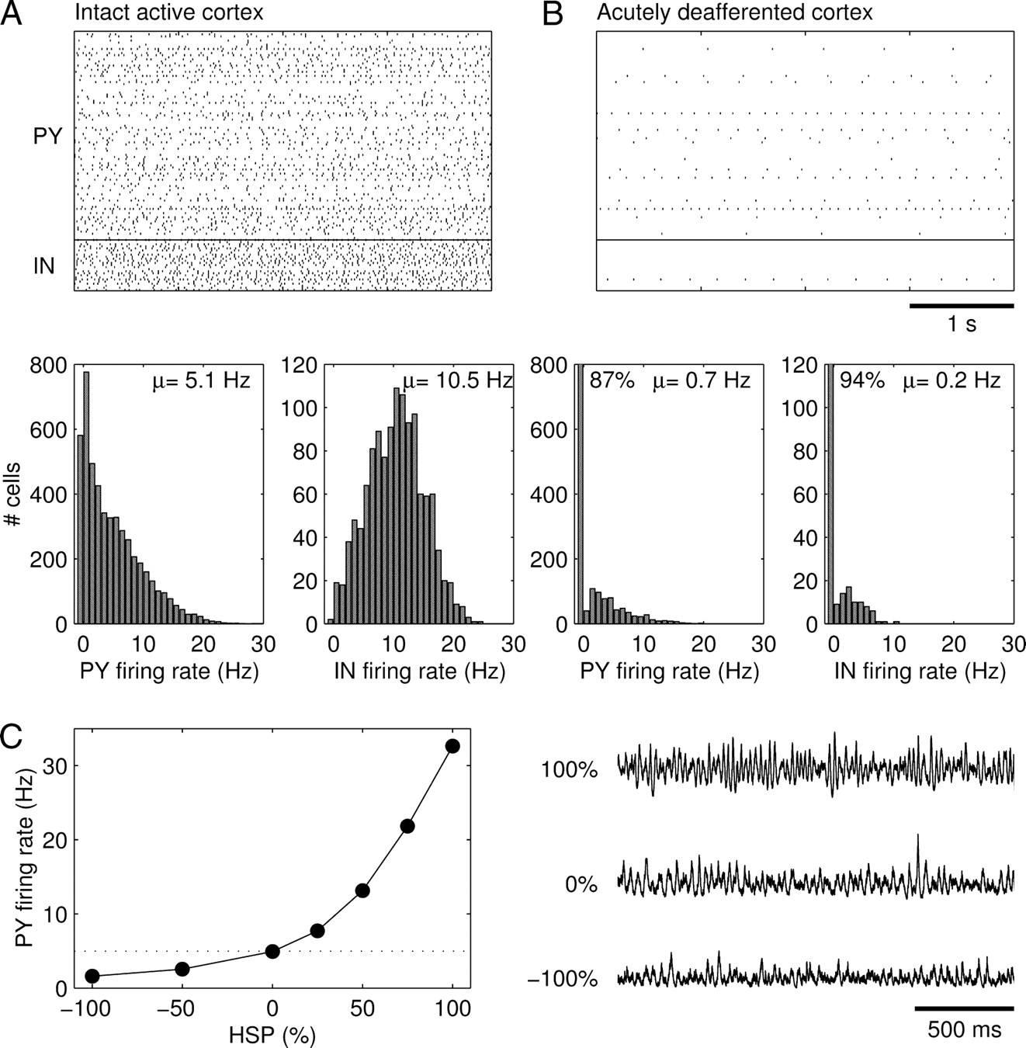
Figure 2. Intact and acutely deafferented cortex models. Spike rasterplots and firing rate histograms of (A) intact ...
Notes:
Figure 2. Intact and acutely deafferented cortex models. Spike rasterplots and firing rate histograms of (A) intact cortex and (B) acutely deafferented cortex. In the rasterplots, spike trains of every 50th PY and IN cell are represented. (C) Synaptic scaling of ḡPY−PY and ḡIN−PY (in opposite directions) in intact cortex modulated the average firing rate of PY cells while maintaining a low-amplitude irregular LNP. The LNPs are scaled by the reverse of the square root of their means for comparison purposes. The simulations in (C) were performed in a network with 500 PY and 125 IN cells and sparse all-to-all synaptic connectivity.
Unless provided in the caption above, the following copyright applies to the content of this slide: Cerebral Cortex V 15 N 6 © Oxford University Press 2004; all rights reserved

Slide 5
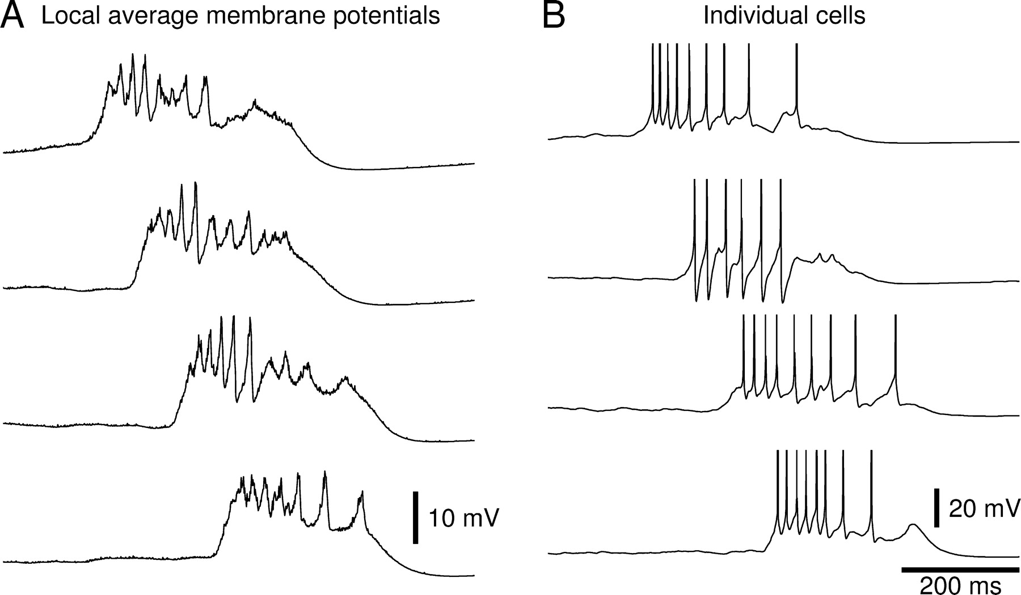
Figure 5. Membrane potentials during burst discharges. (A) Average PY cell membrane potentials at four locations ...
Notes:
Figure 5. Membrane potentials during burst discharges. (A) Average PY cell membrane potentials at four locations (20–40–60–80% along the length of the network) during a spontaneous network burst that occurred after 70% HSP. (B) Membrane potentials of three PY cells and one IN cell (second from top) at each of the four locations.
Unless provided in the caption above, the following copyright applies to the content of this slide: Cerebral Cortex V 15 N 6 © Oxford University Press 2004; all rights reserved

Slide 6
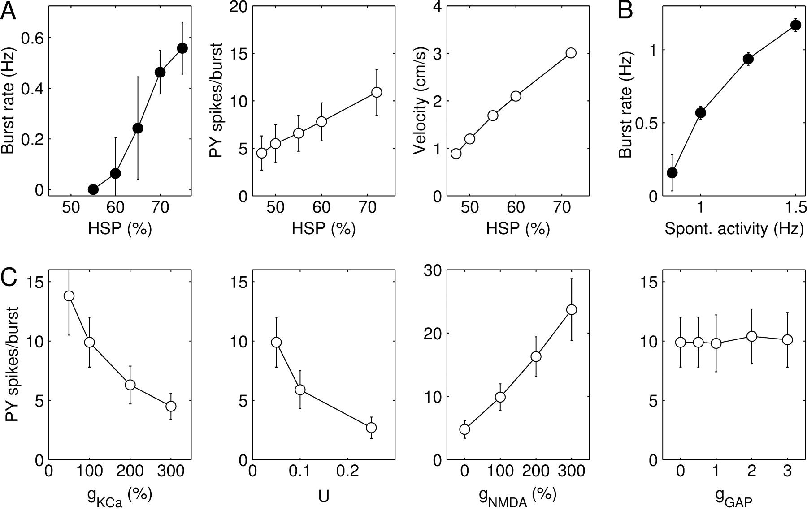
Figure 6. Parameter dependence of burst discharges. (A) Rate at which bursts repeated, average number of PY cell spikes ...
Notes:
Figure 6. Parameter dependence of burst discharges. (A) Rate at which bursts repeated, average number of PY cell spikes per burst and speed of burst propagation as a function of the amount of HSP. Number of spikes per burst and burst velocity were measured from evoked burst discharges in a model with reduced spontaneous activity. (B) Rate at which bursts repeated as a function of the spontaneous firing rate of PY cells. (C) Dependence of the average number of PY spikes per burst on ḡKCa, parameter U of short-term synaptic depression, ḡPY–PY,NMDA and the summated electrical coupling conductance gGAP. The values of ḡKCa and ḡPY–PY,NMDA are expressed as a percentage of their default values and that of gGAP as a fraction of the leak conductance of individual IN cells. Burst discharges were evoked after 70% HSP.
Unless provided in the caption above, the following copyright applies to the content of this slide: Cerebral Cortex V 15 N 6 © Oxford University Press 2004; all rights reserved

Slide 7
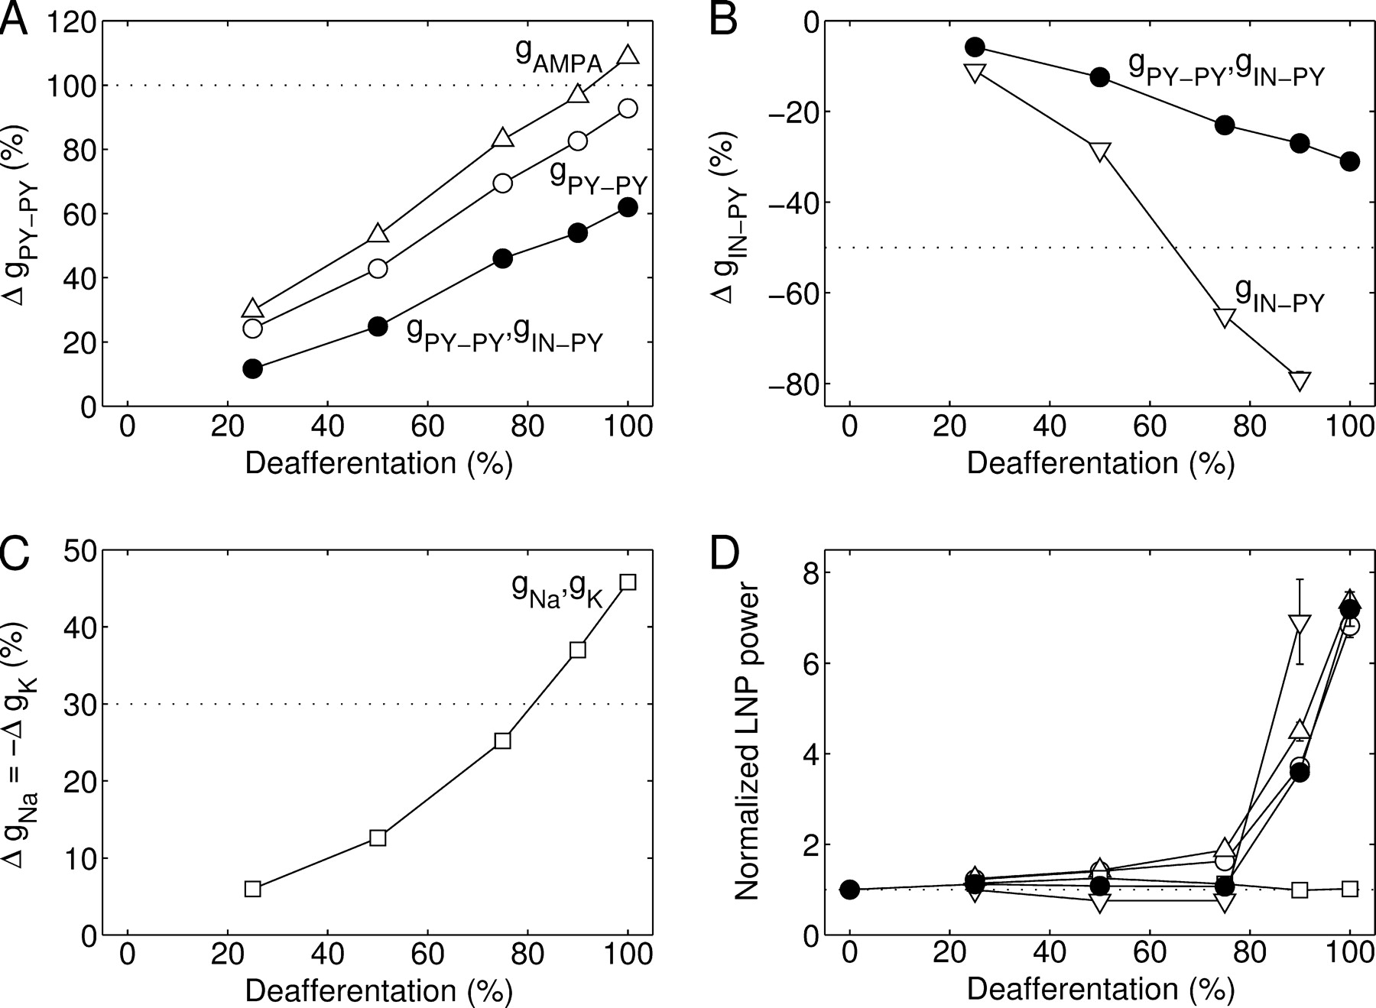
Figure 7. Different strategies of homeostatic regulation. The conductance changes that were required to restore the ...
Notes:
Figure 7. Different strategies of homeostatic regulation. The conductance changes that were required to restore the average PY cell firing rate to 5 Hz after (A) upregulation of PY–PY synapses alone, with AMPA component only (open triangle) or both AMPA and NMDA components (open circle), (B) downregulation of IN–PY synapses alone (open inverted triangle), or (C) upregulation of intrinsic excitability alone (open square). The conductance changes required in the default model incorporating all homeostatic synaptic processes are shown for comparison (filled circle). Note that in fully deafferented cortex a 100% downregulation of IN–PY synapses alone was not sufficient to restore firing rates. (D) Average power of LNPs computed for 10 contiguous blocks of 100 PY cells, normalized with respect to that of intact cortex. These simulations were performed in networks with 1000 PY and 250 IN cells and dense local synaptic connections.
Unless provided in the caption above, the following copyright applies to the content of this slide: Cerebral Cortex V 15 N 6 © Oxford University Press 2004; all rights reserved

Slide 8
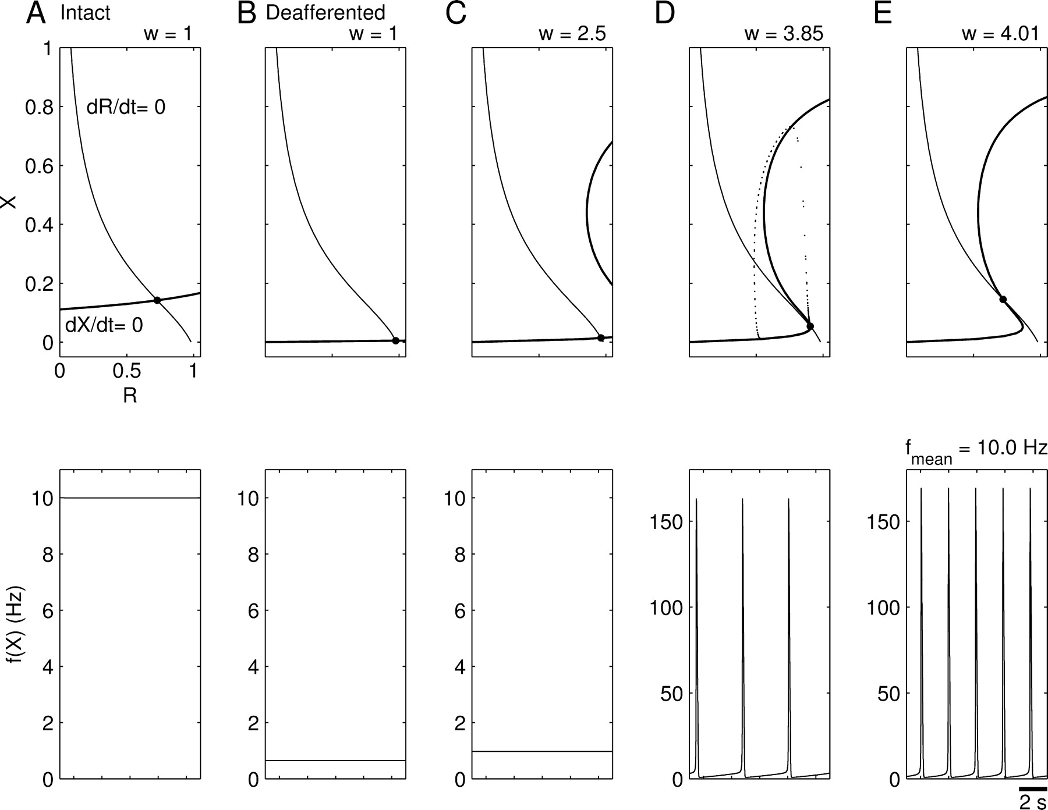
Figure 8. Homeostatic synaptic plasticity restores burst firing after deafferentation in a simplified firing rate ...
Notes:
Figure 8. Homeostatic synaptic plasticity restores burst firing after deafferentation in a simplified firing rate model. The reduced model consisted of a single PY unit, representing a population of PY cells with average membrane potential X ∈ [0,1] , that received extrinsic and recurrent synaptic inputs. The recurrent excitation was subject to short-term depression with R denoting the available synaptic resources. The upper panels show the nullclines of the system with intact extrinsic input (A) and of the deafferented system at different values of synaptic coupling W = 5.69w, where w = 1 in (B), w = 2.50 in (C), w = 3.85 in (D) and w = 4.01 in (E). The lower panels show the respective time evolutions of firing rate f(X). See Results for a detailed explanation. Parameter values were U = 0.05, τR = 750 ms, τX = 10 ms.
Unless provided in the caption above, the following copyright applies to the content of this slide: Cerebral Cortex V 15 N 6 © Oxford University Press 2004; all rights reserved

