Slide 1
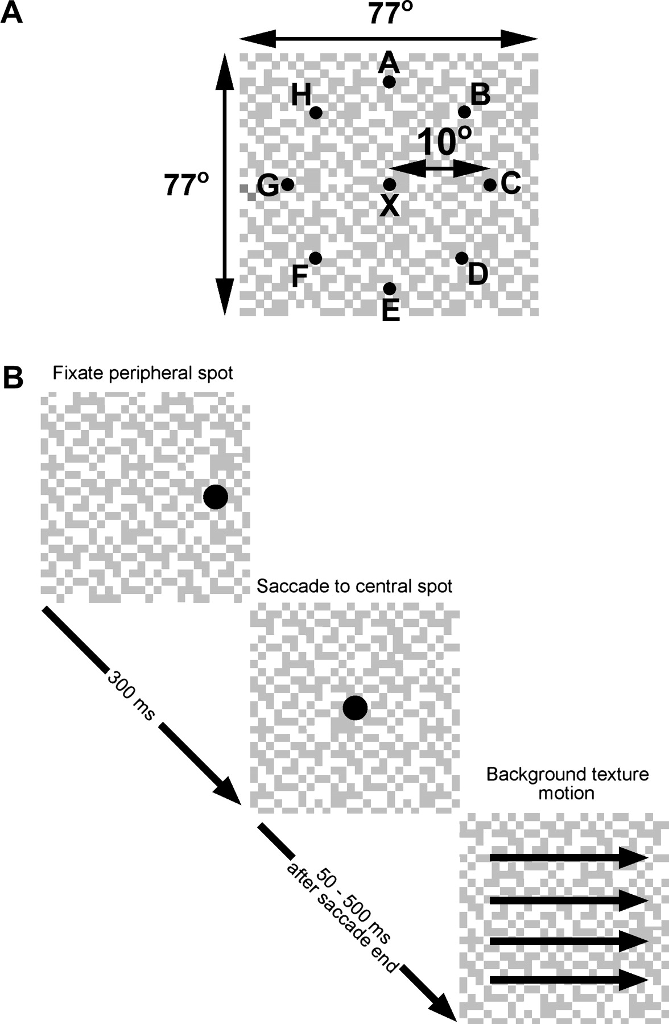
Figure 1. (A) Schematic drawing of the stimulus (not to scale). The texture was 77° × 77° and consisted of random black ...
Notes:
Figure 1. (A) Schematic drawing of the stimulus (not to scale). The texture was 77° × 77° and consisted of random black and white squares with 0.8° sides. Points A–H mark fixation points 10° peripheral to a central point X. (B) For the ocular following paradigm, a saccade was made from a peripheral point to X, then the central fixation point disappeared, and the background texture moved in the cell's preferred direction (see Results for details). The contrast of the stimulus in the figure has been set artificially low for schematic reasons. The texture contrast was 100%, and the fixation marks were red spots.
Unless provided in the caption above, the following copyright applies to the content of this slide: © 2006 The AuthorsThis is an Open Access article distributed under the terms of the Creative Commons Attribution Non-Commercial License (http://creativecommons.org/licenses/by-nc/2.0/uk/) which permits unrestricted non-commercial use, distribution, and reproduction in any medium, provided the original work is properly cited.

Slide 2
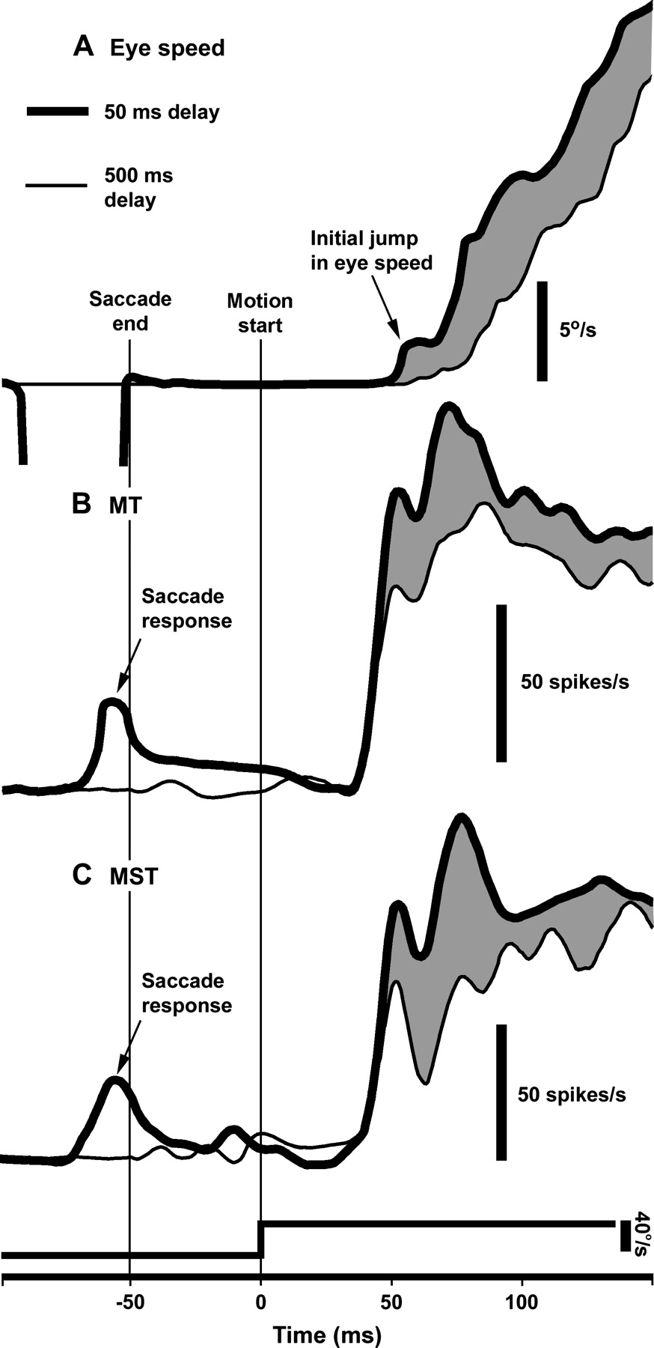
Figure 2. Eye speed and spike rate profiles. (A) Eye speed profiles generated by motion either 50 ms (thick line) or ...
Notes:
Figure 2. Eye speed and spike rate profiles. (A) Eye speed profiles generated by motion either 50 ms (thick line) or 500 ms (thin line) after saccade end (80 repeats). The gray area shows the difference between the 2 eye speed profiles. The postsaccadic background motion was 40°/s. Using the same line conventions, SDFs are shown for single MT (B) and MST (C) neurons stimulated 50 or 500 ms after a saccade.
Unless provided in the caption above, the following copyright applies to the content of this slide: © 2006 The AuthorsThis is an Open Access article distributed under the terms of the Creative Commons Attribution Non-Commercial License (http://creativecommons.org/licenses/by-nc/2.0/uk/) which permits unrestricted non-commercial use, distribution, and reproduction in any medium, provided the original work is properly cited.

Slide 3
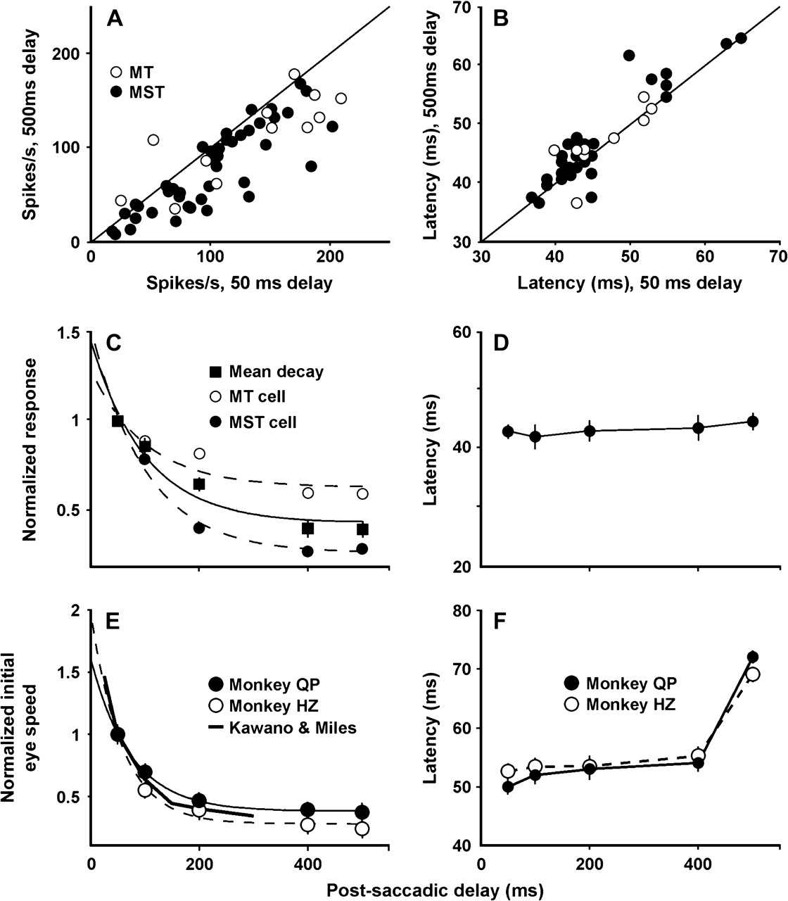
Figure 3. Responses to motion after saccades. The mean spike rates (A) and neuronal latencies (B) of 12 MT and 42 MST ...
Notes:
Figure 3. Responses to motion after saccades. The mean spike rates (A) and neuronal latencies (B) of 12 MT and 42 MST neurons generated by preferred direction motion starting 50 or 500 ms after saccades. (C) Decay functions for the mean response amplitudes of all tested cells (squares, solid line) and for 2 individual cells (circles, dashed lines). The lines are fitted exponential functions. Error bars are standard error (SE). Data for individual cells are based on 16 repetitions. (D) Response latencies of all tested cells plotted against postsaccadic delay. Error bars are SE. (E) Mean initial eye speeds for 2 monkeys plotted against postsaccadic delay. The data points have been fit with exponentials. The thick line shows data from Kawano and Miles (1986). (F) Latencies of ocular following plotted against postsaccadic delay for the 2 monkeys.
Unless provided in the caption above, the following copyright applies to the content of this slide: © 2006 The AuthorsThis is an Open Access article distributed under the terms of the Creative Commons Attribution Non-Commercial License (http://creativecommons.org/licenses/by-nc/2.0/uk/) which permits unrestricted non-commercial use, distribution, and reproduction in any medium, provided the original work is properly cited.

Slide 4
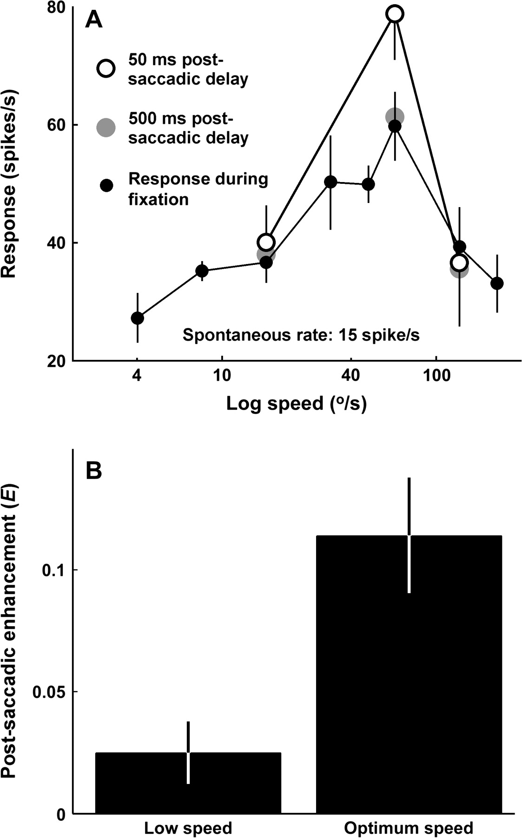
Figure 4. Speed dependence of enhancement. (A) Speed-tuning function of an MST neuron (small filled symbols, n = 10). ...
Notes:
Figure 4. Speed dependence of enhancement. (A) Speed-tuning function of an MST neuron (small filled symbols, n = 10). The large gray symbols show responses to motion 500 ms after saccade end (n = 16). Open symbols show the responses of the same neuron to 3 test speeds presented 50 ms after saccades (n = 16). The responses are significantly enhanced only at optimum test speeds (t-test, P < 0.01). Error bars are standard error (SE). (B) Bar graphs of the postsaccadic enhancement (E, see Results) at low and optimal speeds. Error bars are SE (n = 13).
Unless provided in the caption above, the following copyright applies to the content of this slide: © 2006 The AuthorsThis is an Open Access article distributed under the terms of the Creative Commons Attribution Non-Commercial License (http://creativecommons.org/licenses/by-nc/2.0/uk/) which permits unrestricted non-commercial use, distribution, and reproduction in any medium, provided the original work is properly cited.

Slide 5
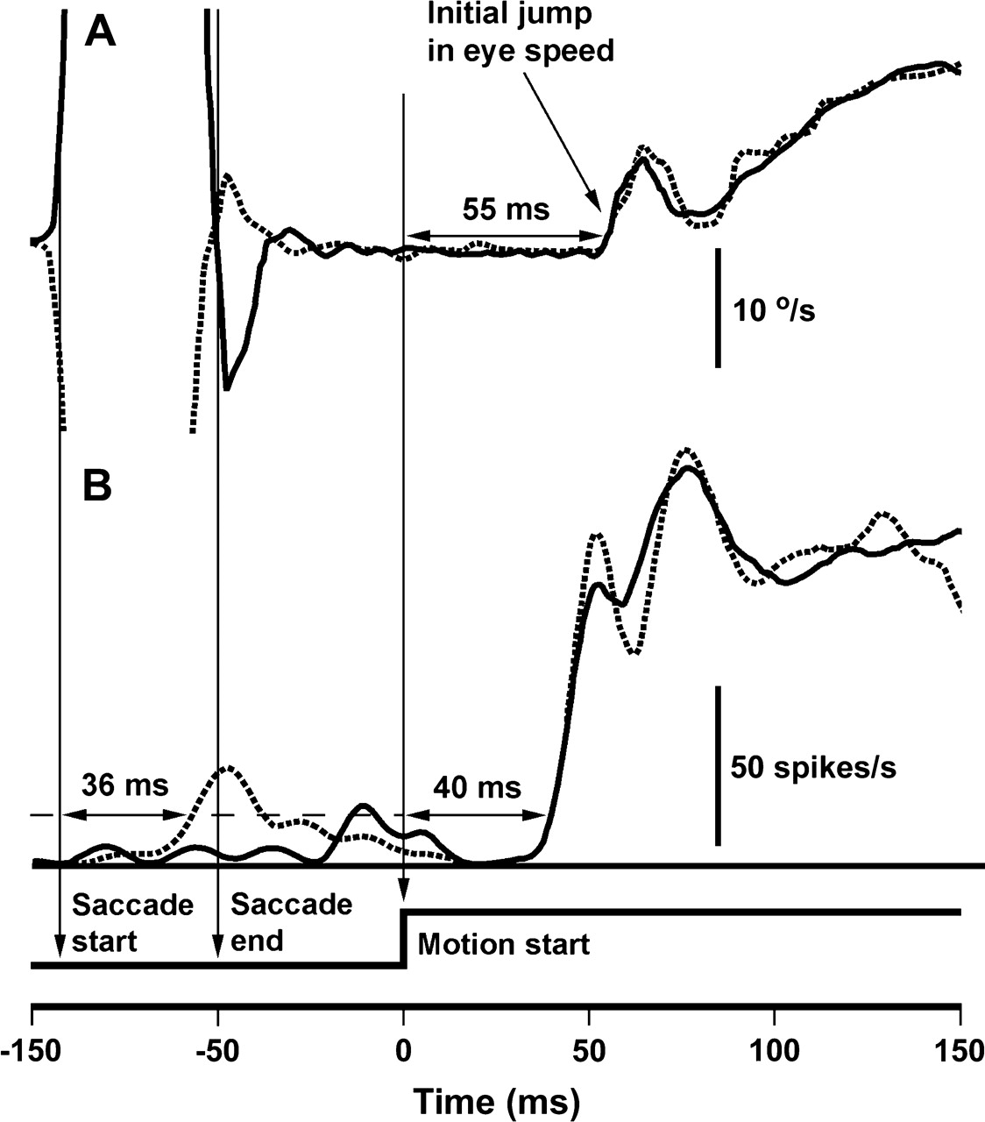
Figure 5. Eye speed and spiking response profiles. (A) Eye speeds showing leftward (dotted) and rightward (solid) ...
Notes:
Figure 5. Eye speed and spiking response profiles. (A) Eye speeds showing leftward (dotted) and rightward (solid) saccades (saccades are truncated) and subsequent ocular following responses to rightward motion at 40°/s (80 repetitions). Thin vertical arrows indicate saccade onset, saccade end, and stimulus onset, respectively. (B) Spike density functions from an MST neuron during the eye movements shown above. The neuron responded optimally to rightward motion during fixation (not shown) and to leftward saccades (dotted line, latency 36 ms). Regardless of the saccade direction, the neuron responded with identical latency and similar amplitude. The horizontal dashed line represents significant spiking.
Unless provided in the caption above, the following copyright applies to the content of this slide: © 2006 The AuthorsThis is an Open Access article distributed under the terms of the Creative Commons Attribution Non-Commercial License (http://creativecommons.org/licenses/by-nc/2.0/uk/) which permits unrestricted non-commercial use, distribution, and reproduction in any medium, provided the original work is properly cited.

Slide 6
Figure 6. Directionality of saccade and postsaccade responses. (A) Responses to preferred direction background motion ...
Notes:
Figure 6. Directionality of saccade and postsaccade responses. (A) Responses to preferred direction background motion 50 ms after saccade end. The ordinate shows responses when the saccade and subsequent motion were in the same direction. The abscissa shows responses when the saccade and motion were in opposite directions. The responses do not differ significantly in the 2 conditions, showing that saccade direction did not influence the amplitude of subsequent motion responses. The diagonal line is the line of equality. (B) Responses of an MT neuron to preferred direction background motion 50 ms after saccades in 8 different directions. The arrows below the graph indicate the directions of the saccades. Error bars are standard error (SE) (n = 16). (C) Responses to saccades in 8 directions for the same cell. It was tuned for leftward retinal slip (rightward saccades). The arrows below the graph indicate the direction of the saccades. Error bars are SE (n = 16). (D) Responses are smaller during saccades (ordinate) than to saccade-like background motion presented to the animal while it fixates (abscissa), as shown by the majority of points falling below the dashed line of equality. Spontaneous rate has been normalized to zero (solid vertical and horizontal lines). Symbols as in (A).
Unless provided in the caption above, the following copyright applies to the content of this slide: © 2006 The AuthorsThis is an Open Access article distributed under the terms of the Creative Commons Attribution Non-Commercial License (http://creativecommons.org/licenses/by-nc/2.0/uk/) which permits unrestricted non-commercial use, distribution, and reproduction in any medium, provided the original work is properly cited.

Slide 7
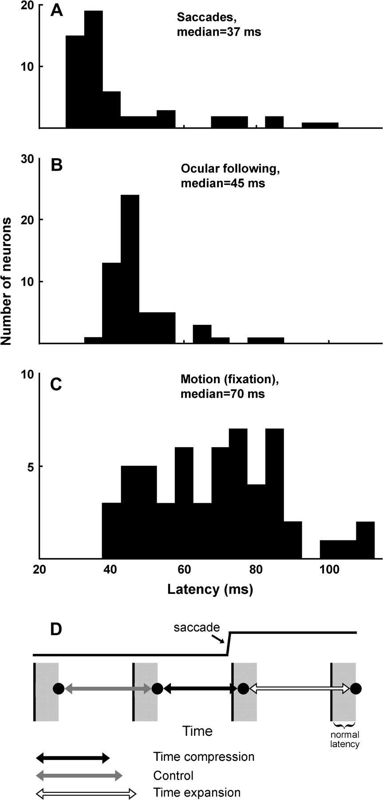
Figure 7. Histograms of cell number against latency (n = 54). (A) Latencies of responses to saccades. (B) Latencies ...
Notes:
Figure 7. Histograms of cell number against latency (n = 54). (A) Latencies of responses to saccades. (B) Latencies generated by motion stimulation 50 ms after saccade end. (C) Latencies of the same neurons to their preferred speeds while the monkeys fixated stationary targets. (D) The decreased latency following saccades could explain perceptual time compression before saccades and time dilation following saccades. Black vertical lines indicate presentation times of a flashed stimulus with equal interstimulus intervals, and gray regions indicate the neuronal latency elicited by that stimulus during fixation. Dots represent observed latency. As summarized in (A–C), latency is shorter around the time of saccades. Time between neuronal responses during maintained fixation serves as the control measure (gray arrow). The decreased latency generated by the saccade reduces the time between responses if consecutively presented stimuli are flashed well before, then just after the saccade (black arrow). Conversely, the reduced response latency causes an increase in time between responses if the stimuli occur just after the saccade, then well after the saccade (empty arrow).
Unless provided in the caption above, the following copyright applies to the content of this slide: © 2006 The AuthorsThis is an Open Access article distributed under the terms of the Creative Commons Attribution Non-Commercial License (http://creativecommons.org/licenses/by-nc/2.0/uk/) which permits unrestricted non-commercial use, distribution, and reproduction in any medium, provided the original work is properly cited.

