Slide 1
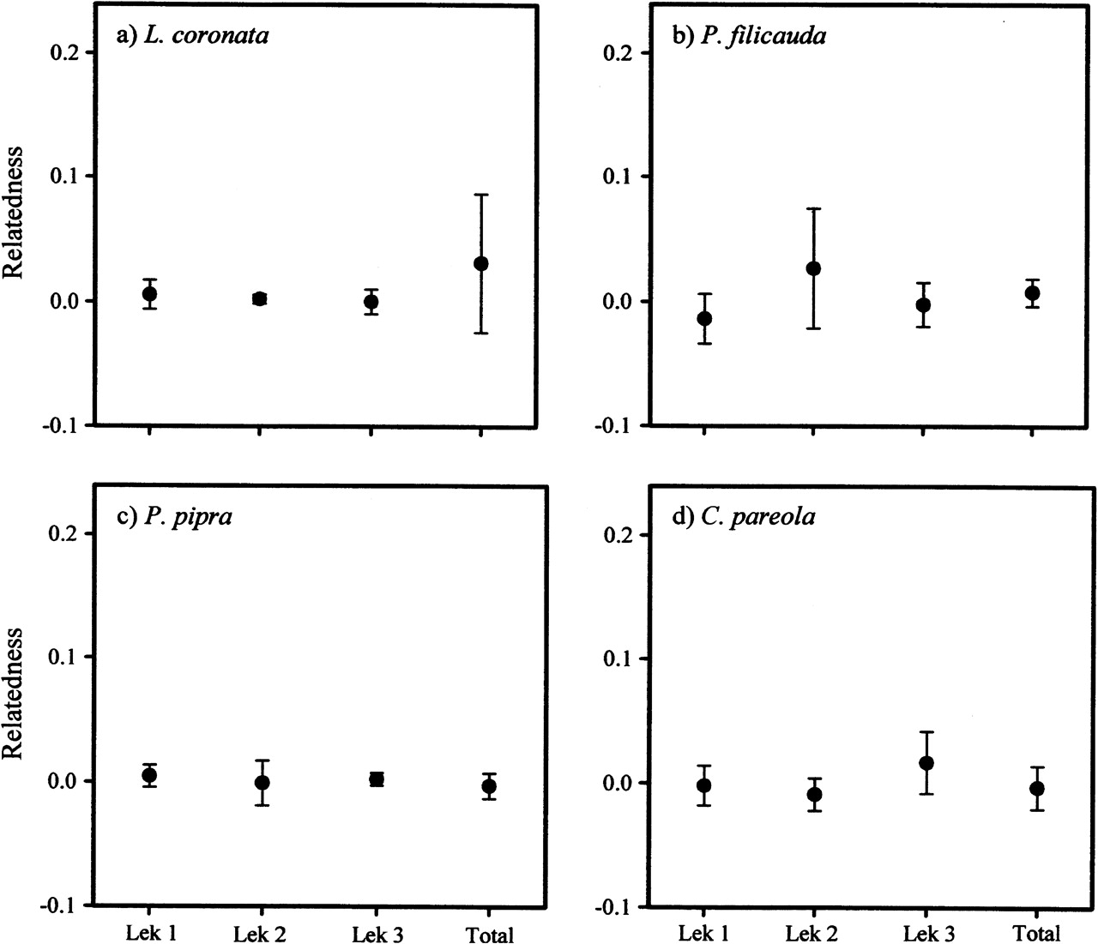
Figure 1 Average pairwise-relatedness values (±95% confidence interval) for males at 3 leks and in the total ...
Notes:
Figure 1 Average pairwise-relatedness values (±95% confidence interval) for males at 3 leks and in the total population for each of 4 manakin species: (a) L. coronata, (b) P. filicauda, (c) P. pipra, and (d) C. pareola. In no case were males within leks significantly more related than expected.
Unless provided in the caption above, the following copyright applies to the content of this slide: © The Author 2006. Published by Oxford University Press on behalf of the International Society for Behavioral Ecology. All rights reserved. For permissions, please e-mail: journals.permissions@oxfordjournals.org

Slide 2
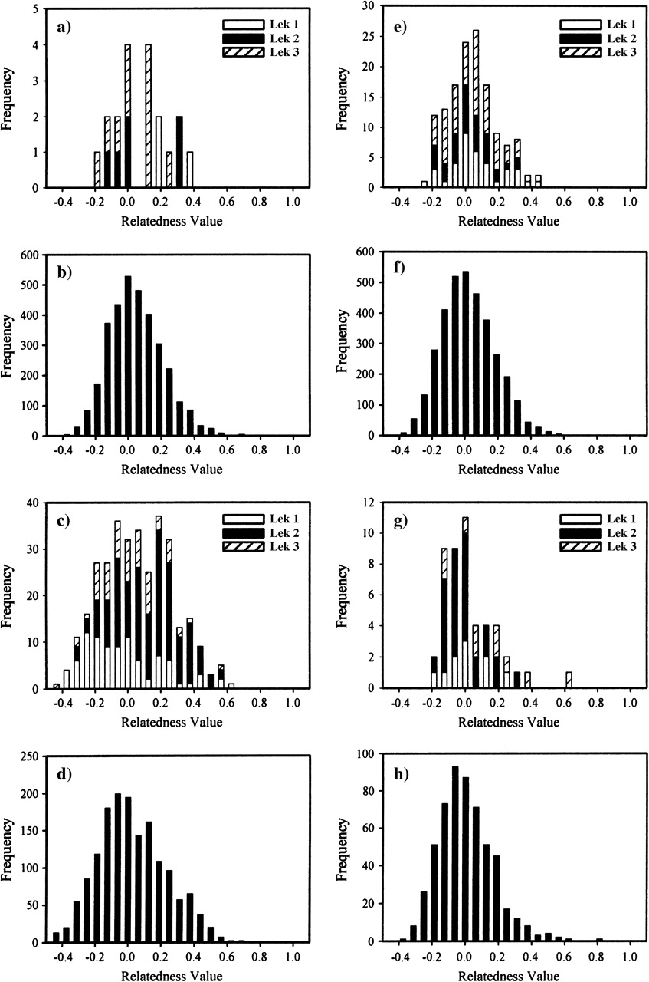
Figure 2 Frequency histogram of pairwise-relatedness values for males at 3 leks and for males in the background ...
Notes:
Figure 2 Frequency histogram of pairwise-relatedness values for males at 3 leks and for males in the background population. Lek and background panels, respectively, are (a) and (b) L. coronata, (c) and (d) P. filicauda, (e) and (f) P. pipra, (g) and (h) C. pareola. Notice that in all cases, the values center fairly evenly on zero relatedness and that lek values appear to be representative subsamples of the population distributions.
Unless provided in the caption above, the following copyright applies to the content of this slide: © The Author 2006. Published by Oxford University Press on behalf of the International Society for Behavioral Ecology. All rights reserved. For permissions, please e-mail: journals.permissions@oxfordjournals.org

