Slide 1
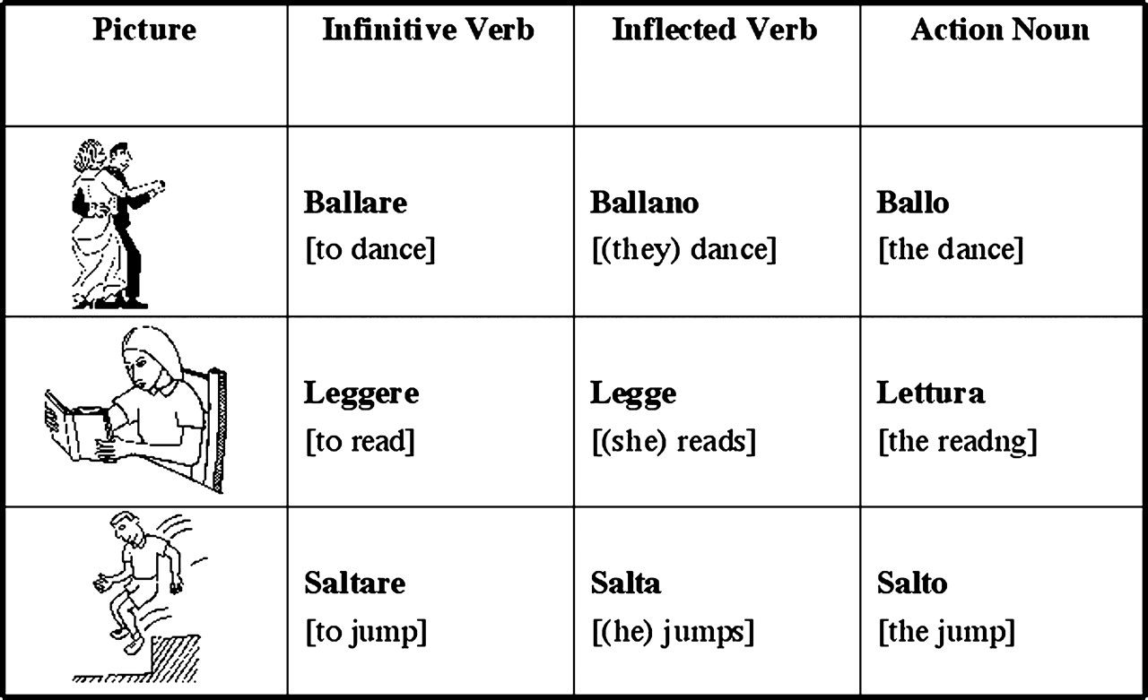
Figure 1. Examples of pictures used in the study along with naming responses required in the 3 different conditions.
Notes:
Figure 1. Examples of pictures used in the study along with naming responses required in the 3 different conditions.
Unless provided in the caption above, the following copyright applies to the content of this slide: © The Author 2007. Published by Oxford University Press. All rights reserved. For permissions, please e-mail: journals.permissions@oxfordjournals.org

Slide 2
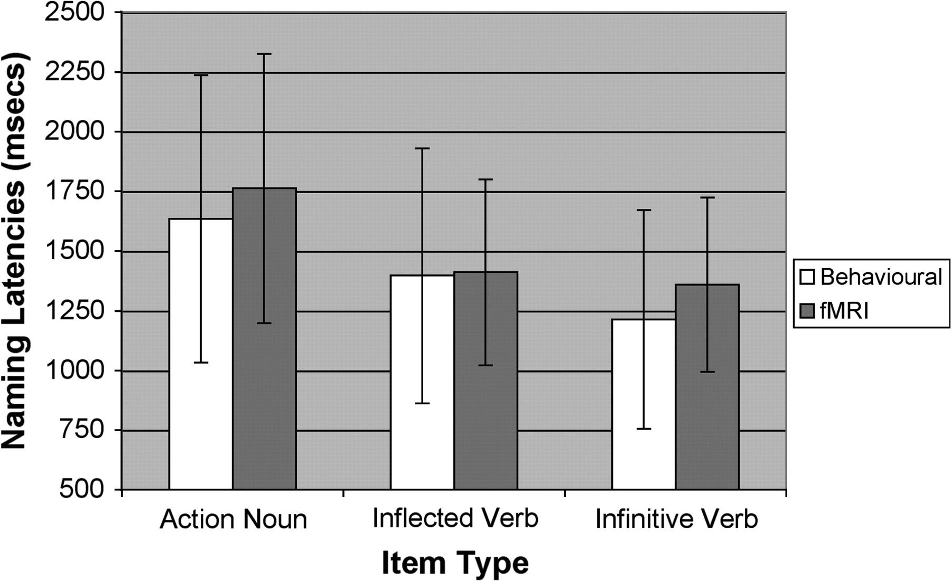
Figure 2. Mean naming latencies (in ms) for the 3 experimental conditions for 14 participants (behavioral, Group 1) who ...
Notes:
Figure 2. Mean naming latencies (in ms) for the 3 experimental conditions for 14 participants (behavioral, Group 1) who performed the naming task outside the scanner and for the 12 participants (fMRI, Group 2) performing the task during scanning.
Unless provided in the caption above, the following copyright applies to the content of this slide: © The Author 2007. Published by Oxford University Press. All rights reserved. For permissions, please e-mail: journals.permissions@oxfordjournals.org

Slide 3
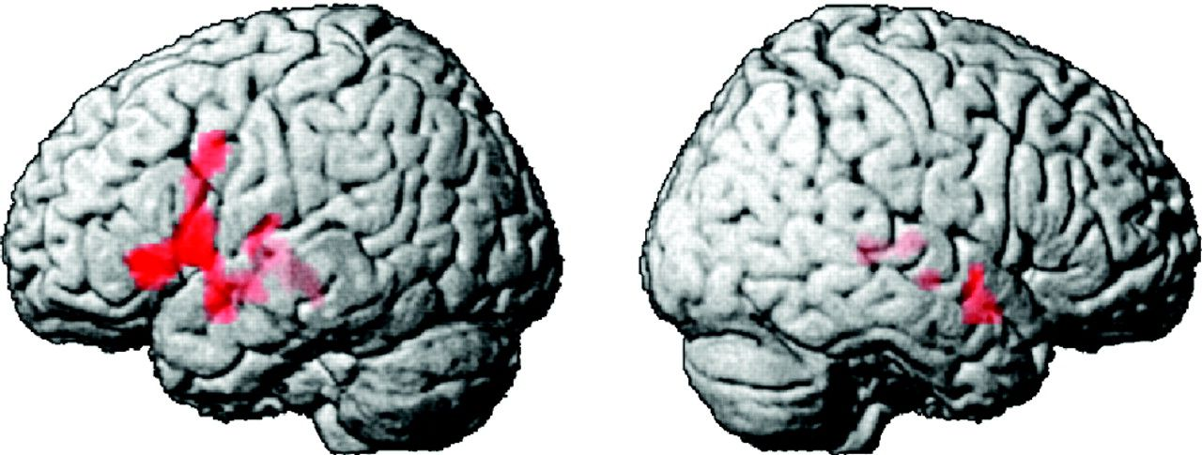
Figure 3. Standard SPM2 3-dimensional rendering showing the significant activations for the main effect including all 3 ...
Notes:
Figure 3. Standard SPM2 3-dimensional rendering showing the significant activations for the main effect including all 3 naming conditions (P < 0.001, family wise error correction).
Unless provided in the caption above, the following copyright applies to the content of this slide: © The Author 2007. Published by Oxford University Press. All rights reserved. For permissions, please e-mail: journals.permissions@oxfordjournals.org

Slide 4
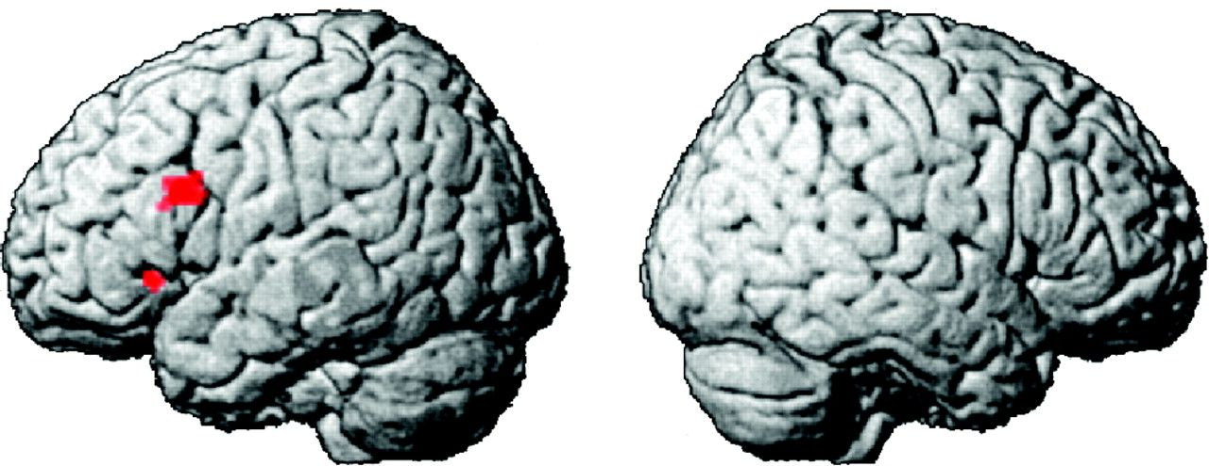
Figure 4. Standard SPM2 3-dimensional rendering showing the significant activations for the direct subtraction Actions ...
Notes:
Figure 4. Standard SPM2 3-dimensional rendering showing the significant activations for the direct subtraction Actions Noun minus Infinitive Verb (P < 0.05, false discovery rate correction).
Unless provided in the caption above, the following copyright applies to the content of this slide: © The Author 2007. Published by Oxford University Press. All rights reserved. For permissions, please e-mail: journals.permissions@oxfordjournals.org

Slide 5
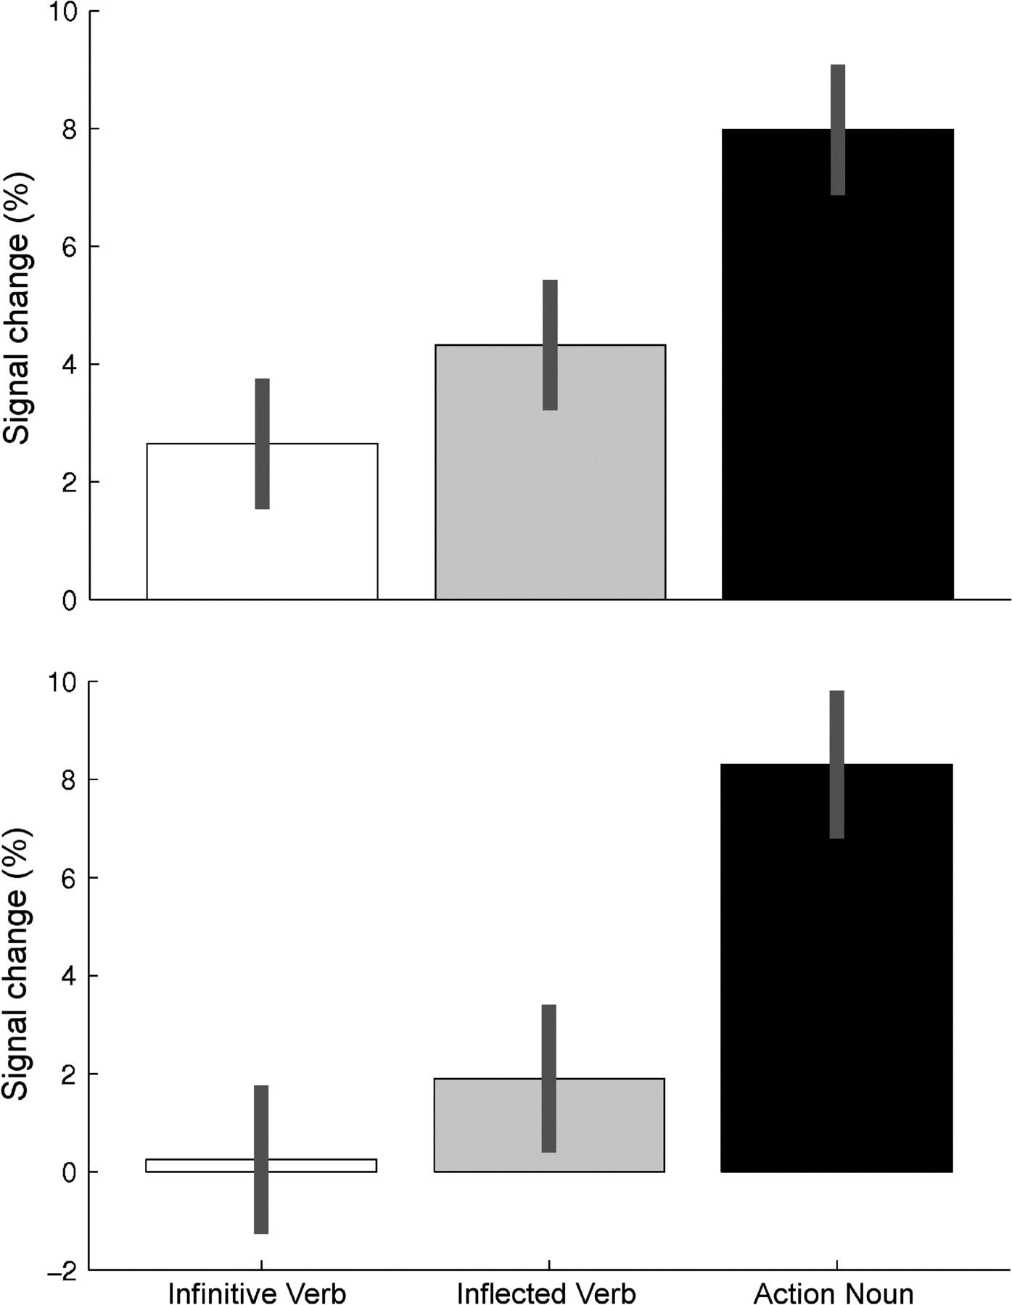
Figure 5. Histograms representing percent signal change and 90% confidence intervals in the 3 experimental conditions ...
Notes:
Figure 5. Histograms representing percent signal change and 90% confidence intervals in the 3 experimental conditions (Infinitive Verb: white; Inflected Verb: gray; Action Noun: black) in 2 different portions (dorsal vs. ventral) of the left IFG (upper part: x = −46, y = 16, z = 26; lower part: x = −48, y = 24, z = −4).
Unless provided in the caption above, the following copyright applies to the content of this slide: © The Author 2007. Published by Oxford University Press. All rights reserved. For permissions, please e-mail: journals.permissions@oxfordjournals.org

