Slide 1
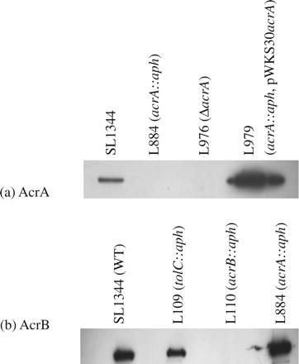
Figure 1 Western Blotting for AcrA and AcrB. (a) AcrA expression was eliminated after disruption of acrA in L884 ...
Notes:
Figure 1 Western Blotting for AcrA and AcrB. (a) AcrA expression was eliminated after disruption of acrA in L884 (acrA::aph) or L976 (ΔacrA), but expression was detected in the complemented strain L979 (acrA::aph, pWKS30acrA). (b) AcrB expression was eliminated by disruption of acrB (L110), but expression was not affected by disruption of either acrA (L884) or tolC (L109).
Unless provided in the caption above, the following copyright applies to the content of this slide: © The Author 2009. Published by Oxford University Press on behalf of the British Society for Antimicrobial Chemotherapy. All rights reserved. For Permissions, please e-mail: journals.permissions@oxfordjournals.org

Slide 2
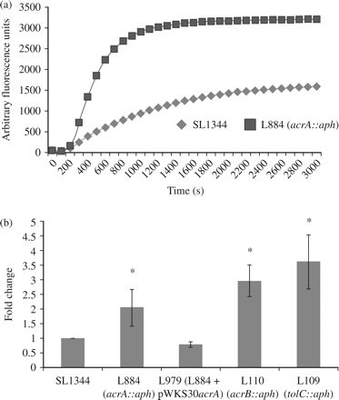
Figure 2 Hoechst H33342 efflux. (a) The accumulation of Hoechst H33342 in L884 (acrA::aph) and SL1344 over time. (b) ...
Notes:
Figure 2 Hoechst H33342 efflux. (a) The accumulation of Hoechst H33342 in L884 (acrA::aph) and SL1344 over time. (b) The mean fold change in accumulation of Hoechst H33342 after 50 min in SL1344, the acrA mutant (L884), the acrA-complemented strain (L979), the acrB mutant (L110) and the tolC mutant (L109). Student's t-tests were performed to compare the accumulation of each strain with that of the wild-type, SL1344, returning P values of 0.04, 0.21, 0.005 and 0.003, respectively. P values of <0.05 are indicated by asterisks.
Unless provided in the caption above, the following copyright applies to the content of this slide: © The Author 2009. Published by Oxford University Press on behalf of the British Society for Antimicrobial Chemotherapy. All rights reserved. For Permissions, please e-mail: journals.permissions@oxfordjournals.org

Slide 3
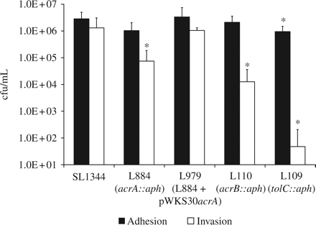
Figure 3 Ability of Salmonella Typhimurium SL1344 and mutants thereof to adhere to, and invade, human intestinal cells ...
Notes:
Figure 3 Ability of Salmonella Typhimurium SL1344 and mutants thereof to adhere to, and invade, human intestinal cells (INT-407). Adhesion of the acrA::aph mutant strain to the INT cell line was not significantly different from the parental strain. However, the mutant had a significantly reduced ability to invade. This phenotype was abolished when the acrA mutation was complemented with pWKS30acrA. P values of <0.05 are indicated by asterisks.
Unless provided in the caption above, the following copyright applies to the content of this slide: © The Author 2009. Published by Oxford University Press on behalf of the British Society for Antimicrobial Chemotherapy. All rights reserved. For Permissions, please e-mail: journals.permissions@oxfordjournals.org

