Slide 1
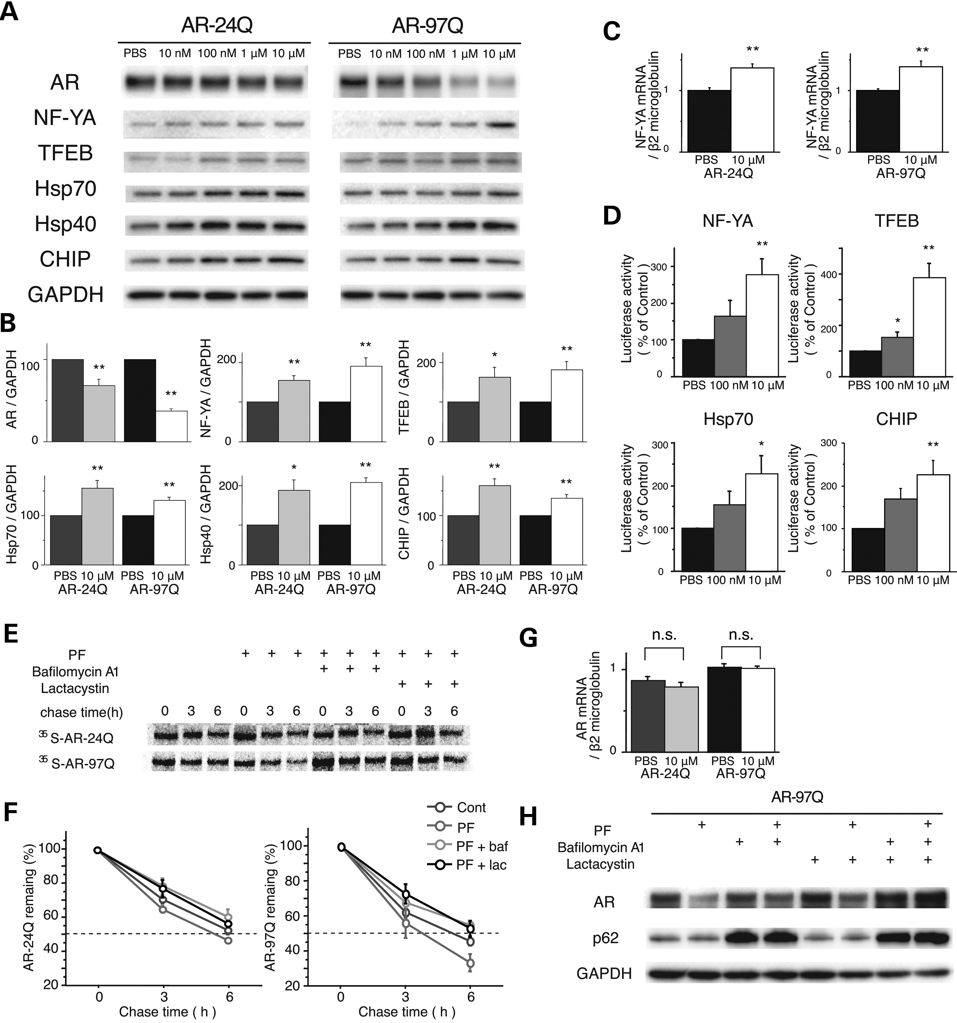
Figure 1. Effects of PF on AR in a cultured cell model of SBMA. (A and B) Western blots and densitometric analyses from ...
Notes:
Figure 1. Effects of PF on AR in a cultured cell model of SBMA. (A and B) Western blots and densitometric analyses from NSC34 cells stably expressing wild-type (24Q) or mutant (97Q) AR (*P < 0.05; **P < 0.01, n = 5, unpaired t-test). (C) The expression level of NF-YA mRNA from NSC34 cells stably expressing wild-type (24Q) or mutant (97Q) AR (**P < 0.01, n = 5, unpaired t-test). (D) Constructs containing NF-YA, TFEB, Hsp70 or CHIP and a luciferase reporter gene were transfected into NSC34 cells. Luciferase activity assays were performed in triplicate in five independent experiments. Relative luciferase activity is represented as a ratio against the luciferase activity in cells transfected with an empty promoter vector (**P < 0.01, n = 5, one-way ANOVA with Tukey–Kramer post hoc test). (E) Pulse-chase analysis of two forms of AR. Data from one representative experiment for wild-type and mutant AR. Stably transfected NSC34 cells were treated with PF (10 µm), bafilomycin A1 (baf; 20 nm) and lactacystin (lac; 2.5 μm) for 16 h. (F) Pulse-chase assessment of the half-life of wild-type (left) and mutant AR (right). (G) Real-time RT–polymerase chain reaction (PCR) of wild-type and mutant AR mRNA. Quantities are presented as the ratio to β2 microglobulin mRNA. The wild-type and mutant AR mRNA levels were similar under PF treatments (n = 5, unpaired t-test). (H) Stably transfected NSC34 cells were treated with PF (10 µm), bafilomycin A1 (20 nm) and lactacystin (2.5 μm) for 16 h. Error bars (B, C, D, F, G), SEM.
Unless provided in the caption above, the following copyright applies to the content of this slide: © The Author 2014. Published by Oxford University Press. All rights reserved. For Permissions, please email: journals.permissions@oup.com

Slide 2
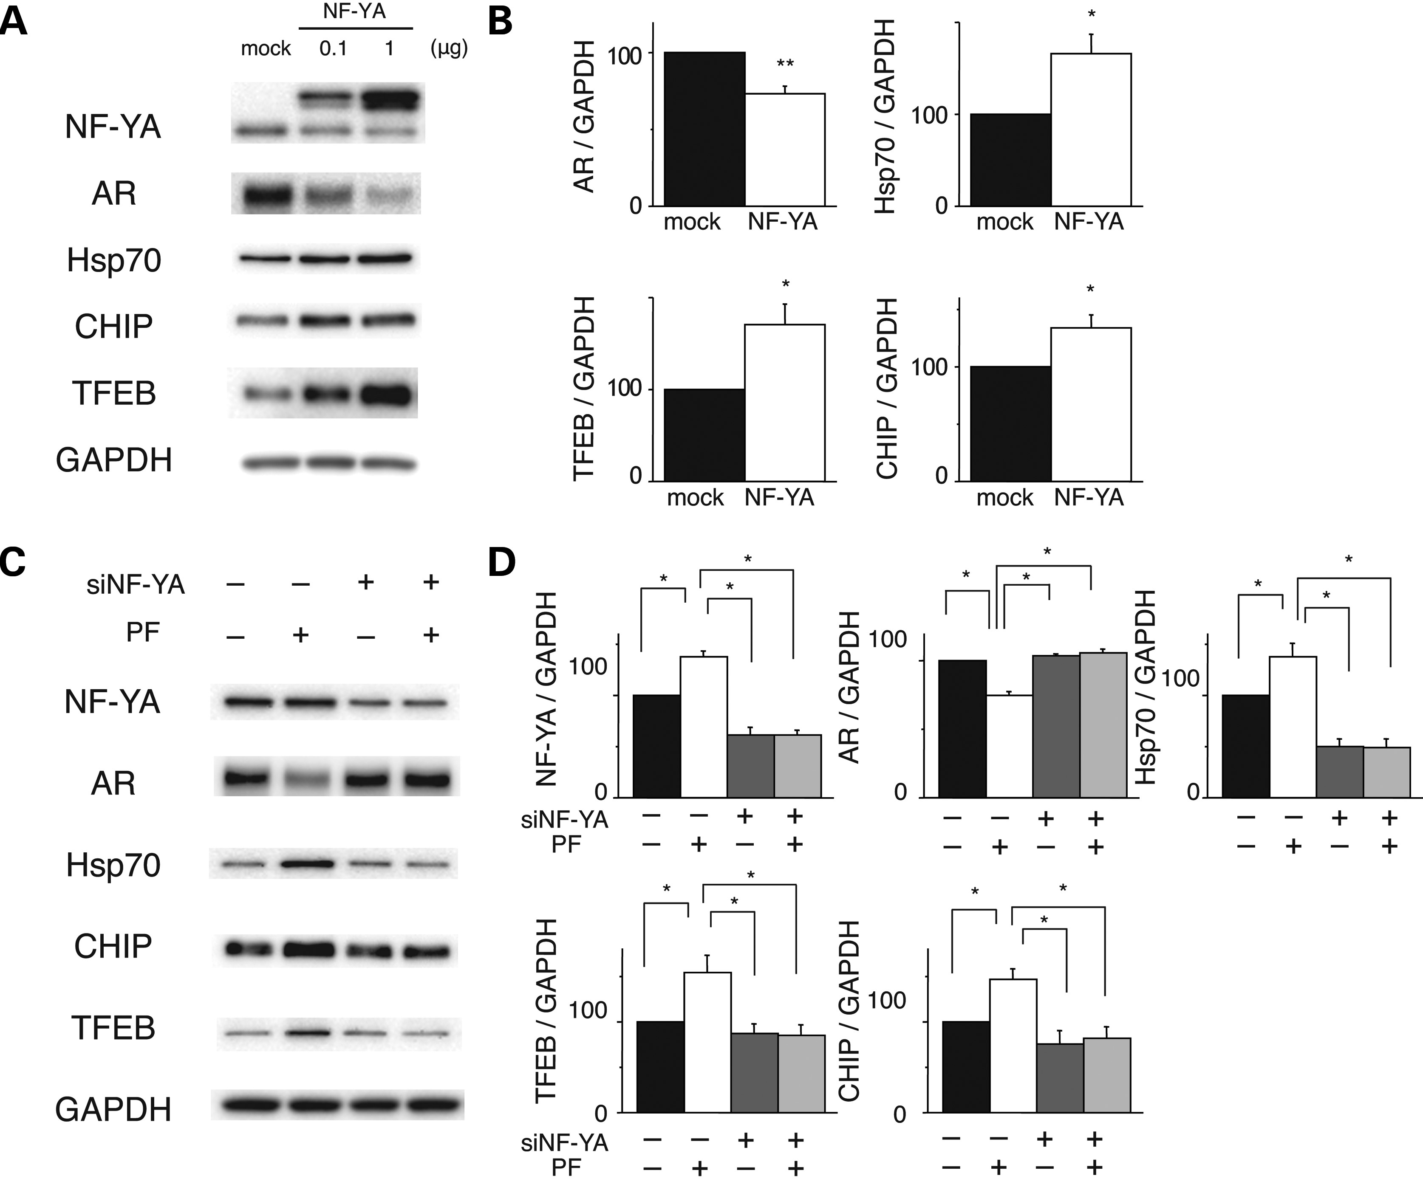
Figure 2. Effects of NF-YA overexpression in cultured cell models of SBMA. (A and B) Western blots and densitometric ...
Notes:
Figure 2. Effects of NF-YA overexpression in cultured cell models of SBMA. (A and B) Western blots and densitometric analyses of NSC34 cells stably expressing mutant AR. Cells were transfected with NF-YA with a V5 tag or the mock vector (*P < 0.05; **P < 0.01, n = 5, unpaired t-test). (C and D) Western blots and densitometric analyses of NSC34 cells stably expressing mutant AR that were transfected with control or NF-YA siRNA and treated with or without PF (*P < 0.05, n = 5, one-way ANOVA with Tukey–Kramer post hoc test). Error bars (B and D), SEM.
Unless provided in the caption above, the following copyright applies to the content of this slide: © The Author 2014. Published by Oxford University Press. All rights reserved. For Permissions, please email: journals.permissions@oup.com

Slide 3
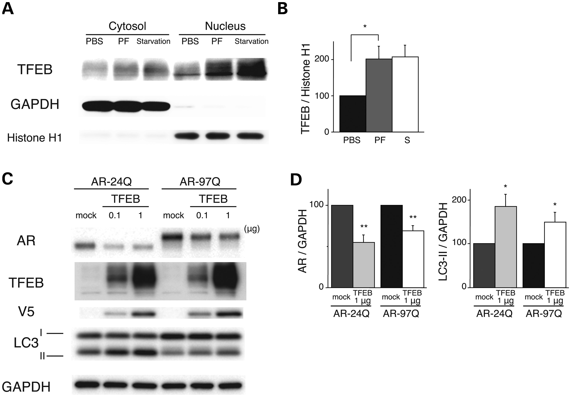
Figure 3. Effects of PF on expression levels of AR via TFEB activation. (A and B) PF facilitates the nuclear ...
Notes:
Figure 3. Effects of PF on expression levels of AR via TFEB activation. (A and B) PF facilitates the nuclear translocation of TFEB. Western blots and densitometric analyses from NSC34 cells treated with 10 µm PF or starvation. Cell lysates were subjected to nuclear or cytosolic fractionation and probed with a TFEB antibody. GAPDH and H1 were used as cytosolic and nuclear markers, respectively (*P < 0.01, n = 5, one-way ANOVA with Tukey–Kramer post hoc test). (C and D) Effects of TFEB overexpression on the expression levels of wild-type (24Q) and mutant (97Q) ARs in NCS34 cells. Western blots and densitometric analyses from NSC34 cells stably expressing AR-24Q or AR-97Q. Cells were transfected with the mock or TFEB-V5 vector (*P < 0.01, n = 5, unpaired t-test). Error bars (B and D), SEM.
Unless provided in the caption above, the following copyright applies to the content of this slide: © The Author 2014. Published by Oxford University Press. All rights reserved. For Permissions, please email: journals.permissions@oup.com

Slide 4
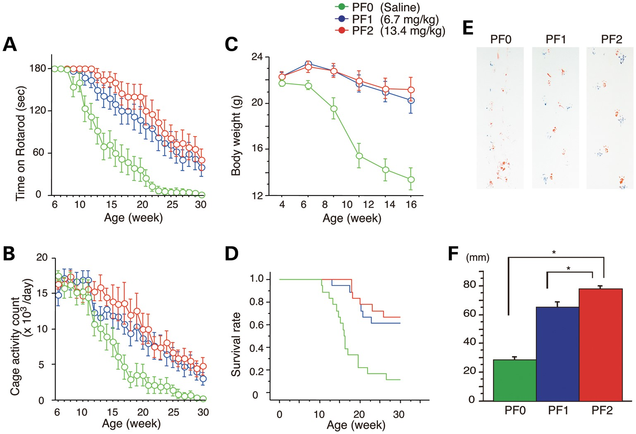
Figure 4. Effects of PF on behavioral phenotypes in AR-97Q mice. Untreated AR-97Q mice (PF0) or mice administered 6.7 ...
Notes:
Figure 4. Effects of PF on behavioral phenotypes in AR-97Q mice. Untreated AR-97Q mice (PF0) or mice administered 6.7 mg/kg (PF1) or 13.4 mg/kg (PF2) PF intraperitoneally every day from ages 5 to 30 weeks were tested for rotarod performance (A), cage activity (B) and body weight (C). PF1 and PF2 mice remained on the rotarod longer and exhibited greater cage activity than PF0 mice. PF0 mice lost weight earlier than PF1 and PF2 mice. All parameters were significantly different in PF2 mice compared with PF0 mice: P < 0.01 at 25 weeks (rotarod and cage activity) and P < 0.01 at 10 weeks (body weight) (n = 18, two-way ANOVA with Tukey–Kramer post hoc test). (D) A Kaplan–Meier plot shows the prolonged survival of PF1 and PF2 mice compared with PF0 mice (P = 0.0002 and 0.0001, respectively; n = 18, log-rank test). (E) Footprints of representative 16-week-old AR-97Q mice treated with or without PF. Front paws are indicated in red, and hind paws are in blue. PF0 mice exhibited motor weakness, demonstrated by the dragging of the legs. PF1 mice walked with somewhat longer steps, and PF2 mice walked almost normally. (F) The length of the steps was measured in 16-week-old AR-97Q mice. Each column shows the average length of the steps of the hind paw. PF1 and PF2 mice walked with significantly longer steps than PF0 mice (*P < 0.01, n = 6, one-way ANOVA with Tukey–Kramer post hoc test). These data suggest that PF ameliorates the phenotypic expression of SBMA in AR-97Q mice in a dose-dependent manner. Error bars (F), SEM.
Unless provided in the caption above, the following copyright applies to the content of this slide: © The Author 2014. Published by Oxford University Press. All rights reserved. For Permissions, please email: journals.permissions@oup.com

Slide 5
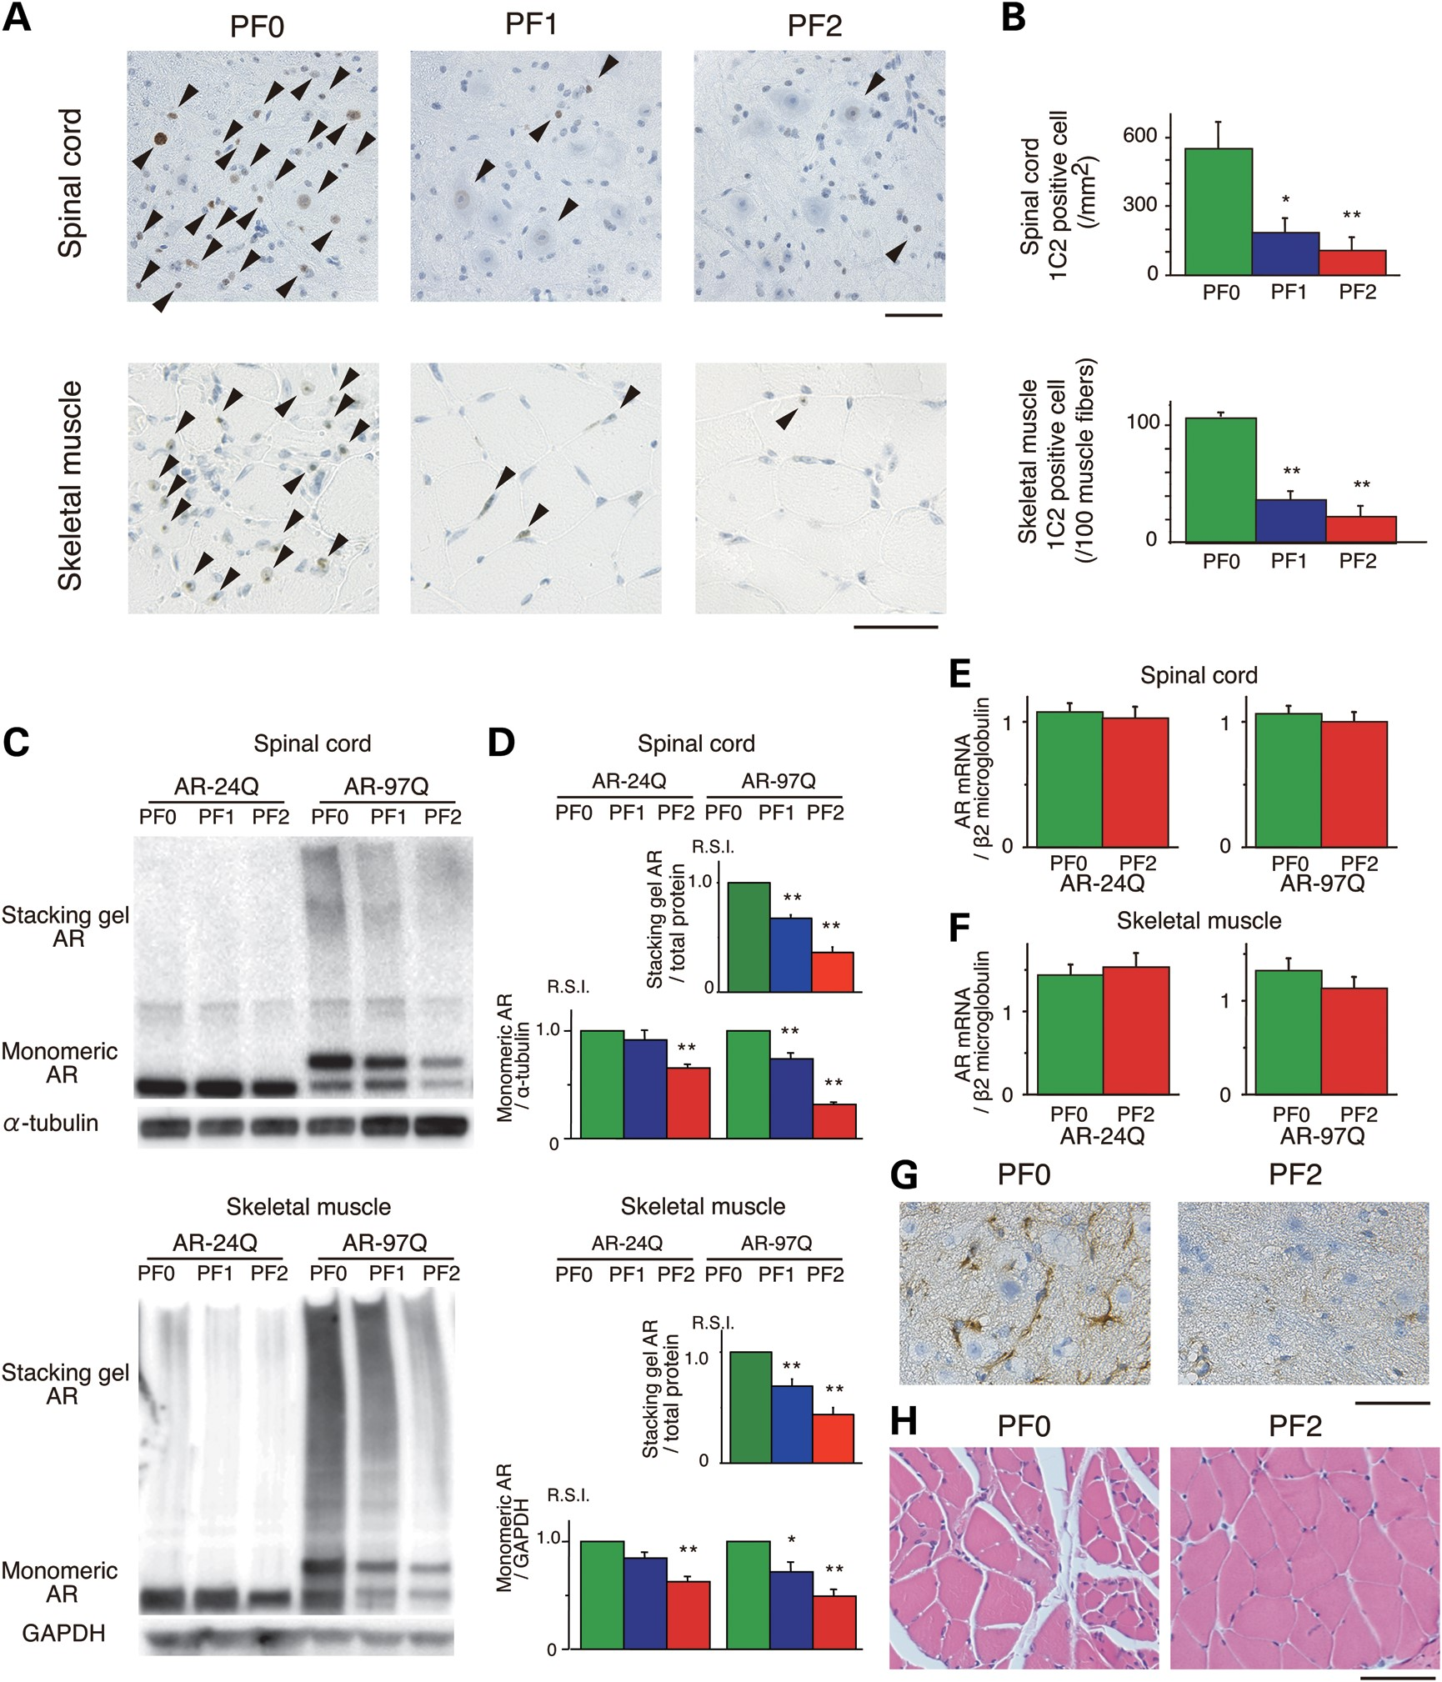
Figure 5. Effects of PF on the nuclear accumulation of abnormal AR in 16-week-old AR-24Q and AR-97Q mice. (A) ...
Notes:
Figure 5. Effects of PF on the nuclear accumulation of abnormal AR in 16-week-old AR-24Q and AR-97Q mice. (A) Immunohistochemical staining for mutant AR using the 1C2 antibody showed a marked reduction in diffuse nuclear staining and NIs (arrow head) in the spinal cord and skeletal muscle of the treated mice compared with the PF0 mice. (B) Quantiﬁcation of the number of 1C2-positive cells in the spinal cord and skeletal muscle of AR-97Q mice treated with or without PF (*P < 0.05; **P < 0.01, n = 6, one-way ANOVA with Tukey–Kramer post hoc test). (C and D) Western blot analysis of total tissue homogenates from the spinal cord and muscle of AR-24Q and AR-97Q mice probed with anti-AR (*P < 0.05; **P < 0.01, n = 5, one-way ANOVA with Tukey–Kramer post hoc test). (E and F) Real-time RT–PCR of wild-type and mutant AR mRNA in the spinal cord (E) and skeletal muscle (F). Quantities are presented as the ratio to β2 microglobulin mRNA (n = 5, unpaired t-test). (G) Immunohistochemical staining with anti-GFAP antibody in the spinal anterior horn of AR-97Q mice. (H) Hematoxylin and eosin staining of the muscles of AR-97Q mice. Error bars (B, D, E and F), SEM. Scale bars: 50 μm.
Unless provided in the caption above, the following copyright applies to the content of this slide: © The Author 2014. Published by Oxford University Press. All rights reserved. For Permissions, please email: journals.permissions@oup.com

Slide 6
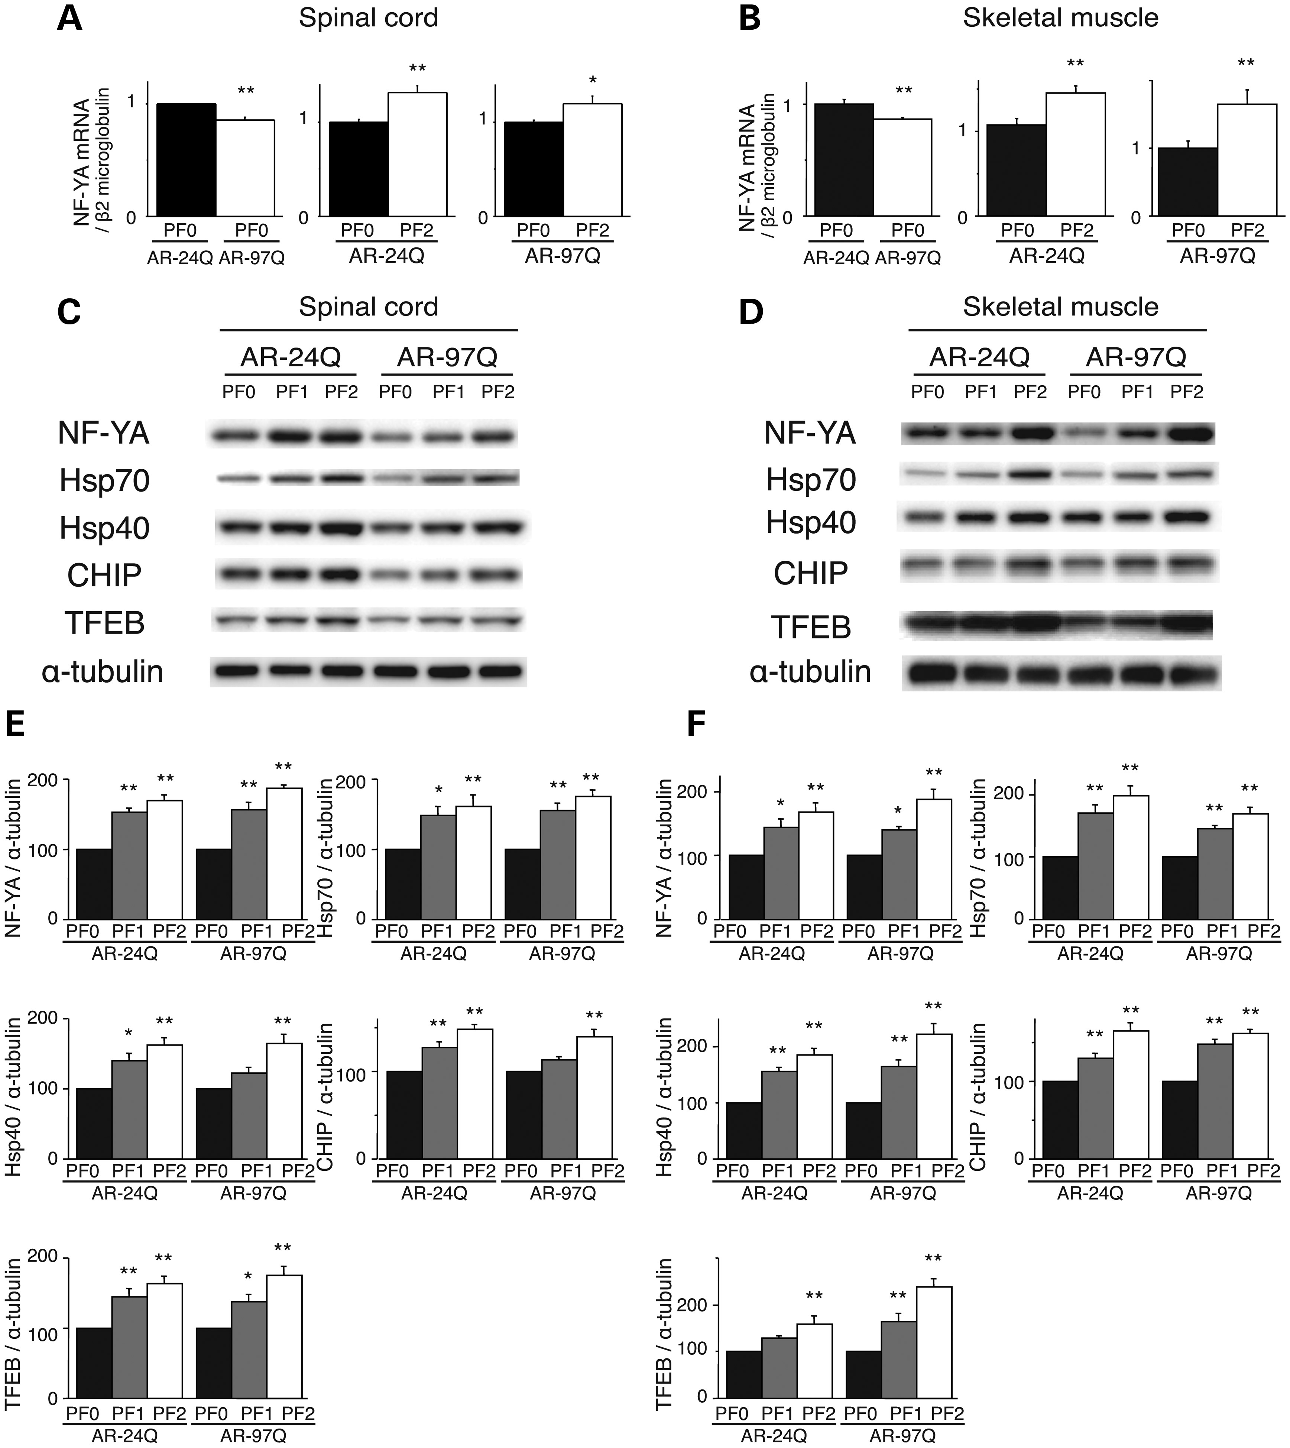
Figure 6. PF increased the expression of molecular chaperones, CHIP and transcription factors in AR-24Q mice and AR-97Q ...
Notes:
Figure 6. PF increased the expression of molecular chaperones, CHIP and transcription factors in AR-24Q mice and AR-97Q mice. The expression levels of NF-YA mRNA in the spinal cord (A) and skeletal muscle (B) of 16-week-old AR-24Q mice and AR-97Q mice (**P < 0.01; ***P < 0.001, n = 5, unpaired t-test). Western blots and densitometric analyses of NF-YA, molecular chaperones, CHIP and TFEB in the spinal cord (C and E) and skeletal muscle (D and F) of 16-week-old AR-24Q mice and AR-97Q mice (*P < 0.05; **P < 0.01, n = 5, one-way ANOVA with Tukey–Kramer post hoc test). Error bars (A, B, E, F), SEM.
Unless provided in the caption above, the following copyright applies to the content of this slide: © The Author 2014. Published by Oxford University Press. All rights reserved. For Permissions, please email: journals.permissions@oup.com

Slide 7
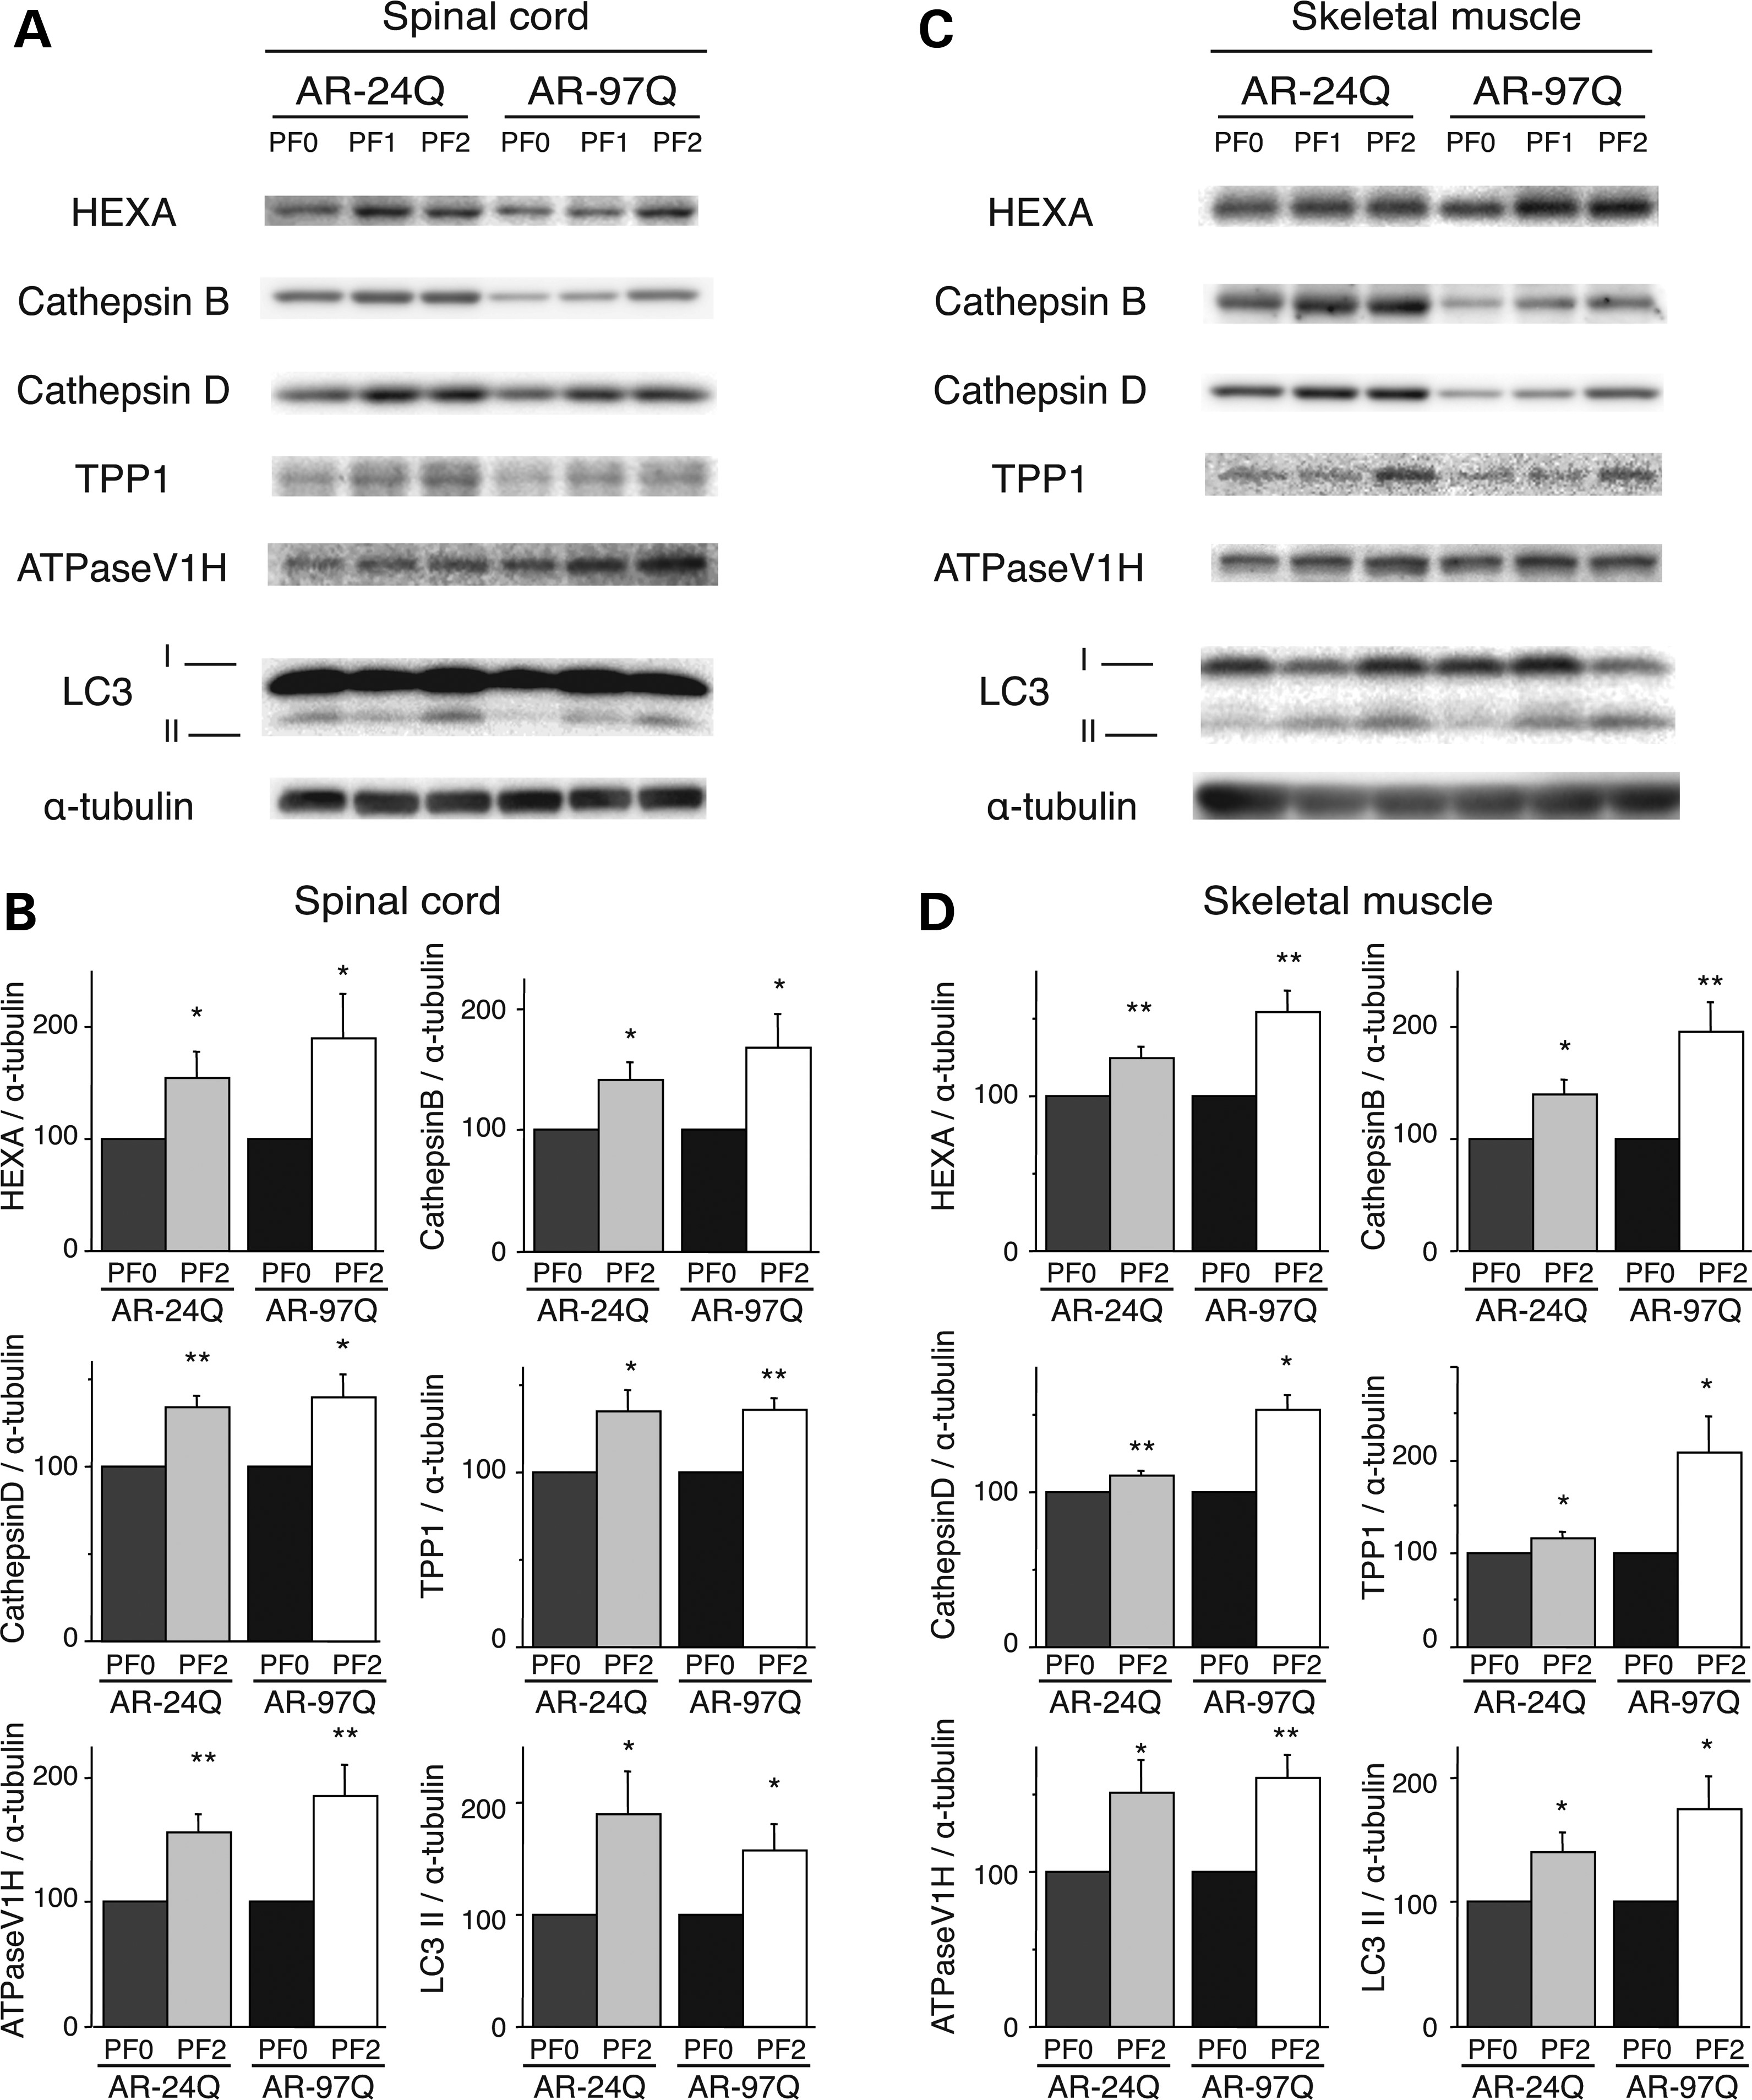
Figure 7. PF increased the expression of lysosomal proteases and LC3-II in AR-24Q and AR-97Q mice. Western blots and ...
Notes:
Figure 7. PF increased the expression of lysosomal proteases and LC3-II in AR-24Q and AR-97Q mice. Western blots and densitometric analyses for lysosomal proteases in the spinal cord (A and B) and skeletal muscle (C and D) of 16-week-old AR-24Q mice and AR-97Q mice (*P < 0.05; **P < 0.01, n = 5, unpaired t-test). Error bars (B, D), SEM.
Unless provided in the caption above, the following copyright applies to the content of this slide: © The Author 2014. Published by Oxford University Press. All rights reserved. For Permissions, please email: journals.permissions@oup.com

