Slide 1
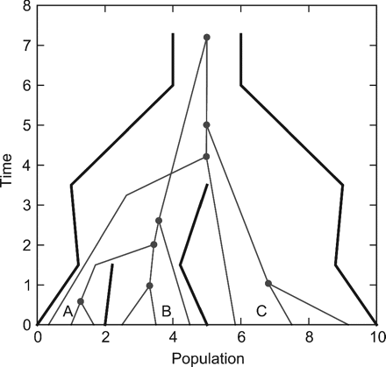
FIG. 1. Species tree visualization. One locus for three individuals from each of the three species giving a total of ...
Notes:
FIG. 1. Species tree visualization. One locus for three individuals from each of the three species giving a total of nine samples. Current population size (t = 0) of A is 2 and at time 1.5 (where it split from B) the population size is 1.
Unless provided in the caption above, the following copyright applies to the content of this slide: © 2009 The AuthorsThis is an Open Access article distributed under the terms of the Creative Commons Attribution Non-Commercial License (http://creativecommons.org/licenses/by-nc/2.5), which permits unrestricted non-commercial use, distribution, and reproduction in any medium, provided the original work is properly cited.

Slide 2
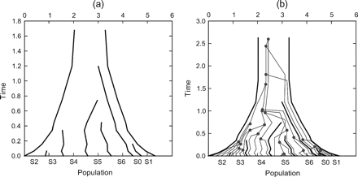
FIG. 2. (a) A simulated species tree from a birth–death process with continuous population sizes. (b) A single gene ...
Notes:
FIG. 2. (a) A simulated species tree from a birth–death process with continuous population sizes. (b) A single gene tree embedded inside the same species tree.
Unless provided in the caption above, the following copyright applies to the content of this slide: © 2009 The AuthorsThis is an Open Access article distributed under the terms of the Creative Commons Attribution Non-Commercial License (http://creativecommons.org/licenses/by-nc/2.5), which permits unrestricted non-commercial use, distribution, and reproduction in any medium, provided the original work is properly cited.

Slide 3
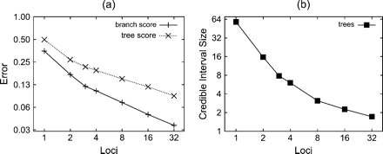
FIG. 3. (a) Species tree estimation error and (b) 95% credible interval size as a function of the number of loci. The ...
Notes:
FIG. 3. (a) Species tree estimation error and (b) 95% credible interval size as a function of the number of loci. The number of individuals sampled per species is four for all experiments. Each graph point is obtained by averaging the error measure (described in the main text) over 100 analyses of simulated data sets. The “branch score” is a measure of the distance in tree space of the estimated species tree to the true tree, incorporating both topology and divergence times. The “tree score” is a measure of the distance between the estimated species tree and the true species tree incorporating information about the population size as well. For details of the tree metrics used, see main text.
Unless provided in the caption above, the following copyright applies to the content of this slide: © 2009 The AuthorsThis is an Open Access article distributed under the terms of the Creative Commons Attribution Non-Commercial License (http://creativecommons.org/licenses/by-nc/2.5), which permits unrestricted non-commercial use, distribution, and reproduction in any medium, provided the original work is properly cited.

Slide 4
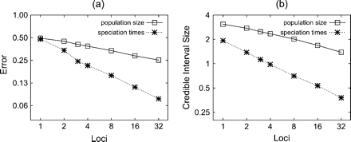
FIG. 4. (a) Relative error and (b) credible interval size for both population size and speciation time point ...
Notes:
FIG. 4. (a) Relative error and (b) credible interval size for both population size and speciation time point estimates. The number of individuals sampled per species is four for all experiments. Each graph point is obtained by averaging over 100 analyses of simulated data sets (see main text for details).
Unless provided in the caption above, the following copyright applies to the content of this slide: © 2009 The AuthorsThis is an Open Access article distributed under the terms of the Creative Commons Attribution Non-Commercial License (http://creativecommons.org/licenses/by-nc/2.5), which permits unrestricted non-commercial use, distribution, and reproduction in any medium, provided the original work is properly cited.

Slide 5
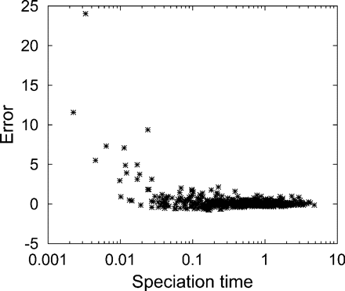
FIG. 5. Speciation time estimate error as a function of speciation time. Data are taken from the main 100 runs with ...
Notes:
FIG. 5. Speciation time estimate error as a function of speciation time. Data are taken from the main 100 runs with two loci, four individuals per species, and the sequence length of 1,600 bp.
Unless provided in the caption above, the following copyright applies to the content of this slide: © 2009 The AuthorsThis is an Open Access article distributed under the terms of the Creative Commons Attribution Non-Commercial License (http://creativecommons.org/licenses/by-nc/2.5), which permits unrestricted non-commercial use, distribution, and reproduction in any medium, provided the original work is properly cited.

Slide 6
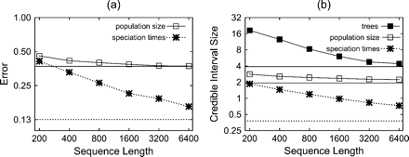
FIG. 6. (a) Relative error and (b) credible interval sizes as a function of sequence length. The number of ...
Notes:
FIG. 6. (a) Relative error and (b) credible interval sizes as a function of sequence length. The number of individuals sampled per species is four for all experiments. The number of independent loci are four for all experiments. Each graph point is obtained by averaging over 100 analyses of simulated data sets. The horizontal line represents the theoretical maximum when sequence length approaches infinity and is calculated by using the gene trees directly without error.
Unless provided in the caption above, the following copyright applies to the content of this slide: © 2009 The AuthorsThis is an Open Access article distributed under the terms of the Creative Commons Attribution Non-Commercial License (http://creativecommons.org/licenses/by-nc/2.5), which permits unrestricted non-commercial use, distribution, and reproduction in any medium, provided the original work is properly cited.

Slide 7
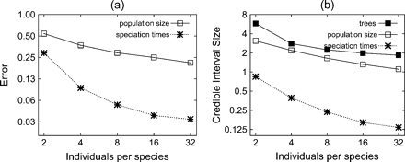
FIG. 7. (a) Relative error and (b) credible interval sizes, as a function of number of individuals sample from each ...
Notes:
FIG. 7. (a) Relative error and (b) credible interval sizes, as a function of number of individuals sample from each species. Each graph point is obtained by averaging over 100 analyses of simulated data sets. The analysis used the true gene trees to reduce the computational cost.
Unless provided in the caption above, the following copyright applies to the content of this slide: © 2009 The AuthorsThis is an Open Access article distributed under the terms of the Creative Commons Attribution Non-Commercial License (http://creativecommons.org/licenses/by-nc/2.5), which permits unrestricted non-commercial use, distribution, and reproduction in any medium, provided the original work is properly cited.

Slide 8
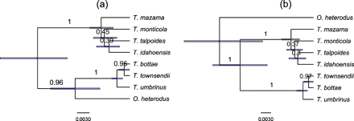
FIG. 8. Phylogeny for seven groups of western pocket gophers (Geomyidae, Thomomys). The analysis is based on seven ...
Notes:
FIG. 8. Phylogeny for seven groups of western pocket gophers (Geomyidae, Thomomys). The analysis is based on seven noncoding nuclear genes from 28 individuals. Clade posterior probability is indicated on the branch. (a) Analysis with no monophyly constraints and (b) analysis with ingroup monophyly enforced.
Unless provided in the caption above, the following copyright applies to the content of this slide: © 2009 The AuthorsThis is an Open Access article distributed under the terms of the Creative Commons Attribution Non-Commercial License (http://creativecommons.org/licenses/by-nc/2.5), which permits unrestricted non-commercial use, distribution, and reproduction in any medium, provided the original work is properly cited.

Slide 9
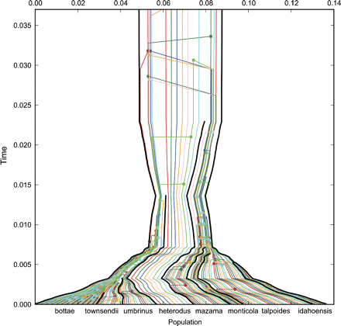
FIG. 9. Western pocket gophers (Geomyidae, Thomomys) species tree with embedded gene trees, each in a different ...
Notes:
FIG. 9. Western pocket gophers (Geomyidae, Thomomys) species tree with embedded gene trees, each in a different color. The species tree was generated using median estimates for the divergence times and population sizes. Note that this representation is for the purpose of visual inspection only, and any inferences should be made directly from the posterior data.
Unless provided in the caption above, the following copyright applies to the content of this slide: © 2009 The AuthorsThis is an Open Access article distributed under the terms of the Creative Commons Attribution Non-Commercial License (http://creativecommons.org/licenses/by-nc/2.5), which permits unrestricted non-commercial use, distribution, and reproduction in any medium, provided the original work is properly cited.

