Slide 1
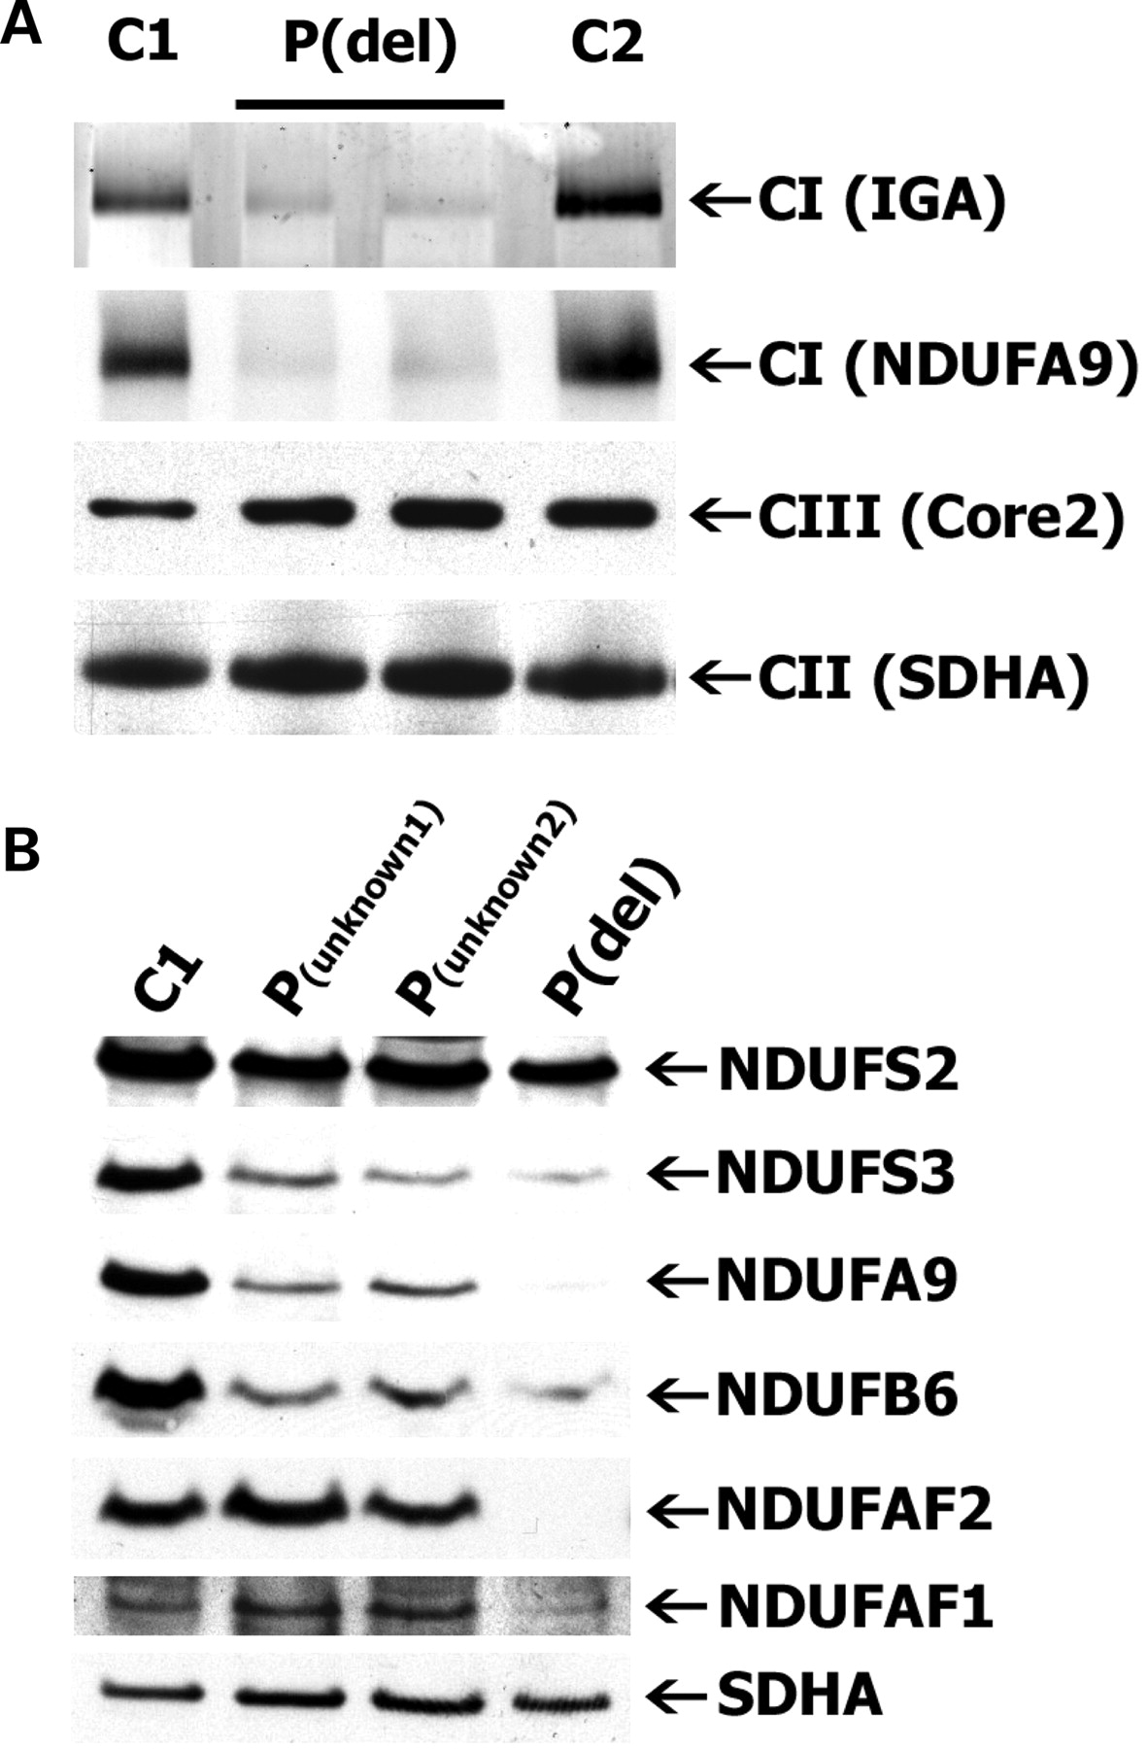
Figure 1. Blue native (BN)- and sodium dodecyl sulfate (SDS)–polyacrylamide gel electrophoresis (PAGE) analysis of ...
Notes:
Figure 1. Blue native (BN)- and sodium dodecyl sulfate (SDS)–polyacrylamide gel electrophoresis (PAGE) analysis of patient and control fibroblasts. (A) One-dimensional BN-PAGE shows a decrease in fully assembled Complex I activity and protein amount for the index patient (P(del)) in duplicate, compared with control fibroblasts (C1 and C2). Subunits against which the antibodies are used are depicted in brackets. (B) SDS–PAGE shows decreased levels of CI subunits in the patient and a total lack of assembly chaperone NDUFAF2. Two CI-deficient patients with unknown mutations are also shown (lanes 2 and 3). IGA: in-gel activity assay.
Unless provided in the caption above, the following copyright applies to the content of this slide: © The Author 2009. Published by Oxford University Press. All rights reserved. For Permissions, please email: journals.permissions@oxfordjournals.org

Slide 2
Figure 2. Complementation of the Complex I (CI) defect with wild-type NDUFAF2. (A) Blue Native-polyacrylamide gel ...
Notes:
Figure 2. Complementation of the Complex I (CI) defect with wild-type NDUFAF2. (A) Blue Native-polyacrylamide gel electrophoresis analysis of transduction of patient and control fibroblasts with baculoviral constructs encoding either wild-type GFP-tagged NDUFAF2, or GFP targeted to mitochondria by the COX8 leader peptide. CI activity as well as protein amount have specifically been restored to normal control levels for the index patient (P(del)) upon NDUFAF2 transduction when compared with transduction with COX8-GFP. Healthy control fibroblasts (C1 and C2) show no changes in CI activity and protein amount after transduction with wild-type NDUFAF2. The CI defect in patients with mutations in the NDUFS4 (P(S4)) and NDUFS7 (P(S7)) subunits cannot be complemented by wild-type NDUFAF2. Levels of CII and CIII remain unaffected upon transduction in each cell line. Subunits against which the antibodies are used are depicted in brackets. (B) SDS–PAGE analysis of expression of NDUFAF2-GFP and COX8-GFP constructs in patient and control fibroblasts using polyclonal anti-EGFP antibody. untr: untransduced; AF2: NDUFAF2-GFP transduced; COX8: COX8-GFP transduced; 830 kD: 830-kDa subcomplex of CI; IGA: in-gel activity assay.
Unless provided in the caption above, the following copyright applies to the content of this slide: © The Author 2009. Published by Oxford University Press. All rights reserved. For Permissions, please email: journals.permissions@oxfordjournals.org

Slide 3
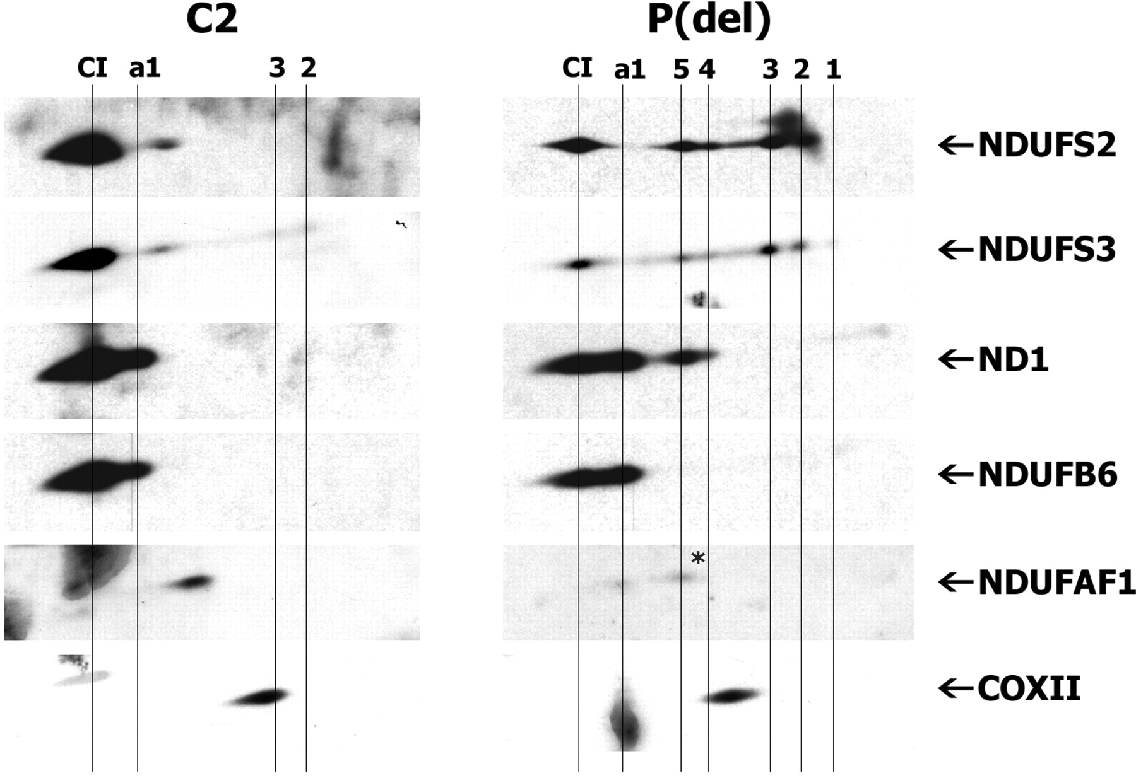
Figure 3. Complex I assembly profile of patient and control fibroblasts. Two-dimensional Blue Native (BN)-/sodium ...
Notes:
Figure 3. Complex I assembly profile of patient and control fibroblasts. Two-dimensional Blue Native (BN)-/sodium dodecyl sulfate–polyacrylamide gel electrophoresis (SDS–PAGE) shows accumulation of low-molecular weight subcomplexes 1–5 in the index patient's fibroblasts (P(del)) and a decrease in the NDUFAF1-containing complex (see asterisk), compared with control fibroblasts (C2). Subcomplexes have been numbered according to the human CI assembly pathway model described before (19). Accumulation of ‘appearing subcomplex 1’ (a1) is also more pronounced for the patient. Normal levels of COXII demonstrate undisturbed CIV assembly.
Unless provided in the caption above, the following copyright applies to the content of this slide: © The Author 2009. Published by Oxford University Press. All rights reserved. For Permissions, please email: journals.permissions@oxfordjournals.org

Slide 4
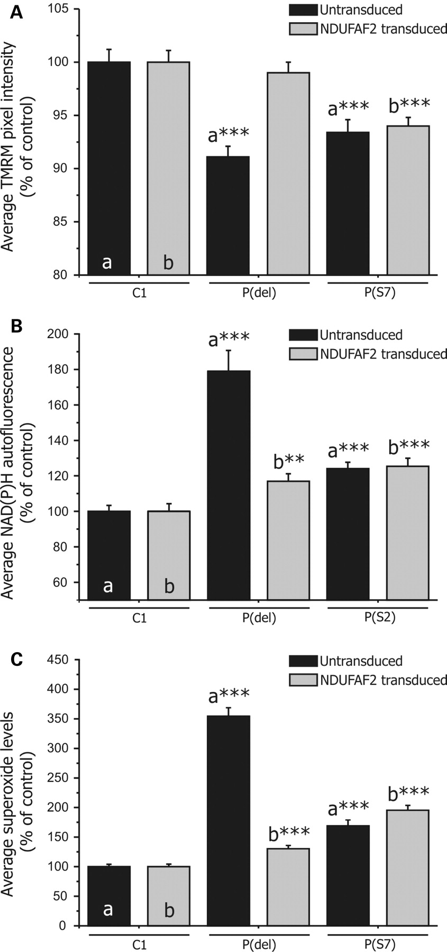
Figure 4. Measurement of mitochondrial membrane potential, cellular NAD(P)H and cellular superoxide levels. ...
Notes:
Figure 4. Measurement of mitochondrial membrane potential, cellular NAD(P)H and cellular superoxide levels. Measurements were performed on patient and control fibroblasts that remained untransduced or had been transduced with the NDUFAF2-GFP baculoviral construct. Measurements of all transduced and untransduced patient cells have been normalized to the average values of the corresponding transduced and untransduced healthy control cells, respectively. (A) Mitochondrial membrane potential of patient [P(del), n = 68; P(S7), n = 31] and control (C1, n = 58) fibroblasts was estimated from the average measured TMRM fluorescence pixel intensity. Wild-type NDUFAF2 almost completely restores membrane potential to normal control levels (C1, n = 55) in the index patient [P(del), n = 87], whereas no significant effect can be observed for the complex I-deficient NDUFS7 patient [P(S7), n = 82]. (B) Cellular NAD(P)H levels of patient [P(del), n = 34; P(S2), n = 57] and control (C1, n = 57) fibroblasts were measured as average NAD(P)H autofluorescence intensity. NAD(P)H levels have significantly been reduced in the index patient (P(del), n = 84) upon NDUFAF2-GFP transduction, but have not been changed for an NDUFS2 patient [P(S2), n = 59]. Control: C1, n = 44. (C) Cellular superoxide levels of patient [P(del), n = 130; P(S7), n = 89] and control fibroblasts (C1, n = 388) were measured as rates of HEt oxidation. The levels of superoxide production have significantly been reduced in the index patient [P(del), n = 145] upon NDUFAF2-GFP transduction, but have not been changed for the NDUFS7 patient [P(S7), n = 157]. Control: C1, n = 215. P-values <0.01 (double-asterisks) and <0.001 (triple-asterisks) were considered significantly different from corresponding control.
Unless provided in the caption above, the following copyright applies to the content of this slide: © The Author 2009. Published by Oxford University Press. All rights reserved. For Permissions, please email: journals.permissions@oxfordjournals.org

Slide 5
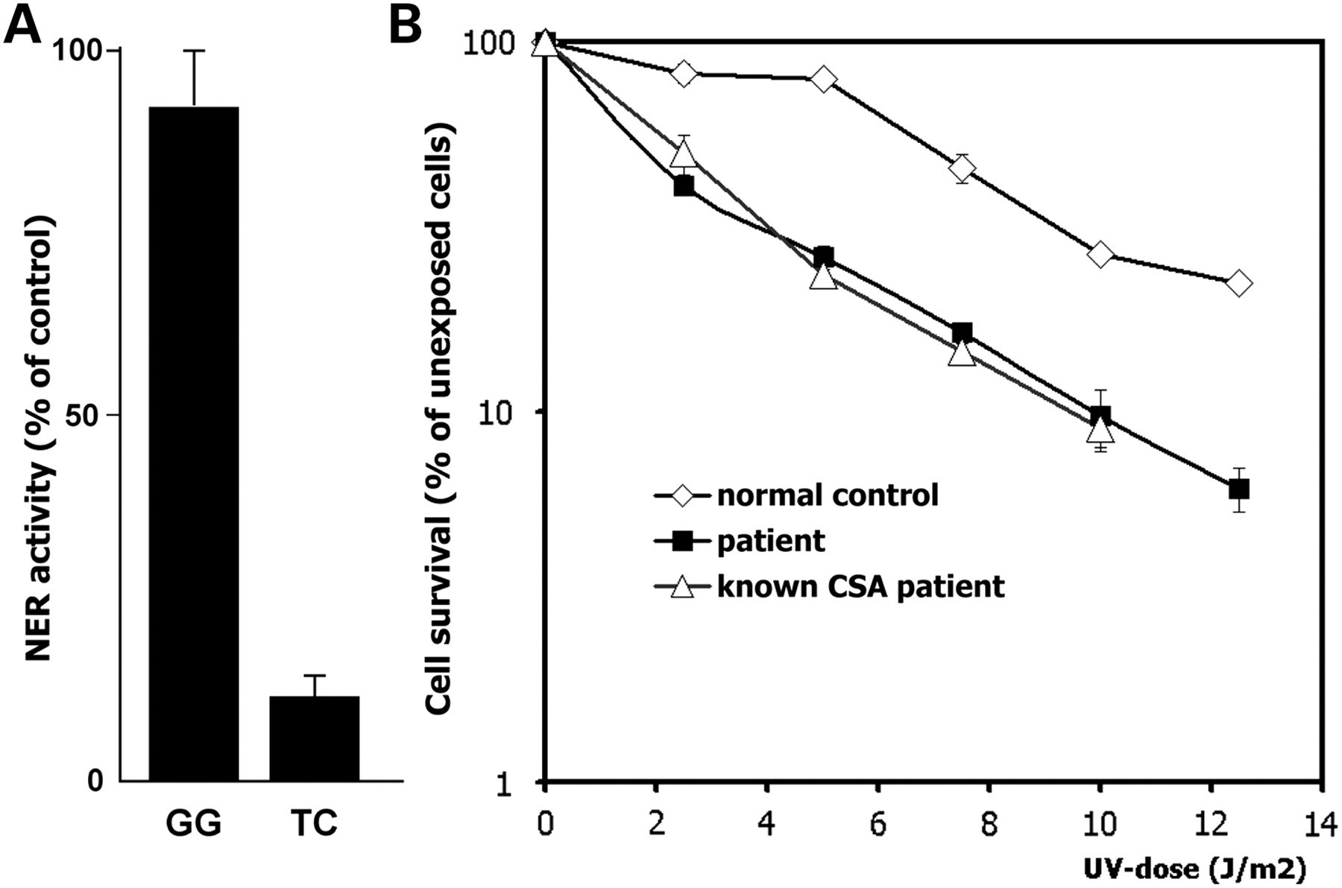
Figure 5. Nucleotide excision repair (NER) analysis of patient and control fibroblasts after exposure to UV radiation. ...
Notes:
Figure 5. Nucleotide excision repair (NER) analysis of patient and control fibroblasts after exposure to UV radiation. (A) NER activities of the index patient have been expressed as percentages of UV-exposed healthy control cells tested in the same experiment. Global genome NER (GG) was measured autoradiographically as ‘unscheduled DNA synthesis’ and transcription-coupled (TC) NER by recovery of overall RNA synthesis after UV exposure as described elsewhere (24). (B) Overall cell survival after exposure to graded UV doses (25). Proliferative activity of patient and control fibroblasts after UV exposure has been expressed as a percentage of unirradiated cells. The UV-survival curve of the index patient matches the curve of a known CSA patient. NER: nucleotide excision repair.
Unless provided in the caption above, the following copyright applies to the content of this slide: © The Author 2009. Published by Oxford University Press. All rights reserved. For Permissions, please email: journals.permissions@oxfordjournals.org

