Slide 1
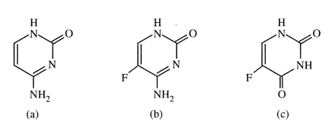
Figure 1. Chemical structures of (a) cytosine, (b) flucytosine and (c) 5-fluorouracil.
Notes:
Figure 1. Chemical structures of (a) cytosine, (b) flucytosine and (c) 5-fluorouracil.
Unless provided in the caption above, the following copyright applies to the content of this slide: © 2000 The British Society for Antimicrobial Chemotherapy

Slide 2
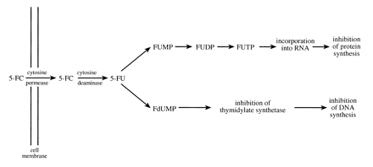
Figure 2. Intracellular pathway and mode of action of 5-fluorouracil. Abbrevations: 5-FC, flucytosine; 5-FU, ...
Notes:
Figure 2. Intracellular pathway and mode of action of 5-fluorouracil. Abbrevations: 5-FC, flucytosine; 5-FU, 5-fluorouracil; FUMP, 5-fluorouridine monophosphate; FUDP, 5-fluorouridine diphosphate; FUTP, 5-fluorouridine triphosphate; FdUMP, 5-fluorodeoxyuridine monophosphate.
Unless provided in the caption above, the following copyright applies to the content of this slide: © 2000 The British Society for Antimicrobial Chemotherapy

