Slide 1
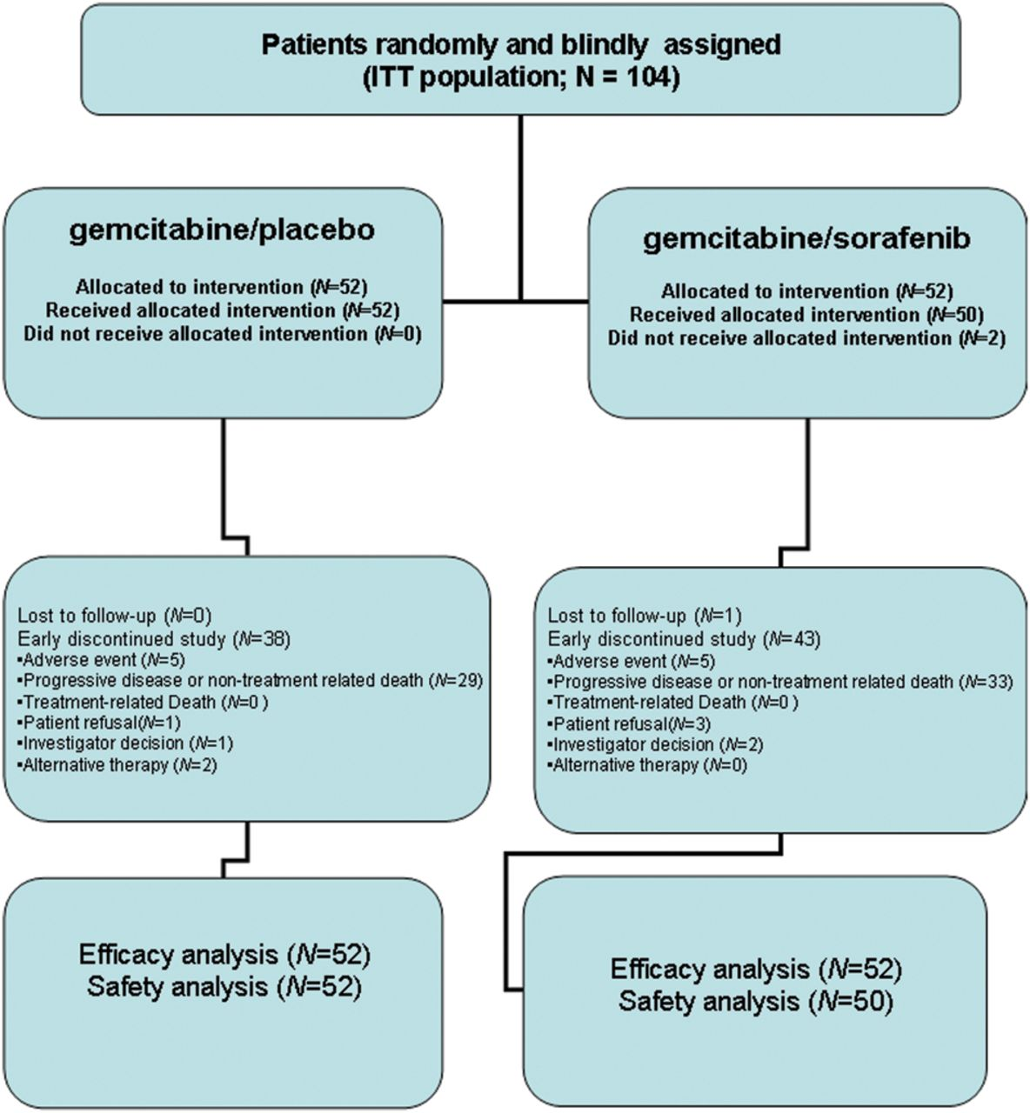
Figure 1. CONSORT diagram.
Notes:
Figure 1. CONSORT diagram.
Unless provided in the caption above, the following copyright applies to the content of this slide: © The Author 2012. Published by Oxford University Press on behalf of the European Society for Medical Oncology. All rights reserved. For permissions, please email: journals.permissions@oup.com.

Slide 2
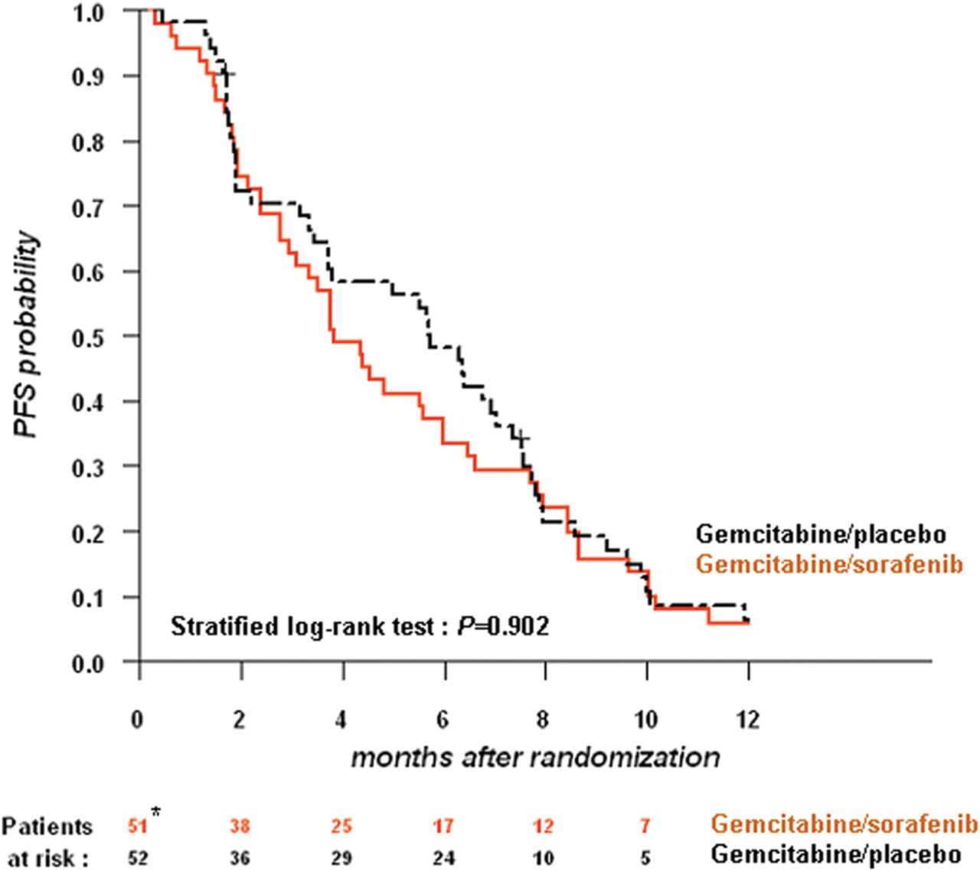
Figure 2. Progression-free survival (PFS) by treatment arm. *There were only 51 patients initially at risk in the ...
Notes:
Figure 2. Progression-free survival (PFS) by treatment arm. *There were only 51 patients initially at risk in the gemcitabine/sorafenib arm, because one patient randomized in this arm did not undergo any tumor evaluation.
Unless provided in the caption above, the following copyright applies to the content of this slide: © The Author 2012. Published by Oxford University Press on behalf of the European Society for Medical Oncology. All rights reserved. For permissions, please email: journals.permissions@oup.com.

Slide 3
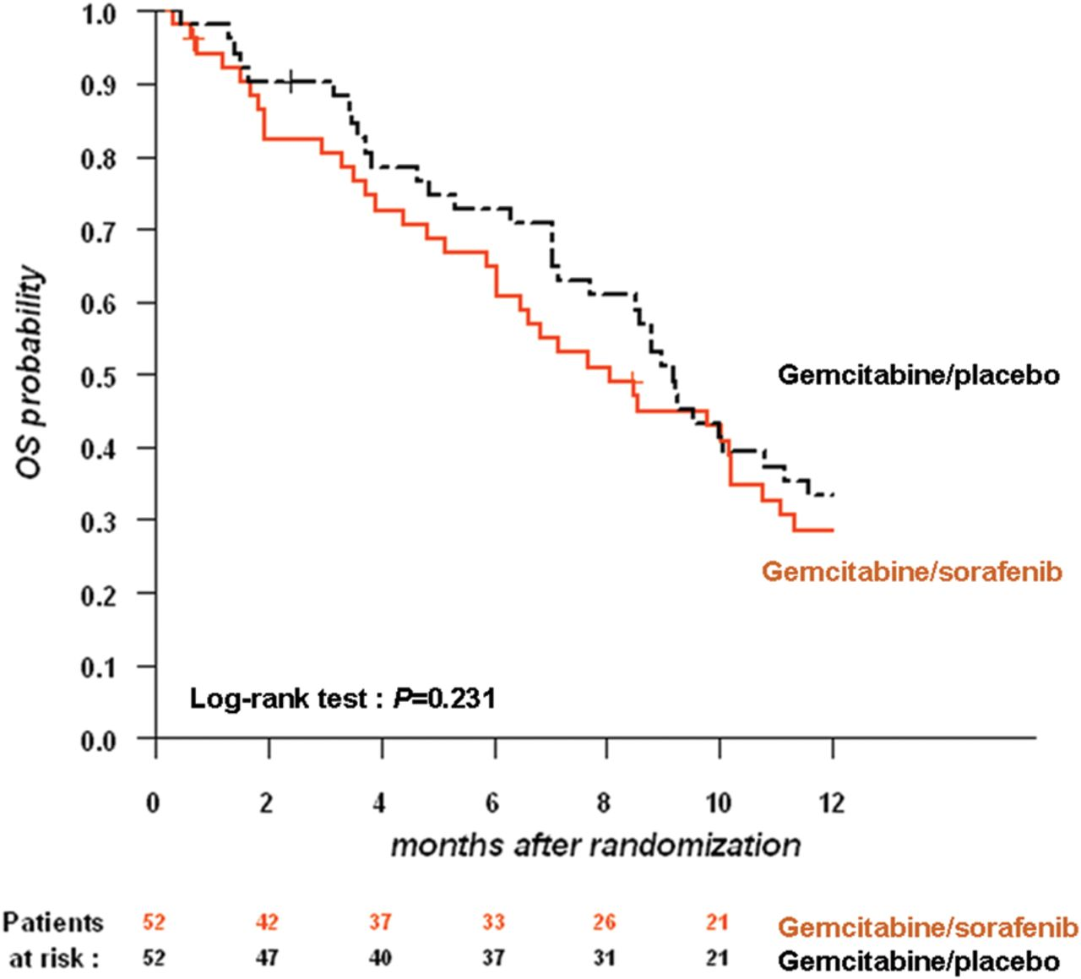
Figure 3. Overall survival (OS) by treatment arm.
Notes:
Figure 3. Overall survival (OS) by treatment arm.
Unless provided in the caption above, the following copyright applies to the content of this slide: © The Author 2012. Published by Oxford University Press on behalf of the European Society for Medical Oncology. All rights reserved. For permissions, please email: journals.permissions@oup.com.

