Slide 1
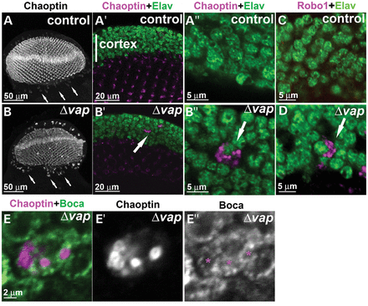
Figure 1. Loss of Vap causes accumulation of membrane proteins in the adult neurons. (A and B) Neurons in the brain of ...
Notes:
Figure 1. Loss of Vap causes accumulation of membrane proteins in the adult neurons. (A and B) Neurons in the brain of 1-day-old adult flies stained with anti-Chaoptin and anti-Elav antibodies. In control flies, Chaoptin labels individual synapses in the lamina (dots) as previously published (102). However, it is also expressed in few cortical neurons of the brain at low levels (A, arrows). In vap null mutant brains, Chaoptin accumulates in the cytoplasm of the neurons of the cortex (B, B’ and B", arrows). A precise excision of P{Mae-UAS.6.11} in vap was used as a control in A-A” (see Materials and Methods). (C and D) Staining of cortical neurons in the adult brain of 1-day-old flies with anti-Robo-1 and anti-Elav. In vap null mutants, Robo-1 accumulates in the cytoplasm of a subset of neurons (arrows, D). (E) Staining of affected neurons in the adult brain of the vap null mutant. Accumulated Chaoptin protein is very closely associated with Boca, an ER marker (indicated by * in E″).
Unless provided in the caption above, the following copyright applies to the content of this slide: © The Author 2013. Published by Oxford University Press. All rights reserved. For Permissions, please email: journals.permissions@oup.com

Slide 2
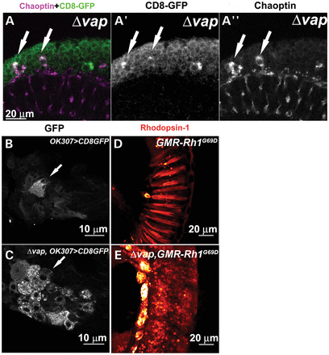
Figure 2. Loss of Vap causes accumulation of membrane proteins in the ER of neurons. (A) Staining of cortical neurons ...
Notes:
Figure 2. Loss of Vap causes accumulation of membrane proteins in the ER of neurons. (A) Staining of cortical neurons in the adult brain of 1-day-old flies expressing the membrane anchored GFP (CD8-GFP) with anti-Chaoptin and anti-GFP antibody. In the vap null mutant neurons, some neurons accumulate both CD8-GFP (arrows, A′) and Chaoptin (arrows, A″). (B and C) Motor neurons in the second thoracic segment of 1-day-old adult flies. CD8-GFP, a membrane protein, is expressed in control flies and the vap null mutant flies with OK307-GAL4 line, a driver with expression in motor neurons (42). CD8-GFP accumulates in the vap null mutant (C, arrow), but not in the WT flies (B, arrow). (D and E) Retina of 1-day-old adult flies stained with anti-Rhodopsin 1. The mutant Rhodopsin (Rh1G69D), a substrate of ERQC, is expressed in control and the vap null mutant eyes with GMR promoter. Rh1G69D mislocalizes and accumulates in punctae of the vap null mutant (E), but not in the control flies (D).
Unless provided in the caption above, the following copyright applies to the content of this slide: © The Author 2013. Published by Oxford University Press. All rights reserved. For Permissions, please email: journals.permissions@oup.com

Slide 3
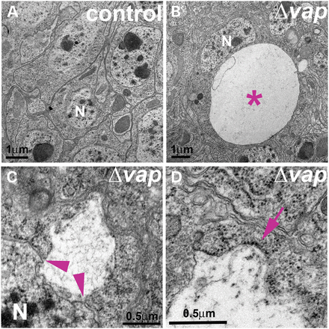
Figure 3. Loss of Vap causes an aberrant ER expansion. (A–D) TEM analysis of neurons of control (A) and of vap null ...
Notes:
Figure 3. Loss of Vap causes an aberrant ER expansion. (A–D) TEM analysis of neurons of control (A) and of vap null mutants (B–D). Large cytoplasmic vacuoles in the neurons of the vap null mutant (asterisk (*), B). The vacuole is contiguous with the nuclear membrane (arrow heads, C). The vacuole is also decorated with electron-dense ribosomes (arrows, D), suggesting that the vacuoles are aberrantly expanded ER. N: Nucleus. A precise excision line was used as a control.
Unless provided in the caption above, the following copyright applies to the content of this slide: © The Author 2013. Published by Oxford University Press. All rights reserved. For Permissions, please email: journals.permissions@oup.com

Slide 4
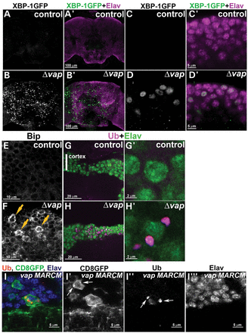
Figure 4. Loss of Vap causes ER stress. (A–D) An ER stress reporter Xbp1-GFP is significantly upregulated in the ...
Notes:
Figure 4. Loss of Vap causes ER stress. (A–D) An ER stress reporter Xbp1-GFP is significantly upregulated in the neurons of the 1-day-old vap null mutant adult brain (B and D), but not in the control flies (A and C). A precise excision line was used as a control. (E and F) Neurons of 1-day-old adult fly brains stained with anti-Bip, an ER stress marker. Bip is upregulated in the neurons of the vap null mutant (arrows in F). (G and H) Staining of the neurons in the cortex of the adult brain of control (G) and the vap null mutant (H) with Ubiquitin antibody. Ubiquitinated proteins accumulate in the cytoplasm of cortical neurons in adult vap null mutant (H and H′), but not in control adults (G and G′). (I) MARCM analysis of adult brains of y w, hsFLP, tub-GAL80, FRT19A/Δ vap, FRT19A; Act-GAL4, UAS-CD8:GFP flies. Ubiquitinated proteins accumulate only in GFP positive vap null mutant clones (I, arrows in I″), suggesting that accumulation of ubiquitinated proteins is associated with cellular autonomous defects. A membrane protein, CD8-GFP accumulates in the cytoplasm of vap null mutant clones (arrows in I′). Staining with GFP (I′), Ubiquitin (I″) and Elav (I‴) antibodies.
Unless provided in the caption above, the following copyright applies to the content of this slide: © The Author 2013. Published by Oxford University Press. All rights reserved. For Permissions, please email: journals.permissions@oup.com

Slide 5
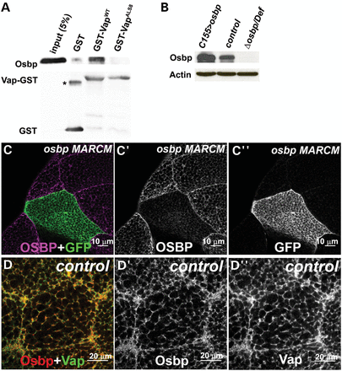
Figure 5. Osbp colocalizes with Vap in the ER. (A) Vap and Osbp interaction in a GST pull-down assay. ...
Notes:
Figure 5. Osbp colocalizes with Vap in the ER. (A) Vap and Osbp interaction in a GST pull-down assay. GST-VapWT binds Osbp, but GST-VapALS8 binding is severely reduced. GST-VapWT and GST-VapALS8 were expressed in bacteria and purified with glutathione–sepharose beads. Osbp protein was overexpressed and extracted from flies. The GST-Vap proteins linked to beads were then incubated with the lysate of these flies. The precipitate and input were analyzed with immunoblots using anti-Osbp antibody and anti-GST antibody. A GST only control was used to test specificity in binding of Vap GST and Osbp proteins. *: GST dimer. (B) Immunoblot analysis of proteins extracted from flies overexpressing Osbp, control (WT) and Δosbp over deficiency Df(3R)ED622, Δosbp/Df flies. Note the lack of Osbp protein expression in Δosbp/Df, showing the specificity of the Osbp antibody (GP89). (C) MARCM analysis of y w, hsFLP, tub-GAL4, UAS-GFP; FRT 82B, Δosbp/FRT 82B, y+, tub-GAL80 flies. Only GFP negative (WT) clones (C″) show Osbp expression (C′), suggesting the specificity of the guinea pig anti-Osbp (GP89) antibody. A portion of the salivary gland stained with anti-Osbp antibody (GP89). GFP marks the osbp null mutant cells (C and C″). (D) Immunostaining of a WT salivary gland cell with anti-Osbp (GP89) and anti-Vap antibody (Rb92). Osbp colocalizes with Vap in the ER.
Unless provided in the caption above, the following copyright applies to the content of this slide: © The Author 2013. Published by Oxford University Press. All rights reserved. For Permissions, please email: journals.permissions@oup.com

Slide 6
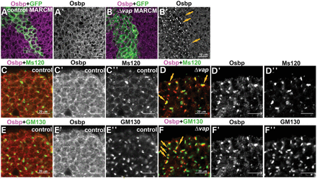
Figure 6. Osbp is mislocalized to the Golgi in vap null mutant cells. (A and B) MARCM analysis shows that Osbp ...
Notes:
Figure 6. Osbp is mislocalized to the Golgi in vap null mutant cells. (A and B) MARCM analysis shows that Osbp accumulates in cytoplasmic punctae of vap null mutant cells (B and arrows in B′) but not in WT cells (A and A′). (C and F) Osbp accumulates in the Golgi of vap null mutant cells. Immunostaining of the 1-day-old adult brain of WT (control) (C and E) and vap null mutant neurons (D and F) with anti-Osbp (C′–F′), anti-Ms120 (C″ and D″) and anti-GM130 (E″ and F″) antibodies, Golgi markers. Osbp barely colocalizes with the Golgi markers, Ms120 KDa protein (C–C″) and GM130 (E–E″) in the WT control, whereas Osbp colocalizes or is closely associated with Ms120 KDa protein (arrows, D–D′) and GM130 (arrows, F–F″) in the vap null mutant neurons.
Unless provided in the caption above, the following copyright applies to the content of this slide: © The Author 2013. Published by Oxford University Press. All rights reserved. For Permissions, please email: journals.permissions@oup.com

Slide 7
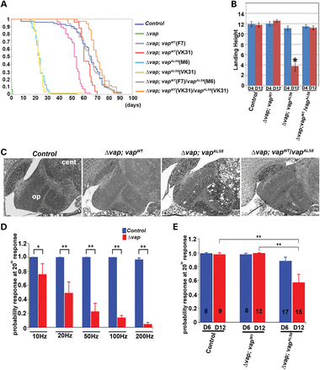
Figure 7. ALS8 mutation causes a partial loss of function of VAP and progressive defects in adult fly brain. (A) ...
Notes:
Figure 7. ALS8 mutation causes a partial loss of function of VAP and progressive defects in adult fly brain. (A) Longevity of adult flies. A Kaplan–Meier curve was used to show the probability of members of each genotype to exceed a certain lifespan. The vapALS8 transgene can rescue the lethality associated with loss of vap, but vapALS8 is not as active as the vapWT transgene. A copy of vapWT can compensate for the defects associated with vapALS8. Genotypes shown: Δvap (vap null mutant), Δvap; vapWT (vap null mutant carrying genomic vapWT, line F7 and line VK31), Δvap; vapALS8 (vap null mutant carrying genomic vapALS8, line M6 and line VK31), Δvap; vapWT/ vap ALS8 (vap null mutant carrying genomic vapWT and vapALS8). Line F7 and M6 are P-element mediated transgenes. VK31 lines are site-specific integrated transgenes. A one-way independent groups ANOVA and post-hoc Tukey HSD tests were used to show a significant difference in lifespan between Δvap; vapWT and Δvap; vapALS8 flies. Longevity: Δvap (pharate lethal, n = 46), control (precise excision line, average 64 days, n = 70), Δvap; vapWT (F7) (average 52 days, n = 56), Δvap; vapWT (VK31) (average 62 days, n = 25), Δvap; vapALS8 (M6) (average 23 days, * P < 0.0001, n = 102, compared with control), Δvap; vapALS8 (VK31) (average14 days, * P < 0.0001 compared with control), Δvap; vapWT(F7)/vap ALS8 (M6) (average 65 days, n = 50) and Δvap; vapWT/vap ALS8 (VK31) (average 67 days, n = 68). (B) Flight test. vapWT can suppress the flight defects associated with vapALS8. Δvap; vapALS8 (VK31) flies exhibit flight defects at day 12 (* P < 0.001 compared with control), but not at day 4 after eclosion. However, Δvap; vapWT/vapALS8 flies do not show flight defects. Flies were individually dropped into a plastic cylinder, and the height at which they landed was recorded. The shorter the distance from the bottom to their landing point, the worse their ability to fly. Numbers tested: control (n = 24), Δvap; vapWT (n = 28), Δvap; vapALS8(n = 24), and Δvap; vapWT/vapALS8 (n = 27). Error bars represent SEM. (C) vapALS8 causes adult brain degeneration. Brain section of 12-day-old adult flies. Δvap; vapALS8 (VK31), but not Δvap; vapWT (VK31) flies show vacuolation of brains in the optic lobe and central lobe. A copy of vapWT suppresses the defects associated with vapALS8. op: optic lobe and cen: central lobe. (D) Loss of Vap causes functional defects in motor neurons in adult flies. In the vap null mutant 1-day-old flies, the TTM muscles are unable to follow a 200 Hz stimulus, but they can almost respond accurately when stimulated at 10 Hz. (D) shows the difference between WT control (n = 16) and vap null mutants (n = 9) at the 20th pulse when stimulated at 10 Hz (control P = 1; Δvap P = 0.76 ± 0.15; mean ± SEM), 20 Hz (control P = 1; Δvap P = 0.49 ± 0.16), 50 Hz (control P = 1; Δvap P = 0.23 ± 0.12), 100 Hz (control P = 1; Δvap P = 0.14 ± 0.03), 200 Hz (control P = 0.97 ± 0.02; Δvap P = 0.04 ± 0.03). n: the number of flies used. * P < 0.05 and ** P < 0.005. (E) vapALS8 causes functional defects in motor neurons in adult flies. Comparison of 6- and 12-day-old flies that are responding to high frequency nerve stimulation (200 Hz) between control, Δvap; vapWT (VK31) and Δvap; vapALS8 (VK31) at 20th pulse. There is no difference in 6- and 12-day-old control flies (6 day P = 0.99 ± 0.013, n = 8; 14 day: P = 0.98 ± 0.025, n = 9) as well as Δvap; vapWT (6 day: 0.98 ± 0.017, n = 8; 12 day: 0.99 ± 0.010, n = 12). However, there is a significant reduction in the ability to follow a 200 Hz stimulus in Δvap; vapALS8 (6 day: P = 0.87 ± 0.057, n = 17; 12 day: P = 0.57 ± 0.116, n = 15. Control flies are those that have a precise excision of P{Mae-UAS.6.11}.
Unless provided in the caption above, the following copyright applies to the content of this slide: © The Author 2013. Published by Oxford University Press. All rights reserved. For Permissions, please email: journals.permissions@oup.com

Slide 8
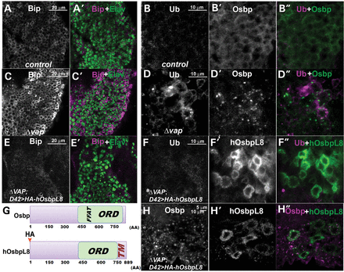
Figure 8. Expression of human OsbpL8 suppresses the ER defects associated with loss of Vap. (A–F, H) Immunostaining of ...
Notes:
Figure 8. Expression of human OsbpL8 suppresses the ER defects associated with loss of Vap. (A–F, H) Immunostaining of the adult brain of WT (control) (A and B), vap null mutant (C and D), vap null mutants expressing HA-hOsbpL8 with neuronal GAL4 (D42) driver (E, F and H). Expression of human OsbpL8 suppresses the upregulation of Bip and accumulation of ubiquitinated proteins caused by loss of Vap (compare E and F to C and D) without restoring the localization of Osbp (H). (G) Graphical overview of the Osbp and hOsbpL8 proteins. Human OsbpL8 contains a transmembrane domain, but neither a Vap binding FFAT motif nor a signal peptide. FFAT: Vap binding site, ORD: Osbp-related domain, TM: transmembrane domain. In UAS hosbpL8 transgene, the HA epitope tag was inserted at the amino terminus of human OsbpL8.
Unless provided in the caption above, the following copyright applies to the content of this slide: © The Author 2013. Published by Oxford University Press. All rights reserved. For Permissions, please email: journals.permissions@oup.com

Slide 9
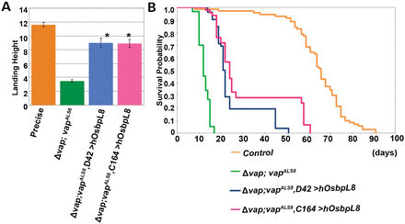
Figure 9. Neuronal expression of OsbpL8 enhances the longevity associated with vap^{ALS8} transgenic flies. (A) ...
Notes:
Figure 9. Neuronal expression of OsbpL8 enhances the longevity associated with vapALS8 transgenic flies. (A) Flight assay of Δvap; vapALS8 flies expressing human OsbpL8 in neurons. Δvap; vapALS8 flies exhibit flight defects at day 12 of adulthood (*P < 0.0001 compared with control). Neuron-specific expression (using D42 GAL4 and C164 GAL4) of OsbpL8 in Δvap; vapALS8 flies significantly abates the defects associated with Δvap; vapALS8. Flies tested: control (precise excision line, average 11.61 in, n = 59) Δvap; vapALS8 (average 3.47 in, n = 49), Δvap; vapALS8; D42-GAL4>UAS-human OsbpL8 (average 8.99 in, n = 45, *P < 0.0001 compared with vapALS8 mutant) and Δvap; vapALS8; C164-GAL4>UAS-human OsbpL8 (average 8.90 in, n = 39, *P < 0.0001 compared with vapALS8 mutant). Error bars represent SEM. (B) Longevities of Δvap; vapALS8 flies expressing human OsbpL8 in neurons. Human OsbpL8 was expressed using two different neuron-specific GAL4 drivers (D42-GAL4 and C164-GAL4). Expression of OsbpL8 in neurons of Δvap; vapALS8 flies significantly enhances the longevity associated with these flies. Longevity: control (precise excision line, average 63.69 days, n = 71), Δvap; vapALS8 (average 12.47 days, n = 150), Δvap; vapALS8; D42-GAL4>UAS-human OsbpL8 (average 25.33 days, n = 52, *P < 0.0001 compared with vapALS8 mutant) and Δvap; vapALS8; C164-GAL4>UAS-human OsbpL8 (average 31.87 days, n = 46, *P < 0.0001 compared with vapALS8 mutant).
Unless provided in the caption above, the following copyright applies to the content of this slide: © The Author 2013. Published by Oxford University Press. All rights reserved. For Permissions, please email: journals.permissions@oup.com

