Slide 1
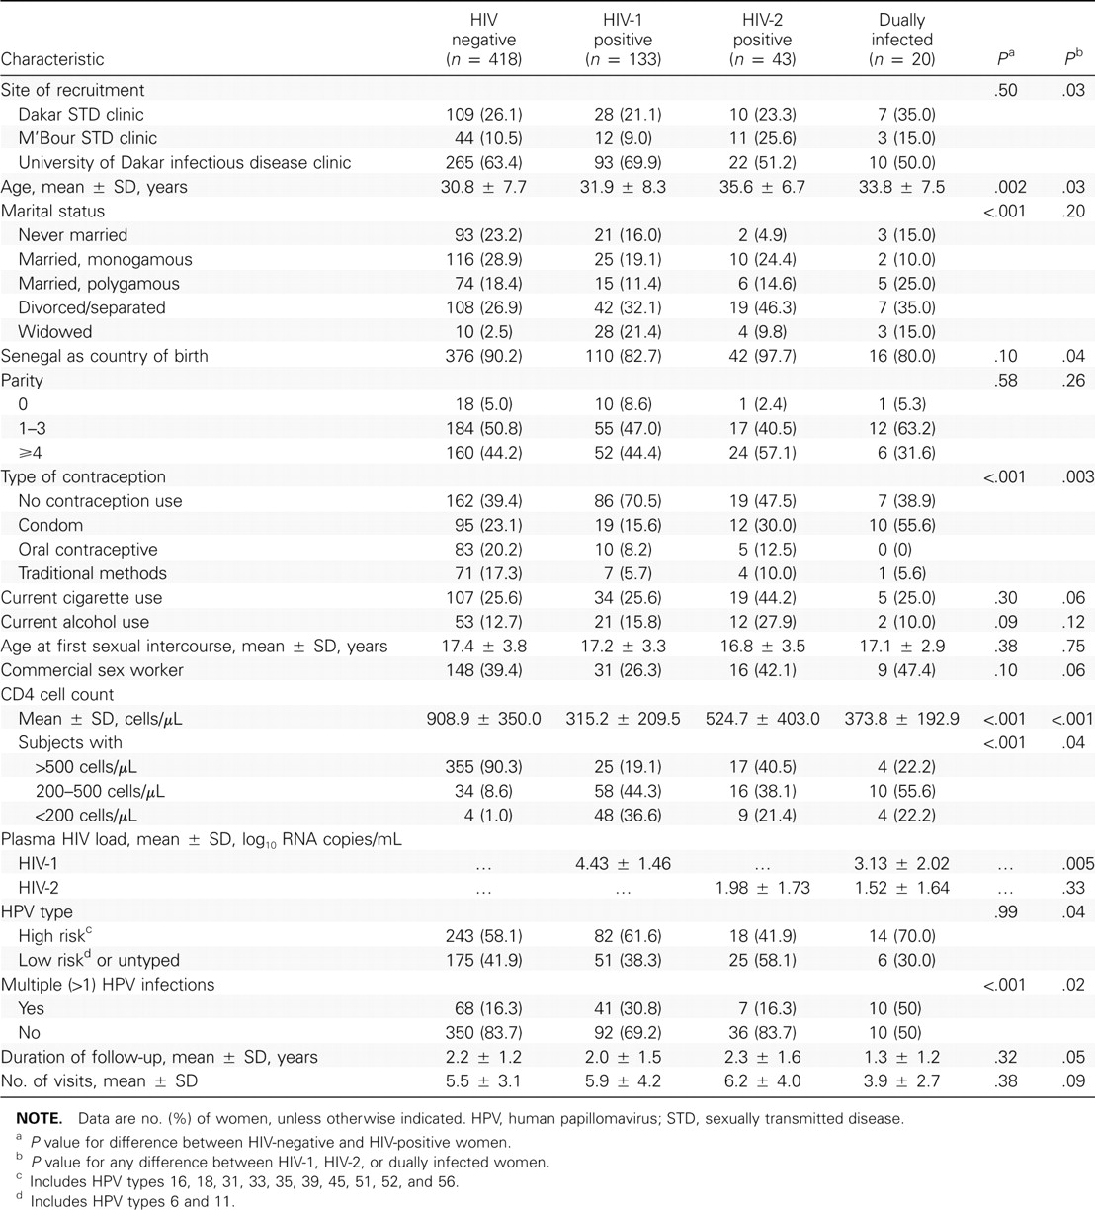
Table 1 Demographic and laboratory characteristics of the study population, by HIV status and type at the baseline ...
Notes:
Table 1 Demographic and laboratory characteristics of the study population, by HIV status and type at the baseline visit.
Unless provided in the caption above, the following copyright applies to the content of this slide: © 2007 by the Infectious Diseases Society of America

Slide 2
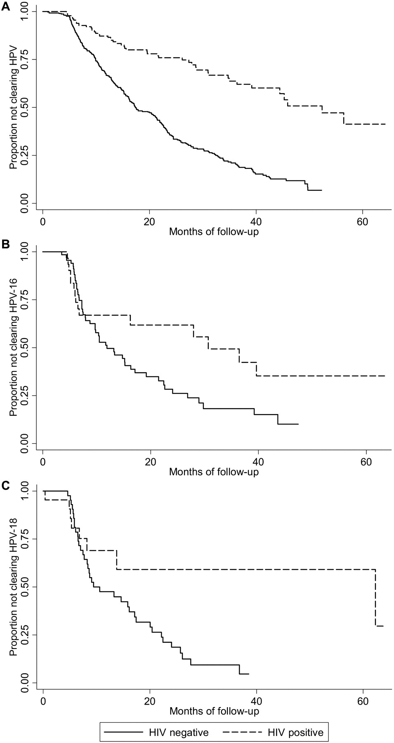
Figure 1 Cumulative incidence of human papillomavirus (HPV) clearance, by HIV status. A, Any HPV infection. B, HPV-16 ...
Notes:
Figure 1 Cumulative incidence of human papillomavirus (HPV) clearance, by HIV status. A, Any HPV infection. B, HPV-16 infection. C, HPV-18 infection.
Unless provided in the caption above, the following copyright applies to the content of this slide: © 2007 by the Infectious Diseases Society of America

Slide 3
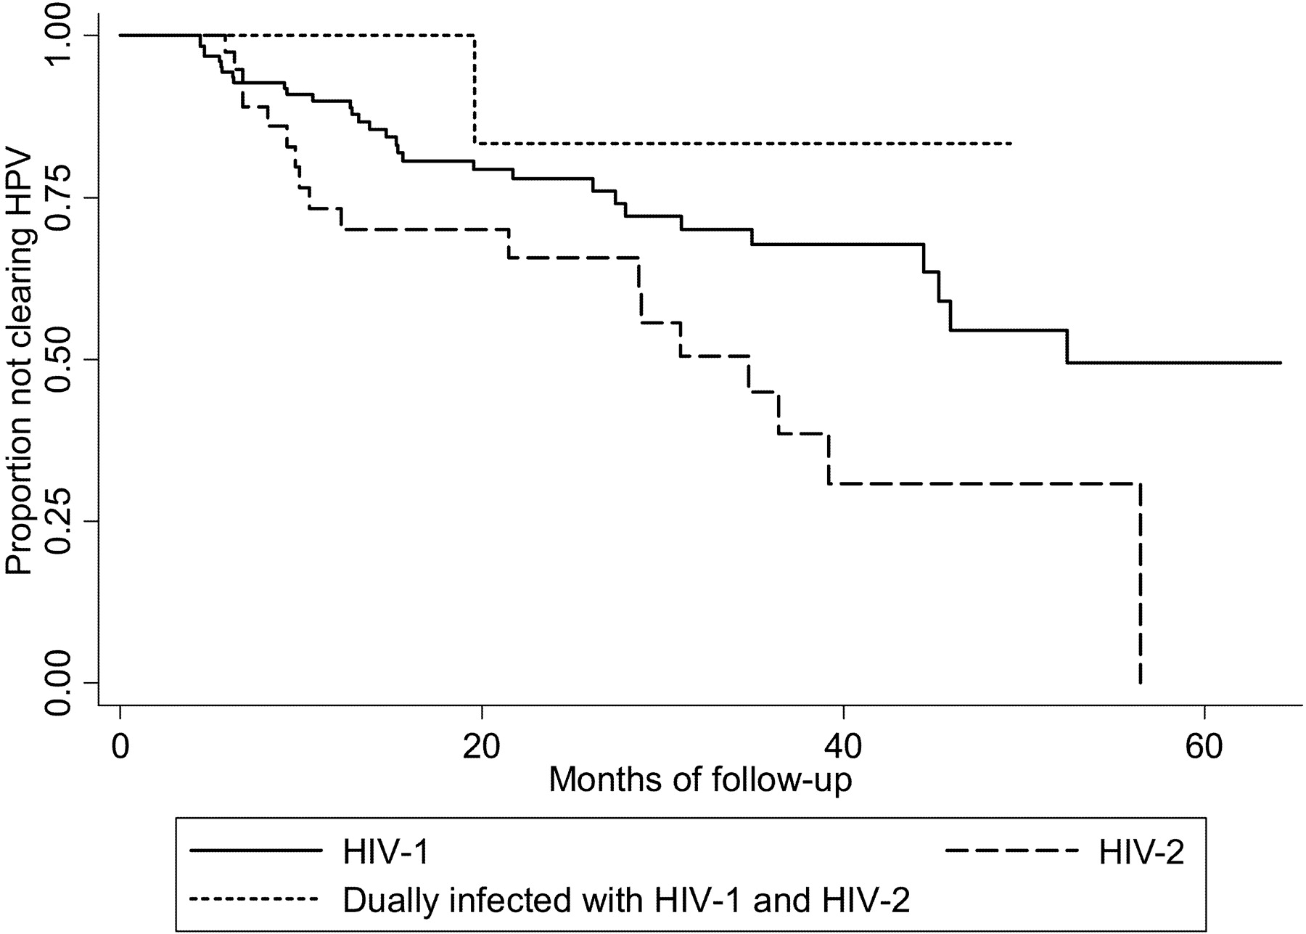
Figure 2 Cumulative incidence of human papillomavirus (HPV) clearance among HIV-positive women, by HIV type.
Notes:
Figure 2 Cumulative incidence of human papillomavirus (HPV) clearance among HIV-positive women, by HIV type.
Unless provided in the caption above, the following copyright applies to the content of this slide: © 2007 by the Infectious Diseases Society of America

Slide 4
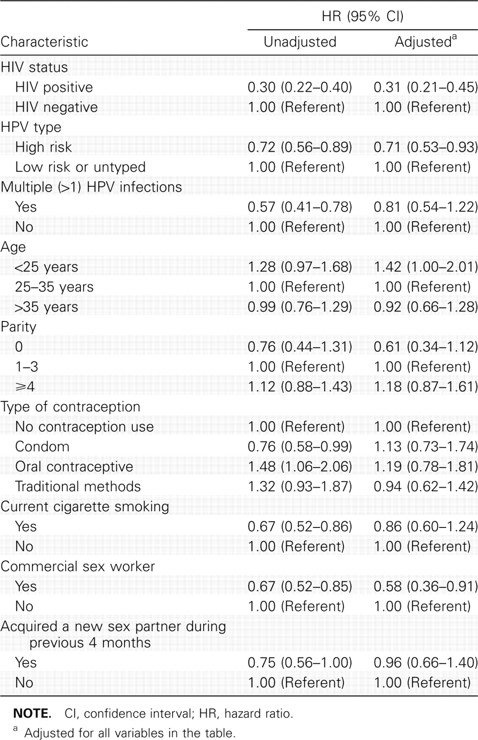
Table 2 Unadjusted and adjusted associations between characteristics of the study population and clearance of human ...
Notes:
Table 2 Unadjusted and adjusted associations between characteristics of the study population and clearance of human papillomavirus (HPV) infection.
Unless provided in the caption above, the following copyright applies to the content of this slide: © 2007 by the Infectious Diseases Society of America

Slide 5
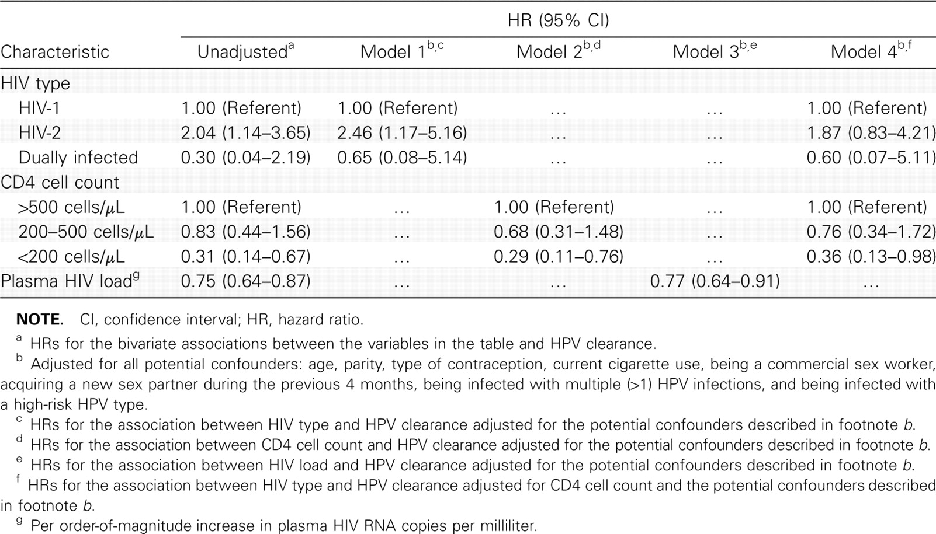
Table 3 Unadjusted and adjusted associations between HIV type, CD4 cell count, and HIV load and clearance of human ...
Notes:
Table 3 Unadjusted and adjusted associations between HIV type, CD4 cell count, and HIV load and clearance of human papillomavirus (HPV) infection among HIV-positive women.
Unless provided in the caption above, the following copyright applies to the content of this slide: © 2007 by the Infectious Diseases Society of America

