Slide 1
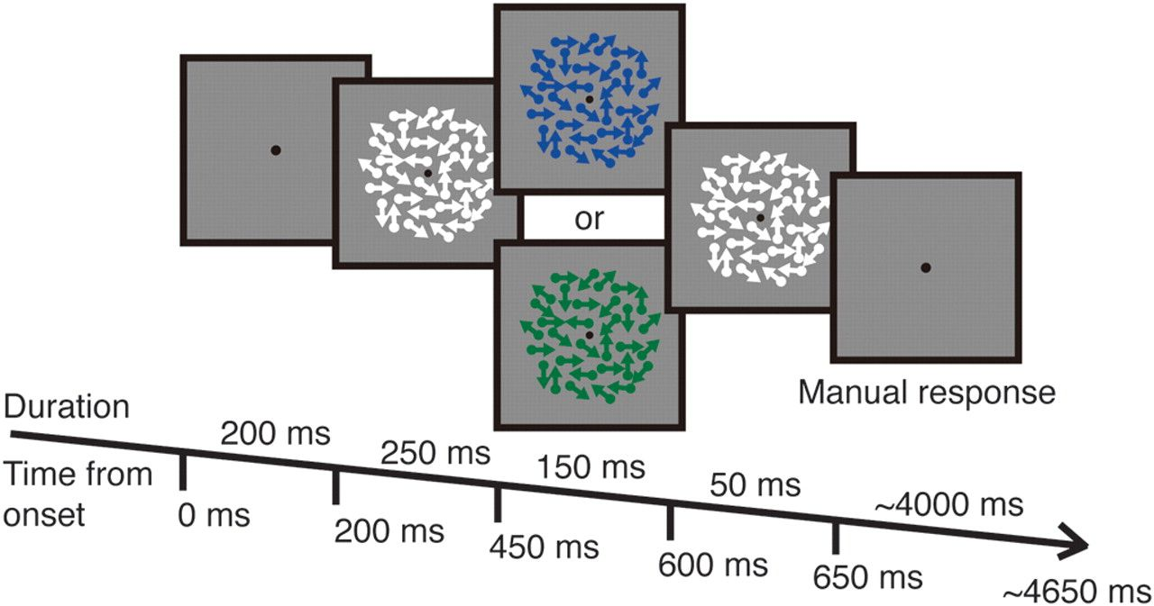
Figure 1. Stimulus presentation. Arrows presented with dots represent the motion direction of each dot and were not ...
Notes:
Figure 1. Stimulus presentation. Arrows presented with dots represent the motion direction of each dot and were not shown in the actual stimuli. The motion coherence of the dots varied from trial to trial. The size of the dots is larger than the actual size for illustrative purposes.
Unless provided in the caption above, the following copyright applies to the content of this slide: © The Author 2011. Published by Oxford University Press. All rights reserved. For permissions, please e-mail: journals.permissions@oup.com

Slide 2
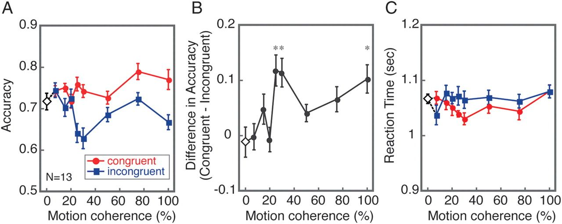
Figure 2. Results from the Experiment 1 (N = 13). The results in the congruent condition are plotted in red and ...
Notes:
Figure 2. Results from the Experiment 1 (N = 13). The results in the congruent condition are plotted in red and incongruent in blue. The accuracy at 0% coherence is shown as an open diamond. Error bars represent standard error of the means, corrected for within-subject comparison (Loftus and Masson 1994). (A) Accuracy. (B) The difference in the response accuracies between the congruent and incongruent conditions. An asterisk indicates the statistical significance (P < 0.05, with Bonferroni correction). (C) Reaction times.
Unless provided in the caption above, the following copyright applies to the content of this slide: © The Author 2011. Published by Oxford University Press. All rights reserved. For permissions, please e-mail: journals.permissions@oup.com

Slide 3
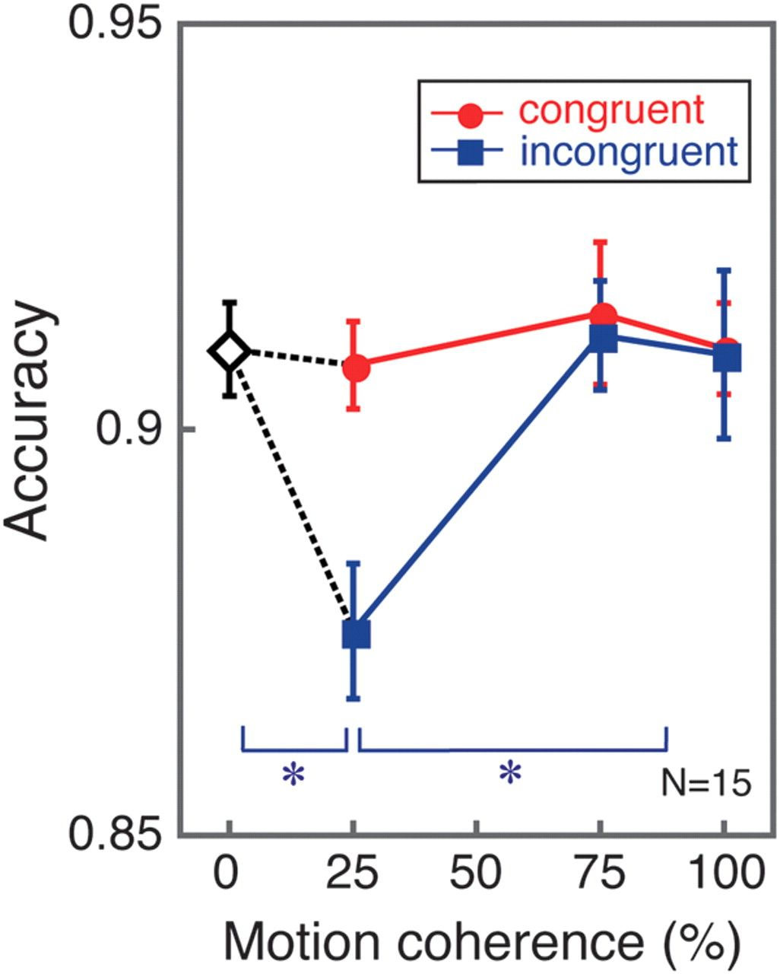
Figure 3. Accuracy (N = 15) during the fMRI scan in the Experiment 2, plotted with standard errors, corrected for ...
Notes:
Figure 3. Accuracy (N = 15) during the fMRI scan in the Experiment 2, plotted with standard errors, corrected for within-subject comparison (Loftus and Masson 1994). Red circles show results from the congruent condition. Blue rectangles show results from the incongruent condition. Performance with 0% motion coherence is represented as an open diamond. An asterisk indicates the statistical significance (P < 0.05, with Bonferroni correction).
Unless provided in the caption above, the following copyright applies to the content of this slide: © The Author 2011. Published by Oxford University Press. All rights reserved. For permissions, please e-mail: journals.permissions@oup.com

Slide 4
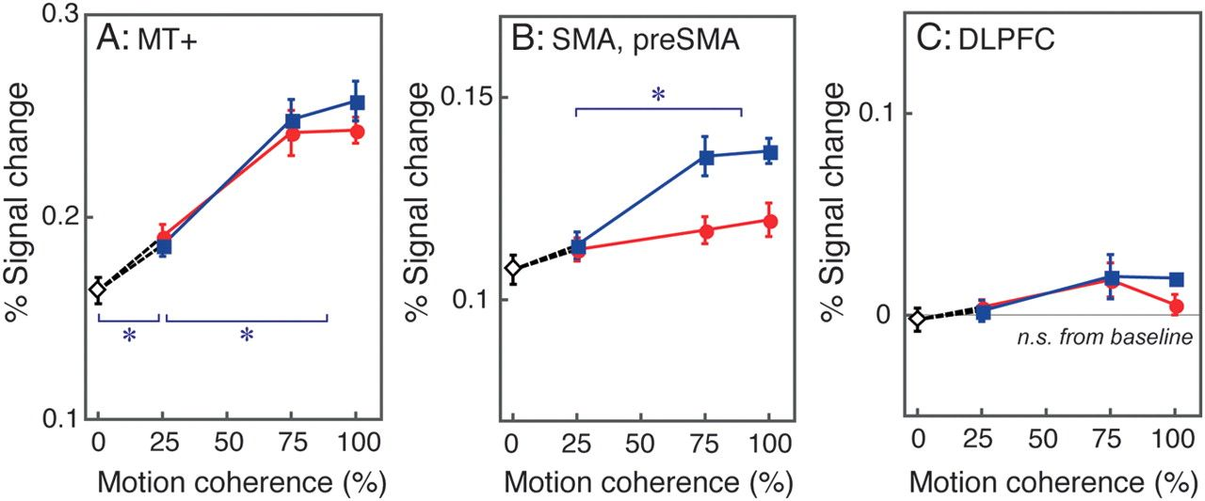
Figure 4. BOLD signal changes in ROIs (N = 15). Error bars represent standard errors, corrected for within-subject ...
Notes:
Figure 4. BOLD signal changes in ROIs (N = 15). Error bars represent standard errors, corrected for within-subject comparison (Loftus and Masson 1994). Red indicates the congruent condition and blue the incongruent condition. (A) MT+. (B) pre-SMA (pre-supplementary motor area) and SMA. (C) DLPFC. An asterisk indicates the statistical significance (P < 0.05, with Bonferroni correction). “N.S. from baseline” means that the overall activations did not significantly differ from the baseline condition.
Unless provided in the caption above, the following copyright applies to the content of this slide: © The Author 2011. Published by Oxford University Press. All rights reserved. For permissions, please e-mail: journals.permissions@oup.com

