Slide 1
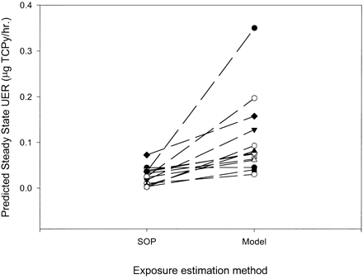
FIG. 1. Comparison of steady-state (background) dose rate predicted by exposure models using environmental data along ...
Notes:
FIG. 1. Comparison of steady-state (background) dose rate predicted by exposure models using environmental data along standard exposure assumptions (SOP) and the model-predicted steady state (Model).
Unless provided in the caption above, the following copyright applies to the content of this slide: © 2001 Society of Toxicology

Slide 2
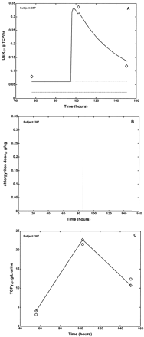
FIG. 2. (A) Model-predicted urinary excretion rate (UER) for one subject (solid line) superimposed over UER predicted ...
Notes:
FIG. 2. (A) Model-predicted urinary excretion rate (UER) for one subject (solid line) superimposed over UER predicted from spot urine samples (data points). The model-predicted steady-state exposure (short dashes) is higher than that predicted by the exposure model (long dash). (B) The model-predicted dose rate, highlighting a single short exposure event above background. (C) The model-predicted simulation of the urinary TCPy concentration for each of the 3 urine samples collected in the MNCPES study, based on the model-predicted exposure events (connected by lines). The actual urinary TCPy concentration measurements are shown as single points.
Unless provided in the caption above, the following copyright applies to the content of this slide: © 2001 Society of Toxicology

Slide 3
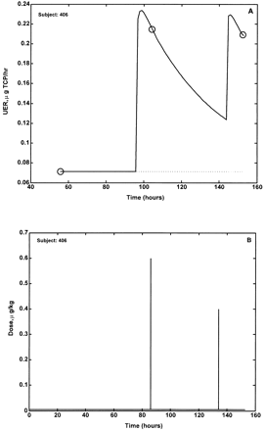
FIG. 3. (A) Predicted and observed UER for a single sub;ject with 2 exposures. There was insufficient environmental ...
Notes:
FIG. 3. (A) Predicted and observed UER for a single sub;ject with 2 exposures. There was insufficient environmental information to estimate steady-state exposure using the exposure model. (B) Predicted steady-state dose along with the 2 predicted exposure events.
Unless provided in the caption above, the following copyright applies to the content of this slide: © 2001 Society of Toxicology

