Slide 1
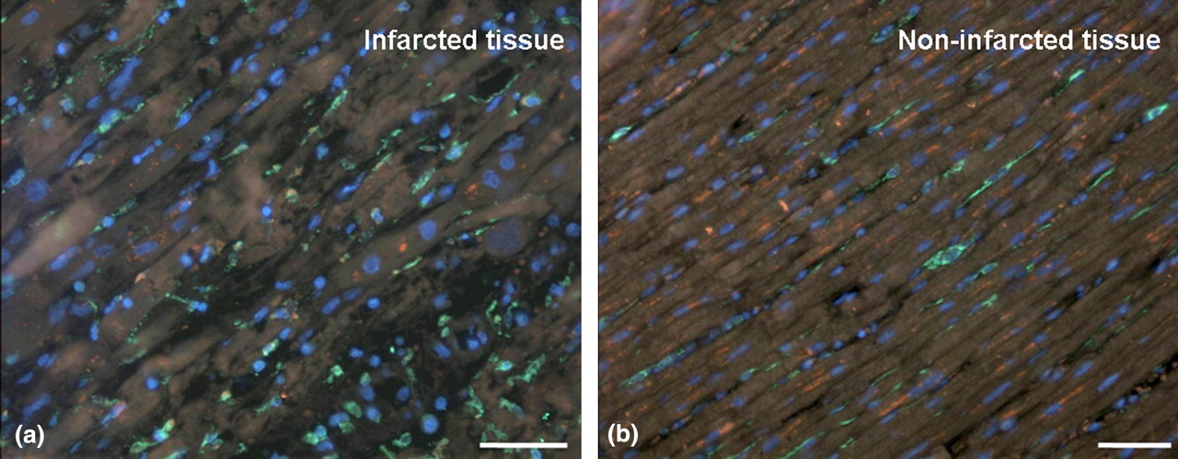
Fig. 1 FISH and immunostaining (CD45/CD68) in infarcted (a) and non-infarcted tissue (b). The nuclei are stained ...
Notes:
Fig. 1 FISH and immunostaining (CD45/CD68) in infarcted (a) and non-infarcted tissue (b). The nuclei are stained blue with DAPI, the green margins represent CD45 and/or CD68 antigen. (The Y-chromosome is not visible at this magnification.) Scale bars=50 μm.
Unless provided in the caption above, the following copyright applies to the content of this slide: The European Society of Cardiology

Slide 2
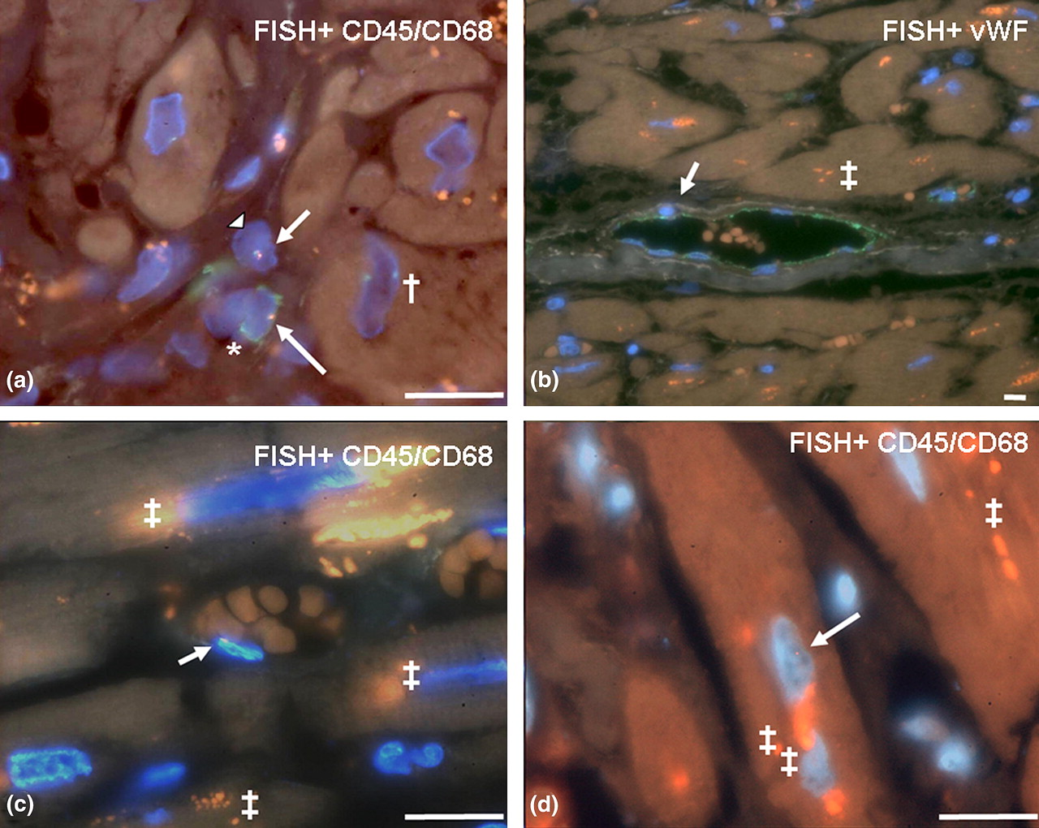
Fig. 2 Host-derived inflammatory cells, non-inflammatory cells, endothelial cells, and cardiomyocytes in ...
Notes:
Fig. 2 Host-derived inflammatory cells, non-inflammatory cells, endothelial cells, and cardiomyocytes in transplanted hearts. We combined FISH and immunostaining for CD45/CD68 (a, c and d) or vWF (b). Immunostaining appears green, nuclei are stained blue (DAPI), and the presence of the Y-chromosome is indicated by a punctate orange signal (arrow); the punctate green (†) signal in Panel a represents the X-chromosome. Each picture displays a representative example of cells, which were identified as host-derived inflammatory cells (a, *), host-derived non-inflammatory cell (a, arrowhead), host-derived endothelial cell in an arteriole (b and c), or host-derived cardiomyocyte according to our fluorescence microscopy criteria (d). Orange signals within the cytoplasm (‡) are caused by lipofuscin. Scale bars=15 μm.
Unless provided in the caption above, the following copyright applies to the content of this slide: The European Society of Cardiology

Slide 3
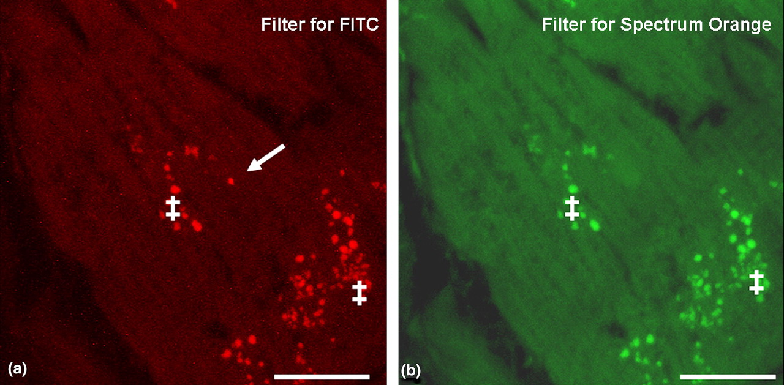
Fig. 3 Y-chromosomes and lipofuscin artefacts. FISH was verified for each intranuclear orange signal by using single ...
Notes:
Fig. 3 Y-chromosomes and lipofuscin artefacts. FISH was verified for each intranuclear orange signal by using single red and green filters. (a) In cardiac tissue, multiple signals appear as potential Y-chromosomes using the single red filter. (b) Only true Y-chromosome signals (see arrow) disappear when the single green filter is used, whereas lipofuscin signals remain visible. Scale bars=10 μm.
Unless provided in the caption above, the following copyright applies to the content of this slide: The European Society of Cardiology

Slide 4
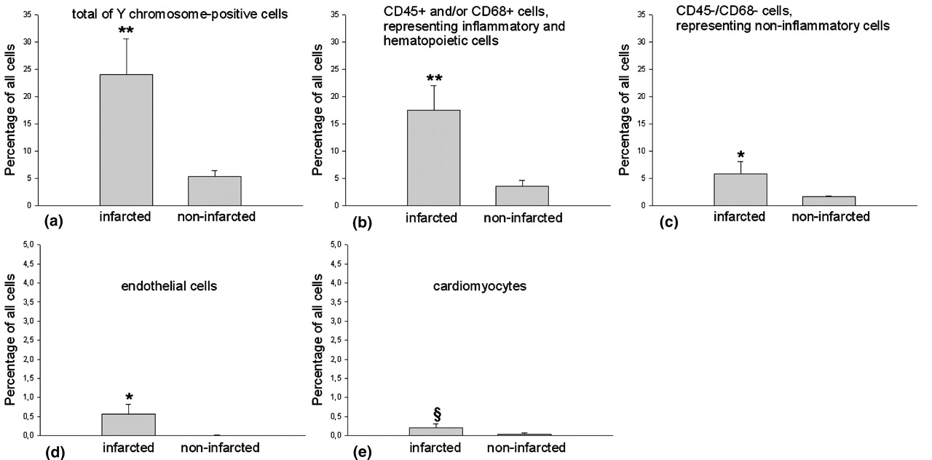
Fig. 4 Different entities of Y-chromosome-positive cells in infarcted vs. non-infarcted transplanted hearts. The bar ...
Notes:
Fig. 4 Different entities of Y-chromosome-positive cells in infarcted vs. non-infarcted transplanted hearts. The bar graphs display average relative abundance of host-derived cells in infarcted (\batchmode \documentclass[fleqn,10pt,legalpaper]{article} \usepackage{amssymb} \usepackage{amsfonts} \usepackage{amsmath} \pagestyle{empty} \begin{document} \(n=5\) \end{document}) and in non-infarcted (\batchmode \documentclass[fleqn,10pt,legalpaper]{article} \usepackage{amssymb} \usepackage{amsfonts} \usepackage{amsmath} \pagestyle{empty} \begin{document} \(n=9\) \end{document}) transplanted heart tissues. (a) Total of Y-chromosome-positive cells. (b) CD45+ and/or CD68+ cells, representing inflammatory and haematopoietic cells. (c) CD45−/CD68− cells, representing non-inflammatory cells. (d) Endothelial cells. (e) Cardiomyocytes. **\batchmode \documentclass[fleqn,10pt,legalpaper]{article} \usepackage{amssymb} \usepackage{amsfonts} \usepackage{amsmath} \pagestyle{empty} \begin{document} \(P{<}0.01\) \end{document}; *\batchmode \documentclass[fleqn,10pt,legalpaper]{article} \usepackage{amssymb} \usepackage{amsfonts} \usepackage{amsmath} \pagestyle{empty} \begin{document} \(P{<}0.05\) \end{document}; \batchmode \documentclass[fleqn,10pt,legalpaper]{article} \usepackage{amssymb} \usepackage{amsfonts} \usepackage{amsmath} \pagestyle{empty} \begin{document} \(^{{\S}}P=0.0548\) \end{document}.
Unless provided in the caption above, the following copyright applies to the content of this slide: The European Society of Cardiology

Slide 5
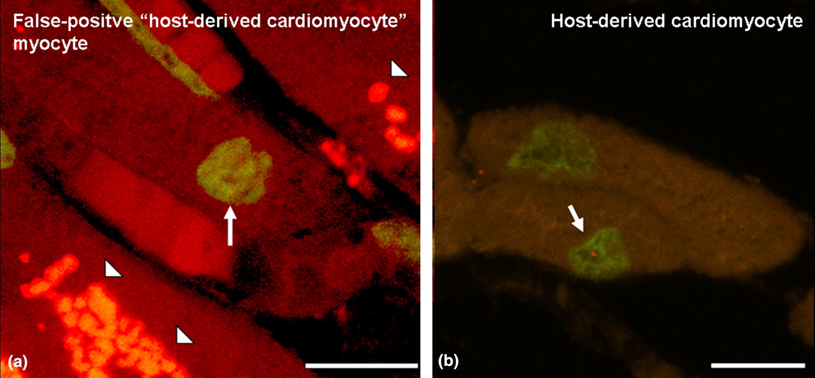
Fig. 5 3D confocal microscopy. Examples of cardiomyocytes apparently containing a Y-chromosome in the same focal ...
Notes:
Fig. 5 3D confocal microscopy. Examples of cardiomyocytes apparently containing a Y-chromosome in the same focal plane by two-dimensional confocal microscopy. Nuclei are stained green with SYBR Green. Arrows indicate the Y-chromosome, arrowheads show autofluorescence of lipofuscin. Three-dimensional analysis of Panel a reveals that the nucleus containing the Y-chromosome is not located within the cardiomyocyte (video 1), whereas in Panel b three-dimensional analysis verifies that the cardiomyocyte contains a Y-chromosome (video 2). Scale bars=10 μm. Videos can be viewed online (doi:10.1016/j.ehj.2004.01.017).
Unless provided in the caption above, the following copyright applies to the content of this slide: The European Society of Cardiology

