Slide 1
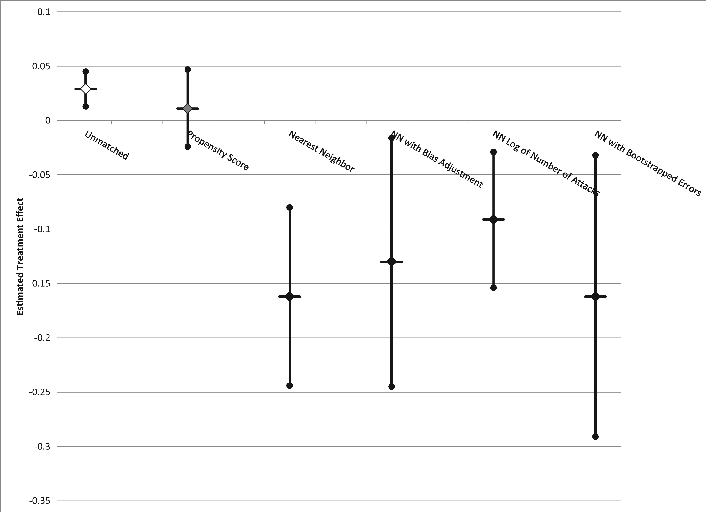
Figure 2. Estimated treatment effects for the treated using propensity score and nearest neighbor matching
Notes:
Figure 2. Estimated treatment effects for the treated using propensity score and nearest neighbor matching
Unless provided in the caption above, the following copyright applies to the content of this slide: © The Author (2016). Published by Oxford University Press on behalf of the International Studies Association.All rights reserved. For permissions, please e-mail: journals.permissions@oup.com

Slide 2
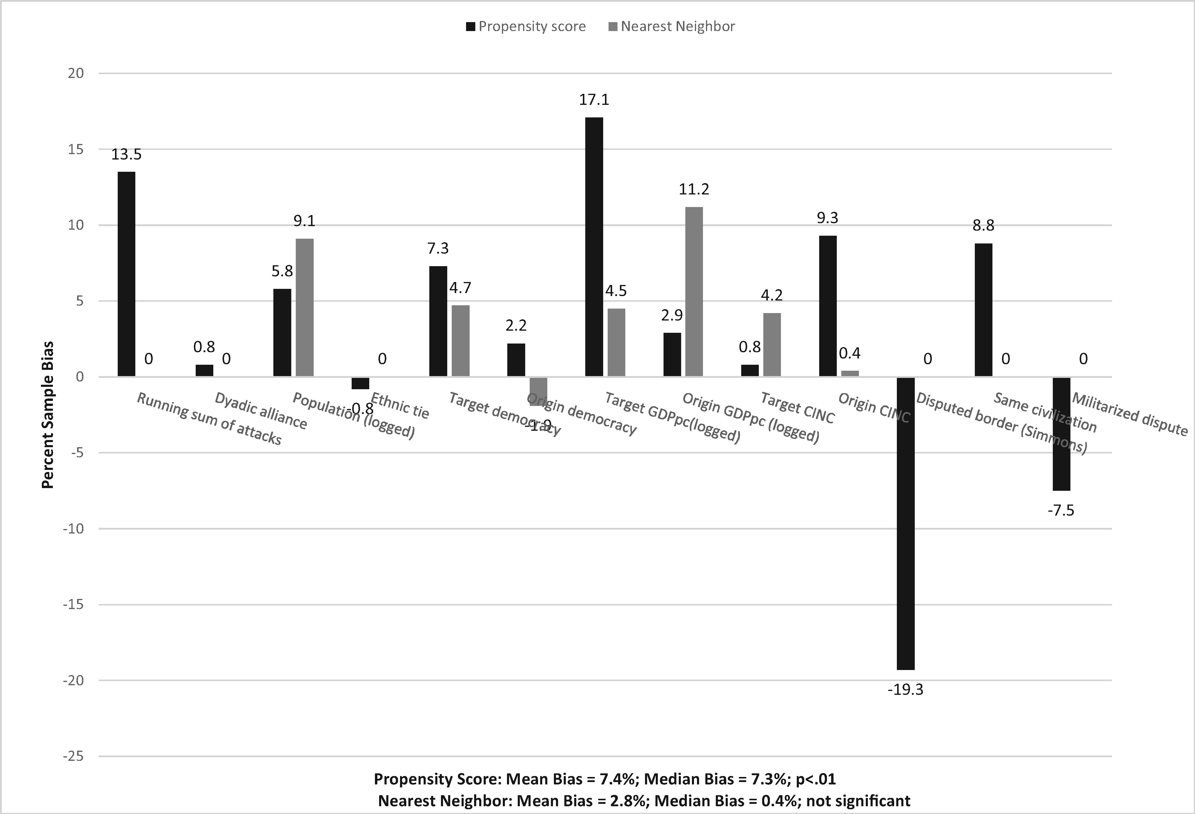
Figure 1. Treated versus control sample balance with propensity score and nearest neighbor matching methods
Notes:
Figure 1. Treated versus control sample balance with propensity score and nearest neighbor matching methods
Unless provided in the caption above, the following copyright applies to the content of this slide: © The Author (2016). Published by Oxford University Press on behalf of the International Studies Association.All rights reserved. For permissions, please e-mail: journals.permissions@oup.com

