Slide 1
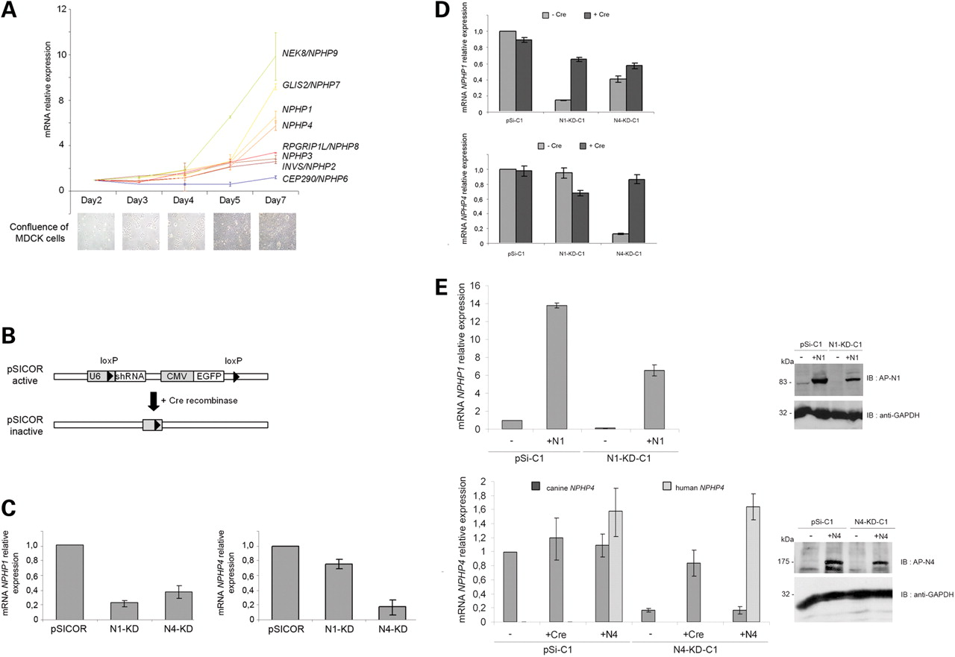
Figure 1. NPHP gene expression during cell polarization and generation of NPHP knockdown, Cre- and cDNA-rescued MDCK ...
Notes:
Figure 1. NPHP gene expression during cell polarization and generation of NPHP knockdown, Cre- and cDNA-rescued MDCK cell line. (A) Quantitative RT–PCR analysis of NPHP gene expression during time-course experiments performed on MDCK cells. Confluence of cells at each time point is shown by light microscopy pictures. (B) Scheme of the lentiviral pSICOR-GFP vector. (C) Quantitative RT–PCR analysis of NPHP1 (left panel) and NPHP4 (right panel) gene expression in polyclonal control pSICOR, N1-KD and N4-KD cell lines. (D) Quantitative RT–PCR analysis of NPHP1 (upper panel) and NPHP4 (lower panel) gene expression in a clonal cell population before and after the addition of Cre recombinase. (E) Quantitative RT–PCR and western blot analysis of human NPHP1 and NPHP4 cDNA expression, introduced by lentiviral infection in knockdown cell lines. NPHP1 primers for quantitative RT–PCR were homologous to both human and canine sequences, whereas two sets of primers specific to human or canine NPHP4 sequences were used. GAPDH protein level was used as protein-loading control.
Unless provided in the caption above, the following copyright applies to the content of this slide: © The Author 2009. Published by Oxford University PressThis is an Open Access article distributed under the terms of the Creative Commons Attribution Non-Commercial License (http://creativecommons.org/licenses/by-nc/2.5/uk/) which permits unrestricted non-commercial use, distribution, and reproduction in any medium, provided the original work is properly cited.

Slide 2
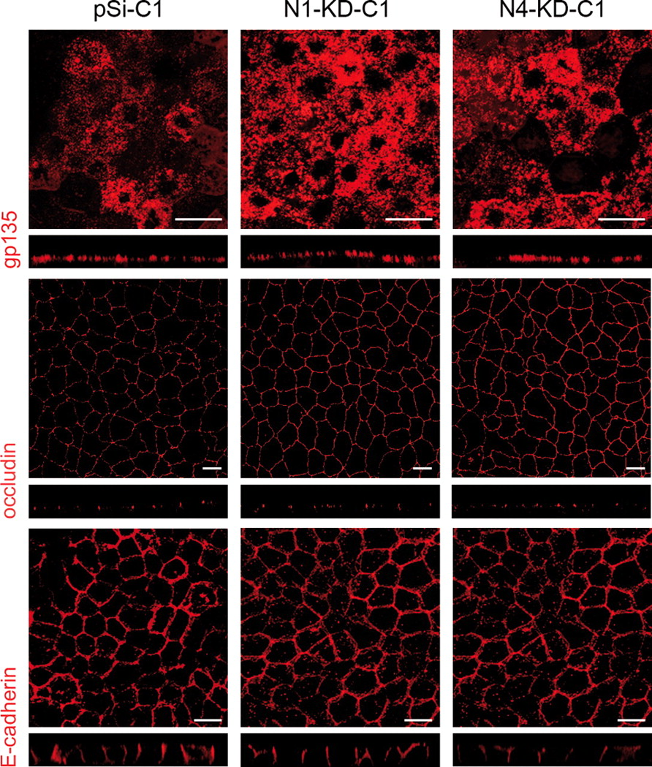
Figure 2. No obvious polarity defects in NPHP knockdown cells. Immunostaining of the apical gp135 protein, the TJ ...
Notes:
Figure 2. No obvious polarity defects in NPHP knockdown cells. Immunostaining of the apical gp135 protein, the TJ protein occludin and the baso-lateral marker E-cadherin was performed on MDCK cells grown on transwell filters for 7 days. Scale bars are 10 µm.
Unless provided in the caption above, the following copyright applies to the content of this slide: © The Author 2009. Published by Oxford University PressThis is an Open Access article distributed under the terms of the Creative Commons Attribution Non-Commercial License (http://creativecommons.org/licenses/by-nc/2.5/uk/) which permits unrestricted non-commercial use, distribution, and reproduction in any medium, provided the original work is properly cited.

Slide 3
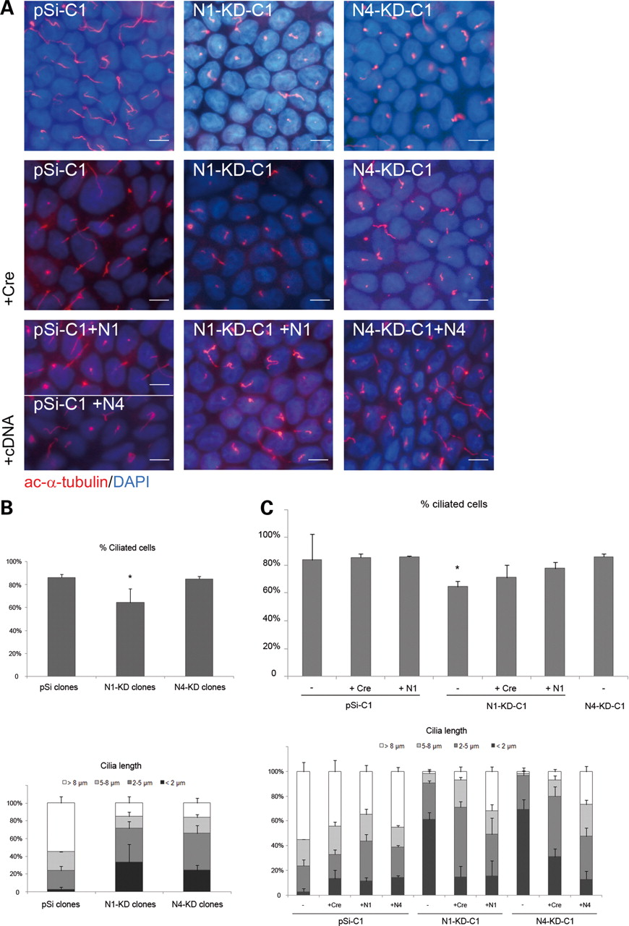
Figure 3. NPHP knockdown cells have abnormal cilia in 2D cultures. (A) Immunostaining of cilia with ...
Notes:
Figure 3. NPHP knockdown cells have abnormal cilia in 2D cultures. (A) Immunostaining of cilia with acetylated-α-tubulin antibody performed on MDCK cells grown on transwell filters for 7 days. Nuclei were stained with DAPI. All the results presented are obtained with the clones pSi-C1, N1-KD-C1 and N4-KD-C1 and the corresponding rescued cell lines after Cre recombination or cDNA re-expression. (B and C) Analysis of the percentage of ciliated cells (upper panel) and cilia length (lower panel) in several clonal cell lines (B) and in rescued cell lines after Cre recombination (+ Cre) or re-expression of human nephrocystin-1 (N1) or nephrocystin-4 (N4) cDNA (C). Data show the average of three different control (pSi-C1 to 3) and knockdown (N1-KD-C1, C2, C5 and N4-KD-C1, C3, C6) clonal cell lines (B). Five hundred cells of each clonal cell line were scored both for the measure of the presence and the length of the primary cilium (P< 0.05 compared with control cell lines, t-test). Scale bars are 10 µm.
Unless provided in the caption above, the following copyright applies to the content of this slide: © The Author 2009. Published by Oxford University PressThis is an Open Access article distributed under the terms of the Creative Commons Attribution Non-Commercial License (http://creativecommons.org/licenses/by-nc/2.5/uk/) which permits unrestricted non-commercial use, distribution, and reproduction in any medium, provided the original work is properly cited.

Slide 4
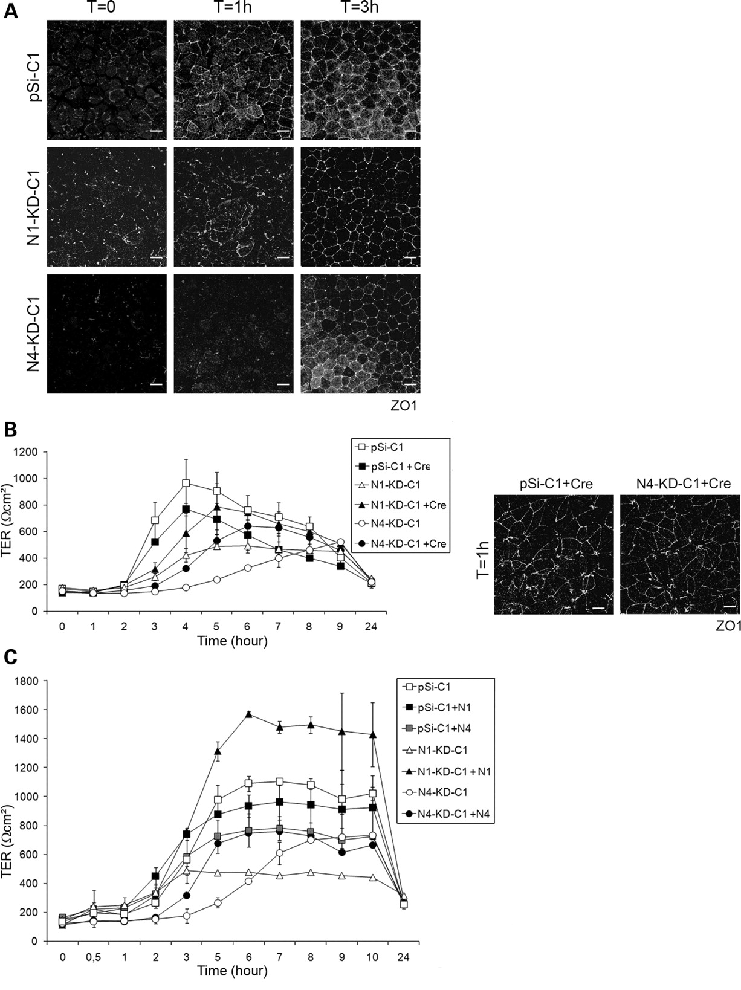
Figure 4. TJ formation is delayed in NPHP knockdown MDCK cells during a calcium switch experiment. Control (pSi-C1 to ...
Notes:
Figure 4. TJ formation is delayed in NPHP knockdown MDCK cells during a calcium switch experiment. Control (pSi-C1 to 3), N1-KD (N1-KD-C1, C5) and N4-KD (N4-KD-C1, C3, C6) MDCK cell lines were subjected to calcium switch experiments to assess the formation of TJs, and only data obtained with pSi-C1, N1-KD-C1 and N4-KD-C1 are shown. (A) Immunostaining of the TJ marker protein ZO1 at different time points after the addition of calcium (T0, 1 h, 3 h) in control and knockdown cell lines. (B and C) TER was measured hourly after calcium switch in control and knockdown (B and C), rescued Cre-infected (B) and expressing nephrocystin-1 or nephrocystin-4 cDNA (C) MDCK cell lines. Immunostaining of ZO1 protein 1 h after calcium switch is shown in rescued Cre-infected control and N4-KD clonal cell lines (B). Scale bars are 10 µm.
Unless provided in the caption above, the following copyright applies to the content of this slide: © The Author 2009. Published by Oxford University PressThis is an Open Access article distributed under the terms of the Creative Commons Attribution Non-Commercial License (http://creativecommons.org/licenses/by-nc/2.5/uk/) which permits unrestricted non-commercial use, distribution, and reproduction in any medium, provided the original work is properly cited.

Slide 5
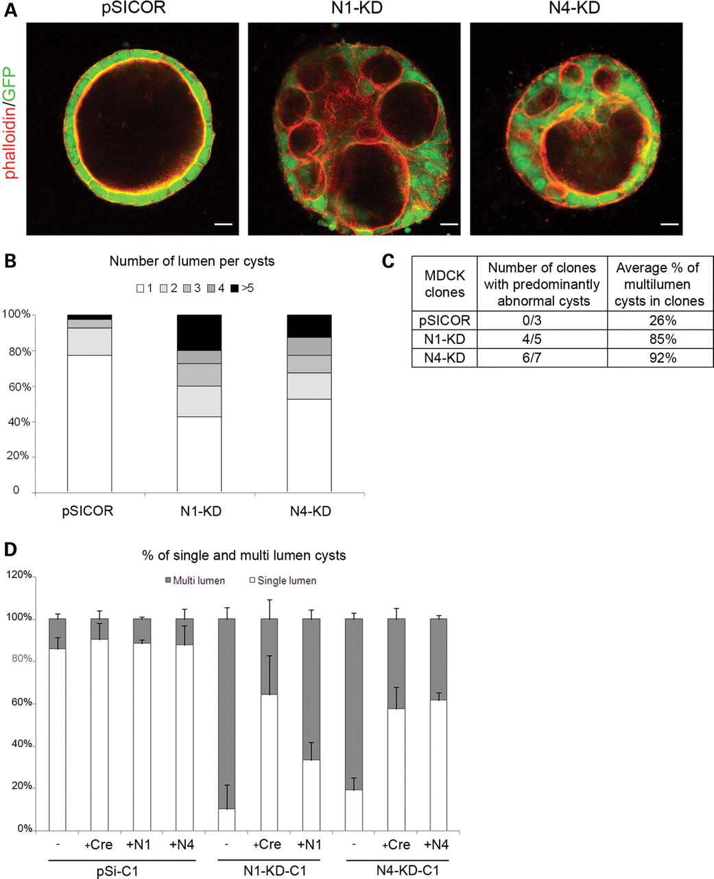
Figure 5. NPHP knockdown MDCK cells form disorganized, multi-lumen cysts when grown in a 3D type-I collagen matrix. (A) ...
Notes:
Figure 5. NPHP knockdown MDCK cells form disorganized, multi-lumen cysts when grown in a 3D type-I collagen matrix. (A) Structure of the control, N1-KD and N4-KD MDCK cysts, grown for 3 weeks in type-I collagen matrix, as assessed by immunostaining of phalloidin. (B) Number of lumen per cysts in control, N1-KD and N4-KD polyclonal cell populations (n = 40). (C) Table summarizing the number of clones with >50% of abnormal cysts and the average percentage of multi-lumen cysts in clones. (D) Quantification of normal cysts in rescued Cre-infected and cDNA-re-expressing cell lines grown in 3D culture (n = 100). The results presented are obtained for the clones pSi-C1, N1-KD-C1 and N4-KD-C1. (E) Immunostainings of the apical marker gp135, the TJ marker ZO1 and the cilia marker acetylated-α-tubulin in clonal cell lines. A GFP marker is co-expressed with shRNA. Scale bars are 20 µm.
Unless provided in the caption above, the following copyright applies to the content of this slide: © The Author 2009. Published by Oxford University PressThis is an Open Access article distributed under the terms of the Creative Commons Attribution Non-Commercial License (http://creativecommons.org/licenses/by-nc/2.5/uk/) which permits unrestricted non-commercial use, distribution, and reproduction in any medium, provided the original work is properly cited.

Slide 6
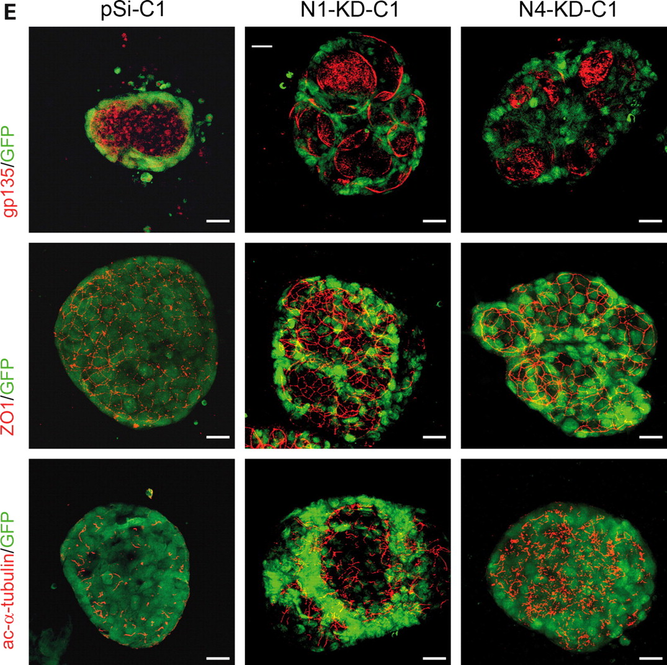
Figure 5. NPHP knockdown MDCK cells form disorganized, multi-lumen cysts when grown in a 3D type-I collagen matrix. (A) ...
Notes:
Figure 5. NPHP knockdown MDCK cells form disorganized, multi-lumen cysts when grown in a 3D type-I collagen matrix. (A) Structure of the control, N1-KD and N4-KD MDCK cysts, grown for 3 weeks in type-I collagen matrix, as assessed by immunostaining of phalloidin. (B) Number of lumen per cysts in control, N1-KD and N4-KD polyclonal cell populations (n = 40). (C) Table summarizing the number of clones with >50% of abnormal cysts and the average percentage of multi-lumen cysts in clones. (D) Quantification of normal cysts in rescued Cre-infected and cDNA-re-expressing cell lines grown in 3D culture (n = 100). The results presented are obtained for the clones pSi-C1, N1-KD-C1 and N4-KD-C1. (E) Immunostainings of the apical marker gp135, the TJ marker ZO1 and the cilia marker acetylated-α-tubulin in clonal cell lines. A GFP marker is co-expressed with shRNA. Scale bars are 20 µm.
Unless provided in the caption above, the following copyright applies to the content of this slide: © The Author 2009. Published by Oxford University PressThis is an Open Access article distributed under the terms of the Creative Commons Attribution Non-Commercial License (http://creativecommons.org/licenses/by-nc/2.5/uk/) which permits unrestricted non-commercial use, distribution, and reproduction in any medium, provided the original work is properly cited.

Slide 7
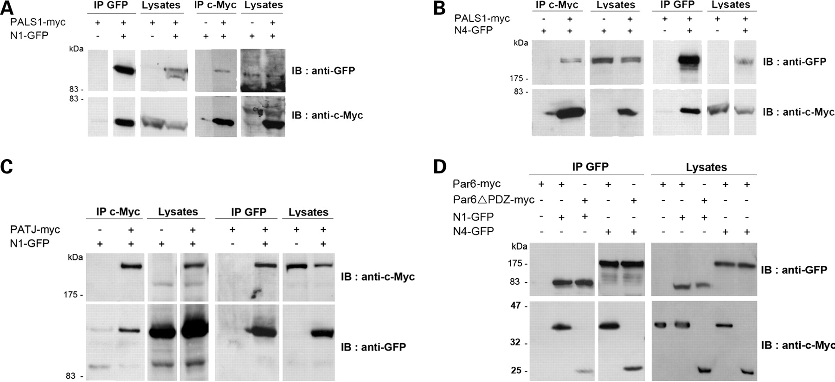
Figure 6. Characterization of the interaction of nephrocystin-1 and nephrocystin-4 with the polarity proteins PALS1, ...
Notes:
Figure 6. Characterization of the interaction of nephrocystin-1 and nephrocystin-4 with the polarity proteins PALS1, PATJ and Par6. (A–D) Co-immunoprecipitation of nephrocystin-1-GFP (N1-GFP) and nephrocystin-4-GFP (N4-GFP) with PALS1-myc (A and B), PATJ-myc (C), Par6-myc or Par6ΔPDZ-myc (D) in HEK293T cells. Lysates were immunoprecipitated with either anti-c-Myc or anti-GFP antibodies and immunoblotted with c-Myc and GFP antibodies.
Unless provided in the caption above, the following copyright applies to the content of this slide: © The Author 2009. Published by Oxford University PressThis is an Open Access article distributed under the terms of the Creative Commons Attribution Non-Commercial License (http://creativecommons.org/licenses/by-nc/2.5/uk/) which permits unrestricted non-commercial use, distribution, and reproduction in any medium, provided the original work is properly cited.

Slide 8
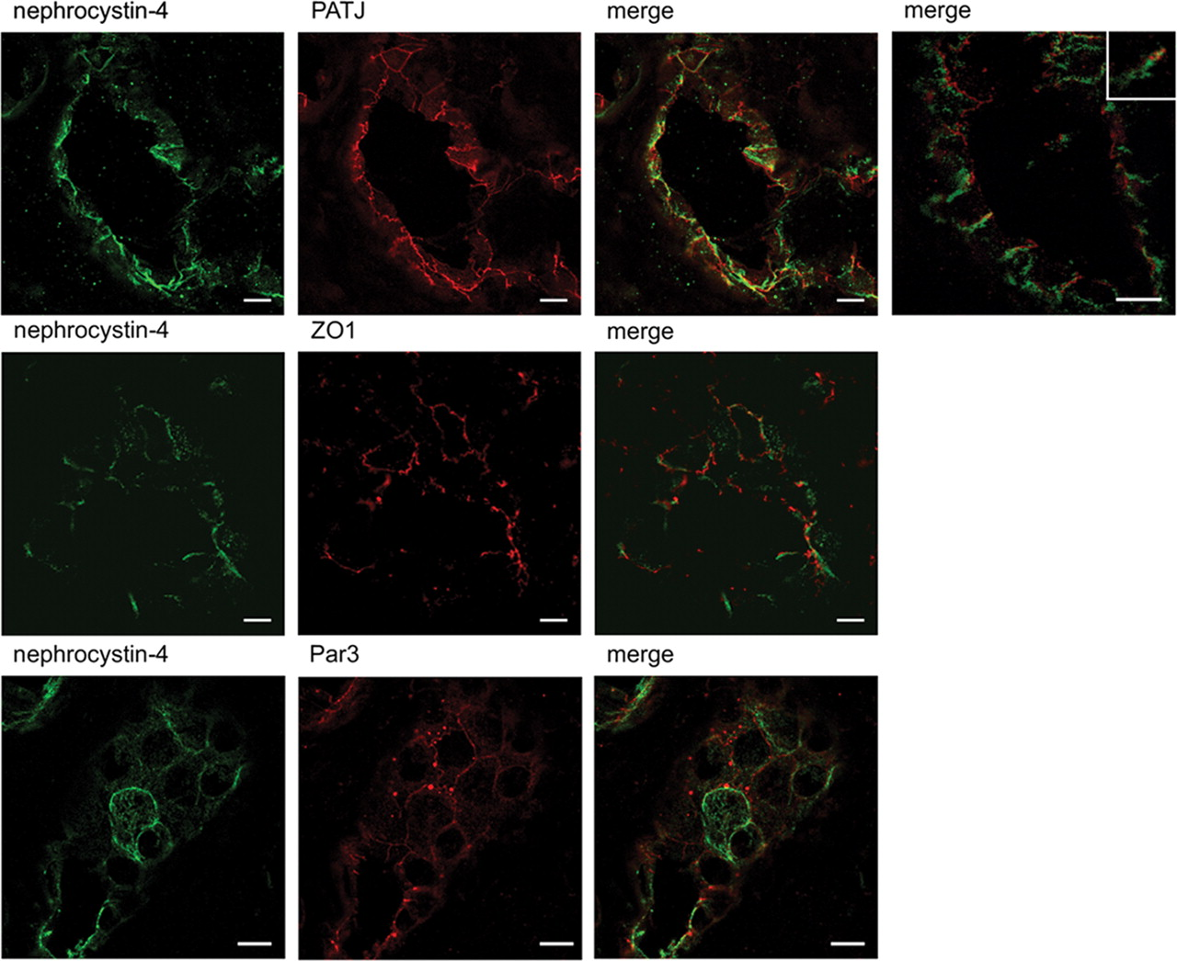
Figure 7. Partial co-localization of nephrocytin-4 and TJ markers in human renal tubules. Nephrocystin-4 (monoclonal ...
Notes:
Figure 7. Partial co-localization of nephrocytin-4 and TJ markers in human renal tubules. Nephrocystin-4 (monoclonal IgG N4, green) showed partial overlap with PATJ, ZO1 and Par3 (red) localization to TJs in distal/collecting duct tubule from normal human kidney tissue. Inset shows higher magnification of a representative overlap between nephrocystin-4 and PATJ staining at the cell–cell membrane. Scale bars are 10 µm.
Unless provided in the caption above, the following copyright applies to the content of this slide: © The Author 2009. Published by Oxford University PressThis is an Open Access article distributed under the terms of the Creative Commons Attribution Non-Commercial License (http://creativecommons.org/licenses/by-nc/2.5/uk/) which permits unrestricted non-commercial use, distribution, and reproduction in any medium, provided the original work is properly cited.

