Slide 1
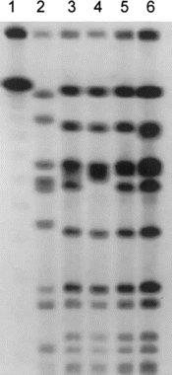
Figure 1 PFGE patterns of methicillin-resistant Staphylococcus aureus isolates from the nares and wound of the patient ...
Notes:
Figure 1 PFGE patterns of methicillin-resistant Staphylococcus aureus isolates from the nares and wound of the patient (lanes 3 and 4, respectively), the dog's nares (lane 5), and the wife's wound (lane 6). Lanes 1 and 2, λ Standard and internal control isolates, respectively.
Unless provided in the caption above, the following copyright applies to the content of this slide: © 2003 by the Infectious Diseases Society of America. All rights reserved.

