Slide 1
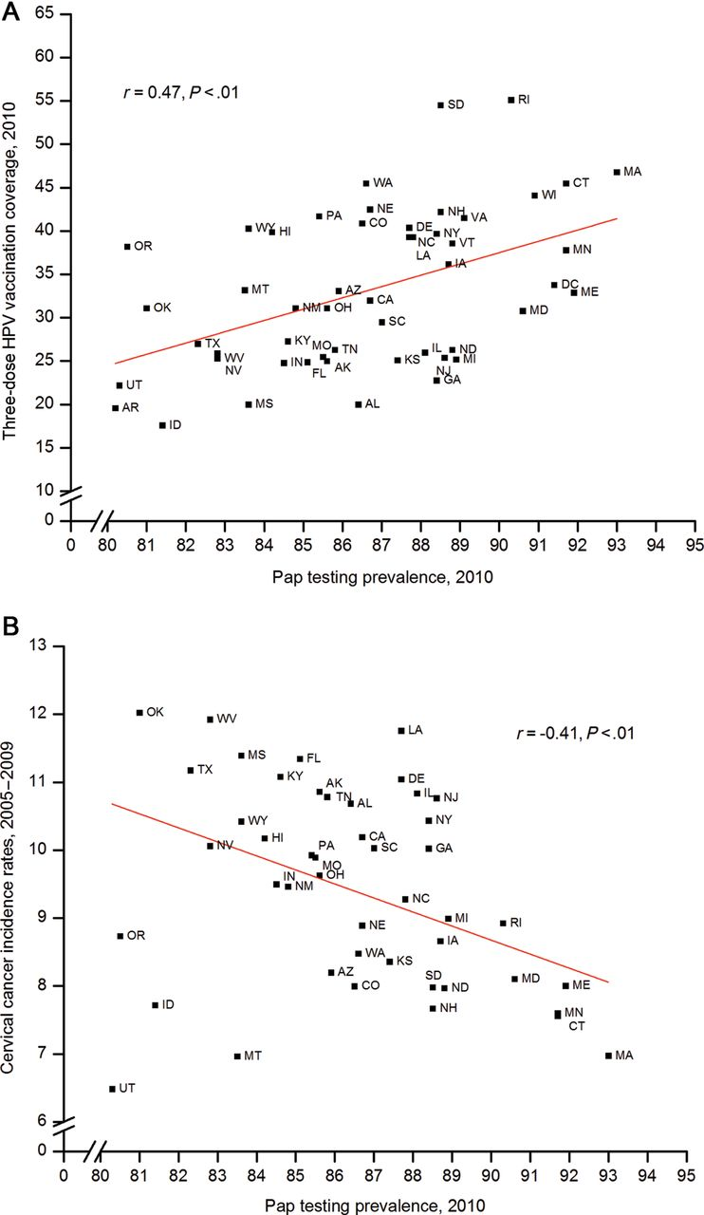
Figure 5. Scatter plots of human pappilomavirus (HPV) vaccination coverage levels (A) and cervical cancer incidence ...
Notes:
Figure 5. Scatter plots of human pappilomavirus (HPV) vaccination coverage levels (A) and cervical cancer incidence rates (B) by Papanicolao (Pap) testing prevalence by state. P values were obtained by a two-sided t test. r, Pearson correlation coefficient. Three-dose HPV vaccination coverage levels are reported for adolescent girls in the 2010 National Immunization Survey-Teen (NIS-Teen) who were born during the period from January 1992 to February 1998. Girls may have received either quadrivalent or bivalent HPV vaccine. Source: National Immunization Survey-Teen 2008, 2010, National Center for Health Statistics, Centers for Disease Control and Prevention, 2010, 2011. Five-year cervical cancer incidence rates during the period from 2005 to 2009 for women aged 15 years or older are per 100,000 population and standardized to the 2000 US standard population. States with missing rates did not meet North American Association of Central Cancer Registries (NAACCR) quality standards for the specified years and are not included in the reporting of incidence. Source: National Program of Cancer Registries and Surveillance, Epidemiology, and End Results Program reported by NAACCR as meeting high-quality incidence data standards for the specified time periods. Percentage of women aged 21 to 65 years with intact uteri who received a Pap test in the previous 3 years in 2010. Source: Behavioral Risk Factor Surveillance System Public Use Data Tape 2010, National Center for Chronic Disease Prevention and Health Promotion, Centers for Disease Control and Prevention, 2011.
Unless provided in the caption above, the following copyright applies to the content of this slide: © The Author 2013. Published by Oxford University Press.This is an Open Access article distributed under the terms of the Creative Commons Attribution Non-Commercial License (http://creativecommons.org/licenses/by-nc/3.0/), which permits non-commercial re-use, distribution, and reproduction in any medium, provided the original work is properly cited. For commercial re-use, please contact journals.permissions@oup.com

Slide 2
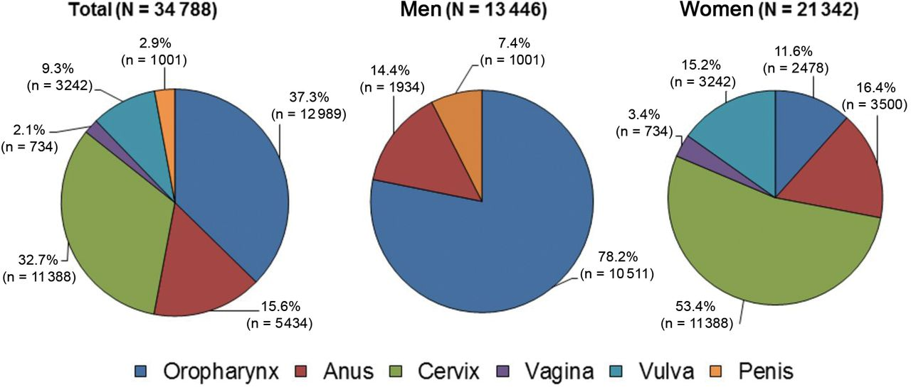
Figure 1. Number of new human papillomavirus (HPV)–associated cancers overall, and by sex, in the United States, 2009. ...
Notes:
Figure 1. Number of new human papillomavirus (HPV)–associated cancers overall, and by sex, in the United States, 2009. Source: National Program of Cancer Registries and Surveillance, Epidemiology, and End Results areas reported by the North American Association of Central Cancer Registries as meeting high-quality incidence data standards for the specified time period. Note that the number of cancer cases underestimates the actual number of cases occurring because of incomplete coverage of population-based registries in 2009 (93%). HPV-associated cancers are defined as cancers at specific anatomic sites and with specific cellular types in which HPV DNA frequently is found. Some of these cancers may not necessarily be HPV-positive because no testing was conducted. Virtually all cervical cancers are due to HPV infection, along with 90% of anal cancers, more than 60% of certain subsites of oropharyngeal cancers, and approximately 40% of vagina, vulva, and penile cancers.
Unless provided in the caption above, the following copyright applies to the content of this slide: © The Author 2013. Published by Oxford University Press.This is an Open Access article distributed under the terms of the Creative Commons Attribution Non-Commercial License (http://creativecommons.org/licenses/by-nc/3.0/), which permits non-commercial re-use, distribution, and reproduction in any medium, provided the original work is properly cited. For commercial re-use, please contact journals.permissions@oup.com

Slide 3
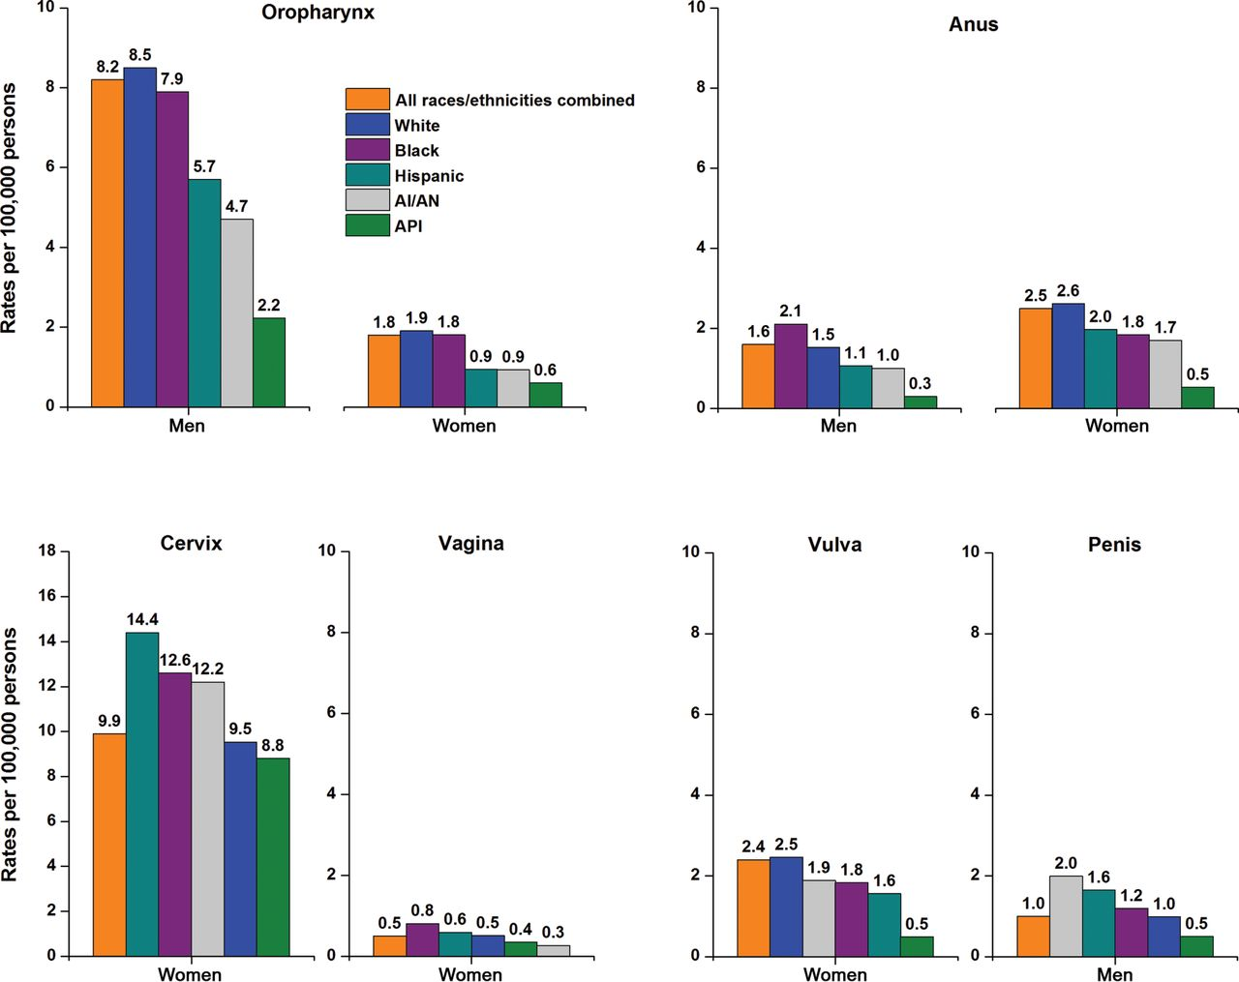
Figure 2. Age-adjusted incidence rates for human papillomavirus (HPV)–associated cancers in the United States by sex ...
Notes:
Figure 2. Age-adjusted incidence rates for human papillomavirus (HPV)–associated cancers in the United States by sex and race and ethnicity, 2005 to 2009. The scale of the y axis differs for cervical cancer. The rates for the period from 2005 to 2009 for the five major racial and ethnic groups are from 47 states: Alabama, Alaska, Arizona, California, Colorado, Connecticut, Delaware, Florida, Georgia, Hawaii, Idaho, Illinois, Indiana, Iowa, Kansas, Kentucky, Louisiana, Maine, Maryland, Massachusetts, Michigan, Minnesota, Mississippi, Missouri, Montana, Nebraska, Nevada, New Hampshire, New Jersey, New Mexico, New York, North Carolina, North Dakota, Ohio, Oklahoma, Oregon, Pennsylvania, Rhode Island, South Carolina, South Dakota, Tennessee, Texas, Utah, Vermont, Washington, West Virginia, Wyoming. Source: National Program of Cancer Registries and Surveillance, Epidemiology, and End Results areas reported by the North American Association of Central Cancer Registries as meeting high-quality incidence data standards for the specified time period. HPV-associated cancers are defined as cancers at specific anatomic sites and with specific cellular types in which HPV DNA frequently is found. Some of these cancers may not necessarily be HPV-positive because no testing was conducted. White, black, Asian/Pacific Islander (API), and American Indian/Alaska Native (AI/AN) (IHS Contract Health Services Delivery Area counties) include Hispanic and non-Hispanic; the race and ethnicity categories are not mutually exclusive.
Unless provided in the caption above, the following copyright applies to the content of this slide: © The Author 2013. Published by Oxford University Press.This is an Open Access article distributed under the terms of the Creative Commons Attribution Non-Commercial License (http://creativecommons.org/licenses/by-nc/3.0/), which permits non-commercial re-use, distribution, and reproduction in any medium, provided the original work is properly cited. For commercial re-use, please contact journals.permissions@oup.com

Slide 4
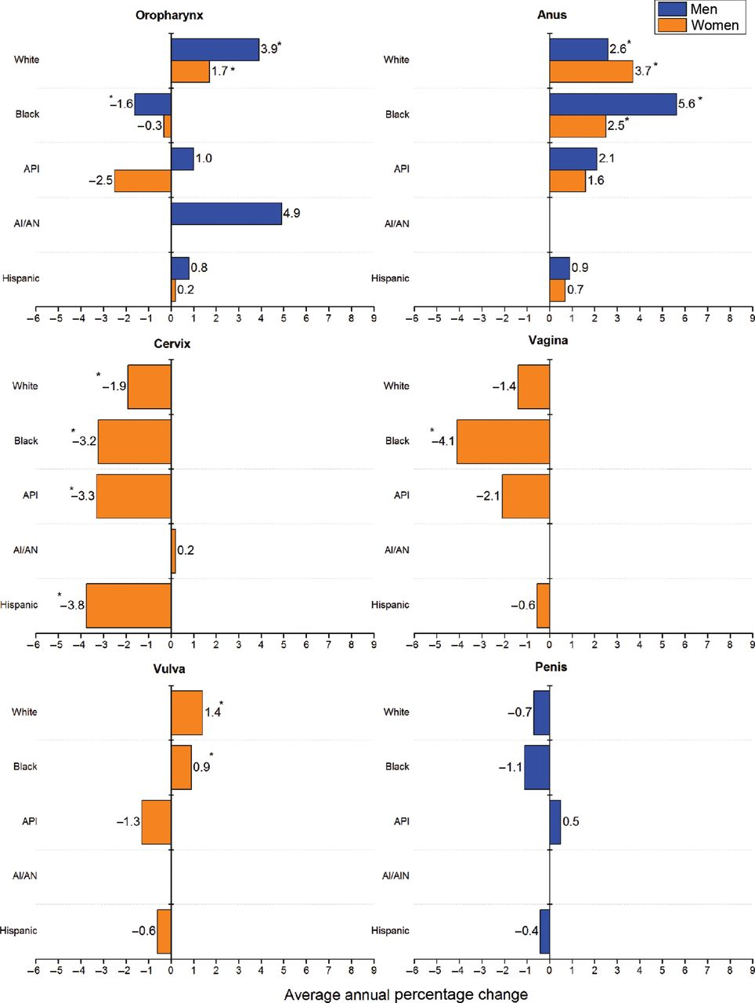
Figure 3. Trends in age-adjusted human papillomavirus (HPV)–associated cancer incidence rates by sex and race and ...
Notes:
Figure 3. Trends in age-adjusted human papillomavirus (HPV)–associated cancer incidence rates by sex and race and ethnicity in the United States, 2000 to 2009. An asterisk indicates average annual percentage change was statistically significantly different from zero at P less than .05. Trends could not be determined for American Indians/Alaska Natives (AI/ANs) for cancers of anus, vagina, vulva, and penis because of sparse data. The rates for the period from 2005 to 2009 for the five major racial and ethnic groups are from 42 states: Alabama, Alaska, Arizona, California, Colorado, Connecticut, Delaware, Florida, Georgia, Hawaii, Idaho, Illinois, Indiana, Iowa, Kentucky, Louisiana, Maine, Maryland, Massachusetts, Michigan, Minnesota, Missouri, Montana, Nebraska, Nevada, New Hampshire, New Jersey, New Mexico, New York, North Dakota, Ohio, Oklahoma, Oregon, Pennsylvania, Rhode Island, South Carolina, Texas, Utah, Vermont, Washington, West Virginia, Wyoming. Source: National Program of Cancer Registries and Surveillance, Epidemiology, and End Results areas reported by the North American Association of Central Cancer Registries as meeting high-quality incidence data standards for the specified time period. HPV-associated cancers are defined as cancers at specific anatomic sites and with specific cellular types in which HPV DNA frequently is found. Some of these cancers may not necessarily be HPV-positive because no testing was conducted. White, black, Asian/Pacific Islander (API), and AI/AN (IHS Contract Health Services Delivery Area counties) include Hispanic and non-Hispanic; the race and ethnicity categories are not mutually exclusive.
Unless provided in the caption above, the following copyright applies to the content of this slide: © The Author 2013. Published by Oxford University Press.This is an Open Access article distributed under the terms of the Creative Commons Attribution Non-Commercial License (http://creativecommons.org/licenses/by-nc/3.0/), which permits non-commercial re-use, distribution, and reproduction in any medium, provided the original work is properly cited. For commercial re-use, please contact journals.permissions@oup.com

Slide 5
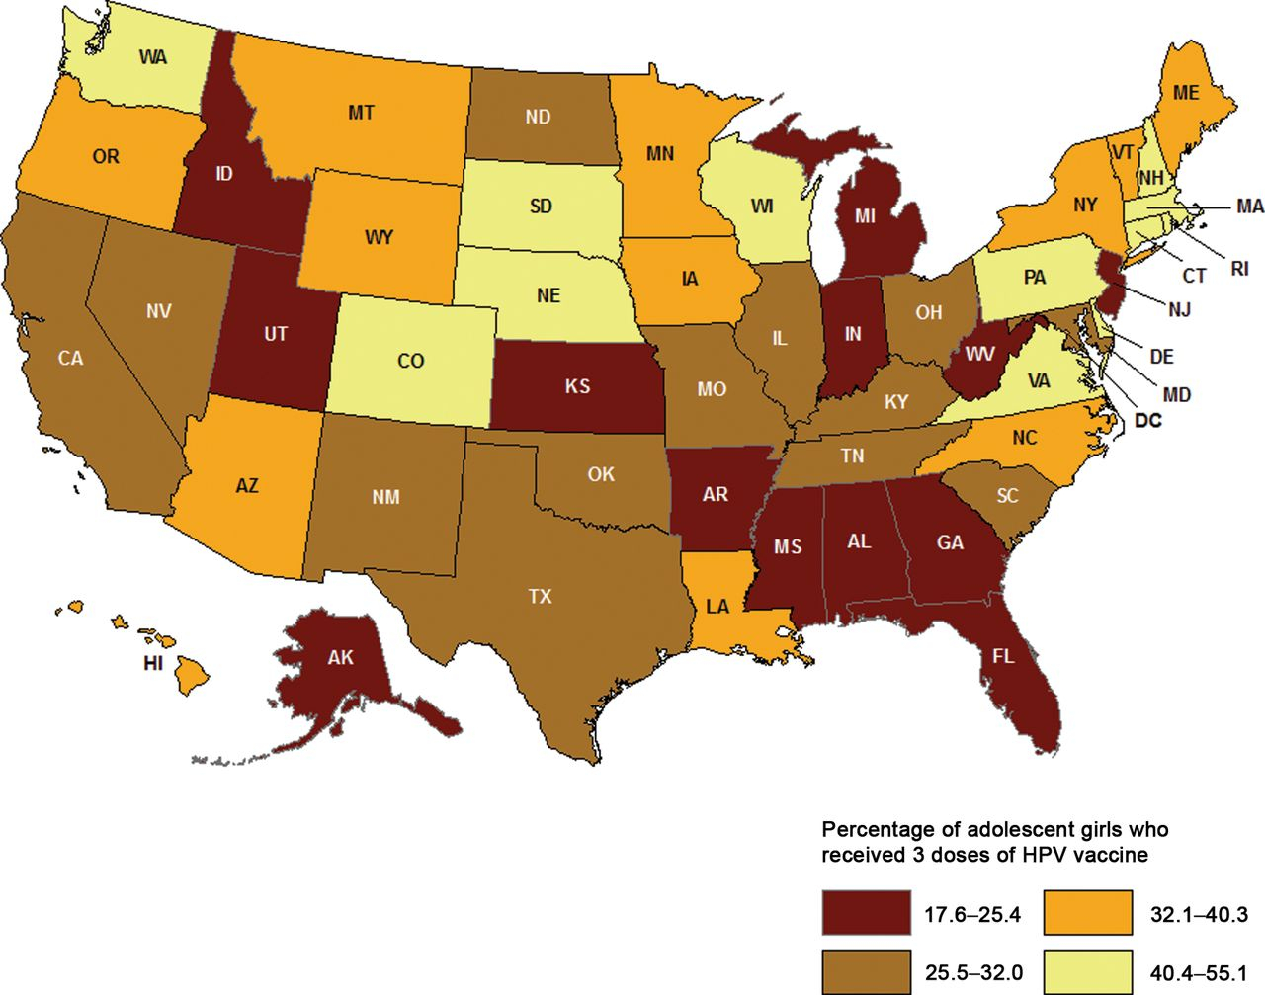
Figure 4. Three-dose human pappilomavirus (HPV) vaccination coverage among girls (aged 13 to 17 years), by state, in ...
Notes:
Figure 4. Three-dose human pappilomavirus (HPV) vaccination coverage among girls (aged 13 to 17 years), by state, in the United States, 2010. Source: National Immunization Survey-Teen (NIS-Teen) 2010, National Center for Health Statistics, Centers for Disease Control and Prevention, 2011. Girls in the 2010 NIS-Teen were born during the period from January 1992 to February 1998 and received either quadrivalent or bivalent human papillomavirus vaccine (some girls received more than three doses).
Unless provided in the caption above, the following copyright applies to the content of this slide: © The Author 2013. Published by Oxford University Press.This is an Open Access article distributed under the terms of the Creative Commons Attribution Non-Commercial License (http://creativecommons.org/licenses/by-nc/3.0/), which permits non-commercial re-use, distribution, and reproduction in any medium, provided the original work is properly cited. For commercial re-use, please contact journals.permissions@oup.com

