Slide 1
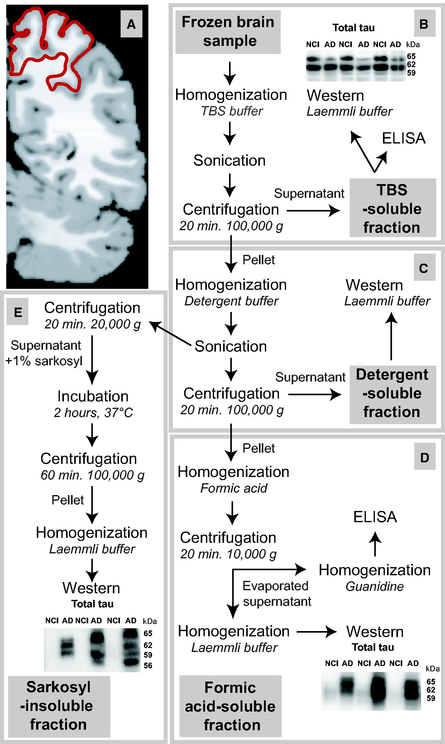
FIGURE 1 Processing method for biochemical analyses.(A) Coronal section of a human brain parietal cortex at Brodmann ...
Notes:
FIGURE 1 Processing method for biochemical analyses.(A) Coronal section of a human brain parietal cortex at Brodmann area 7 indicated in red (adapted from BioImage Suite [139]).(B–E) Workflow to generate a tris-buffered saline (TBS)-soluble protein fraction containing cytosolic and extracellular proteins(B), a detergent-soluble fraction containing membrane-bound proteins(C), a formic acid-soluble fraction(D), and a sarkosyl-insoluble fraction(E), the last two consisting of detergent-insoluble proteins.
Unless provided in the caption above, the following copyright applies to the content of this slide: © 2017 American Association of Neuropathologists, Inc. All rights reserved.This is an Open Access article distributed under the terms of the Creative Commons Attribution Non-Commercial License (http://creativecommons.org/licenses/by-nc/4.0/), which permits non-commercial reuse, distribution, and reproduction in any medium, provided the original work is properly cited. For commercial re-use, please contact journals.permissions@oup.com

Slide 2
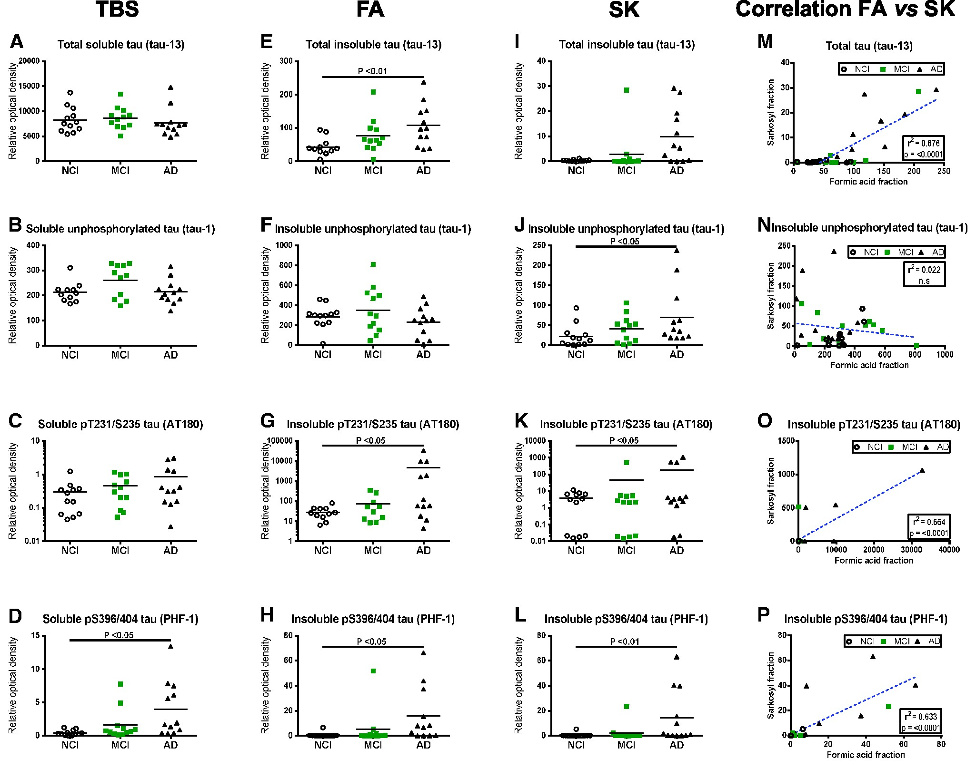
FIGURE 2 Differential expression and phosphorylation of tau in water-soluble and detergent-insoluble fractions of the ...
Notes:
FIGURE 2 Differential expression and phosphorylation of tau in water-soluble and detergent-insoluble fractions of the parietal cortex and comparison between extraction methods.(A–L) Tau protein levels (Western blot) in tris-buffered saline-soluble fractions (TBS)(A–D), formic acid-soluble fractions (FA)(E–H), and sarkosyl-insoluble fractions (SK)(I–L), from parietal cortices of healthy control subjects (NCI) and study participants with either MCI or AD. Individual values are shown and bars represent the means. Antibodies used for immunodetection are indicated. Levels of pT231/S235 tau are on a log scale. Statistical comparisons were performed using a nonparametric Kruskal–Wallis test followed by Dunn’s multiple comparison tests.(M–P) Linear regression analyses assessing the difference in tau levels (Western blot) between FA and SK fractions for each tau species.
Unless provided in the caption above, the following copyright applies to the content of this slide: © 2017 American Association of Neuropathologists, Inc. All rights reserved.This is an Open Access article distributed under the terms of the Creative Commons Attribution Non-Commercial License (http://creativecommons.org/licenses/by-nc/4.0/), which permits non-commercial reuse, distribution, and reproduction in any medium, provided the original work is properly cited. For commercial re-use, please contact journals.permissions@oup.com

Slide 3
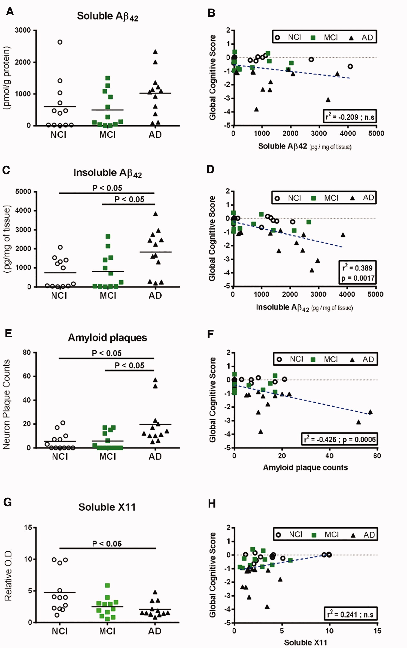
FIGURE 3 Comparison of Aβ42 peptide levels, plaque counts and X11 protein concentrations in the parietal cortex and ...
Notes:
FIGURE 3 Comparison of Aβ42 peptide levels, plaque counts and X11 protein concentrations in the parietal cortex and correlation to global cognitive scores.(A–D) Quantitative measurement (ELISA) in the parietal cortices of healthy control subjects (NCI) and study participants with either MCI or AD and linear regression with global cognitive score of soluble Aβ42(A, B) and insoluble Aβ42(C, D).(E, F) Amyloid plaque counts and linear regression with global cognitive score.(G, H) Soluble X11 protein levels (Western blot) and linear regression with global cognitive score in the parietal cortices of healthy control subjects (NCI) and study participants with either MCI or AD. Individual values are shown and the bar represents the mean. Statistical comparisons were performed using nonparametric Kruskal–Wallis test followed by Dunn’s multiple comparison tests.
Unless provided in the caption above, the following copyright applies to the content of this slide: © 2017 American Association of Neuropathologists, Inc. All rights reserved.This is an Open Access article distributed under the terms of the Creative Commons Attribution Non-Commercial License (http://creativecommons.org/licenses/by-nc/4.0/), which permits non-commercial reuse, distribution, and reproduction in any medium, provided the original work is properly cited. For commercial re-use, please contact journals.permissions@oup.com

Slide 4
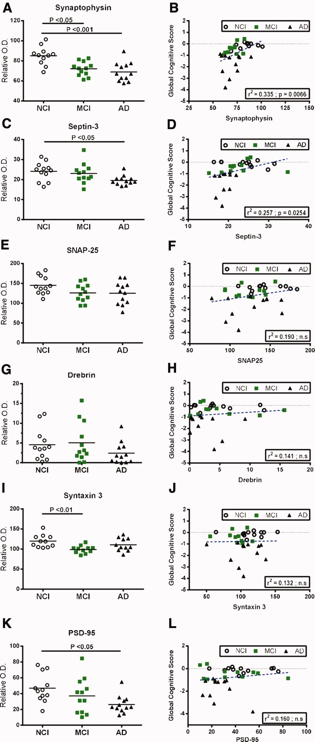
FIGURE 4 Alterations of synaptic markers in the parietal cortex of MCI or AD subjects and correlations with global ...
Notes:
FIGURE 4 Alterations of synaptic markers in the parietal cortex of MCI or AD subjects and correlations with global cognitive score.(A–L) Synaptophysin(A, B), septin-3(C, D), SNAP25(E, F), drebrin(G, H), syntaxin 3(I, J), PSD-95(K, L) protein levels (Western blot) from detergent-soluble fractions and linear regression analysis with global cognitive score in the parietal cortices of healthy control subjects (NCI) and study participants with either MCI or AD. Individual values are shown and the bar represents the mean. Statistical comparisons were performed using a nonparametric Kruskal–Wallis test followed by Dunn’s multiple comparison tests.
Unless provided in the caption above, the following copyright applies to the content of this slide: © 2017 American Association of Neuropathologists, Inc. All rights reserved.This is an Open Access article distributed under the terms of the Creative Commons Attribution Non-Commercial License (http://creativecommons.org/licenses/by-nc/4.0/), which permits non-commercial reuse, distribution, and reproduction in any medium, provided the original work is properly cited. For commercial re-use, please contact journals.permissions@oup.com

Slide 5
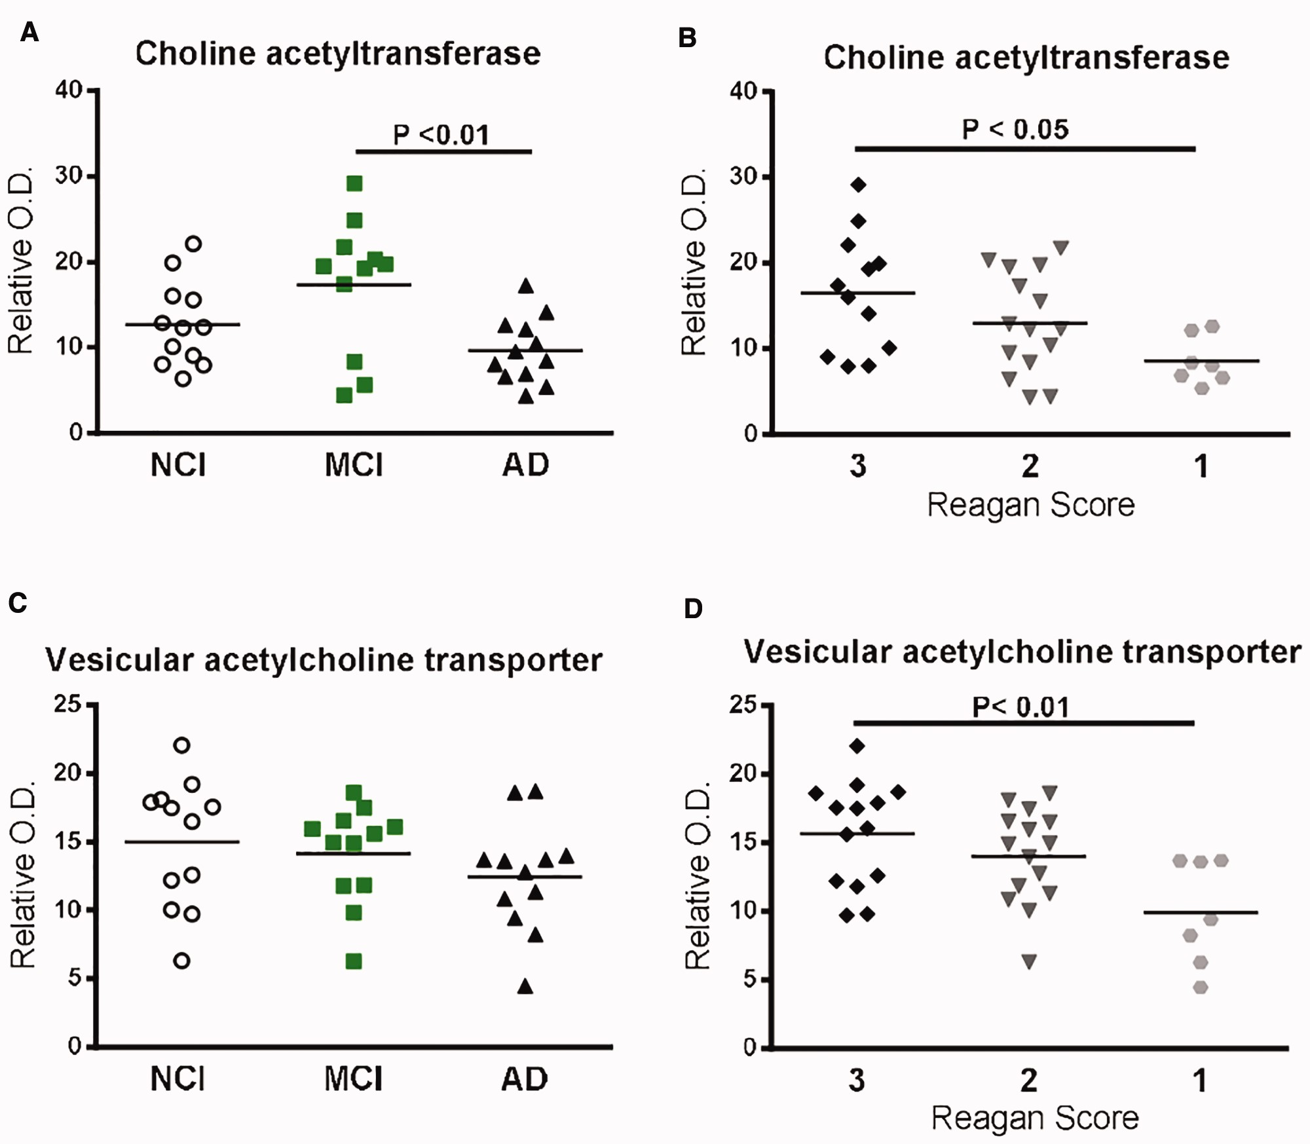
FIGURE 5 Protein levels of cholinergic markers based on cognitive scores (NCI, MCI or AD), or Reagan score (3,2,1) and ...
Notes:
FIGURE 5 Protein levels of cholinergic markers based on cognitive scores (NCI, MCI or AD), or Reagan score (3,2,1) and correlations with pathological markers.(A, B) ChAT protein levels (Western blot) in detergent-soluble fractions from parietal cortices of study volunteers either divided according to cognitive impairment (NCI, MCI or AD)(A) or Reagan score(B).(C, D) VAChT protein levels (Western blot) in the parietal cortices of study volunteers either divided according to cognitive impairment (NCI, MCI or AD)(C), or Reagan score(D). Individual values are shown and the bars represent the mean. Statistical comparisons were performed using a nonparametric Kruskal–Wallis test followed by Dunn’s multiple comparison tests.
Unless provided in the caption above, the following copyright applies to the content of this slide: © 2017 American Association of Neuropathologists, Inc. All rights reserved.This is an Open Access article distributed under the terms of the Creative Commons Attribution Non-Commercial License (http://creativecommons.org/licenses/by-nc/4.0/), which permits non-commercial reuse, distribution, and reproduction in any medium, provided the original work is properly cited. For commercial re-use, please contact journals.permissions@oup.com

Slide 6
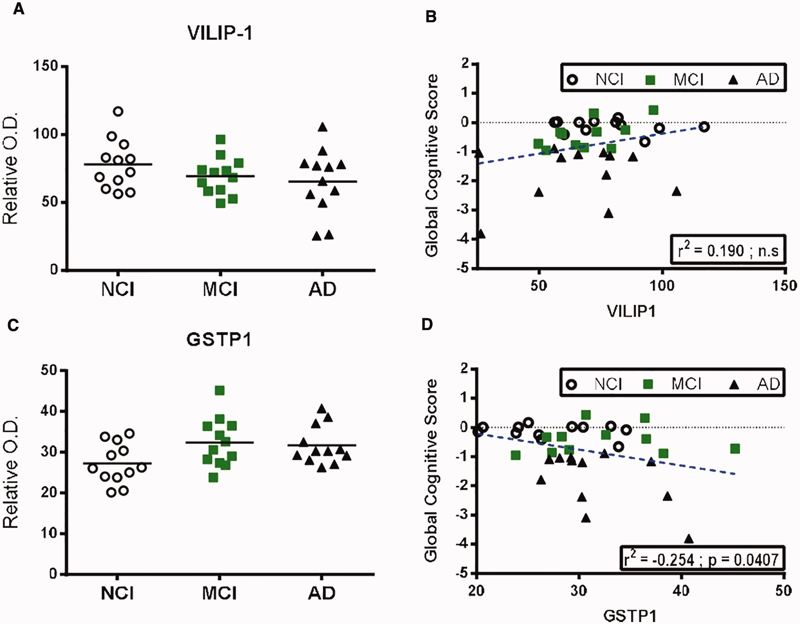
FIGURE 6 Comparison of protein levels of VILIP-1 and GSTP1 in the parietal cortex and correlation to global cognitive ...
Notes:
FIGURE 6 Comparison of protein levels of VILIP-1 and GSTP1 in the parietal cortex and correlation to global cognitive score.(A–D) VILIP-1(A, B) and GSTP1(C, D) protein levels (Western blot) in TBS-soluble fractions and linear regression analysis with global cognitive score in the parietal cortices of healthy control subjects (NCI) and study participants with either MCI or AD. Individual values are shown and the bar represents the mean. Statistical comparisons were performed using a nonparametric Kruskal–Wallis test followed by Dunn’s multiple comparison tests.
Unless provided in the caption above, the following copyright applies to the content of this slide: © 2017 American Association of Neuropathologists, Inc. All rights reserved.This is an Open Access article distributed under the terms of the Creative Commons Attribution Non-Commercial License (http://creativecommons.org/licenses/by-nc/4.0/), which permits non-commercial reuse, distribution, and reproduction in any medium, provided the original work is properly cited. For commercial re-use, please contact journals.permissions@oup.com

