Slide 1
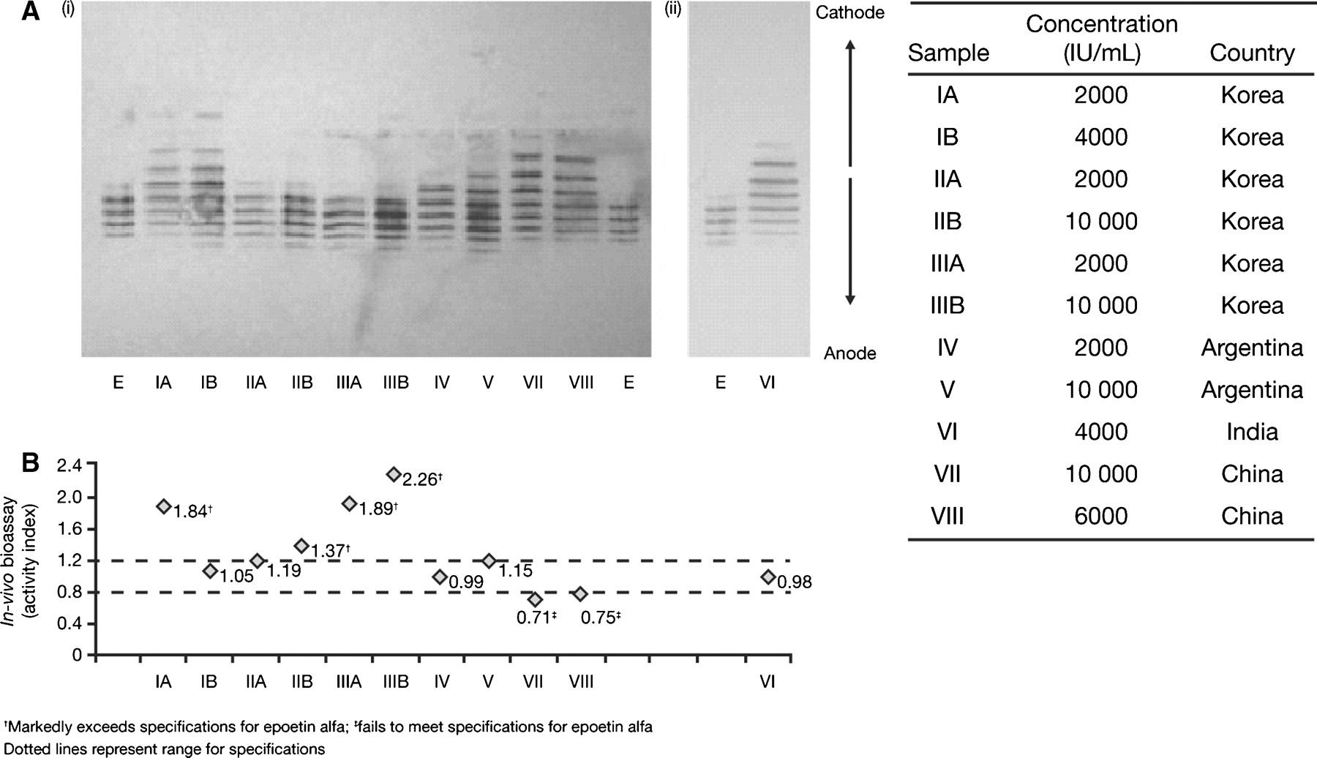
Fig. 1 Physicochemical and biological characteristics of non-innovator epoetin products available outside of the ...
Notes:
Fig. 1 Physicochemical and biological characteristics of non-innovator epoetin products available outside of the United States and Europe. (A) Isoelectric focusing (i)/ western blot (ii) isoform distribution of 11 non-innovator epoetins compared to Eprex® (E). The table shows the location where each sample was obtained. (B) Bioactivity, determined by an in vivo bioassay in mice, was higher than specifications in four samples (137–226%) and below specifications in two samples (71–75%) [35].
Unless provided in the caption above, the following copyright applies to the content of this slide: © Oxford University Press 2009

Slide 2
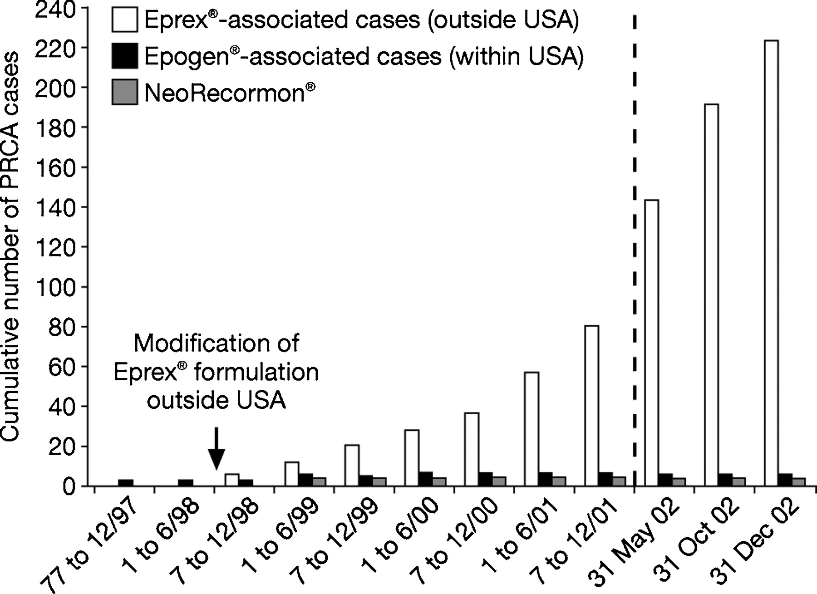
Fig. 2 Antibody-mediated pure red cell aplasia (PCRA) cases, 1997–2002. Data from Schellekens [18], by permission of ...
Notes:
Fig. 2 Antibody-mediated pure red cell aplasia (PCRA) cases, 1997–2002. Data from Schellekens [18], by permission of Oxford University Press.
Unless provided in the caption above, the following copyright applies to the content of this slide: © Oxford University Press 2009

