Slide 1
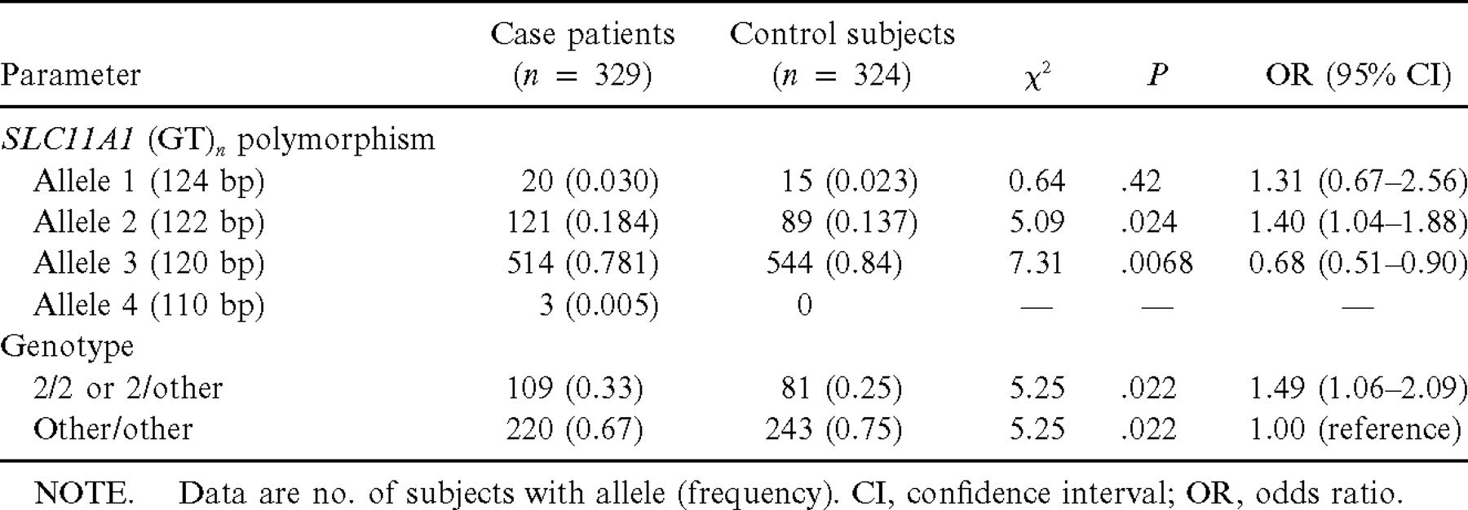
Table 1 Allele and genotype frequencies of SLC11A1 promoter polymorphism in patients with tuberculosis and unaffected ...
Notes:
Table 1 Allele and genotype frequencies of SLC11A1 promoter polymorphism in patients with tuberculosis and unaffected control subjects
Unless provided in the caption above, the following copyright applies to the content of this slide: © 2002 by the Infectious Diseases Society of America

Slide 2
Table 2 Tumor necrosis factor (TNF)–α, interleukin (IL)–1β, and IL-10 responses to lipopolysaccharide (LPS; 1 ng/mL) ...
Notes:
Table 2 Tumor necrosis factor (TNF)–α, interleukin (IL)–1β, and IL-10 responses to lipopolysaccharide (LPS; 1 ng/mL) or LPS (1 ng/mL) plus interferon (IFN)–γ (200 IU/mL) in 276 healthy blood bank donors
Unless provided in the caption above, the following copyright applies to the content of this slide: © 2002 by the Infectious Diseases Society of America

Slide 3
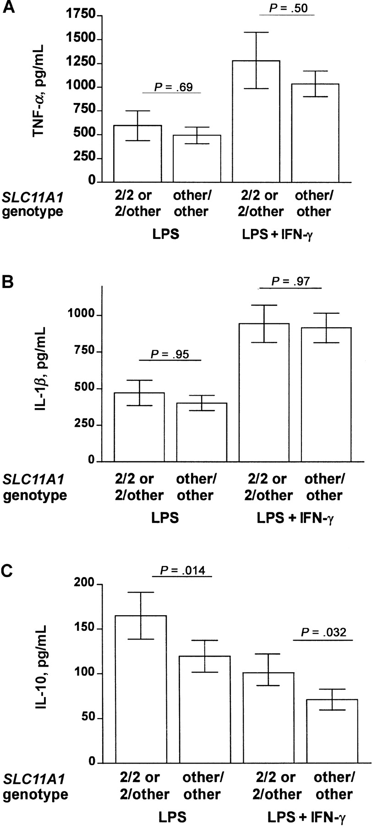
Figure 1 Lipopolysaccharide (LPS)–induced tumor necrosis factor (TNF)–α, interleukin (IL)–1β, and IL-10 production by ...
Notes:
Figure 1 Lipopolysaccharide (LPS)–induced tumor necrosis factor (TNF)–α, interleukin (IL)–1β, and IL-10 production by healthy persons according to presence or absence of allele 2 of the SLC11A1 promoter polymorphism. Data are geometric means and 95% confidence intervals. The unpaired Student’s t test was used to test for significance between persons carrying allele 2 of the SLC11A1 promoter polymorphism (n=73) and those who do not (n=203)
Unless provided in the caption above, the following copyright applies to the content of this slide: © 2002 by the Infectious Diseases Society of America

Slide 4
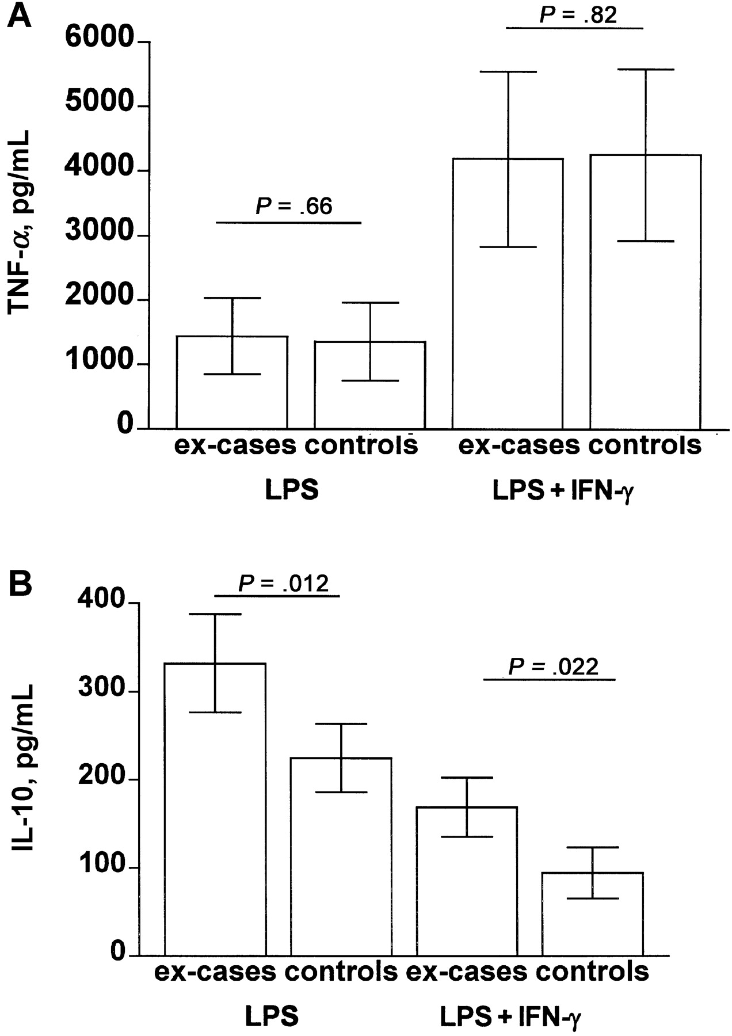
Figure 2 Lipopolysaccharide (LPS)–induced cytokine production (tumor necrosis factor [TNF]–α and interleukin [IL]–10) ...
Notes:
Figure 2 Lipopolysaccharide (LPS)–induced cytokine production (tumor necrosis factor [TNF]–α and interleukin [IL]–10) by persons with cured tuberculosis (ex–case patients) and purified protein derivative skin test–positive persons with evidence of latent infection but no history of tuberculosis (control subjects) with and without interferon (IFN)–γ priming. Data are geometric means and 95% confidence intervals. The paired Student’s t test was used to test for statistical significance (n=38 in each group)
Unless provided in the caption above, the following copyright applies to the content of this slide: © 2002 by the Infectious Diseases Society of America

