Slide 1
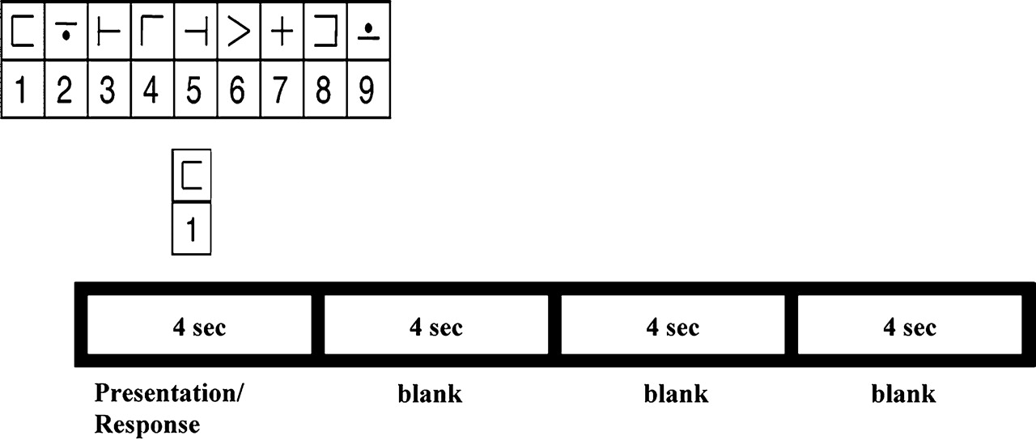
Figure 1. Trial sequence of the modified DSST. On each trial, a code table appeared in the middle of the screen while a ...
Notes:
Figure 1. Trial sequence of the modified DSST. On each trial, a code table appeared in the middle of the screen while a probe digit–symbol pair appeared below it. These stimuli stayed on the screen for 3.5 s followed by variable intertrial intervals (0.5, 4.5, 8.5, or 12.5 s).
Unless provided in the caption above, the following copyright applies to the content of this slide: © The Authors 2010. Published by Oxford University Press.This is an Open Access article distributed under the terms of the Creative Commons Attribution Non-Commercial License (http://creativecommons.org/licenses/by-nc/2.5), which permits unrestricted non-commercial use, distribution, and reproduction in any medium, provided the original work is properly cited.

Slide 2
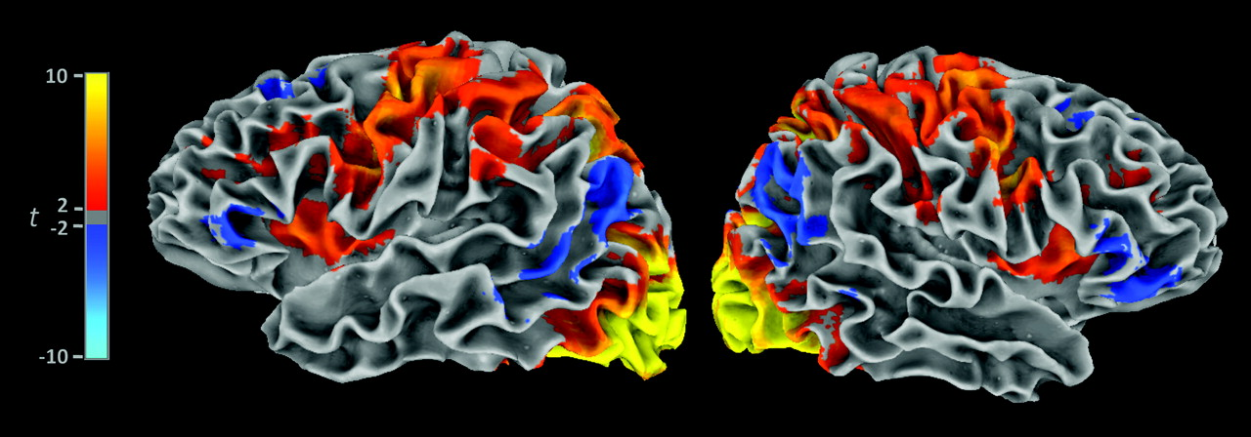
Figure 2. Average t-values (thresholded from cyan to blue and red to yellow, respectively, at −2.00 ≥ t ≥ 2.00, P < ...
Notes:
Figure 2. Average t-values (thresholded from cyan to blue and red to yellow, respectively, at −2.00 ≥ t ≥ 2.00, P < 0.05 uncorrected), spatially normalized to Talairach space via affine transformation to the Colin-brain template. The mean t-values are shown on surface models created from the Colin template. These results show task-related signal change in the previously identified target regions, including dorsolateral PFC (BA 9 and BA 46), ventrolateral (BA 44, BA 45, and BA 47) PFC, and inferior parietal cortex (BA 39 and BA 40).
Unless provided in the caption above, the following copyright applies to the content of this slide: © The Authors 2010. Published by Oxford University Press.This is an Open Access article distributed under the terms of the Creative Commons Attribution Non-Commercial License (http://creativecommons.org/licenses/by-nc/2.5), which permits unrestricted non-commercial use, distribution, and reproduction in any medium, provided the original work is properly cited.

Slide 3
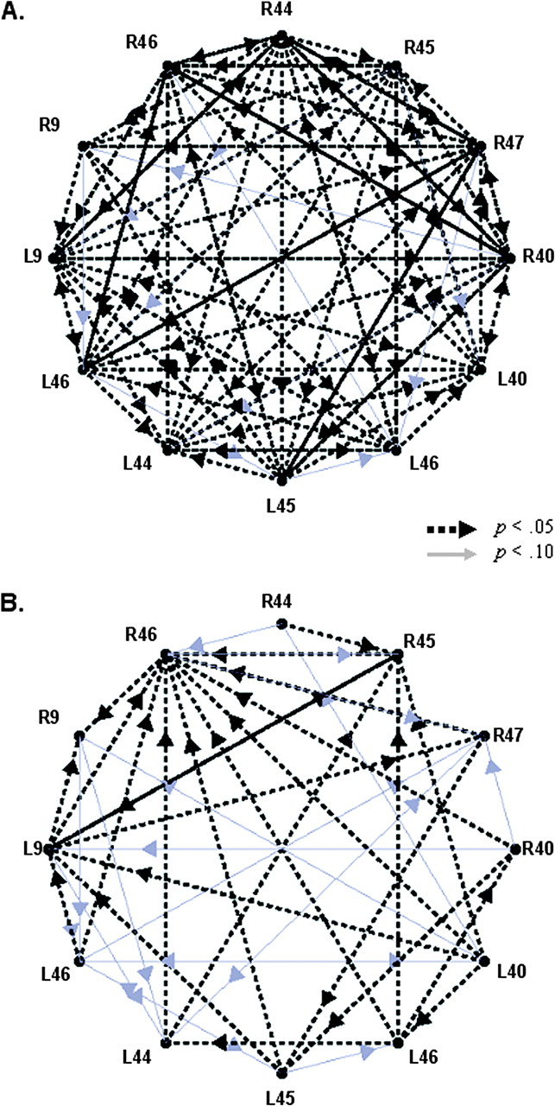
Figure 3. Results of the GCAs for the vigilance task (A) and for the DSST task (B). For both tasks, the results are ...
Notes:
Figure 3. Results of the GCAs for the vigilance task (A) and for the DSST task (B). For both tasks, the results are arranged in a circular fashion with rostral information represented on the left side of each circle, relatively ventral and posterior regions are illustrated in the middle portions so that the caudal-most ROIs are on the right side of the circle. Arrows indicate significant influences; thicker black and dashed arrows represent influences with P < 0.05; thinner gray arrows represent influences with 0.05 < P < 0.10.
Unless provided in the caption above, the following copyright applies to the content of this slide: © The Authors 2010. Published by Oxford University Press.This is an Open Access article distributed under the terms of the Creative Commons Attribution Non-Commercial License (http://creativecommons.org/licenses/by-nc/2.5), which permits unrestricted non-commercial use, distribution, and reproduction in any medium, provided the original work is properly cited.

Slide 4
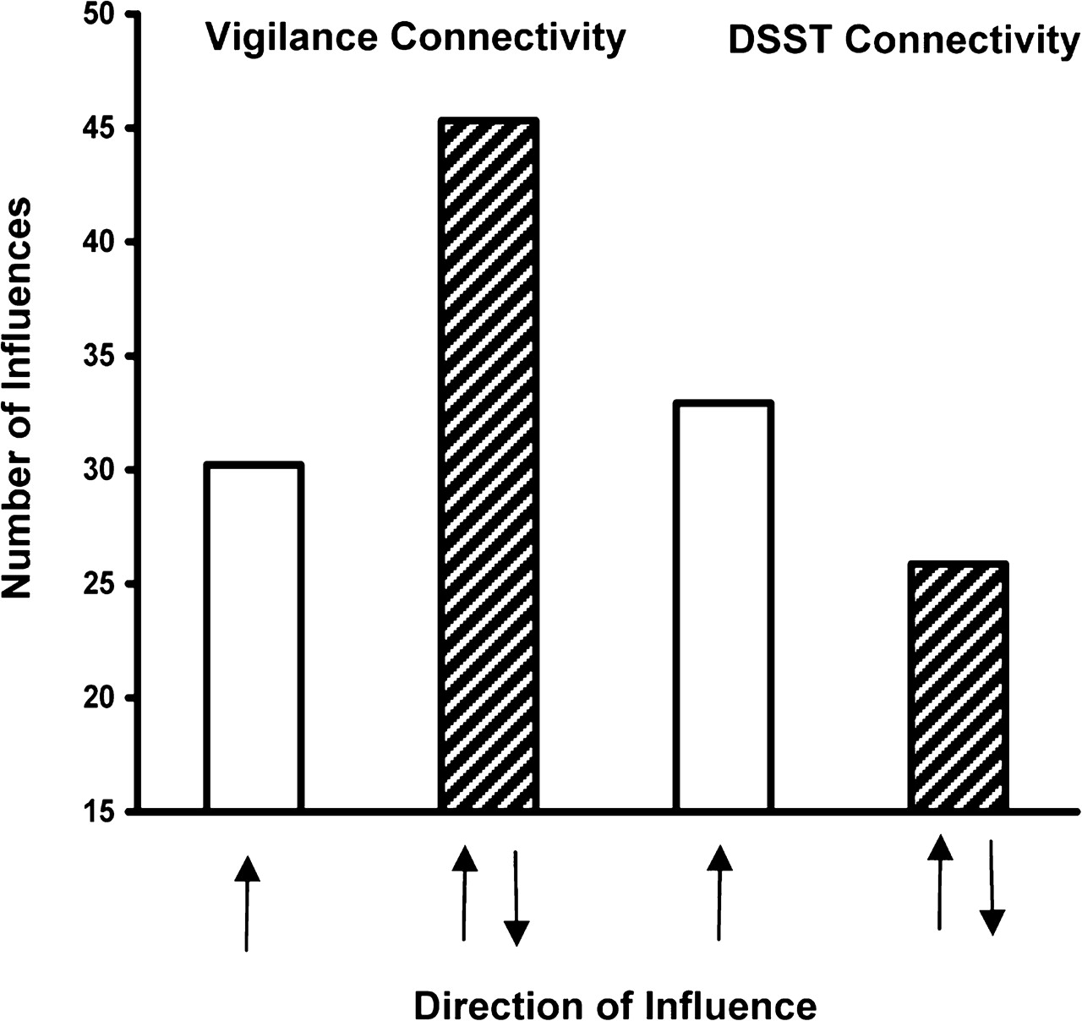
Figure 4. Mean numbers of unidirectional and bidirectional influences for both task types across ROIs. Unidirectional ...
Notes:
Figure 4. Mean numbers of unidirectional and bidirectional influences for both task types across ROIs. Unidirectional influences are illustrated in solid open bars and labeled with single arrows. Bidirectional influences are illustrated as filled bars and labeled with 2 arrows.
Unless provided in the caption above, the following copyright applies to the content of this slide: © The Authors 2010. Published by Oxford University Press.This is an Open Access article distributed under the terms of the Creative Commons Attribution Non-Commercial License (http://creativecommons.org/licenses/by-nc/2.5), which permits unrestricted non-commercial use, distribution, and reproduction in any medium, provided the original work is properly cited.

Slide 5
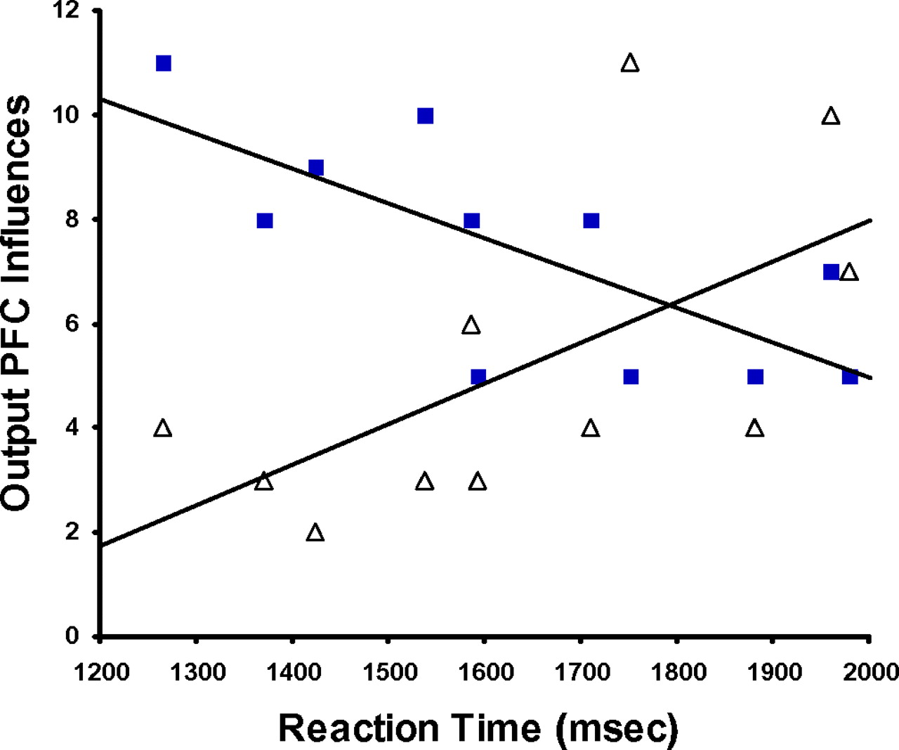
Figure 5. Scatterplot showing relationships between DSST RT and unidirectional output PFC influences (determined by ...
Notes:
Figure 5. Scatterplot showing relationships between DSST RT and unidirectional output PFC influences (determined by GCA) from BA 9 for the vigilance (filled squares) and DSST (open triangles) tasks.
Unless provided in the caption above, the following copyright applies to the content of this slide: © The Authors 2010. Published by Oxford University Press.This is an Open Access article distributed under the terms of the Creative Commons Attribution Non-Commercial License (http://creativecommons.org/licenses/by-nc/2.5), which permits unrestricted non-commercial use, distribution, and reproduction in any medium, provided the original work is properly cited.

