Slide 1
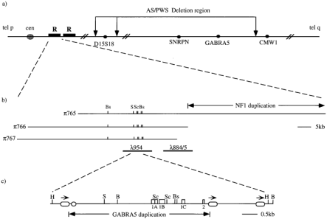
Figure 1 (a) Representation of chromosome 15 showing the location of the GABRA5 duplication and repeats in relation to ...
Notes:
Figure 1 (a) Representation of chromosome 15 showing the location of the GABRA5 duplication and repeats in relation to the Angelman and Prader-Willi deletion . (b) P1 (π) and bacteriophage (λ) clones across the GABRA5 duplicated locus. The location of the NF1 duplication is also shown. The centromeric-telomeric orientation of the phage and P1 contig has not been determined. (c) Map of the GABRA5 duplication; squares, exons; ovals, Alus; arrows, 5′ to 3′ direction; circle, (CA) repeat; Bg, BglII; Bs, BssHII; H, HindlII; S, SalI; Sc, SacII.
Unless provided in the caption above, the following copyright applies to the content of this slide: © 1998 Oxford University Press

Slide 2
Table 1 GABRA5:GABRA5 duplication homology (%)
Notes:
Table 1 GABRA5:GABRA5 duplication homology (%)
Unless provided in the caption above, the following copyright applies to the content of this slide: © 1998 Oxford University Press

Slide 3
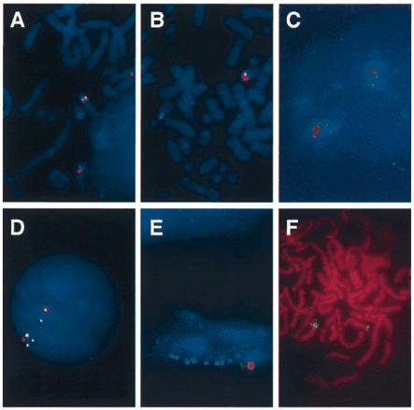
Figure 2 Characterization of the GAABRA5 duplication and surrounding region by FISH in different individuals. (a) ...
Notes:
Figure 2 Characterization of the GAABRA5 duplication and surrounding region by FISH in different individuals. (a) Hybridization probes π766 (green) and D15S18 (red) to a metaphase spread of chromosomes from a normal individual. (b) Hybridization of probes λ954 (green) and D15Z1 (red) to metaphase chromosomes from cell line WJK36 from an individual with Angelman syndrome who is heterozygously deleted for D15S18. (c) Hybridization of probes λ885 (green) and D15Z1 (red) to a nucleus from individual B treated by released chromatin technique. (d) Hybridization of λ954 (green) and λ885 (red) to an interphase nucleus from individual C. (e) Hybridization of chromatin fibers from individual A with λ885 (green) and D15Z1 (red). (f) Hybridization of π925 (green) to metaphase chromosomes from individual A.
Unless provided in the caption above, the following copyright applies to the content of this slide: © 1998 Oxford University Press

Slide 4
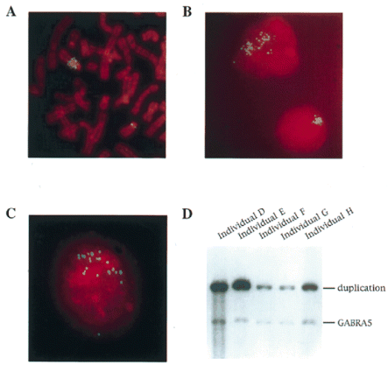
Figure 3 The repeat region is amplified in an individual with a proximal 15q amplification. (a) Hybridization of λ885 ...
Notes:
Figure 3 The repeat region is amplified in an individual with a proximal 15q amplification. (a) Hybridization of λ885 to a spread of metaphase chromosomes from individual D. (b) Hybridization of π925 to nuclei from individual D. (c) Hybridization of λ954 to a nucleus from individual D. (d) Southern blot of BglII-digested genomic DNA from individuals D-H, hybridized with the GAABRA5 probe, 438S/P, and duplication-specific probe, p834.
Unless provided in the caption above, the following copyright applies to the content of this slide: © 1998 Oxford University Press

Slide 5
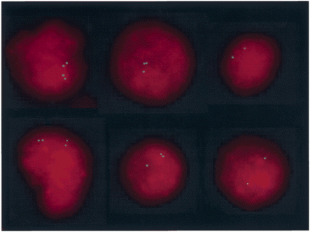
Figure 4 Asynchronous replication of the GABRA5 duplication. Hybridization of probe λ885 to a mixed population of cell ...
Notes:
Figure 4 Asynchronous replication of the GABRA5 duplication. Hybridization of probe λ885 to a mixed population of cell nuclei from individual I.
Unless provided in the caption above, the following copyright applies to the content of this slide: © 1998 Oxford University Press

