Slide 1
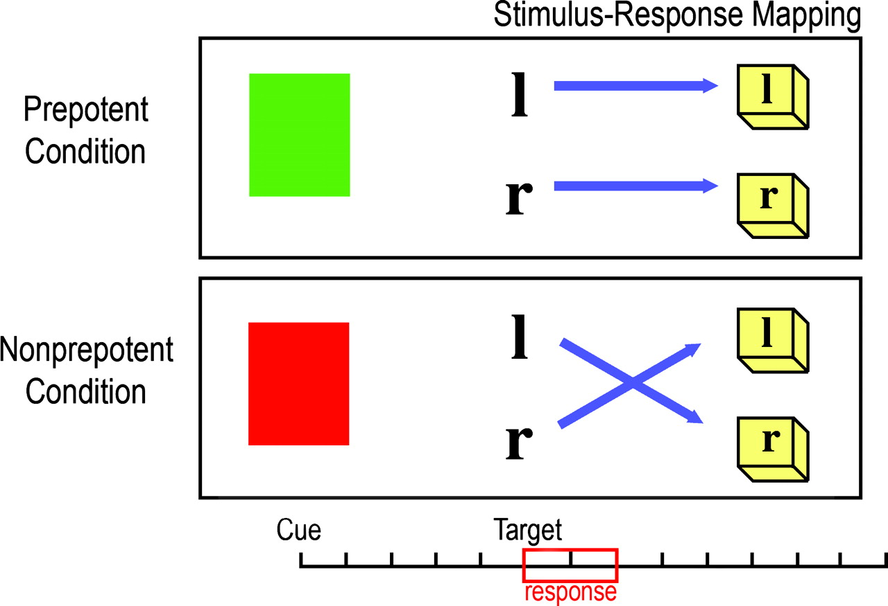
Figure 1. Stimulus–response incompatibility task. The timeline across the bottom represents the task timing for each ...
Notes:
Figure 1. Stimulus–response incompatibility task. The timeline across the bottom represents the task timing for each trial. Each tick represents one scan (1500 ms). Cue onset occurs at trial start (0 s). Target onset occurs 7.5 s after trial start.
Unless provided in the caption above, the following copyright applies to the content of this slide: Cerebral Cortex V 15 N 7 © Oxford University Press 2004; all rights reserved

Slide 2
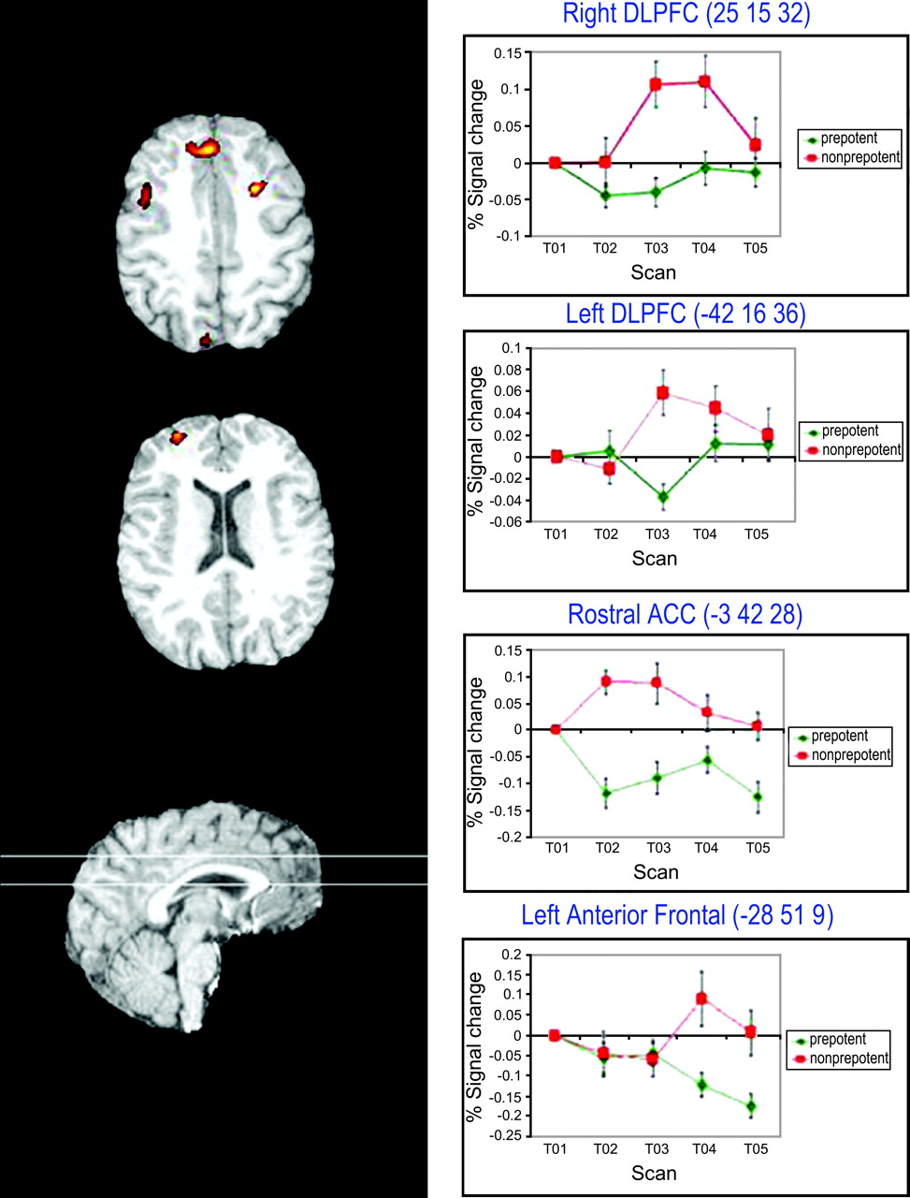
Figure 2. Regions active for preparing to overcome a prepotent response tendency.
Notes:
Figure 2. Regions active for preparing to overcome a prepotent response tendency.
Unless provided in the caption above, the following copyright applies to the content of this slide: Cerebral Cortex V 15 N 7 © Oxford University Press 2004; all rights reserved

Slide 3
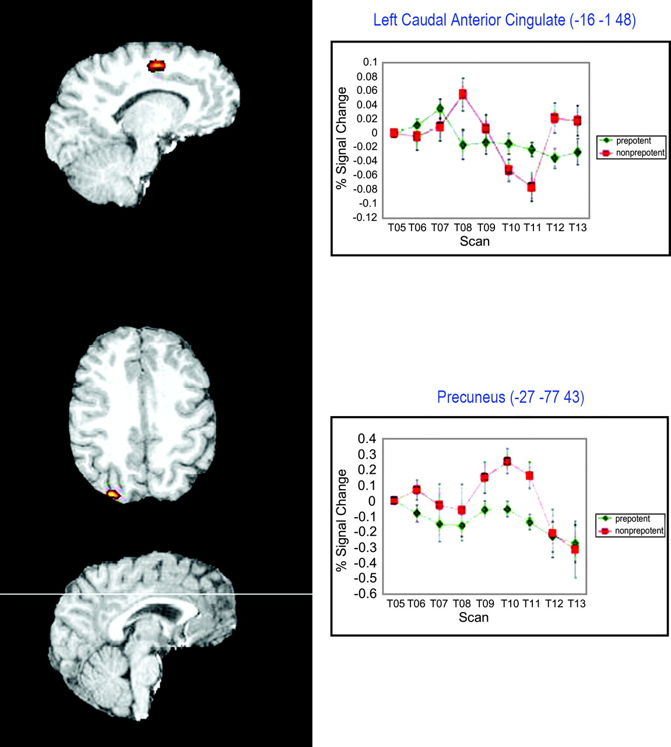
Figure 3. Regions showing activity for overcoming a prepotent response tendency for the target phase of the task.
Notes:
Figure 3. Regions showing activity for overcoming a prepotent response tendency for the target phase of the task.
Unless provided in the caption above, the following copyright applies to the content of this slide: Cerebral Cortex V 15 N 7 © Oxford University Press 2004; all rights reserved

Slide 4
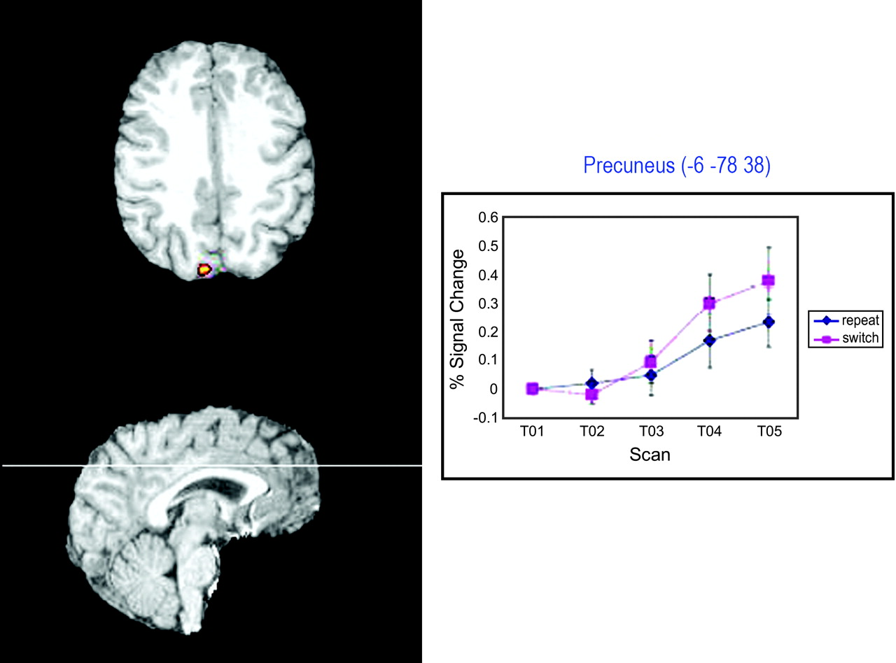
Figure 4. Preparation related task switch activity.
Notes:
Figure 4. Preparation related task switch activity.
Unless provided in the caption above, the following copyright applies to the content of this slide: Cerebral Cortex V 15 N 7 © Oxford University Press 2004; all rights reserved

Slide 5
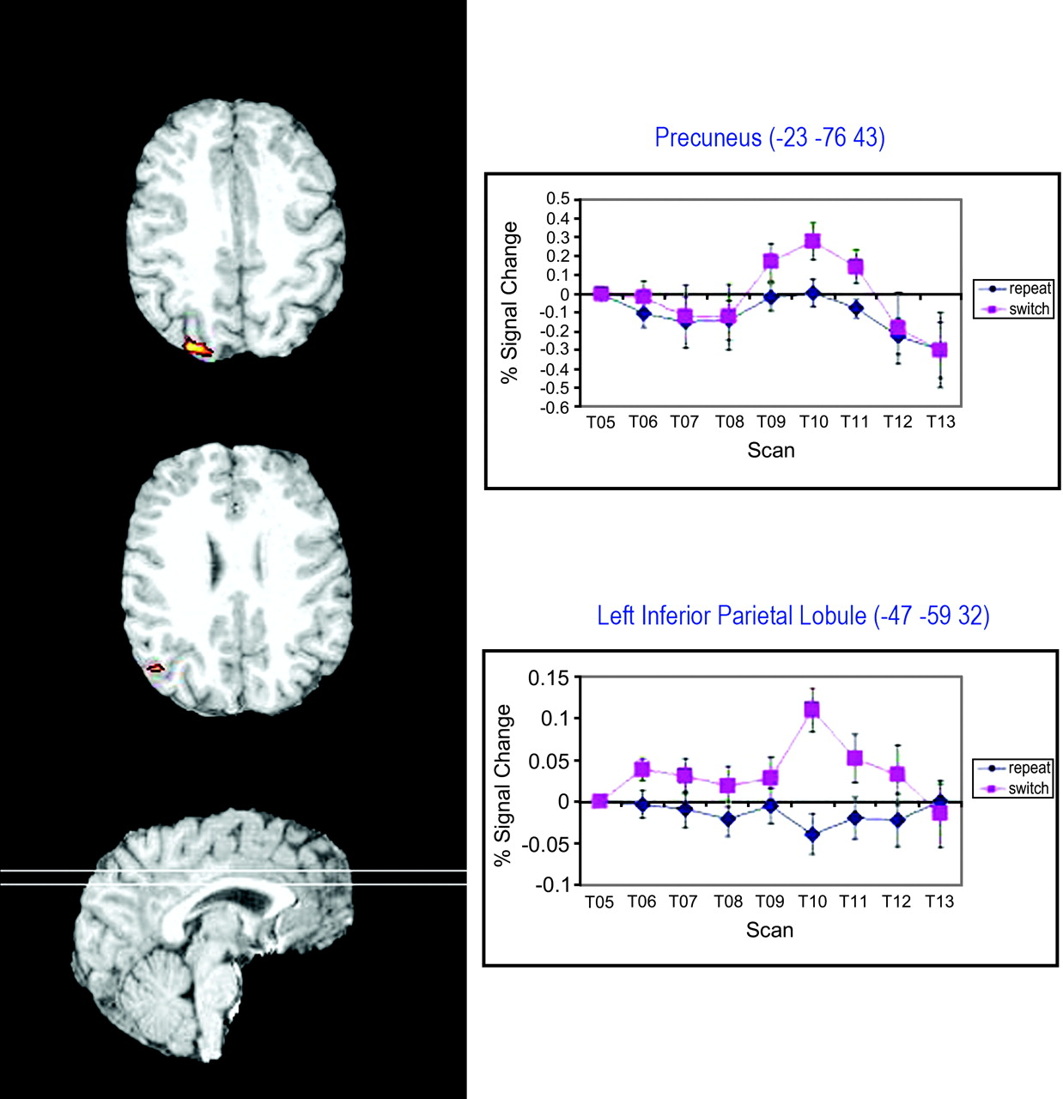
Figure 5. Target related task switch activity.
Notes:
Figure 5. Target related task switch activity.
Unless provided in the caption above, the following copyright applies to the content of this slide: Cerebral Cortex V 15 N 7 © Oxford University Press 2004; all rights reserved

