Slide 1
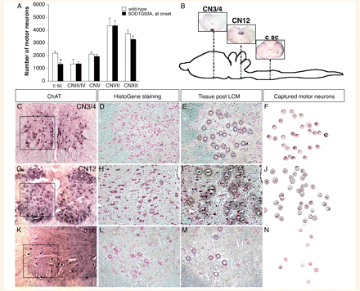
Figure 1 LCM of motor neurons from subpopulations showing differential vulnerability to degeneration in amyotrophic ...
Notes:
Figure 1 LCM of motor neurons from subpopulations showing differential vulnerability to degeneration in amyotrophic lateral sclerosis. (A) Approximately 40% of cervical spinal motor neurons had degenerated in the SOD1G93A rats at the time of disease onset, as defined by grip strength analysis, while the number of motor neurons in the different brain stem nuclei remained unchanged. (B) Schematic figure depicting the rat brain, brainstem and spinal cord, displaying three nuclei of motor neurons along the rostrocaudal axis of the CNS which show differential vulnerability to degeneration in amyotrophic lateral sclerosis: CN3/4, CN12 and the lateral motor column of the cervical spinal cord. Motor neurons in the (C–F) CN3/4, (G–J) CN12 and (K–N) the cervical spinal cord, visualized by (C, G and K) choline acetyltransferase (ChAT) staining or (D, H and L) HistoGene staining were isolated by LCM (E, F, I, J, M and N).
Unless provided in the caption above, the following copyright applies to the content of this slide: © The Author (2010). Published by Oxford University Press on behalf of the Guarantors of Brain. All rights reserved. For Permissions, please email: journals.permissions@oxfordjournals.org

Slide 2
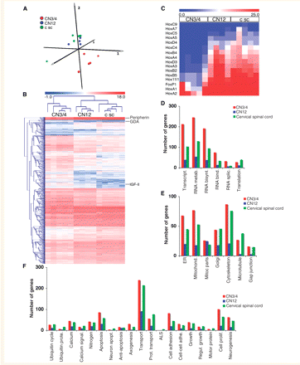
Figure 2 Global gene expression analysis of motor neurons isolated from CN3/4, CN12 and the cervical spinal cord of ...
Notes:
Figure 2 Global gene expression analysis of motor neurons isolated from CN3/4, CN12 and the cervical spinal cord of normal rats. (A) Correspondence analysis of the gene expression data (22 911 genes) showed that individual samples within each nucleus clustered together and that motor neurons of the CN12 and the cervical spinal cord were closely associated, whereas motor neurons of CN3/4 were less associated with the other motor neuron nuclei. (B) Hierarchial clustering, using Euclidean distance, of the 1968 genes (extracted by ANOVA using a P-value set to 0.01) that were differentially expressed between the three nuclei, showed that individual samples within each somatic motor neuron nucleus clustered closely together, and that motor neurons of CN12 shared more genes with those of the cervical spinal cord compared to CN3/4. Within the heat map, the location of peripherin, which was predominantly expressed in spinal motor neurons, and the CN3/4-restricted genes IGF-II and guanine deaminase (GDA) have been indicated. (C) Heat map displaying the differential expression pattern of Hox genes in motor neuron subpopulations (CN3/4, CN12 and cervical spinal cord) according to their anterior–posterior position within the brain and spinal cord (extracted using two-sided t-test with 1000 permutations, and a P-value set to ≤ 0.05). (D–F) Examples of gene groups that showed a high differential expression level between the three different motor neuron subpopulations. ALS = amyotrophic lateral sclerosis.
Unless provided in the caption above, the following copyright applies to the content of this slide: © The Author (2010). Published by Oxford University Press on behalf of the Guarantors of Brain. All rights reserved. For Permissions, please email: journals.permissions@oxfordjournals.org

Slide 3
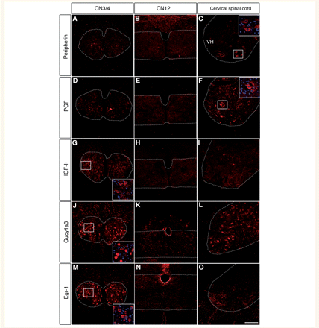
Figure 3 Confirmation of protein expression of genes differentially expressed in motor neurons of the cervical spinal ...
Notes:
Figure 3 Confirmation of protein expression of genes differentially expressed in motor neurons of the cervical spinal cord, CN12 and the CN3/4. Immunofluorescent analysis using confocal microscopy was used to analyse the protein expression of genes found to be differentially expressed between different groups of motor neurons using microarray. Consistent with the microarray RNA data, the protein expression of peripherin in motor neurons of CN3/4 (A) and CN12 appeared low (B), whereas in cervical spinal cord it was high (C and inset). Placental growth factor (PGF) was localized to motor neurons of the spinal cord (F and inset) and to a lesser extent to motor neuron of CN3/4 (D) and CN12 (E). IGF-II protein was expressed in motor neurons of CN3/4 (G and inset), but was below the detection level in motor neurons of CN12 (H) and the cervical spinal cord (I). Gucy1a3 protein was present in motor neurons of the CN3/4. Gucy1a3 was also localized to additional cell types within and surrounding the CN3/4 (J and inset). The level of Gucy1a3 in CN12 was very low (K) whereas it was more easily detected in motor neurons of the cervical spinal cord (L). Early growth response 1 (Egr-1) protein was highly expressed in motor neurons of CN3/4 (M), while the expression level in motor neurons of CN12 and the cervical spinal cord was much lower (N and O). Scale bar: 100 µm (O, applies to A–N).
Unless provided in the caption above, the following copyright applies to the content of this slide: © The Author (2010). Published by Oxford University Press on behalf of the Guarantors of Brain. All rights reserved. For Permissions, please email: journals.permissions@oxfordjournals.org

Slide 4
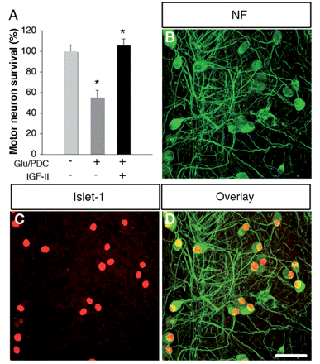
Figure 4 IGF-II protected spinal motor neurons in primary culture from glutamate-induced toxicity. (A) The number of ...
Notes:
Figure 4 IGF-II protected spinal motor neurons in primary culture from glutamate-induced toxicity. (A) The number of spinal motor neurons in primary culture was significantly decreased after the addition of 20 µM glutamate (Glu) and 100 µM of the glutamate uptake blocker PDC (P < 0.001, ANOVA). Pretreatment of the cultures with IGF-II (10–100 ng/ml) for 2–4 h prior to glutamate insult protected motor neurons against the toxicity (P < 0.001, ANOVA). Confocal analysis of (B and D) 150 kD neurofilament (NF) and (C and D) islet-1 expression in primary spinal cord cultures pretreated with IGF-II show the presence of large numbers of motor neurons in the cultures after 7 days of combined IGF-II and glutamate treatment. Scale bar: 50 µm (D, applies to B and C). Asterisk signifies a statistically significant difference with a P < 0.01, by ANOVA.
Unless provided in the caption above, the following copyright applies to the content of this slide: © The Author (2010). Published by Oxford University Press on behalf of the Guarantors of Brain. All rights reserved. For Permissions, please email: journals.permissions@oxfordjournals.org

Slide 5
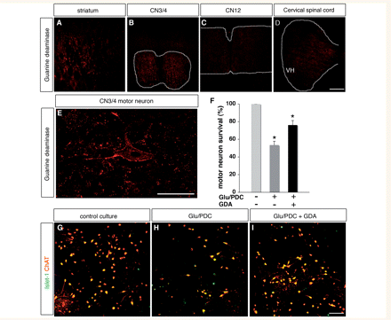
Figure 5 Guanine deaminase was expressed within CN3/4 motor neurons and exogenous delivery protected primary spinal ...
Notes:
Figure 5 Guanine deaminase was expressed within CN3/4 motor neurons and exogenous delivery protected primary spinal motor neurons from glutamate toxicity. Immunofluorescent analysis using confocal microscopy was used to analyse the protein expression of guanine deaminase (GDA). (A) Striatal tissue was used as a positive control for the antibody staining. (B and E) Consistent with the microarray RNA data, guanine deaminase protein was present in motor neurons of the CN3/4 as well as within other surrounding cell types within this nucleus. The level of guanine deaminase in CN12 and cervical spinal cord was very low (C and D). (F–I) The addition of glutamate (Glu, 20 µM) and the glutamate uptake blocker PDC (100 µM) to primary spinal cord culture decreased the number of motor neurons (P < 0.001, ANOVA). Pretreatment of the cultures with guanine deaminase (100 ng/ml) for 3–4 h prior to glutamate insult protected motor neurons against the toxicity (P < 0.001, ANOVA). Scale bars: 100 µm (D, applies to A–C), 50 µm (E) and 50 µm (I, applies to G and H). ChAT = choline acetyltransferase. Asterisk signifies a statistically significant difference with a P < 0.01, by ANOVA.
Unless provided in the caption above, the following copyright applies to the content of this slide: © The Author (2010). Published by Oxford University Press on behalf of the Guarantors of Brain. All rights reserved. For Permissions, please email: journals.permissions@oxfordjournals.org

