Slide 1
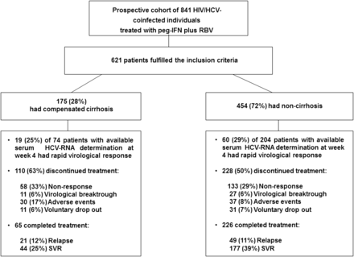
Figure 1. Study flow chart. Abbreviations: HCV, hepatitis C virus; HIV, human immunodeficiency virus; peg-IFN, ...
Notes:
Figure 1. Study flow chart. Abbreviations: HCV, hepatitis C virus; HIV, human immunodeficiency virus; peg-IFN, pegylated interferon; RBV, ribavirin; SVR, sustained virological response.
Unless provided in the caption above, the following copyright applies to the content of this slide: © The Author 2012. Published by Oxford University Press on behalf of the Infectious Diseases Society of America. All rights reserved. For Permissions, please e-mail: journals.permissions@oup.com.

Slide 2
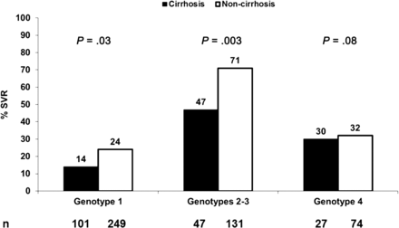
Figure 2. Sustained virological response rates to pegylated interferon plus ribavirin in cirrhotic and noncirrhotic ...
Notes:
Figure 2. Sustained virological response rates to pegylated interferon plus ribavirin in cirrhotic and noncirrhotic patients according to hepatitis C virus genotype (intention-to-treat analysis). Abbreviation: SVR, sustained virological response.
Unless provided in the caption above, the following copyright applies to the content of this slide: © The Author 2012. Published by Oxford University Press on behalf of the Infectious Diseases Society of America. All rights reserved. For Permissions, please e-mail: journals.permissions@oup.com.

Slide 3
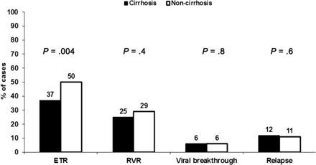
Figure 3. Virological responses at different time points in cirrhotic and noncirrhotic patients. Abbreviations: ETR, ...
Notes:
Figure 3. Virological responses at different time points in cirrhotic and noncirrhotic patients. Abbreviations: ETR, end of treatment response; RVR, rapid virological response.
Unless provided in the caption above, the following copyright applies to the content of this slide: © The Author 2012. Published by Oxford University Press on behalf of the Infectious Diseases Society of America. All rights reserved. For Permissions, please e-mail: journals.permissions@oup.com.

