Slide 1
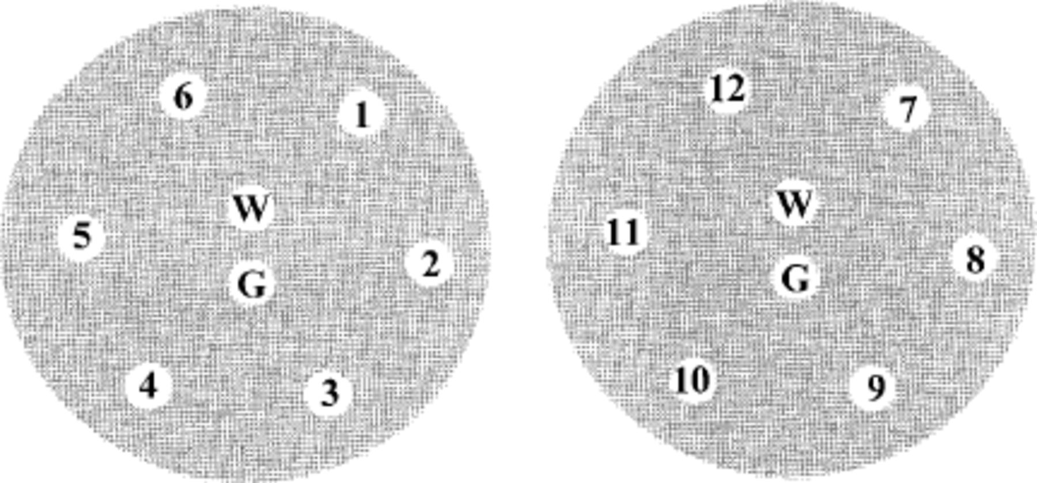
Fig. 1. Graphic representation of petri dishes inoculated with entomopathogens and distribution of treatments applied ...
Notes:
Fig. 1. Graphic representation of petri dishes inoculated with entomopathogens and distribution of treatments applied with blank paper discs. Numbers and letter represent treatments. W, distilled water; G, glyphosate; 1, RoundUp Ready-To-Use; 2, RoundUp Ultra2; 3, RoundUp Original; 4, RoundUp Original blank; 5, RoundUp Pro; 6, RoundUp Pro blank; 7, RoundUp Ultra; 8, RoundUp Ultra blank; 9, RoundUp RT; 10, RoundUp RT blank; 11, RoundUp UltraRT; 12, RoundUp UltraRT blank
Unless provided in the caption above, the following copyright applies to the content of this slide: © 2002 Entomological Society of AmericaThis is an Open Access article distributed under the terms of the Creative Commons Attribution Non-Commercial License (http://creativecommons.org/licenses/by-nc/3.0/), which permits non-commercial reuse, distribution, and reproduction in any medium, provided the original work is properly cited. For commercial re-use, please contact journals.permissions@oup.com

Slide 2
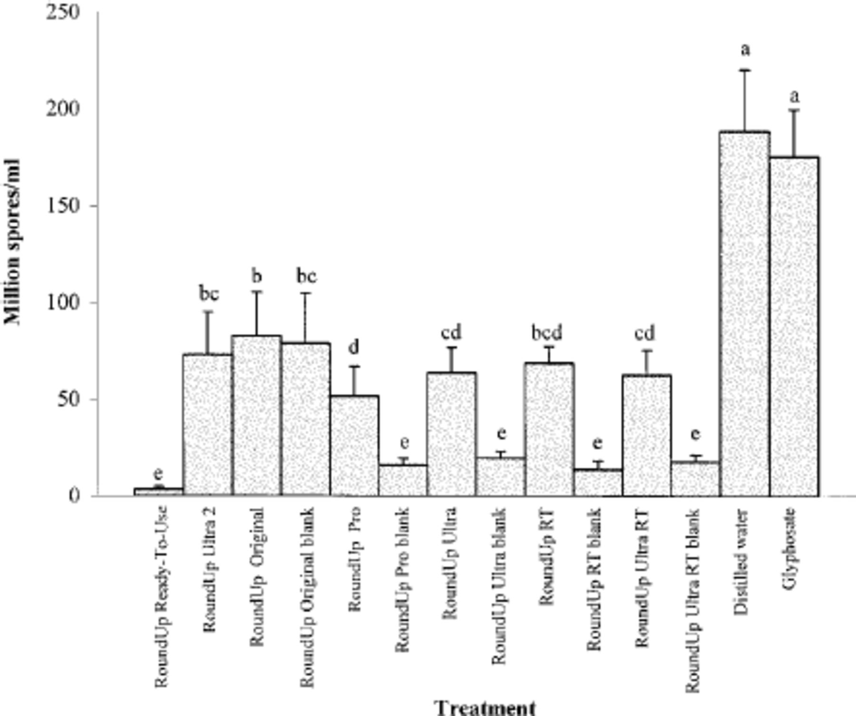
Fig. 2. Effect of different glyphosate, glyphosate formulations, and blank formulations on the in vitro growth of ...
Notes:
Fig. 2. Effect of different glyphosate, glyphosate formulations, and blank formulations on the in vitro growth of Neozygites floridana. Data are average spore concentration (spores × l06/ml; ± SD). Bars with same letters are not statistically different (P < 0.050, Fisher protected LSD test)
Unless provided in the caption above, the following copyright applies to the content of this slide: © 2002 Entomological Society of AmericaThis is an Open Access article distributed under the terms of the Creative Commons Attribution Non-Commercial License (http://creativecommons.org/licenses/by-nc/3.0/), which permits non-commercial reuse, distribution, and reproduction in any medium, provided the original work is properly cited. For commercial re-use, please contact journals.permissions@oup.com

