Slide 1
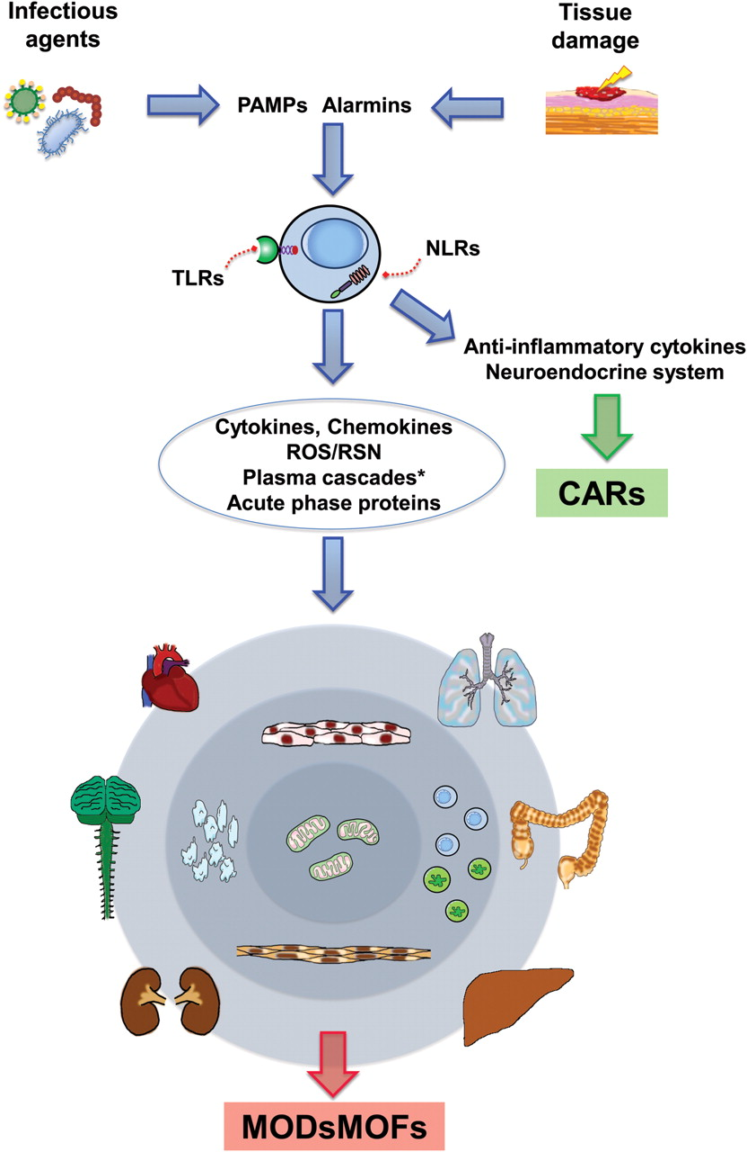
Figure 1 Schematic representation of the pathogenic mechanisms of SIRS and sepsis. PAMPs are exogenous molecules ...
Notes:
Figure 1 Schematic representation of the pathogenic mechanisms of SIRS and sepsis. PAMPs are exogenous molecules derived from microorganisms. Alarmins are endogenous molecules derived from damaged tissues. PAMPs and alarmins are inducers recognized by pattern recognition receptors which are present on both the surface (TLR) and the cytosol (NLR) of immune cells. Their activation triggers the production of inflammatory mediators and effectors which may alter the function of tissues and organs, eventually leading to MODs and MOFs which are frequently lethal. Activation of immune cells can also unleash an anti-inflammatory response characterized by the release of anti-inflammatory cytokines and activation of the neuroendocrine system. This anti-inflammatory response can eventually become prevalent, leading to CARs, characterized by immune anergy associated with a high risk of severe infections and death. *Complement system, coagulation system, fibrinolytic system, and kallicrein–kinin system; CARs, compensatory anti-inflammatory response syndrome; MODs, multiple organ dysfunction syndrome; MOFs, multiple organ failure syndrome; NLR, NOD-like receptors; PAMPs, pathogen-associated molecular patterns; RNS, reactive nitrogen species; ROS, reactive oxygen species; SIRS, systemic inflammatory response syndrome; TLR, Toll-like receptors.
Unless provided in the caption above, the following copyright applies to the content of this slide: Published on behalf of the European Society of Cardiology. All rights reserved. © The Author 2012. For permissions please email: journals.permissions@oup.com

