Slide 1
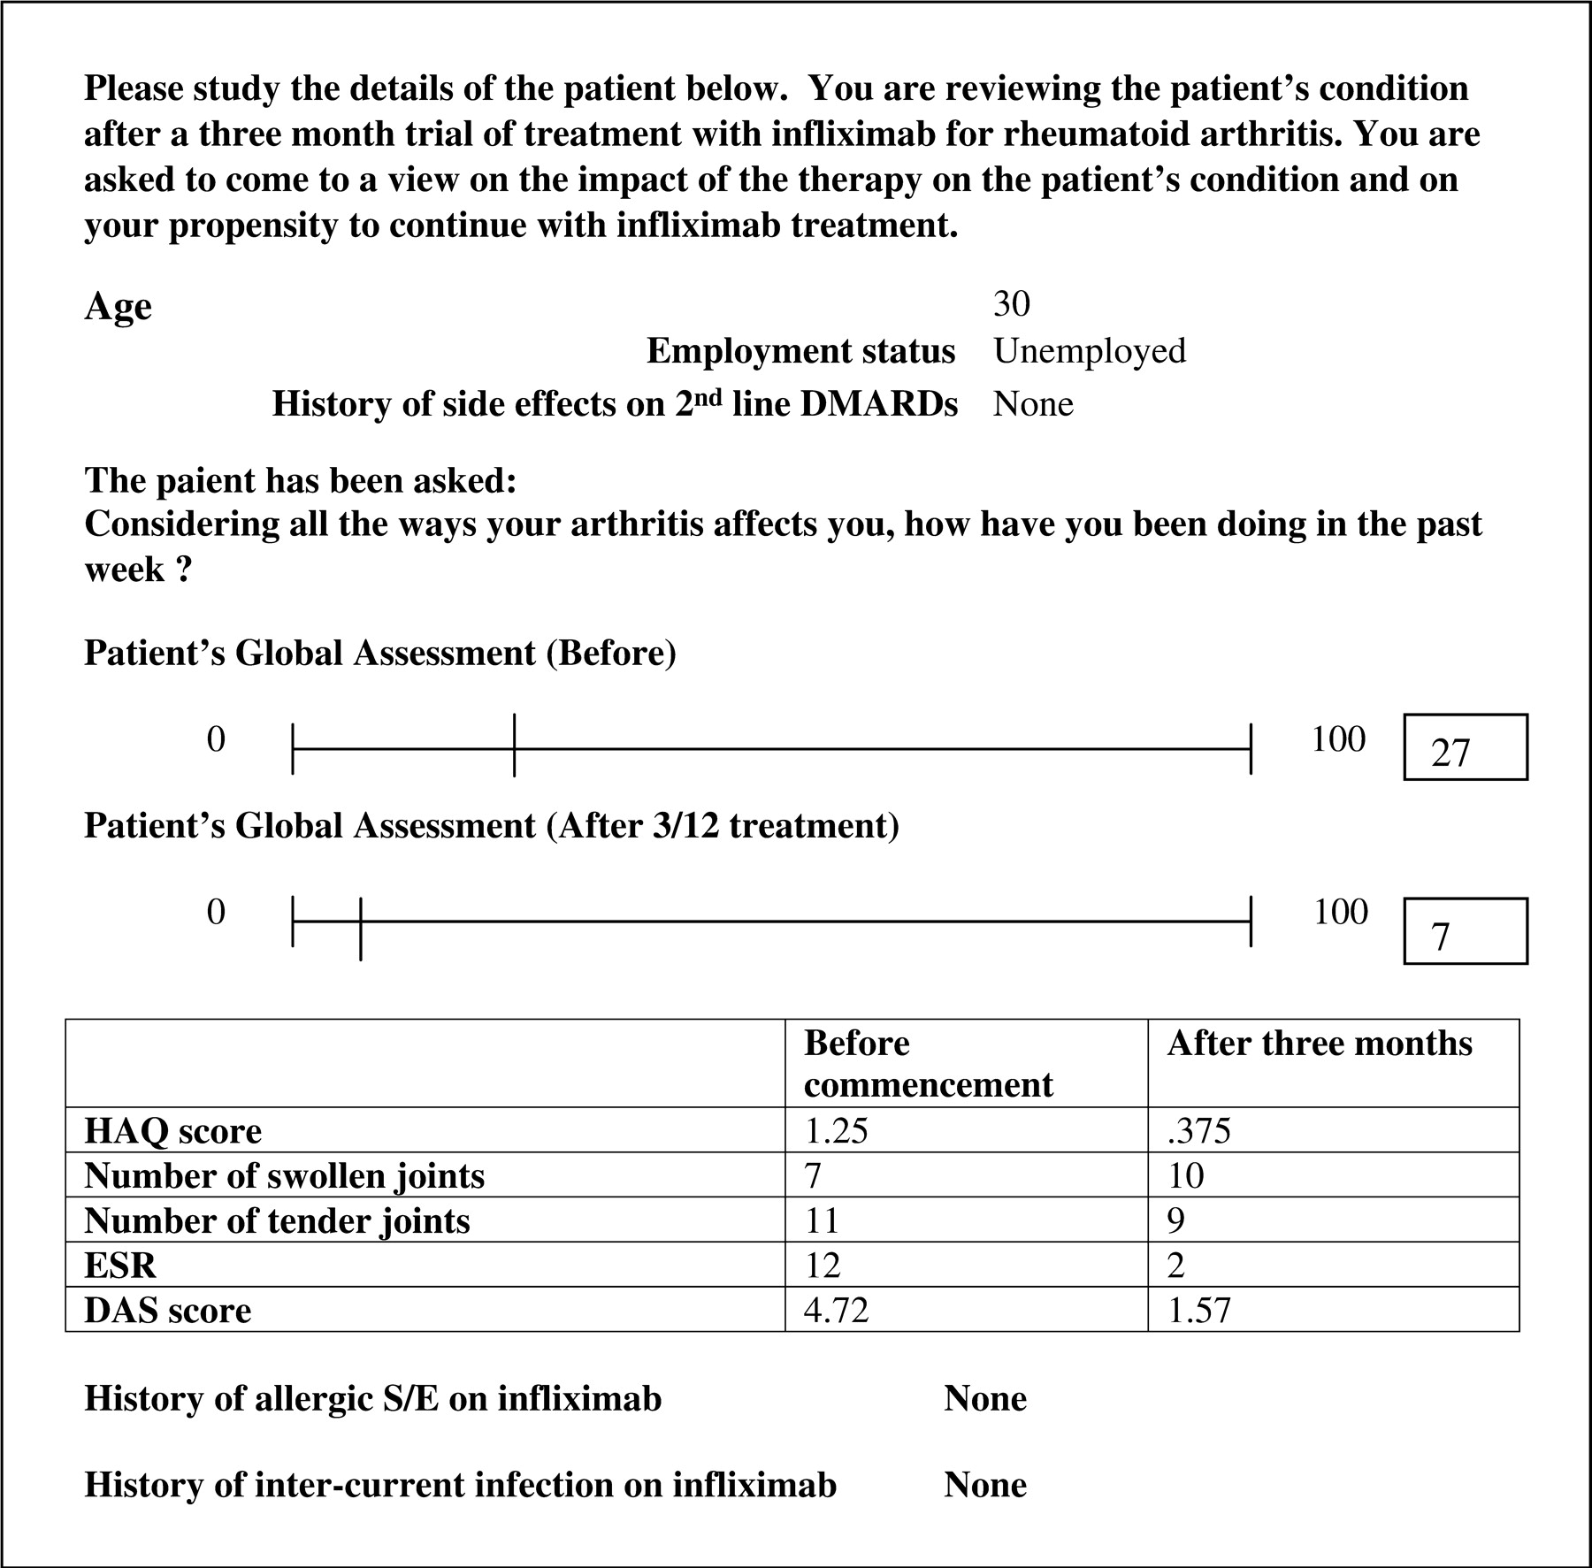
Fig. 1. Demographic and clinical information of the one patient, judgments on whom disclosed significant differences ...
Notes:
Fig. 1. Demographic and clinical information of the one patient, judgments on whom disclosed significant differences between the consultants in the two locations.
Unless provided in the caption above, the following copyright applies to the content of this slide: © The Author 2005. Published by Oxford University Press on behalf of the British Society for Rheumatology. All rights reserved. For Permissions, please email: journals.permissions@oxfordjournals.org

Slide 2
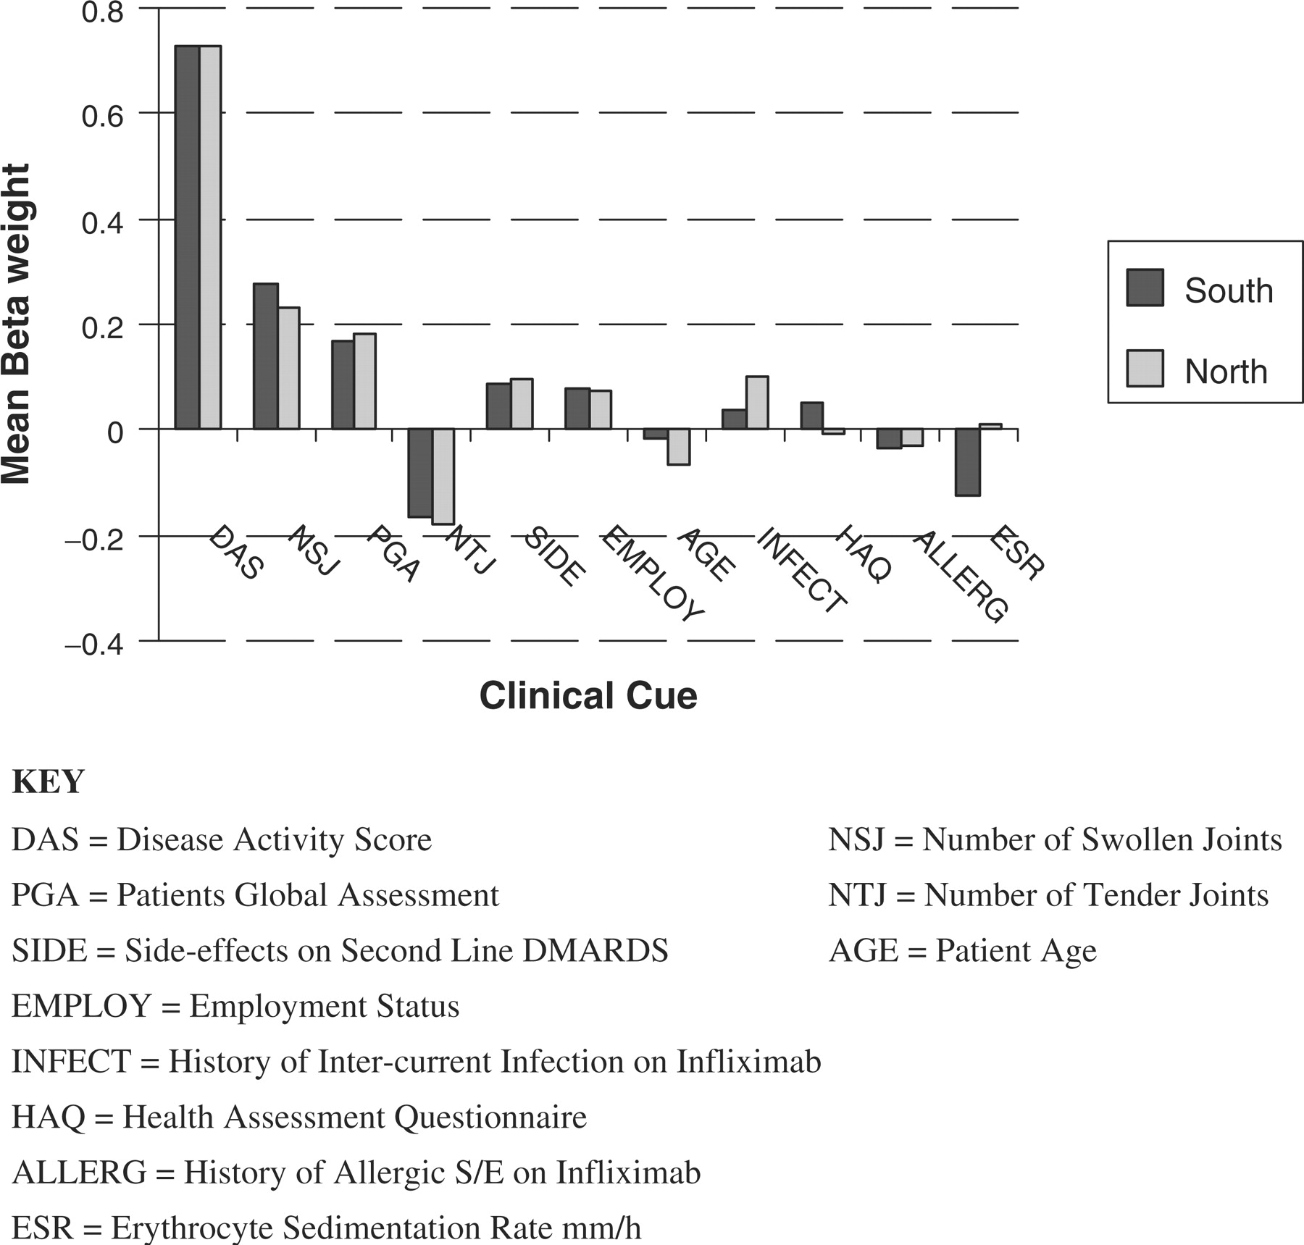
Fig. 2. Mean influence (β-weight) of each cue on the change judgement for both groups of consultants.
Notes:
Fig. 2. Mean influence (β-weight) of each cue on the change judgement for both groups of consultants.
Unless provided in the caption above, the following copyright applies to the content of this slide: © The Author 2005. Published by Oxford University Press on behalf of the British Society for Rheumatology. All rights reserved. For Permissions, please email: journals.permissions@oxfordjournals.org

