Slide 1
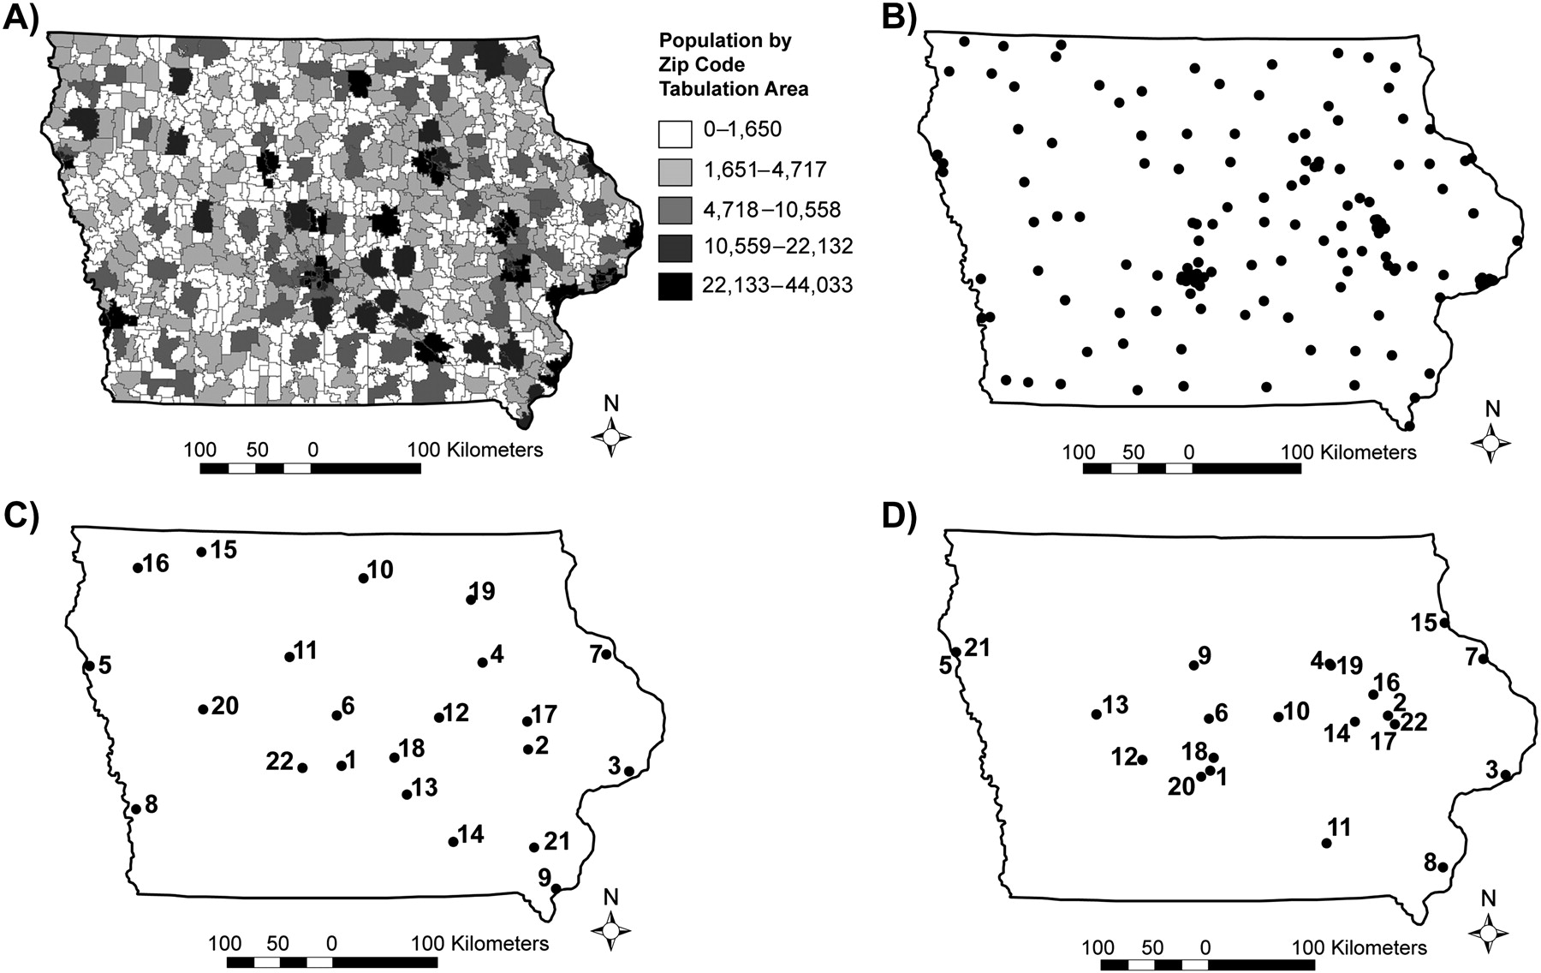
Figure 1. A) The population distribution for the state of Iowa. B) The 143 different possible locations for ...
Notes:
Figure 1. A) The population distribution for the state of Iowa. B) The 143 different possible locations for influenza-like illness sentinel sites. C) The 22 influenza-like illness sentinel locations (based on the 143 sentinel locations) chosen by the authors’ maximal coverage model. The numbers represent the order in which the sites were chosen by the model. D) The 22 Iowa Department of Public Health influenza-like illness sentinel locations for the 2006–2007 influenza season. The numbers represent the order in which the existing sites should have been chosen to maximize coverage.
Unless provided in the caption above, the following copyright applies to the content of this slide: American Journal of Epidemiology © The Author 2009. Published by Oxford University Press on behalf of the Johns Hopkins Bloomberg School of Public Health. All rights reserved. For permissions, please e-mail: journals.permissions@oxfordjournals.org.

Slide 2
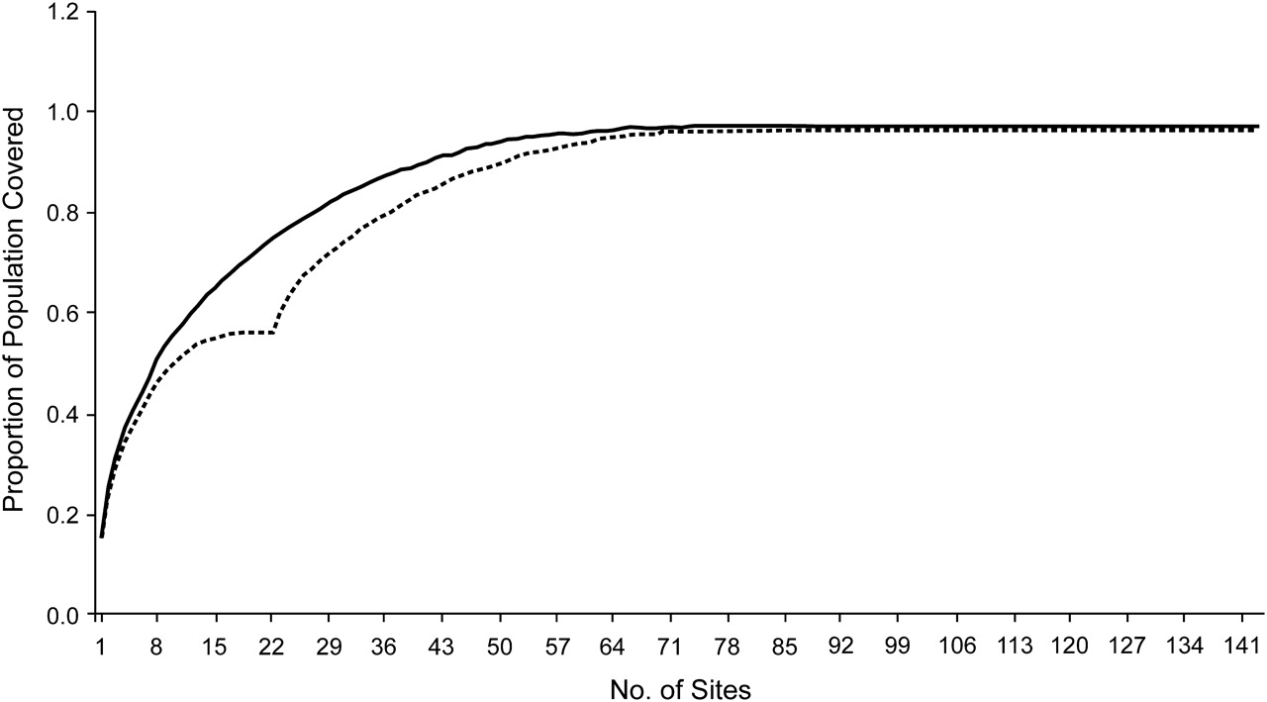
Figure 2. Population coverage (proportion) as a function of additional hospital surveillance units for a fixed, ...
Notes:
Figure 2. Population coverage (proportion) as a function of additional hospital surveillance units for a fixed, prespecified distance of 20 miles (32.2 km). The upper, solid curve represents the proportion of population coverage as each new surveillance site is added if the sites are selected de novo; the lower, dashed curve represents the proportion of population coverage when new surveillance sites are added incrementally to the 22 original 2006–2007 Iowa Department of Public Health–influenza-like illness surveillance locations.
Unless provided in the caption above, the following copyright applies to the content of this slide: American Journal of Epidemiology © The Author 2009. Published by Oxford University Press on behalf of the Johns Hopkins Bloomberg School of Public Health. All rights reserved. For permissions, please e-mail: journals.permissions@oxfordjournals.org.

Slide 3
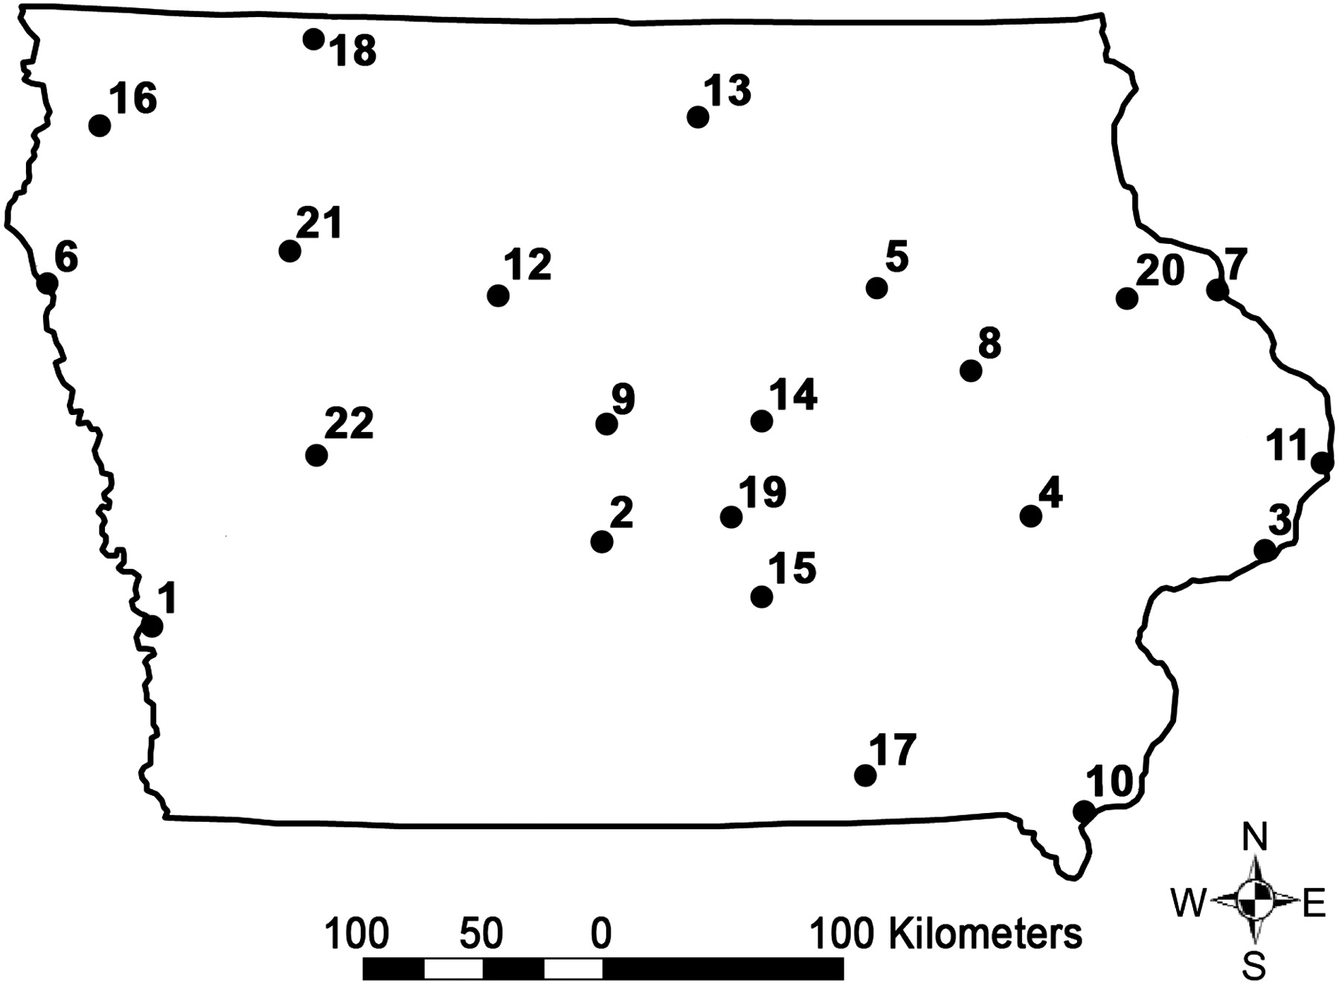
Figure 3. The 22 Iowa influenza-like illness sentinel locations chosen by the maximal coverage model when considering ...
Notes:
Figure 3. The 22 Iowa influenza-like illness sentinel locations chosen by the maximal coverage model when considering the border population in neighboring states. Numbers correspond to the selection order.
Unless provided in the caption above, the following copyright applies to the content of this slide: American Journal of Epidemiology © The Author 2009. Published by Oxford University Press on behalf of the Johns Hopkins Bloomberg School of Public Health. All rights reserved. For permissions, please e-mail: journals.permissions@oxfordjournals.org.

Slide 4
Figure 4. Population coverage (proportion) as a function of additional health care provider surveillance units, for a ...
Notes:
Figure 4. Population coverage (proportion) as a function of additional health care provider surveillance units, for a fixed, prespecified distance of 20 miles (32.2 km), considering the population adjacent to Iowa's border. The upper, solid curve represents the proportion of population coverage as each new surveillance site is added if the sites are selected by the algorithm; the lower, dashed curve represents the proportion of population coverage starting from the 22 currently selected surveillance sites.
Unless provided in the caption above, the following copyright applies to the content of this slide: American Journal of Epidemiology © The Author 2009. Published by Oxford University Press on behalf of the Johns Hopkins Bloomberg School of Public Health. All rights reserved. For permissions, please e-mail: journals.permissions@oxfordjournals.org.

