Slide 1
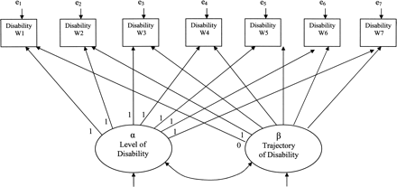
Figure 1. Conceptual latent growth model of disability over 7 years: North Carolina Established Populations for the ...
Notes:
Figure 1. Conceptual latent growth model of disability over 7 years: North Carolina Established Populations for the Epidemiologic Studies of the Elderly, 1986–1992. The latent construct for the level has fixed paths to each measure of disability: the value of 1 for the path to disability at each wave. The latent construct for the slope has fixed paths for the first two measures of disability, 0 and 1, respectively, to set the metric of the slope (McArdle & Hamagami, 1991). Each subsequent disability measure is fixed to a consecutively higher number (2, 3, etc.) to estimate the linear slope
Unless provided in the caption above, the following copyright applies to the content of this slide: The Gerontological Society of America

