Slide 1
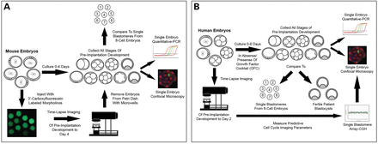
Figure 1. Experimental design of mouse and human embryo experiments in this study. (A) Non-injected mouse zygotes were ...
Notes:
Figure 1. Experimental design of mouse and human embryo experiments in this study. (A) Non-injected mouse zygotes were cultured up to 4 days and all stages of pre-implantation development were collected for single-embryo Q-PCR or confocal microscopy. Similar Q-PCR analysis was also performed on single blastomeres from eight-cell mouse embryos on Day 3. Functional analysis of a particular epigenetic regulator was accomplished by microinjecting with 3′-carboxyfluorescein-labeled morpholinos and embryo development monitored by time-lapse imaging for comparison to non-injected embryos by Q-PCR and confocal microscopy. (B) Similar human embryo experiments were performed in the absence or presence of a growth factor cocktail (GFC) up to 6 days of culture with additional Q-PCR comparison to fertile patient blastocysts and functional assessment of human embryonic development via previously identified cell cycle parameters predictive of blastocyst formation and aneuploidy generation. The chromosomal status of single human blastomeres was evaluated by array-comparative genomic hybridization (A-CGH) for correlation to single blastomere gene expression results from the same embryo or by whole embryo confocal microscopy of micronuclei formation.
Unless provided in the caption above, the following copyright applies to the content of this slide: © The Author 2014. Published by Oxford University Press.This is an Open Access article distributed under the terms of the Creative Commons Attribution Non-Commercial License (http://creativecommons.org/licenses/by-nc/4.0/), which permits non-commercial re-use, distribution, and reproduction in any medium, provided the original work is properly cited. For commercial re-use, please contact journals.permissions@oup.com

Slide 2
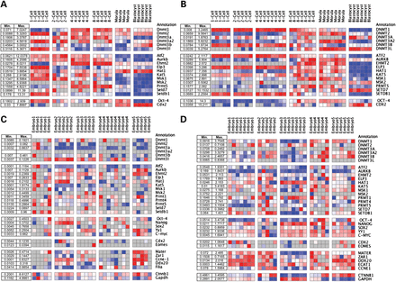
Figure 2. Epigenetic regulator expression in single mouse and human embryos and blastomeres. The expression of DNA ...
Notes:
Figure 2. Epigenetic regulator expression in single mouse and human embryos and blastomeres. The expression of DNA methyltransferases (DNMTs), histone-modifying enzymes, OCT-4 and CDX2 was analyzed in (A) mouse and (B) human embryos throughout pre-implantation development by microfluidic Q-PCR. Cycle threshold (Ct) values were normalized to the most stable housekeeping genes and graphed for comparison between the two species. Similar Q-PCR analysis of DNMTs, histone-modifying enzymes and maternal effect, zygotic activation, pluripotency and housekeeping genes as well as cell lineage markers in individual blastomeres from Day 3 (C) mouse and (D) human embryos performed at approximately the eight-cell stage. Grey squares indicate no expression, whereas blue, white and red squares correspond to low, medium and high expression, respectively. The range of expression levels for each gene is as shown on the left with the minimum (Min.) and maximum (Max.) values. The graphs of non-normalized values are shown in Supplementary Data.
Unless provided in the caption above, the following copyright applies to the content of this slide: © The Author 2014. Published by Oxford University Press.This is an Open Access article distributed under the terms of the Creative Commons Attribution Non-Commercial License (http://creativecommons.org/licenses/by-nc/4.0/), which permits non-commercial re-use, distribution, and reproduction in any medium, provided the original work is properly cited. For commercial re-use, please contact journals.permissions@oup.com

Slide 3
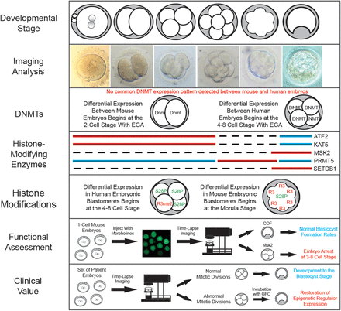
Figure 7. Summary model of epigenetic regulation during pre-implantation development. Embryonic development was ...
Notes:
Figure 7. Summary model of epigenetic regulation during pre-implantation development. Embryonic development was monitored in both mouse and human embryos by imaging analysis from the zygote to the blastocyst stage. While no common DNMT expression pattern was detected, we did observe similar gene expression profiles for ATF2, KAT5, MSK2, PRMT5 and SETDB1 between mouse and human embryos, which was determined to be due, in part, to differences in expression at the single-cell level and coincided with the timing of EGA in each species. We also observed differences in the sub-compartmentalization of particular histone modifications between blastomeres in the same embryo of the two species; in humans, this occurred at the four- to eight-cell stages, while mice exhibited differential blastomere expression beginning at the morula stage. The function of the histone-modifying enzyme, Msk2, was further assessed by morpholino technologies and determined to induce micronuclei formation, embryo arrest and eventual blastomere lysis at the three- to eight-cell stages. Correlations to human embryonic development were made by observing low MSK2 expression in human embryos with aneuploidy, micronuclei and aberrant mitotic divisions. Based on the restoration of epigenetic regulator expression in infertile patient embryos incubated with a growth factor cocktail (GFC), we also suggest the clinical value of GFC addition to those embryos with abnormal cell cycle parameters subjected to prolonged culture.
Unless provided in the caption above, the following copyright applies to the content of this slide: © The Author 2014. Published by Oxford University Press.This is an Open Access article distributed under the terms of the Creative Commons Attribution Non-Commercial License (http://creativecommons.org/licenses/by-nc/4.0/), which permits non-commercial re-use, distribution, and reproduction in any medium, provided the original work is properly cited. For commercial re-use, please contact journals.permissions@oup.com

Slide 4
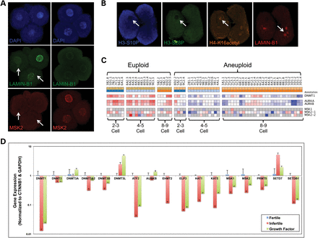
Figure 6. Association between mitosis, aneuploidy and the expression of epigenetic regulators in human embryos. (A) ...
Notes:
Figure 6. Association between mitosis, aneuploidy and the expression of epigenetic regulators in human embryos. (A) Human zygotes were cultured until the four-cell stage and previously identified cell cycle parameters predictive of blastocyst formation and ploidy status were measured by time-lapse image analysis. Embryos with abnormal parameter timing and micronuclei exhibited low MSK2 expression, whereas high MSK2 expression was observed in embryos with intact primary nuclei and normal parameter timing as quantified in Supplementary Data. (B) A lack of both H3-S10P and H3-S28P, two of the histone modifications that MSK2 mediates, was also observed in embryos with micronuclei in contrast to elevated H4-K16acetyl, which has been shown to be involved in DNA repair and apoptosis. (C) Gene expression analysis of cleavage-stage human embryos determined to be euploid or aneuploid by A-CGH as shown in Supplementary Data. Note the high levels of expression of both MSK2 isoforms, DNMT1, AURKA and AURKB, but not MSK1 in euploid embryos (n = 13) compared with aneuploid embryos (n = 20). Grey squares indicate no expression, whereas blue, white and red squares correspond to low, medium and high expression, respectively. (D) Comparison of DNMT and histone-modifying enzyme expression in fertile, infertile and GFC-treated blastocysts (n = 6–8 embryos from each group) by Q-PCR demonstrates that growth factor supplementation can partially restore the expression of epigenetic regulators to levels observed in embryos from fertile patients and beginning at the eight-cell stage of development as demonstrated in Supplementary Data.
Unless provided in the caption above, the following copyright applies to the content of this slide: © The Author 2014. Published by Oxford University Press.This is an Open Access article distributed under the terms of the Creative Commons Attribution Non-Commercial License (http://creativecommons.org/licenses/by-nc/4.0/), which permits non-commercial re-use, distribution, and reproduction in any medium, provided the original work is properly cited. For commercial re-use, please contact journals.permissions@oup.com

Slide 5
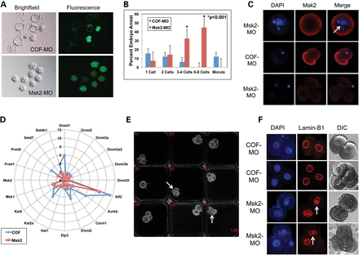
Figure 5. Msk2 knockdown induces mitotic arrest and is associated with aneuploidy generation. (A) Brighfield imaging ...
Notes:
Figure 5. Msk2 knockdown induces mitotic arrest and is associated with aneuploidy generation. (A) Brighfield imaging and fluorescent microscopy of 3′-carboxyfluorescein-labeled standard control morpholino (COF-MO) and Msk2 morpholino (Msk2 MO)-injected mouse embryos demonstrates that the Msk2 MO-mediated embryonic arrest occurs at the cleavage stage. (B) A closer examination of each developmental stage reveals a significant increase (P < 0.001) in Msk2 MO-induced arrest at the three- to eight-cell stages. (C) Confocal microscopy of Msk2 expression in DAPI stained embryos shows that the embryo arrest that occurred at the one-cell stage following Msk2 MO injection is due to other reasons such as polyploidy (indicated by white arrow) and that reduced Msk2 expression is observed in Msk2 MO compared with COF-MO-injected embryos. (D) Gene expression analysis of DNMTs and histone-modifying enzymes in COF-MO and Msk2 MO-injected embryos demonstrates that Msk2 knockdown has effects on other known mitotic regulators. (E) The last frame of an image sequence compiled into a time-lapse movie (Supplementary Data), which shows increased blastomere movement and eventual lysis resembling mitotic catastrophe in some Msk2 MO-injected embryos. (F) Lamin-B1-encapsulated micronuclei are observed in Msk2 MO, but not COF-MO-injected embryos stained with DAPI and imaged by DIC (n = 10 embryos from each group), suggesting that mouse embryos may avoid chromosomal instability by inducing cell lysis.
Unless provided in the caption above, the following copyright applies to the content of this slide: © The Author 2014. Published by Oxford University Press.This is an Open Access article distributed under the terms of the Creative Commons Attribution Non-Commercial License (http://creativecommons.org/licenses/by-nc/4.0/), which permits non-commercial re-use, distribution, and reproduction in any medium, provided the original work is properly cited. For commercial re-use, please contact journals.permissions@oup.com

Slide 6
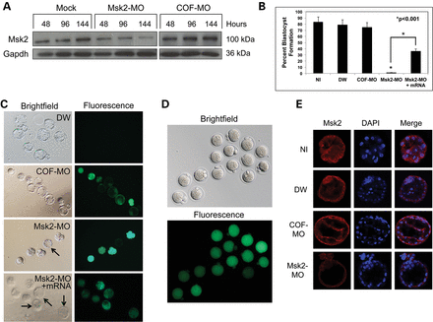
Figure 4. Knockdown of Msk2 expression reduces blastocyst formation rates. (A) The efficiency of Msk2 knockdown was ...
Notes:
Figure 4. Knockdown of Msk2 expression reduces blastocyst formation rates. (A) The efficiency of Msk2 knockdown was first assessed by nucleofecting undifferentiated E8.5 mEG cells with water (mock), Msk2 morpholino (Msk2 MO) or 3′-carboxyfluorescein-labeled standard control morpholino (COF-MO) and Msk2 expression (100 kDa) evaluated using Gapdh (36 kDa) as a loading control by western blot analysis 48–144 h later. (B) Blastocyst formation rates were calculated for non-injected (NI; n = 73) as well as water (DW; n = 19), COF-MO (n = 71) and Msk2 MO (n = 73) injected mouse embryos. Graphic representation of the percentages for each experimental group, including the percent blastocyst formation following the co-injection of Msk2 MO and Msk2 mRNA (Msk2 MO + mRNA; n = 33) in embryos is as shown and corresponds to Table 1. (C) Brightfield imaging and fluorescent microscopy of embryos in each group from one representative experiment. Note the single blastocyst observed following injection with the Msk2 MO (indicated by black arrow), (D) which may be explained by the amount of morpholino injected as revealed by slight differences in fluorescent intensities at the zygote stage. (E) Reduced Msk2 expression was detected in the single Msk2 MO-injected blastocyst obtained in comparison with the other experimental groups.
Unless provided in the caption above, the following copyright applies to the content of this slide: © The Author 2014. Published by Oxford University Press.This is an Open Access article distributed under the terms of the Creative Commons Attribution Non-Commercial License (http://creativecommons.org/licenses/by-nc/4.0/), which permits non-commercial re-use, distribution, and reproduction in any medium, provided the original work is properly cited. For commercial re-use, please contact journals.permissions@oup.com

Slide 7
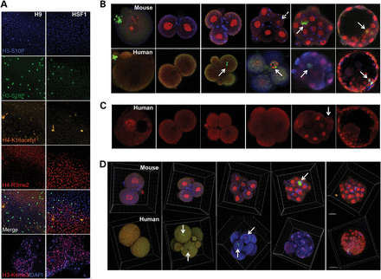
Figure 3. Multi-channel confocal analysis of histone modifications in mouse and human embryos. (A) Undifferentiated ...
Notes:
Figure 3. Multi-channel confocal analysis of histone modifications in mouse and human embryos. (A) Undifferentiated hESC lines (H9; XX and HSF1; XY) were immunostained with several different histone modification antibodies and Histone H3-S10P (blue), H3-S28P (green), H4-K16acetyl (orange) and H4-R3me2 (red) were chosen for further analysis based on their expression pattern. Since histone H4-R3me2 has been shown to be associated with both transcriptional activation and repression, the undifferentiated hESCs were also incubated with a primary antibody for Histone H3-K4me3 (red), a transcriptionally active mark, and DAPI (blue). Both H3-S10P and DAPI required the use of the blue confocal channel and, therefore, could not be analyzed simultaneously. (B) The expression and localization of histone H3-S10P, H3-S28P, H4-K16acetyl and H4-R3me2 was then analyzed in mouse and human embryos throughout pre-implantation development by multi-channel confocal microscopy (n = 6–8 embryos per stage). Note the difference in developmental stage when different histone modification sub-compartmentalization begins between mouse and human blastomeres in the same embryo (indicated by white solid arrows), although some differences in the expression level of the same histone mark such as H4-R3me2 is still observed in mouse embryos (shown by white-dashed arrows). (C) Similar confocal analysis of histone H3-K4me3 in human embryos exhibiting positive expression in one of the pronuclei at the zygote stage as well as certain blastomeres beginning at the eight-cell stage. (D) 3-D modeling of histone modifications in mouse and human embryos from the two-cell to blastocyst stage by Z-stack confocal microscopy demonstrating further evidence of differences in the timing of first sub-compartmentalization between the two species. Note that individual human blastomeres simultaneously expressed either completely different histone modification marks such as H3-S28P and H4-R3me2 or were entirely devoid of histone modification expression observed in other blastomeres within the same embryo at the four- to eight-cell stage (indicated by white solid arrows). The immunostaining controls and single-channel confocal analysis are shown in Supplementary Data, respectively; scale bar for mouse = 20 µm and for human = 50 µm.
Unless provided in the caption above, the following copyright applies to the content of this slide: © The Author 2014. Published by Oxford University Press.This is an Open Access article distributed under the terms of the Creative Commons Attribution Non-Commercial License (http://creativecommons.org/licenses/by-nc/4.0/), which permits non-commercial re-use, distribution, and reproduction in any medium, provided the original work is properly cited. For commercial re-use, please contact journals.permissions@oup.com

