Slide 1
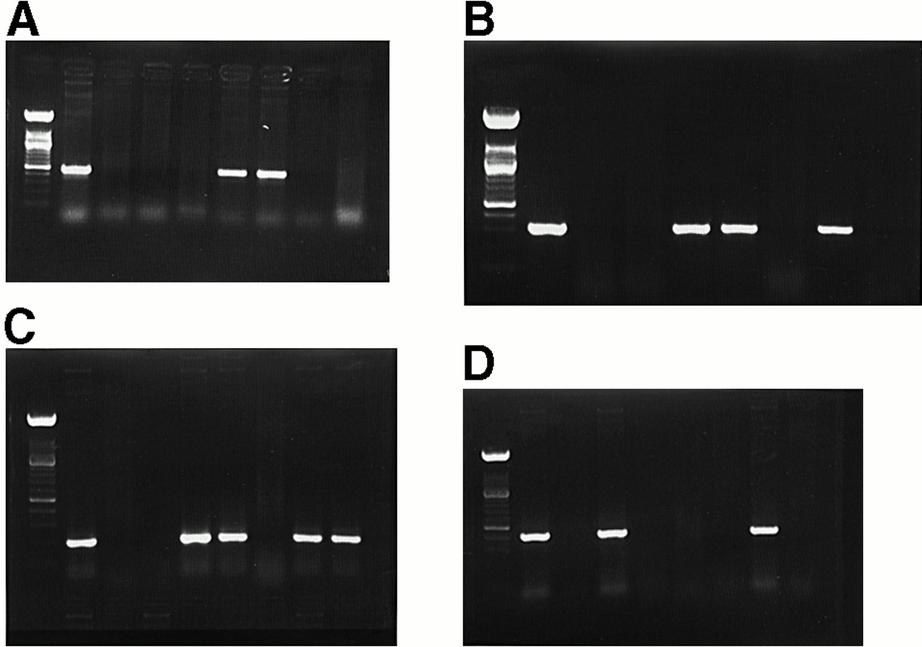
Fig. 1. Results of HPV PCR on esophageal epithelium. (A) PCR amplification of HPV L1 in human esophageal epithelium ...
Notes:
Fig. 1. Results of HPV PCR on esophageal epithelium. (A) PCR amplification of HPV L1 in human esophageal epithelium samples. Lane 1, DNA marker (100 bp DNA ladder, GIBCO BRL); lane 2, positive control (HeLa cell DNA); lane 3, negative control (without template); lanes 6 and 7, positive samples; lanes 4, 5, 8 and 9, negative samples. (B) PCR amplification of HPV-16 E6 in human esophageal epithelium samples. Lane 1, DNA markers (100 bp DNA ladder); lane 2, positive control [HPV-16 positive esophageal carcinoma (13)]; lane 3, negative control (without template); lane 5, 6 and 8, positive samples; lanes 4, 7 and 9, negative samples. (C) PCR amplification of HPV-16 E7 in human esophageal epithelium samples. Lane 1, DNA markers (100 bp DNA ladder); lane 2, positive control [HPV-16 positive esophageal carcinoma (13)]; lane 3, negative control (without template); lanes 5, 6, 8 and 9, positive samples; lanes 4 and 7, negative samples. (D) PCR amplification of HPV-18 E6 in human esophageal epithelium samples. Lane 1, DNA markers (100 bp DNA ladder); lane 2, positive control (HeLa cell DNA); lane 3, negative control (without template); lanes 4 and 8, positive samples; lanes 5, 6, 7 and 9, negative samples.
Unless provided in the caption above, the following copyright applies to the content of this slide: © Oxford University Press

Slide 2
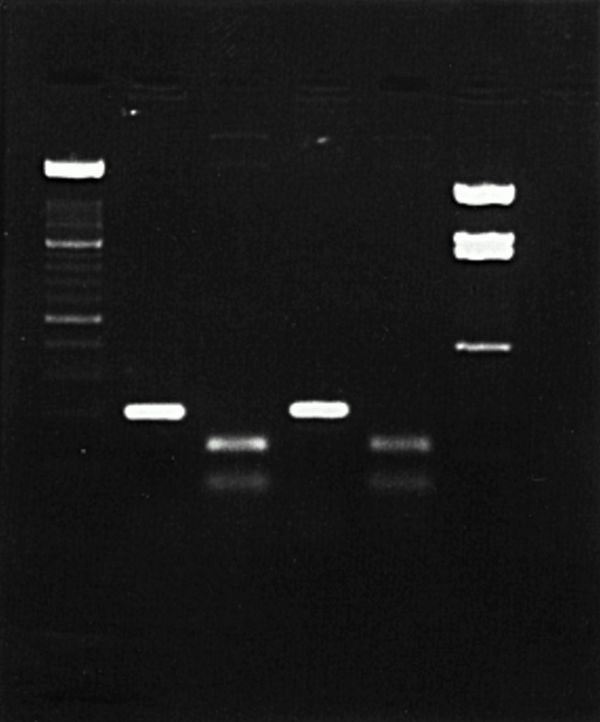
Fig. 2. AccI digestion of HPV-16 E7 PCR products. Lane 1, DNA markers (100 bp DNA ladder); lanes 2 and 3, positive ...
Notes:
Fig. 2. AccI digestion of HPV-16 E7 PCR products. Lane 1, DNA markers (100 bp DNA ladder); lanes 2 and 3, positive control, uncut and cut; lanes 4 and 5, positive sample, uncut and cut; lane 6, DNA markers (PBR322/BSTNI, Biolabs).
Unless provided in the caption above, the following copyright applies to the content of this slide: © Oxford University Press

Slide 3
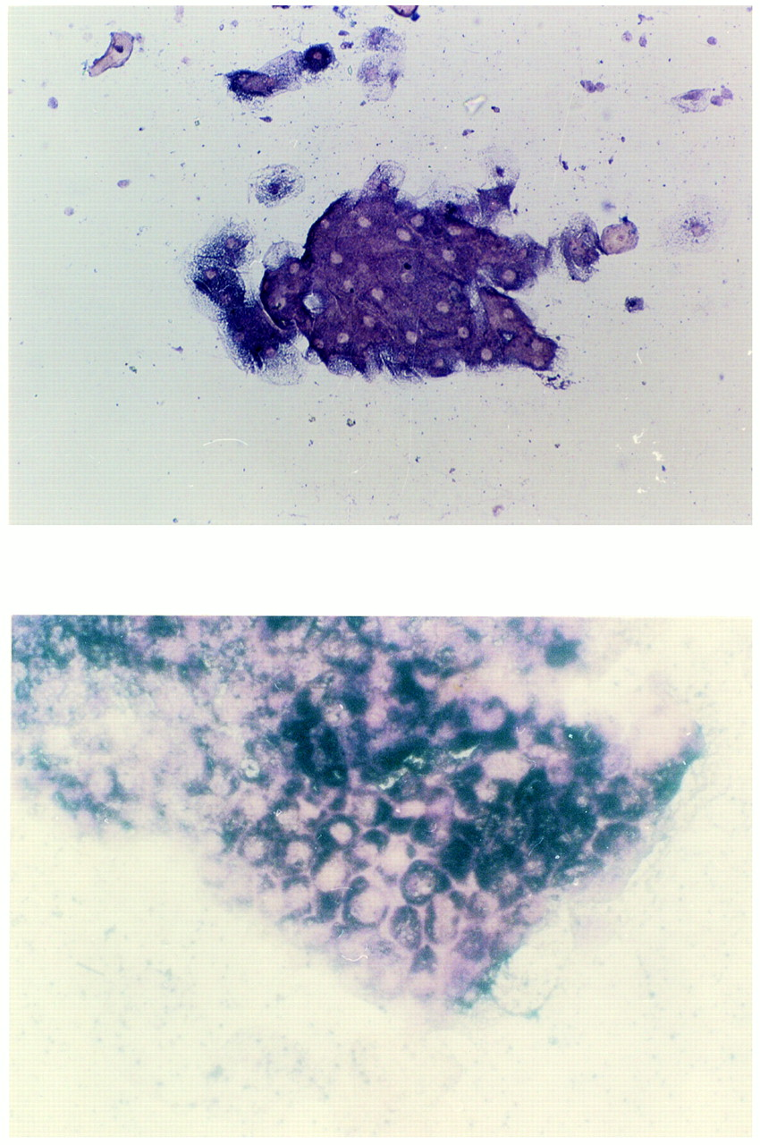
Fig. 3. (A) ISH positive of HPV-16 E6 mRNA in one of the samples of morphologically normal human esophageal ...
Notes:
Fig. 3. (A) ISH positive of HPV-16 E6 mRNA in one of the samples of morphologically normal human esophageal epithelium. The positive signal is located in the cytoplasm. Magnification, 200×. (B) ISH positive of HPV-16 E6 mRNA in a sample with mild dyspasia. The positive signal is located in the cytoplasm. Magnification, 200×.
Unless provided in the caption above, the following copyright applies to the content of this slide: © Oxford University Press

