Slide 1
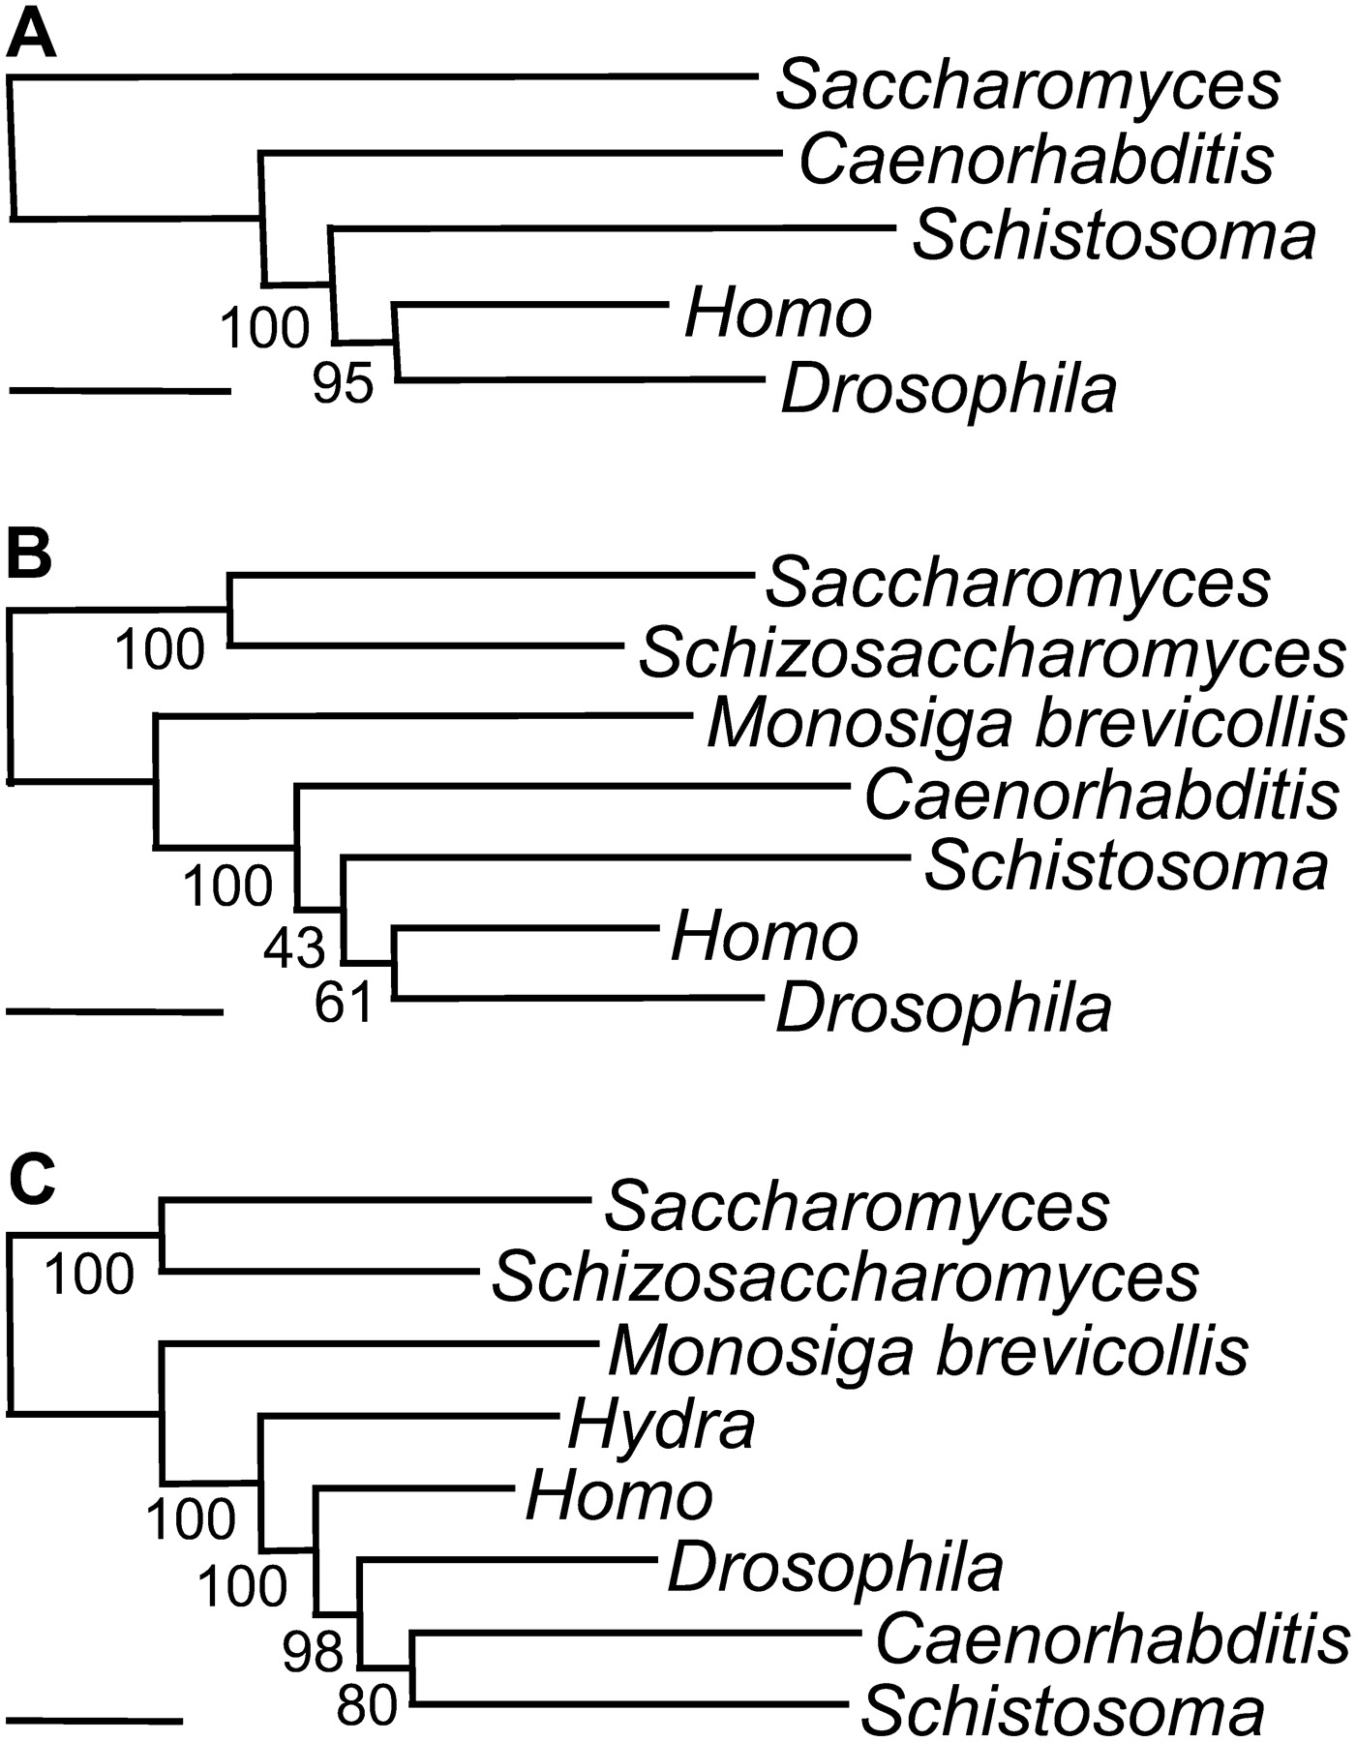
FIG. 1.— LBA and the effect of the out-group. Trees were inferred with an ML method using a separate WAG + F + Γ ...
Notes:
FIG. 1.— LBA and the effect of the out-group. Trees were inferred with an ML method using a separate WAG + F + Γ model. The in-group species remain identical, and the out-group is (A) a distantly related yeast, (B) two yeasts and a more closely related choanoflagellate, Monosiga, or (C) two yeasts, a choanoflagellate, and a very closely related cnidarian, Hydra. The early emergence of nematodes (Caenorhabditis) and platyhelminths (Schistosoma) is due to an LBA artifact that disappears when a close out-group is used. BVs are indicated to the left of each node. The scale bar represents 0.1 substitutions per site for a unit branch length.
Unless provided in the caption above, the following copyright applies to the content of this slide: Published by Oxford University Press 2005.

Slide 2
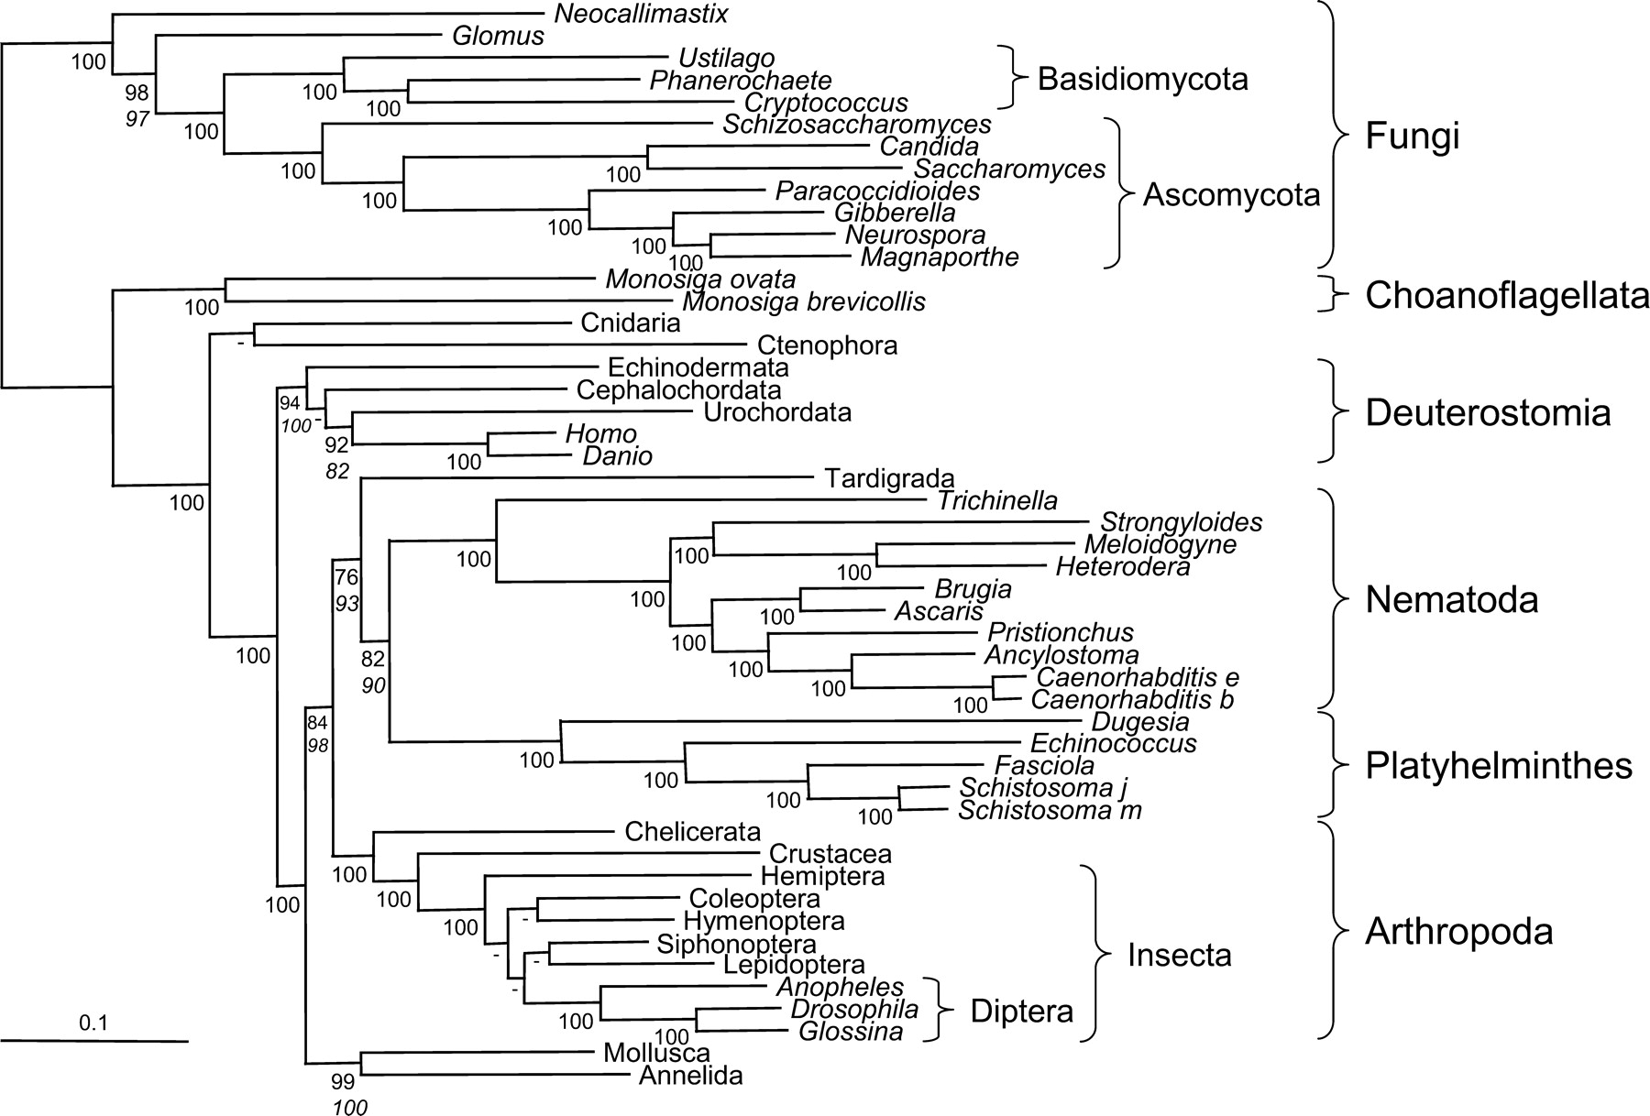
FIG. 2.— Tree based on 146 genes (35,371 amino acid positions). Trees were inferred with an ML method. The same ...
Notes:
FIG. 2.— Tree based on 146 genes (35,371 amino acid positions). Trees were inferred with an ML method. The same topology (except for a few not supported nodes) was obtained using either a separate WAG + F + Γ model or a concatenated JTT + F + Γ model. The values indicated correspond to bootstrap support values of the separate (upper) or concatenated (lower, in italic) models. When both are equal to 100%, only the first one is indicated, and when at least one is below 75%, the node is indicated by a hyphen.
Unless provided in the caption above, the following copyright applies to the content of this slide: Published by Oxford University Press 2005.

Slide 3
FIG. 3.— Evolutionary rates, gene removal, and the new animal phylogeny. For each of the 146 genes, the ratio of the ...
Notes:
FIG. 3.— Evolutionary rates, gene removal, and the new animal phylogeny. For each of the 146 genes, the ratio of the mean evolutionary rate in nematodes and platyhelminths to the mean evolutionary rate in annelids, molluscs, and deuterostomes is displayed (A). A ratio higher than one indicates that nematodes and platyhelminths evolve faster than annelids, molluscs, and deuterostomes. Only 14 genes have a ratio below one. Genes with the highest ratio are removed five at a time, and the evolution of BVs for the four nodes of interest is monitored (B). The monophyly of Protostomia is used to indicate when gene removal leads to a significant decrease in the phylogenetic signal.
Unless provided in the caption above, the following copyright applies to the content of this slide: Published by Oxford University Press 2005.

Slide 4
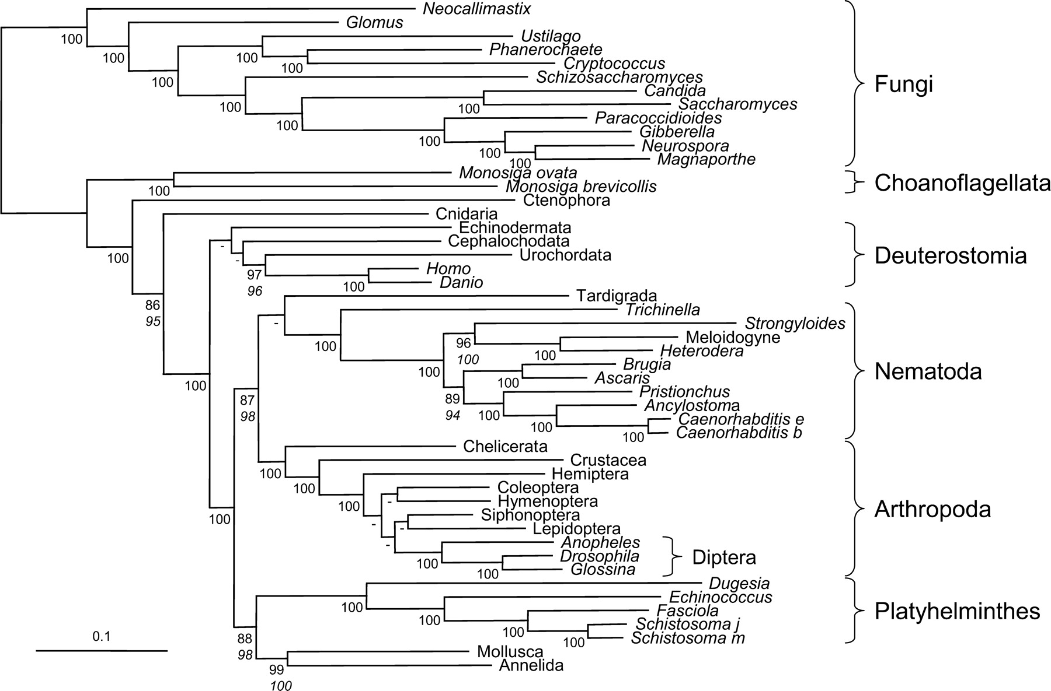
FIG. 4.— ML tree inferred from the separate analysis of 71 genes that evolve slowly in nematodes and platyhelminths ...
Notes:
FIG. 4.— ML tree inferred from the separate analysis of 71 genes that evolve slowly in nematodes and platyhelminths (20,705 amino acid positions). For phylogenetic methods, see legend of figure 2. It should be noted that the use of slowly evolving genes alone is not sufficient to overcome the LBA artifact. If the same taxon sampling as in figure 1A and B was used, nematodes and platyhelminths still artifactually emerged at the base of the Bilateria (fig. S6, Supplementary Material online). The monophyly of Ecdysozoa was only recovered when the cnidarian sequence was used as an out-group, however, with a weak support (fig. S6C, Supplementary Material online). A reduced support, when only a few species were used (51% instead of 87% here), demonstrates the important effect of a large species sampling. The support for grouping nematodes and tardigrades to the exclusion of arthropods decreased from 76% to 65% when the fast-evolving nematode genes were removed. This suggests that this weakly supported grouping (instead of the expected sister-group relationship of arthropods and tardigrades) is rather the result of an LBA artifact, in agreement with the very long branches of these two groups. In fact, the monophyly of Ecdysozoa could be the result of an LBA artifact because arthropods, nematodes, and tardigrades were all fast evolving. To test this hypothesis, only the slowest evolving arthropod (chelicerate) was retained. Even in this case, the fast-evolving nematodes still clustered with arthropods (fig. S7, Supplementary Material online) with high support. Therefore, the monophyly of Ecdysozoa is most likely correct, albeit LBA could potentially increase its support (Siddall 1998).
Unless provided in the caption above, the following copyright applies to the content of this slide: Published by Oxford University Press 2005.

