Slide 1
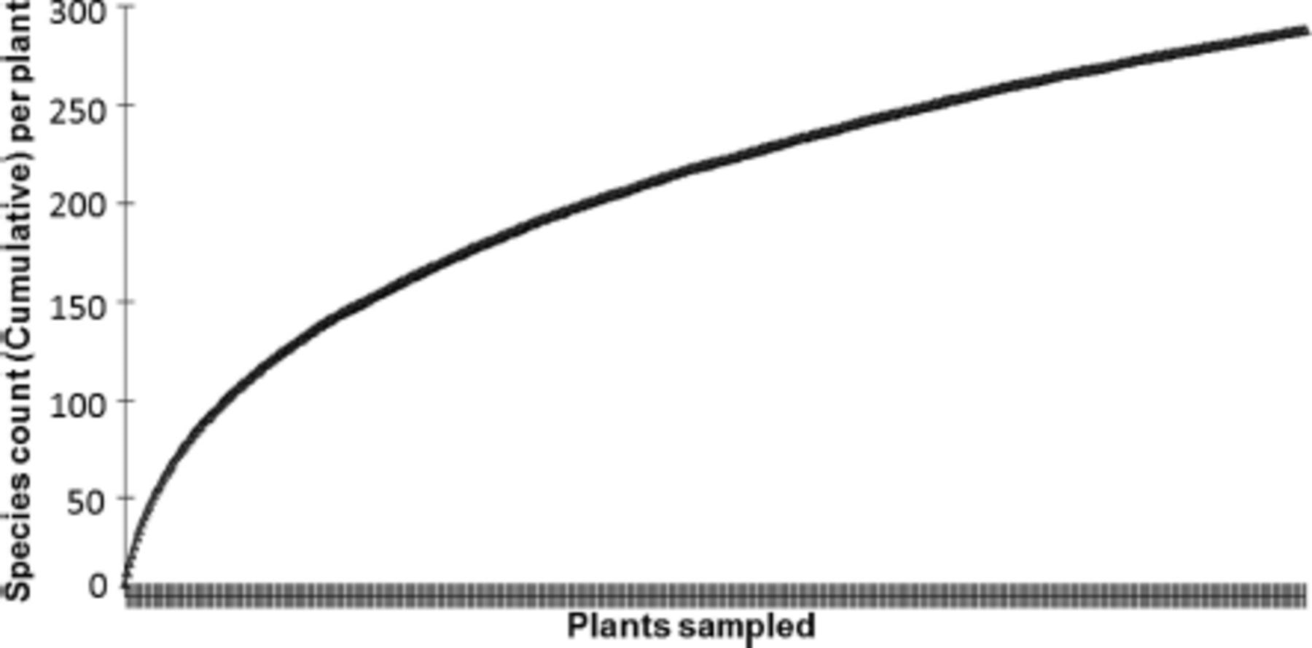
Fig. 1. Species accumulation curve of arthropods collected on 480 Bt maize and non-Bt maize plants during two growing ...
Notes:
Fig. 1. Species accumulation curve of arthropods collected on 480 Bt maize and non-Bt maize plants during two growing seasons at two localities.
Unless provided in the caption above, the following copyright applies to the content of this slide: © 2014 Entomological Society of America

