Slide 1
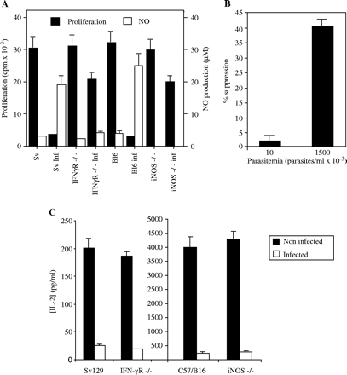
Fig. 1. NO- and IFN-γ-independent immunosuppression in T. cruzi-infected mice. iNOS^{−/−} and ...
Notes:
Fig. 1. NO- and IFN-γ-independent immunosuppression in T. cruzi-infected mice. iNOS−/− and IFNγR−/− mice as well as their littermate controls, C57BL6 and Sv129, were intraperitoneally infected, or not, with T. cruzi parasites as described in the Methods. At the peak of parasitemia (14 days post infection), SC were obtained and cultured with ConA. (A) Proliferation was measured as [3H]thymidine incorporation after 72 h of stimulation, and NO production was measured by the Griess reaction. (B) Immunosuppression in iNOS−/− mice is related to parasitemia. Uninfected and 14-days-infected iNOS−/− mice were sacrificed and SC proliferation was measured in response to Con A. Parasitemia levels were measured as the number of parasites/ml in blood. (C) IL-2 production by SC from infected mice. After 24 h stimulation of SC, supernatants were collected and IL-2 concentration was determined by ELISA. Results are the means ±SD of three different experiments, with three mice per group in each one. All values in presence of AgC10 were significantly different from untreated controls (P < 0.001).
Unless provided in the caption above, the following copyright applies to the content of this slide: © 2004 The Japanese Society for Immunology

Slide 2
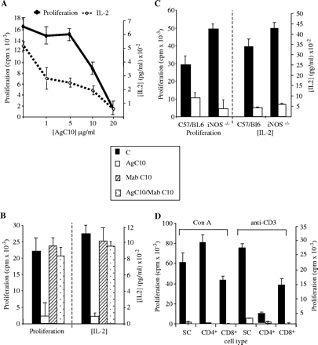
Fig. 2. AgC10 inhibits SC proliferation and IL-2 production. (A) Sv129 mice SC were stimulated with 5 μg/ml of Con A ...
Notes:
Fig. 2. AgC10 inhibits SC proliferation and IL-2 production. (A) Sv129 mice SC were stimulated with 5 μg/ml of Con A for 72 h, in the presence or absence of increasing concentrations of AgC10 (1, 5, 10 and 20 μg/ml). After 24 h stimulation of SC, supernatants were collected and IL-2 concentration was determined by ELISA. Proliferation was measured 72 h after stimulation as [3H]thymidine incorporation. All IL-2 values in presence of AgC10 were significantly different from controls (P < 0.001). In contrast, only proliferation values in presence of AgC10 10 μg/ml or higher were significantly different from controls (P < 0.001). (B) Neutralization of AgC10 inhibitory activity by MAb C10. SC were stimulated as above in the presence of AgC10 (10 μg/ml), Mab C10 (20 μg/ml) or both, and proliferation and IL-2 production was measured as above. Only values in presence of AgC10 but not Mab C10 or AgC10 plus Mab C10 were significantly different from untreated controls (P < 0.001). (C) C57/BL6 as well as iNOS−/− mice were stimulated in the same conditions as (A), in the presence or absence of 20 μg/ml AgC10, and proliferation and IL-2 production were measured as explained in (A). Results are the means ±SD of triplicate cultures of three different experiments. (D) Sv129 mice SC, or purified CD4+ and CD8+ T lymphocytes from the spleen were stimulated as in (A) in the presence or absence of AgC10 (20 μg/ml) and proliferation was measured as in (A). Contamination with remaining non CD4+ or CD8+ respective cells after isolation from SC was <2%. All values in presence of AgC10 were different from untreated controls (P < 0.001).
Unless provided in the caption above, the following copyright applies to the content of this slide: © 2004 The Japanese Society for Immunology

Slide 3
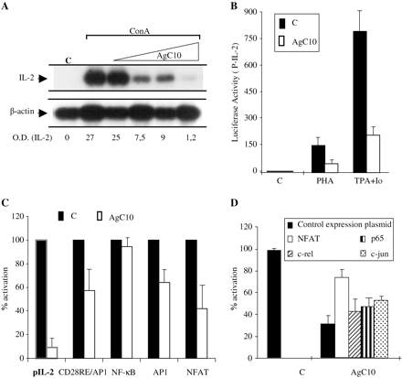
Fig. 3. AgC10 inhibits IL-2 transcription. (A) C57BL6 SC were stimulated for 48 h with 5 μg/ml of Con A in the ...
Notes:
Fig. 3. AgC10 inhibits IL-2 transcription. (A) C57BL6 SC were stimulated for 48 h with 5 μg/ml of Con A in the presence or absence of growing concentrations of AgC10 (1, 5, 10 and 20 μg/ml), except the unstimulated controls (C). After stimulation, RNA was isolated and 20 μg were electrophoresed in agarose gel, transferred to a nylon membrane and hybridized with IL-2 and β-actin probes. Numeric values indicate the relative absorbance of the specific RNA bands. A representative experiment of the three performed is shown. (B and C) Jurkat cells were transiently transfected with 0.5 μg of IL-2 promoter or multimerized CD28RE/AP1, NF-κB, AP1 or NFAT promoters coupled to luciferase reporter gene. Once transfected, cells were stimulated with 15 ng/ml of TPA plus 1 μM of calcium ionophore (B and C) or with PHA 2 mM (B), and treated with 15 μg/ml of AgC10 where indicated for 16 h. Cells were lysed and luciferase activity was quantified and normalized by measuring protein concentration in each sample. Data is represented as the mean ±SD of three different experiments. The P-values were: pIL-2 (P < 0.001); CD28RE (P <0.01); NFAT (P < 0.001); NF-κB (n.s.); AP1 (P < 0.01). (D) Jurkat cells were co-transfected with 0.5 μg of pIL-2luc and 0.5 μg of the expression plasmids for NFAT, c-rel, p65, c-jun or its correspondent empty plasmids as controls. After stimulation with 15 ng/ml of TPA plus calcium ionophore 1 μM, in the presence or absence of 15 μg/ml of AgC10, luciferase activity was quantified and normalized as previously mentioned and represented as % of activation by TPA/Io. Only the reversion for NFAT was statistically significant (P < 0.001).
Unless provided in the caption above, the following copyright applies to the content of this slide: © 2004 The Japanese Society for Immunology

Slide 4
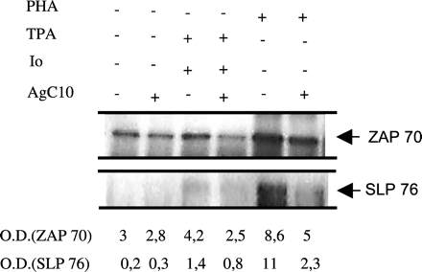
Fig. 4. Effect of AgC10 on tyrosine phosphorylation at early steps of T cell activation. Jurkat cells were stimulated ...
Notes:
Fig. 4. Effect of AgC10 on tyrosine phosphorylation at early steps of T cell activation. Jurkat cells were stimulated for 5 min with TPA (15 ng/ml) plus calcium ionophore (1 μM) or with PHA (2 mM), in the presence or absence of 20 μg/ml of AgC10 (added to the culture 45 min before stimulation). After stimulation, protein extracts were obtained and 1.5 mg were immunoprecipitated with anti-phospho-tyrosine mAb. The obtained immunocomplexes were subjected to western blotting with the appropiate antibodies (anti-ZAP70 and anti-SLP76). Numeric values indicate the relative absorbance of the specific proteins. A representative experiment of the five performed is shown.
Unless provided in the caption above, the following copyright applies to the content of this slide: © 2004 The Japanese Society for Immunology

Slide 5
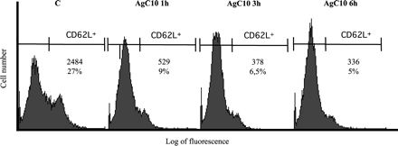
Fig. 5. AgC10 competes out binding of mAb anti-CD62L to SC. Sv129 SC were cultured with 15 μg/ml of AgC10 at 4°C for ...
Notes:
Fig. 5. AgC10 competes out binding of mAb anti-CD62L to SC. Sv129 SC were cultured with 15 μg/ml of AgC10 at 4°C for the indicated times (1, 3 and 6 h), except the control (C). After treatment, cells were centrifuged, resuspended in PBS 2% FCS, and stained with 10 μg/ml of mAb anti-CD62L coupled to fluorescein. Once stained, cells were fixed with PBS 1% paraformaldehyde and analyzed by flow cytometry. Values in each profile show percentage and percentage × fluorescence mean of positive cells. A representative experiment of the three performed is shown.
Unless provided in the caption above, the following copyright applies to the content of this slide: © 2004 The Japanese Society for Immunology

Slide 6
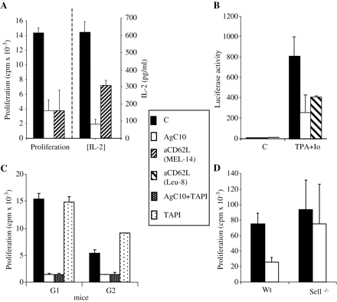
Fig. 6. Involvement of L-selectin on AgC10 inhibition of T cell activation. (A) Sv129 mice SC were stimulated with 5 ...
Notes:
Fig. 6. Involvement of L-selectin on AgC10 inhibition of T cell activation. (A) Sv129 mice SC were stimulated with 5 μg/ml of ConA for 72 h, in the presence or absence of 20 μg/ml of AgC10 or 10 μg/ml of anti-CD62L (Mel 14). Proliferation was measured as [3H]thymidine incorporation. After 24 h stimulation of SC, supernatants were collected and IL-2 concentration was determined by ELISA. Results are the means ±SD of triplicate cultures from three different experiments. (B) Jurkat cells were transiently transfected with 0.5 μg of IL-2 promoter coupled to luciferase (pIL-2luc). Once transfected, cells were stimulated with 15 ng/ml of TPA plus 1 μM of calcium ionophore, and treated with 15 μg/ml of AgC10 or 10 μg/ml of anti-human CD62L mAb Leu8 where indicated, for 16 h. AgC10 and Leu8 were added to the culture 1 h before the stimuli. Cells were then lysed and luciferase activity was quantified and normalized by measuring protein concentration in each sample. Data are represented as the mean ±SD of three different experiments. All values in presence of AgC10 (P < 0.001) or anti-CD62L antibodies (P < 0.005) were significantly different. (C) Sv129 SC were stimulated as in (A), in the presence or absence of AgC10 (20 μg/ml), alone or combined with L-selectin shedding inhibitor, TAPI-2 (50 μM). Proliferation was measured as in (A). G1 and G2 represent two different groups of three mice each. All values in presence of AgC10 were significantly different from controls (P < 0.001). Moreover, no statistically significant differences were observed in presence or absence of TAPI-2. (D) L-selectin-deficient mice (Sell−/−) or littermate control (wt) SC, were stimulated with 5 μg/ml of ConA for 72 h, in the presence or absence of 20 μg/ml of AgC10, and proliferation was measured as previously mentioned. Results are the mean of two different experiments with three mice in each group in each experiment.
Unless provided in the caption above, the following copyright applies to the content of this slide: © 2004 The Japanese Society for Immunology

