Slide 1
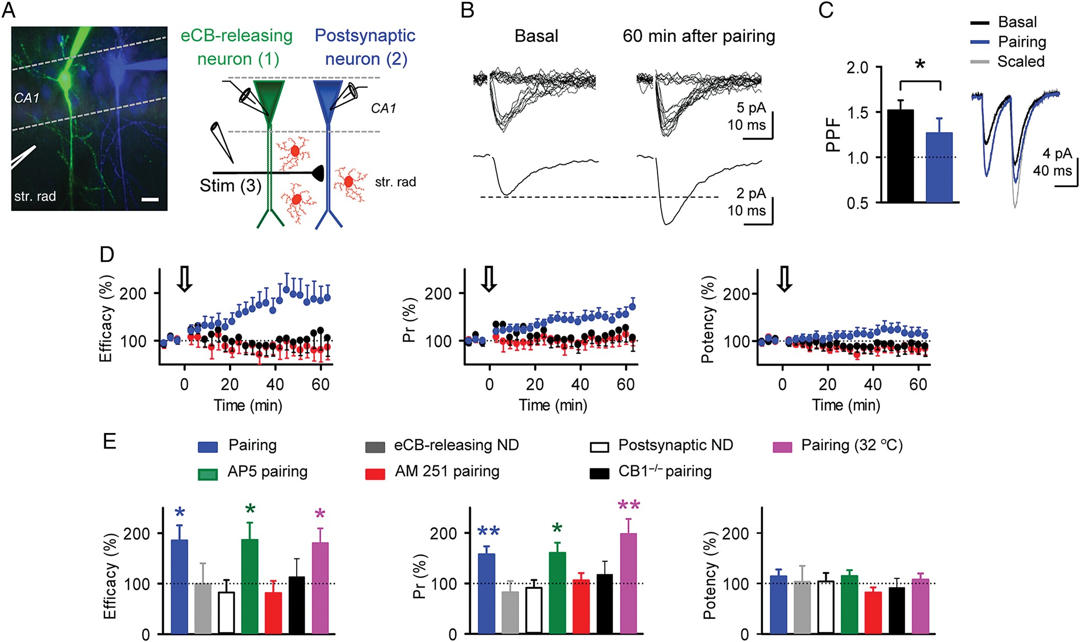
Figure 1. Endocannabinoid signaling induces LTP of transmitter release at single hippocampal synapses. (A) Left, ...
Notes:
Figure 1. Endocannabinoid signaling induces LTP of transmitter release at single hippocampal synapses. (A) Left, false-color image of 2 CA1 pyramidal neurons filled with AlexaFluor 488 (1, green) and sulforhodamine B (2, blue) through the recording pipettes, and stimulus pipette (3). Scale bar, 10 μm. Right, schematic drawing of the experimental approach depicting paired recordings and the minimal stimulating electrode. (B) Representative synaptic responses evoked by minimal stimulation showing regular EPSC amplitudes and failures of synaptic transmission (20 stimuli; top traces) and averaged EPSCs (n = 60 stimuli, including successes and failures; bottom traces) before (basal) and 60 min after pairing protocol. (C) Averaged EPSCs evoked by paired-pulse stimulation and PPF ratio before (black) and 60 min after pairing protocol (blue). Gray trace is the scaled trace of the basal EPSC. (D) Synaptic efficacy, probability of neurotransmitter release (Pr) and synaptic potency versus time after the pairing protocol in control (blue circles; n = 12), in the presence of the CB1R antagonist AM251 (2 μm; red circles; n = 5), and in slices from CB1R−/− mice (black circles; n = 6). Zero time corresponds to the beginning of neuronal depolarizations (arrow) (as in all other figures). (E) Relative changes of synaptic parameters 60 min after pairing protocol in control (n = 12), unpaired depolarization of eCB-releasing neuron (n = 8) or postsynaptic neuron (n = 6), after pairing protocol in AP5 (n = 10), after pairing protocol in AM251 (n = 5), in CB1R −/− mice (n = 6), and after pairing at 32 °C (n = 10). ND, neuronal depolarization. *P < 0.05, **P < 0.01. Data are represented as mean ± SEM (as in all other figures).
Unless provided in the caption above, the following copyright applies to the content of this slide: © The Author 2014. Published by Oxford University Press. All rights reserved. For Permissions, please e-mail: journals.permissions@oup.com

Slide 2
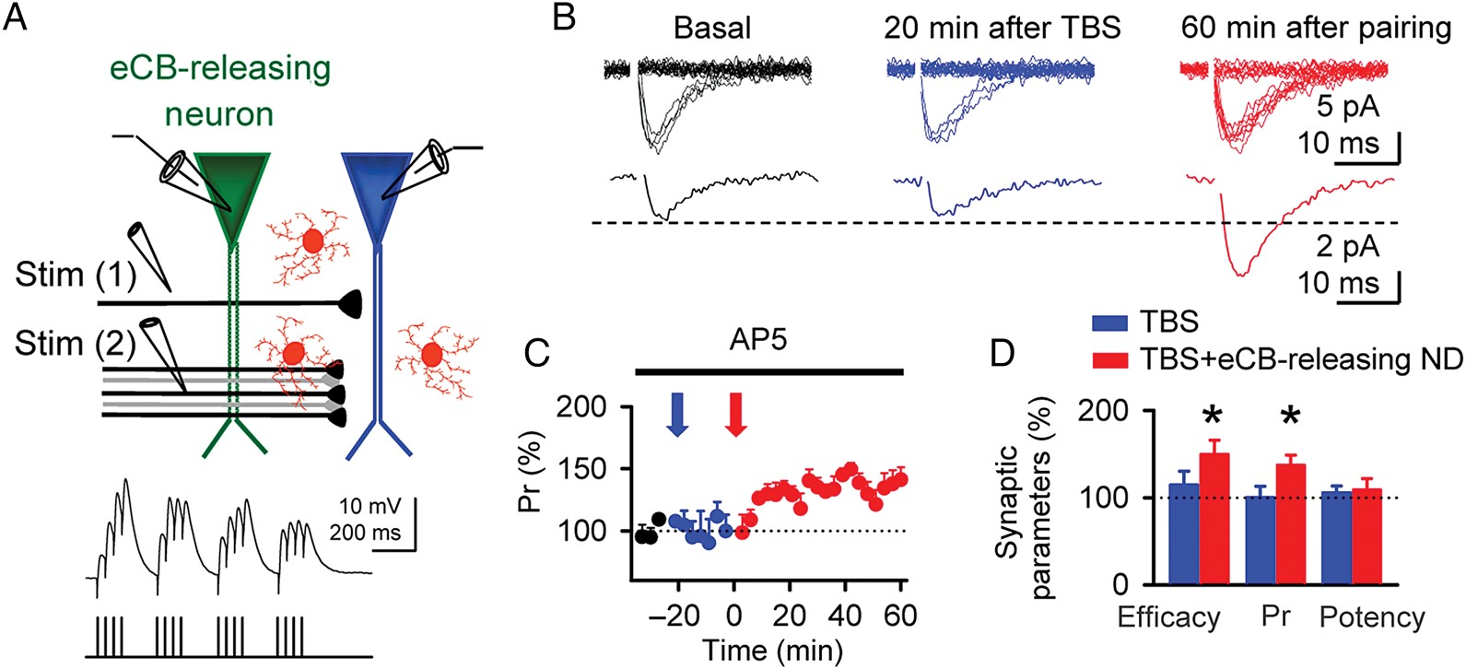
Figure 2. Pairing endocannabinoid signaling and synaptically induced postsynaptic depolarization induces LTP. (A) ...
Notes:
Figure 2. Pairing endocannabinoid signaling and synaptically induced postsynaptic depolarization induces LTP. (A) Schematic drawing of the experimental approach depicting paired recordings and the minimal (1) and TBS (2) stimulating electrodes. (B) Representative synaptic responses (20 stimuli; top traces) and averaged EPSCs (20 stimuli, including successes and failures; bottom traces) recorded from the postsynaptic neuron in basal conditions (black), 20 min after TBS alone (blue), and 60 min after pairing TBS with the depolarization of the eCB-releasing neuron (red). These experiments were performed in the presence of AP5 to prevent NMDARs-mediated plasticity evoked by TBS stimulation. (C) Relative changes of Pr in basal conditions (black circles), after TBS alone (blue), and after pairing TBS with the depolarization of the eCB-releasing neuron (red). Blue arrow indicates TBS alone and red arrow indicates pairing of TBS with the depolarization of the eCB-releasing neuron. Zero time corresponds to the beginning of the paired protocol. (D) Relative change of synaptic parameters 20 min after TBS protocol and 60 min after paired protocol (n = 6). *P < 0.05.
Unless provided in the caption above, the following copyright applies to the content of this slide: © The Author 2014. Published by Oxford University Press. All rights reserved. For Permissions, please e-mail: journals.permissions@oup.com

Slide 3
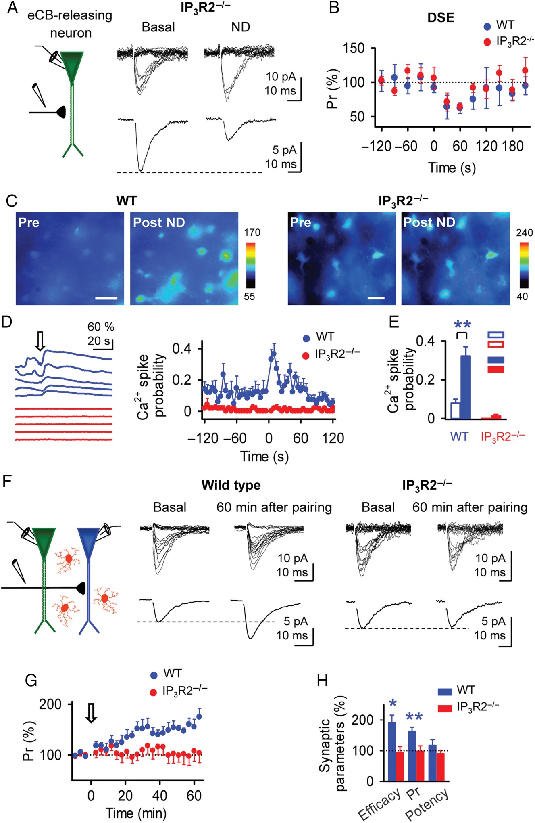
Figure 3. Endocannabinoid-induced LTP requires astrocyte Ca²⁺ signal. (A) Representative synaptic responses ...
Notes:
Figure 3. Endocannabinoid-induced LTP requires astrocyte Ca2+ signal. (A) Representative synaptic responses (20 stimuli; top traces) and averaged EPSCs (n = 20 stimuli, including successes and failures; bottom traces) recorded from the eCB-releasing neuron before (basal) and after the neuronal depolarization (ND) to 0 mV in transgenic mouse IP3R2−/−. (B) Pr versus time in wild-type (n = 6) and IP3R2−/− mice (n = 6). Note the similar depolarization-induced suppression of excitation (DSE; dots denote the average response of 30 s bins). (C) Pseudocolor images representing fluorescence intensities of fluo-4-filled astrocytes before (Pre) and after depolarizing the eCB-releasing neuron to 0 mV (Post ND) in wild-type and IP3R2−/− mice. Scale bar, 20 μm. (D) Left, representative astrocyte Ca2+ responses to depolarization of the eCB-releasing neuron from 5 astrocytes shown in C. Right, astrocyte Ca2+ spike probability versus time from wild-type and IP3R2−/− mice (74 and 55 astrocytes from n = 8 and 8 slices, respectively). (E) Astrocyte Ca2+ spike probability before (basal, open bars) and after depolarizing the eCB-releasing neuron to 0 mV in wild-type and IP3R2−/− mice (filled bars; n = 8 and 8 slices, respectively). (F) Synaptic responses (20 stimuli; top traces) and averaged EPSCs (n = 20 stimuli, including successes and failures; bottom traces) recorded from the postsynaptic neuron before (basal) and 60 min after pairing protocol in slices from wild-type and IP3R2−/− mice. (G) Pr versus time after pairing protocol in slices from wild-type (n = 7) and IP3R2−/− mice (n = 8). (H) Relative changes of synaptic parameters 60 min after pairing protocol in wild-type (n = 7) and IP3R2−/− mice (n = 8). *P < 0.05, **P < 0.01.
Unless provided in the caption above, the following copyright applies to the content of this slide: © The Author 2014. Published by Oxford University Press. All rights reserved. For Permissions, please e-mail: journals.permissions@oup.com

Slide 4
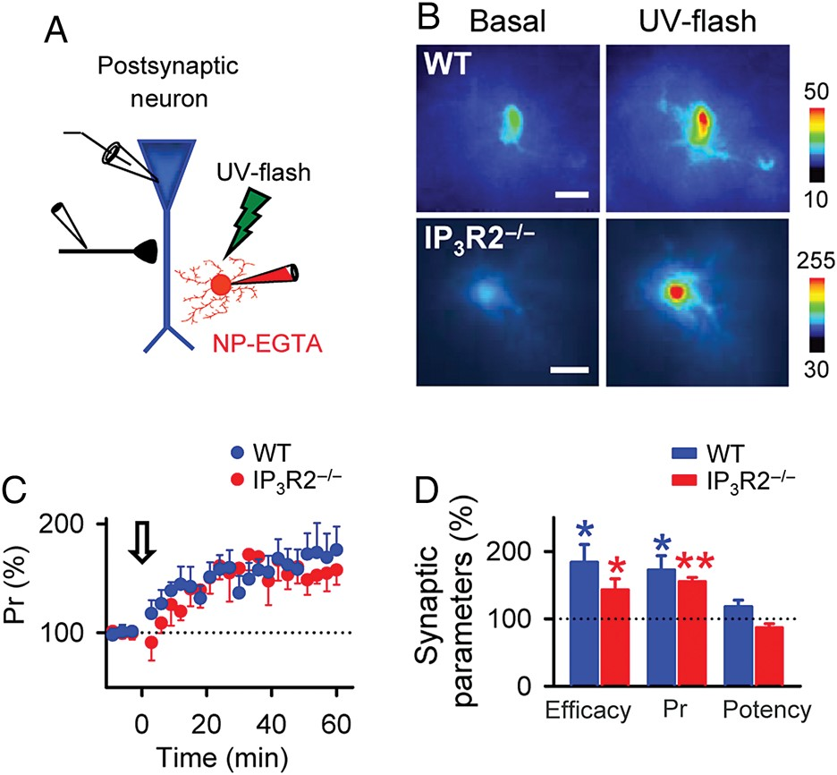
Figure 4. Pairing astrocyte stimulation and mild postsynaptic depolarization induces LTP in wild-type and ...
Notes:
Figure 4. Pairing astrocyte stimulation and mild postsynaptic depolarization induces LTP in wild-type and IP3R2−/− mice. (A) Schematic drawing depicting the recorded postsynaptic neuron and astrocyte filled with the Ca2+-cage NP-EGTA. (B) Pseudocolor images representing fluorescence intensities of fluo-4-filled astrocytes before (basal) and after UV-light stimulation in wild-type and IP3R2−/− mice. Scale bar, 10 μm. (C) Pr versus time after pairing the UV-light stimulation and the mild postsynaptic depolarization (to −30 mV) in wild-type (n = 6) and IP3R2−/− mice (n = 6). Zero time corresponds to the beginning of the paired stimuli (arrow). (D) Relative change of synaptic parameters 60 min after the paired stimuli in wild-type (n = 6) and IP3R2−/− mice (n = 6). *P < 0.05, **P < 0.01.
Unless provided in the caption above, the following copyright applies to the content of this slide: © The Author 2014. Published by Oxford University Press. All rights reserved. For Permissions, please e-mail: journals.permissions@oup.com

Slide 5
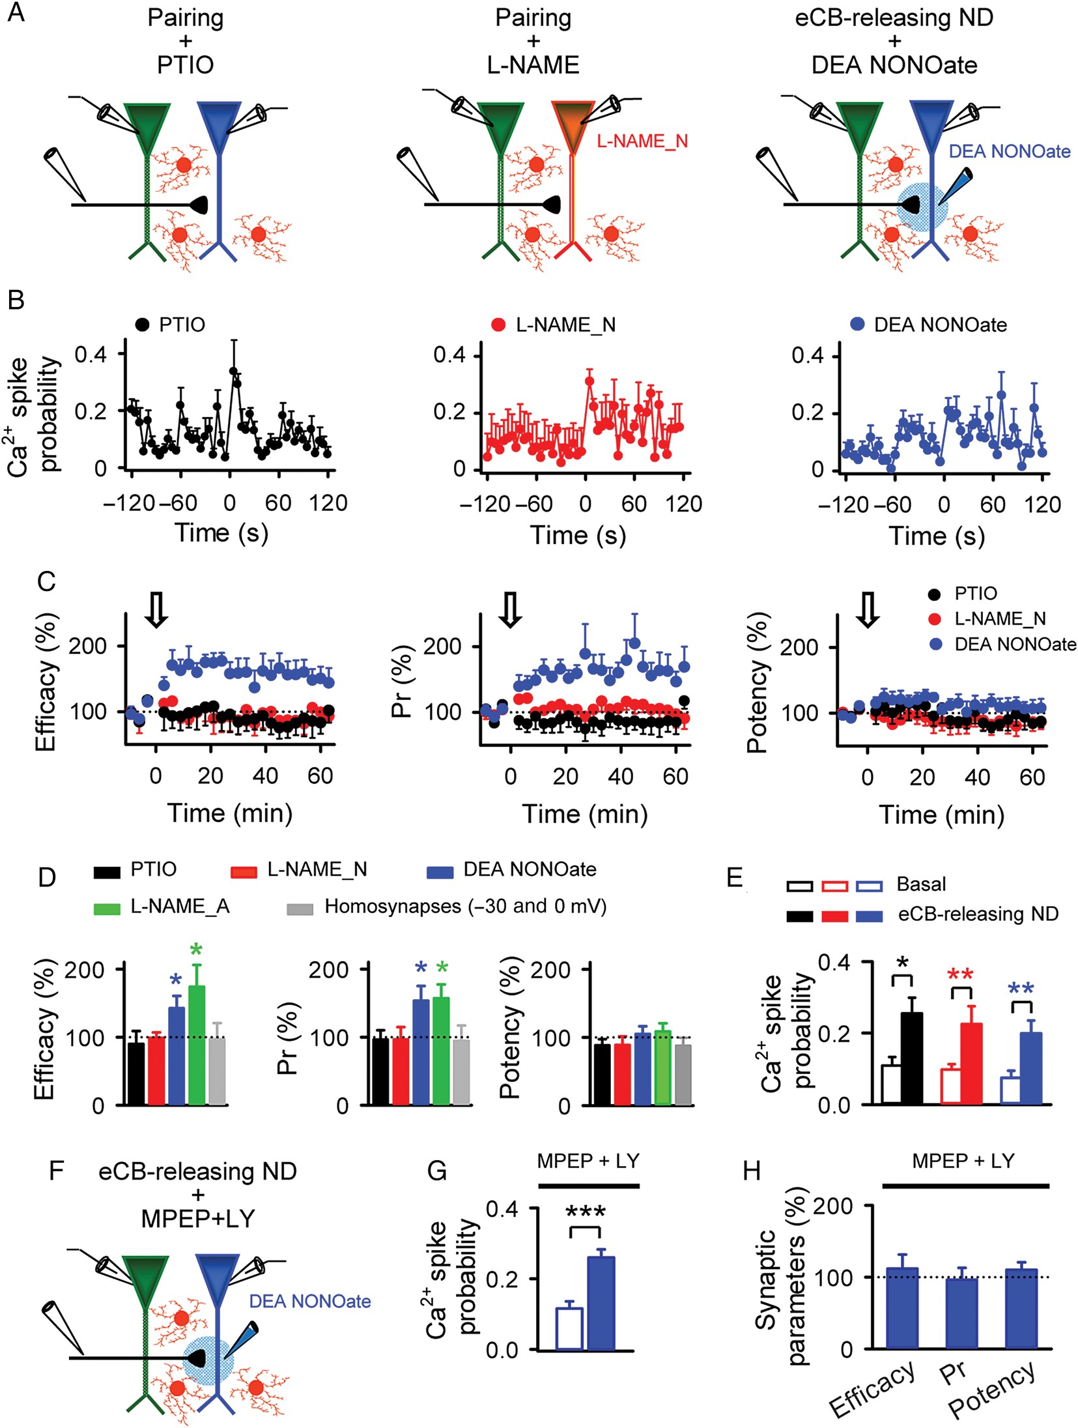
Figure 5. Endocannabinoid-induced LTP depends on postsynaptic nitric oxide production. (A) Schematic drawing depicting ...
Notes:
Figure 5. Endocannabinoid-induced LTP depends on postsynaptic nitric oxide production. (A) Schematic drawing depicting the experimental conditions: paired depolarizing protocol in the presence of 100 μm PTIO (left) or after loading the postsynaptic neuron with 100 μm L-NAME (center; L-NAME_N), and paring eCB-releasing neuronal depolarization to 0 mV with a puff of 100 μm DEA NONOate (right). (B) Astrocyte Ca2+ spike probability versus time in each condition (left to right: n = 7, 5, and 11 slices, respectively). Zero time corresponds to the beginning of the eCB-releasing neuronal depolarization. (C) Synaptic parameters versus time in presence of PTIO (n = 6), postsynaptic L-NAME_N (n = 5), and DEA NONOate (n = 9). (D) Relative changes of synaptic parameters 60 min after stimuli in presence of PTIO, postsynaptic L-NAME_N, L-NAME_A (astrocytes loading with L-NAME; n = 11), DEA NONOate, and pairing protocol (−30 and 0 mV) in single neuron (homosynapses; n = 9). (E) Basal and maximum astrocyte Ca2+ spike probability in the presence of PTIO (black), postsynaptic L-NAME_N (red), and DEA NONOate (blue). (F) Schematic drawing depicting paired recordings and a puff of 100 μm DEA NONOate in the presence of group I mGluR antagonists, MPEP, and LY367385. (G) Basal and maximum astrocyte Ca2+ spike probability evoked by eCB-releasing neuronal depolarization in the presence of MPEP and LY367385 (86 astrocytes from n = 9 slices). (H) Relative changes of synaptic parameters before and 60 min after pairing a DEA NONOate puff with the depolarization of the eCB-releasing neuron in the presence of MPEP and LY367385 (n = 11). *P < 0.05, **P < 0.01, ***P < 0.001.
Unless provided in the caption above, the following copyright applies to the content of this slide: © The Author 2014. Published by Oxford University Press. All rights reserved. For Permissions, please e-mail: journals.permissions@oup.com

Slide 6
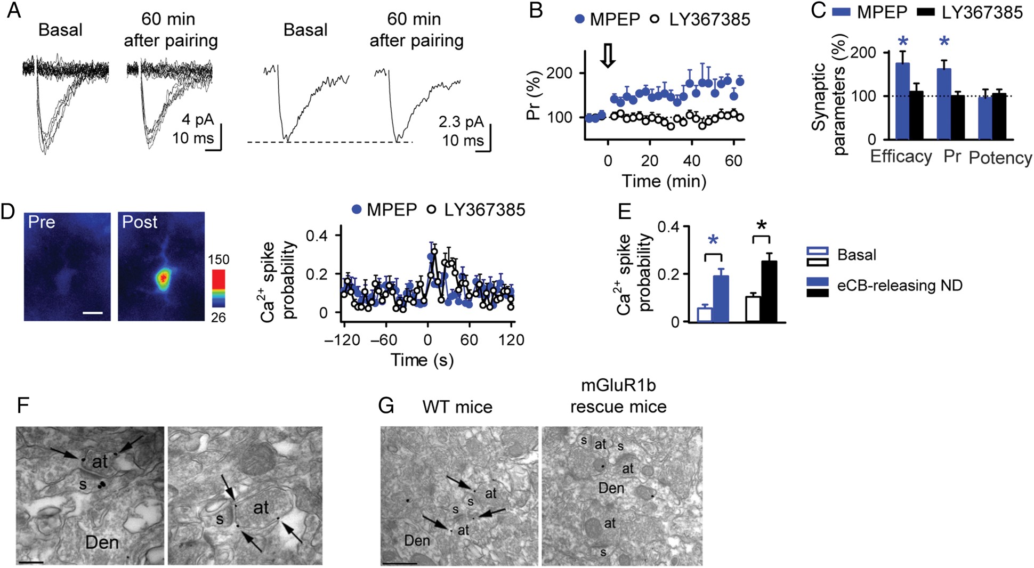
Figure 6. Endocannabinoid-induced LTP is mediated by presynaptic mGluRs type 1. (A) Representative synaptic responses ...
Notes:
Figure 6. Endocannabinoid-induced LTP is mediated by presynaptic mGluRs type 1. (A) Representative synaptic responses (20 stimuli; left traces) and averaged EPSCs (20 stimuli, including successes and failures; right traces) recorded from the postsynaptic neuron before (basal) and 60 min after pairing protocol in the presence of LY367385 (100 μm). (B) Pr versus time in the presence of MPEP and LY367385 (n = 6 and n = 12, respectively). Zero time corresponds to the beginning of the paired depolarizing protocol. (C) Relative change of synaptic parameters 60 min after pairing protocol in MPEP and LY367385 (n = 6 and n = 12, respectively). (D) Pseudocolor images representing fluorescence intensities of a fluo-4-filled astrocyte before (Pre) and after depolarizing the eCB-releasing neuron to 0 mV (Post) in the presence of LY367385. Scale bar, 10 μm. Astrocyte Ca2+ spike probability versus time in the presence of MPEP and LY367385 (64 astrocytes, n = 7 slices and 91 astrocytes, n = 6 slices, respectively). Zero time corresponds to the beginning of the eCB-releasing neuronal depolarization. (E) Basal and maximum astrocyte Ca2+ spike probability in the presence of MPEP and LY367385. (F) Electron micrographs of the CA1 hippocampal region showing immunoparticles for mGluR1 in the stratum radiatum. Immunoparticles for mGluR1 were located at presynaptic sites along the plasma membrane (arrows) of excitatory axon terminals (at) establishing asymmetrical synapses with dendritic spines (s) of CA1 pyramidal cells. Den, dendritic shafts of pyramidal cell. Scale bar, 0.2 μm. (G) Characterization of the pan-mGluR1 antibody immunoparticles for mGluR1 in WT animal (left panel), and mGluR1b rescue mice (right panel). Left, few immunogold particles for mGluR1 were detected at presynaptic sites along the plasma membrane (arrows) of excitatory axon terminals (at) in the stratum radiatum, presumably Schaffer's collaterals, always outside the active zone. Right, immunogold particles for mGluR1 were never detected at presynaptic sites, but only occasionally on mitochondria or myelinated axons. Den, dendritic shaft; s, dendritic spine. Scale bar, 0.5 μm. *P < 0.05.
Unless provided in the caption above, the following copyright applies to the content of this slide: © The Author 2014. Published by Oxford University Press. All rights reserved. For Permissions, please e-mail: journals.permissions@oup.com

Slide 7
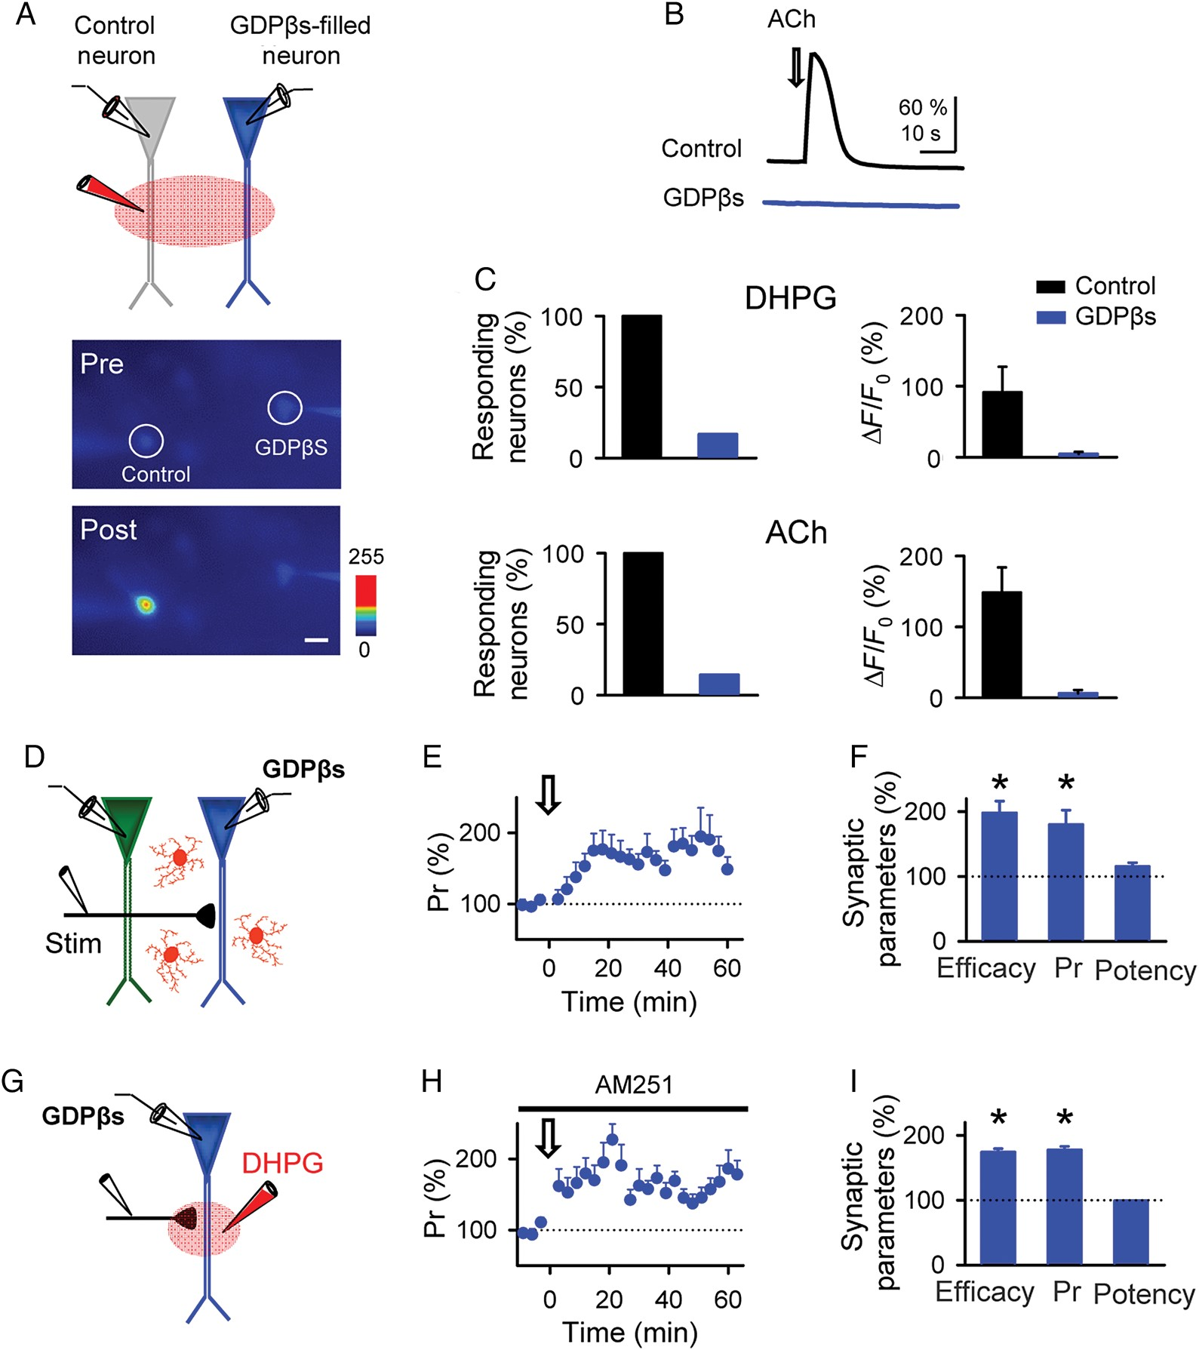
Figure 7. Presynaptic locus of astrocyte-mediated endocannabinoid-induced LTP. (A) Top, schematic drawing of the ...
Notes:
Figure 7. Presynaptic locus of astrocyte-mediated endocannabinoid-induced LTP. (A) Top, schematic drawing of the experimental approach depicting GDPβS dialysis into the postsynaptic neuron. Bottom, pseudocolor images representing fluorescence intensities of a fluo-4-filled neuron (Control) and a GDPβS–fluo-4-filled neuron (GDPβS) before (Pre) and after (Post) a puff application of ACh. Scale bar 20 μm. (B) Time course of the Ca2+ response of the cells indicated in A. (C) Number of control and GDPβS-filled neurons showing a Ca2+ increase evoke by DHPG (top, n = 7 and 6, respectively) and Ach (bottom, n = 11 and 14, respectively). (D) Schematic drawing of the experimental approach depicting paired recordings in the presence of postsynaptic GDPβS. (E) Pr versus time before and after the paired depolarizing protocol in GDPβS-filled postsynaptic neuron (n = 9). Zero time corresponds to the beginning of the paired depolarizing protocol. (F) Relative changes of synaptic parameters 60 min after the paired depolarizing protocol in GDPβS-filled postsynaptic neurons (n = 9). (G) Schematic drawing of the experimental approach depicting the pairing of a puff of 300 μm DHPG with a mild depolarization of the GDPβS-filled postsynaptic neuron in the presence of AM251 (2 μm). (H) Pr versus time before and after the puff of DHPG in the presence of AM251 (n = 10). Zero time corresponds to the beginning of the puff of DHPG. (I) Relative changes of synaptic parameters 60 min after puff application of DHPG in the presence of AM251 (n = 10). *P < 0.05.
Unless provided in the caption above, the following copyright applies to the content of this slide: © The Author 2014. Published by Oxford University Press. All rights reserved. For Permissions, please e-mail: journals.permissions@oup.com

Slide 8
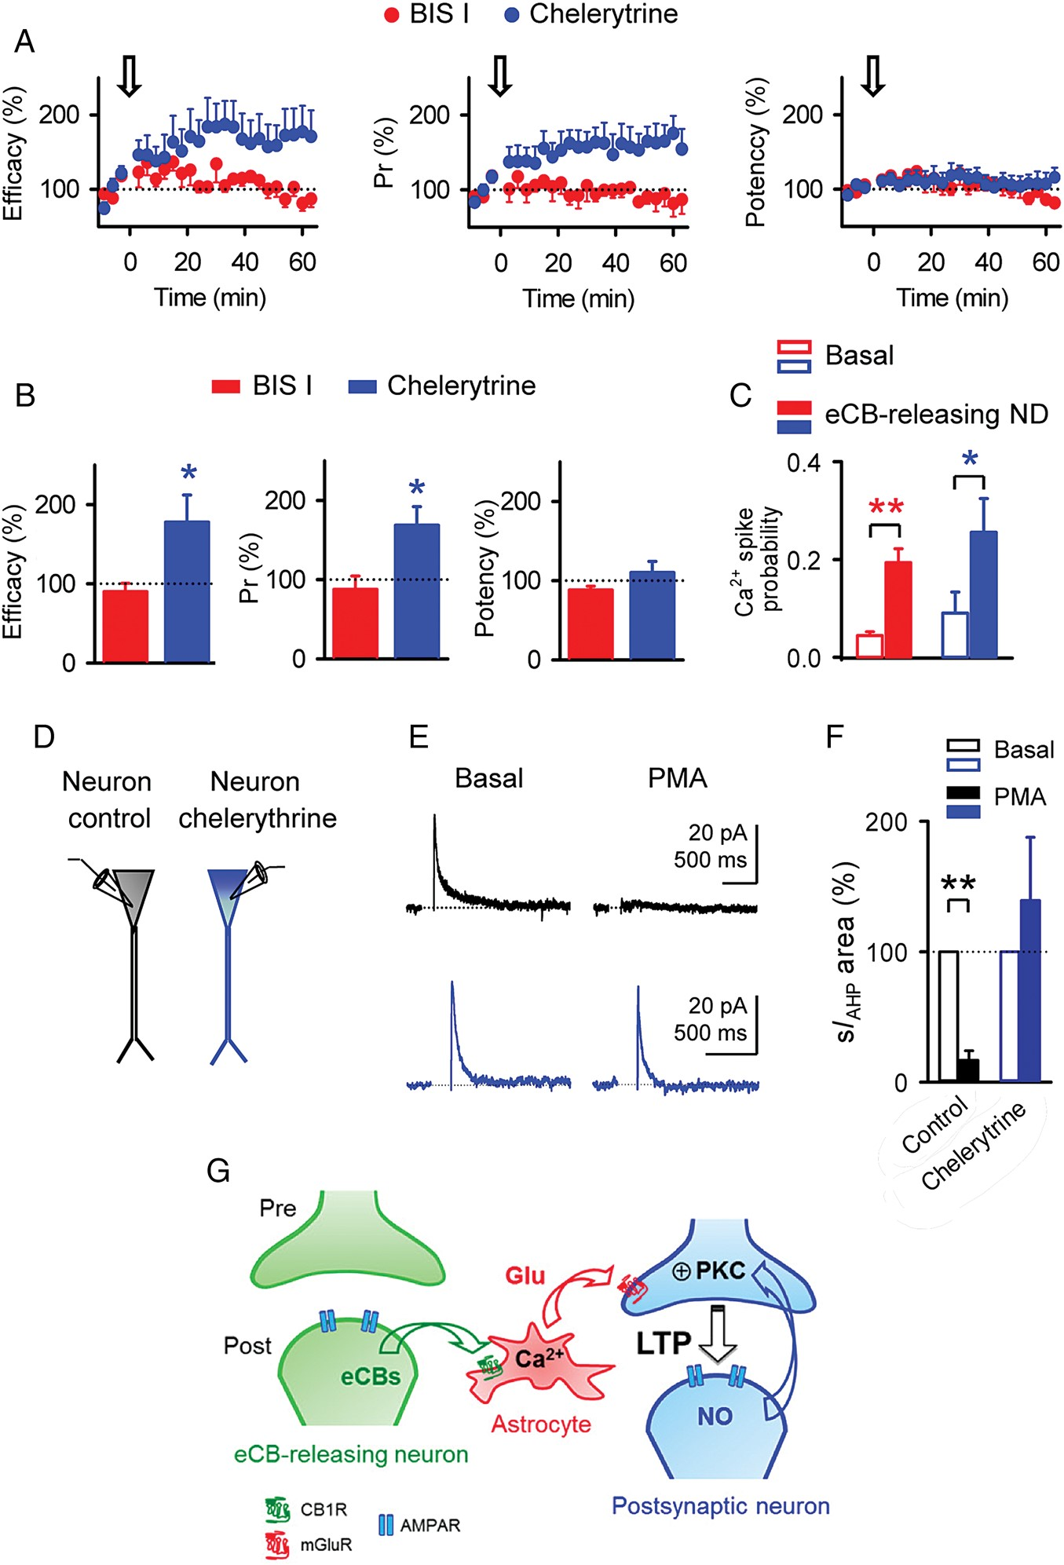
Figure 8. Endocannabinoid-induced LTP is mediated by PKC activation. (A) Synaptic parameters versus time in the ...
Notes:
Figure 8. Endocannabinoid-induced LTP is mediated by PKC activation. (A) Synaptic parameters versus time in the presence of PKC inhibitor BIS I (2 μm) and after loading the postsynaptic neuron with 1 μm chelerytrine (n = 4 and 9, respectively). Zero time corresponds to the beginning of the paired depolarizing protocol. (B) Relative change of synaptic parameters 60 min after the paired depolarizing protocol in the presence of BIS I and chelerytrine (n = 4 and 9, respectively). (C) Basal and maximum astrocyte Ca2+ spike probability in the presence of BIS I and chelerytrine (58 and 46 astrocytes from n = 6 and 6 slices, respectively). (D) Schematic drawing depicting a control neuron and a neuron filled with chelerythrine. (E) Representative traces showing the sIAHP evoked by 200 ms depolarizing pulses before and 20 min after perfusion with PMA (15 μm), in a control neuron (black traces) and in a chelerythrine-filled neuron (blue traces). (F) Relative changes of sIAHP area in each condition (n = 4). (G) Schematic drawing representing the signaling pathways involved in the endocannabinoid-induced hippocampal lateral LTP. *P < 0.05, **P < 0.01.
Unless provided in the caption above, the following copyright applies to the content of this slide: © The Author 2014. Published by Oxford University Press. All rights reserved. For Permissions, please e-mail: journals.permissions@oup.com

