Slide 1
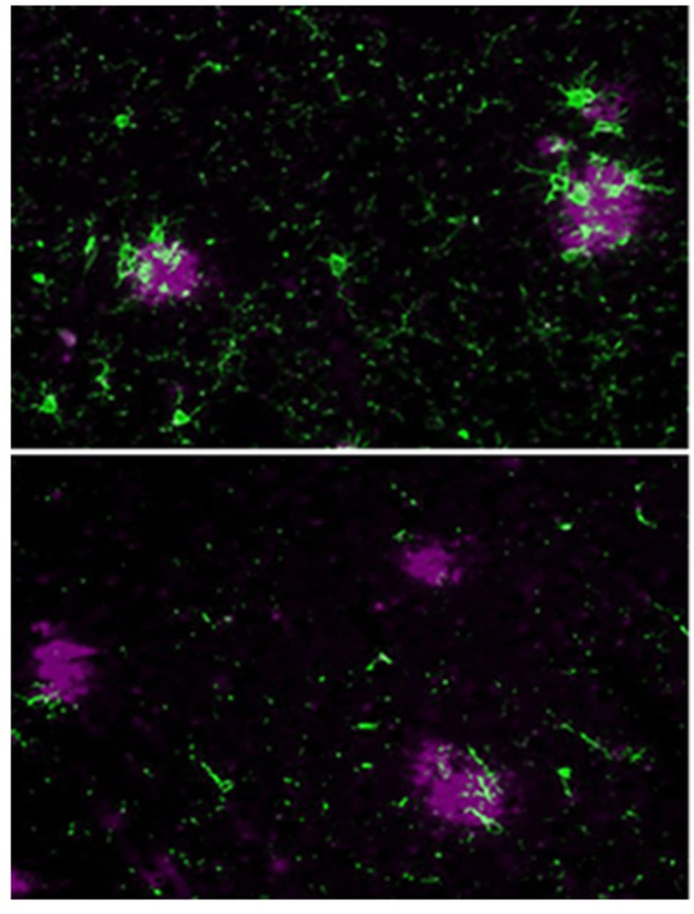
Increasing data implicate adaptive immunity in Alzheimer’s disease pathophysiology, but its involvement ...
Notes:
Increasing data implicate adaptive immunity in Alzheimer’s disease pathophysiology, but its involvement remains poorly defined. Using a mouse model, Dansokho et al. show that regulatory T cells slow cognitive decline and modulate the microglial response to amyloid deposition. The results support the therapeutic potential of regulatory T cell-based immunotherapy.
Unless provided in the caption above, the following copyright applies to the content of this slide: © The Author (2016). Published by Oxford University Press on behalf of the Guarantors of Brain. All rights reserved. For Permissions, please email: journals.permissions@oup.com

Slide 2
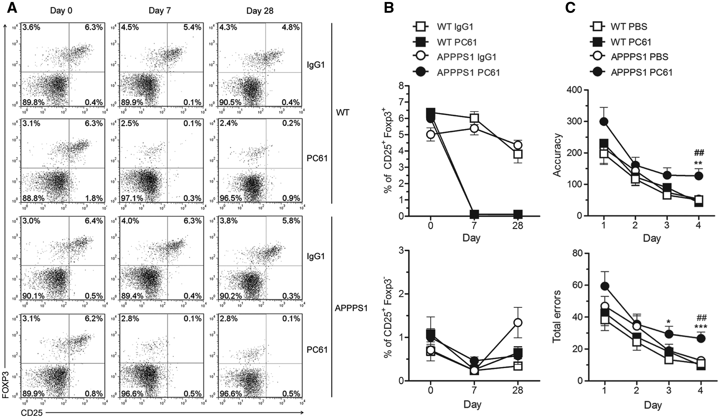
Figure 1 Early depletion of Tregs accelerates the onset of cognitive deficits in APPPS1 mice . Four- to 5-week-old ...
Notes:
Figure 1 Early depletion of Tregs accelerates the onset of cognitive deficits in APPPS1 mice . Four- to 5-week-old APPPS1 mice and wild-type (WT) littermates were injected intraperitoneally with 200 µg of anti-CD25 antibody (PC61) and treatment was repeated 4 weeks later. Controls were injected with either PBS or 200 µg of control IgG1 antibody. ( A and B ) Frequency of CD4 + CD25 + Foxp3 + Tregs and CD4 + CD25 + Foxp3 - Teffs was evaluated in the blood by flow cytometry before (Day 0) and after initiating the treatment (Day 7, Day 28). ( A ) Representative flow cytometry plots gated on CD4 + T cells. ( B ) Percentages of CD25 + Foxp3 + Tregs and CD25 + Foxp3 − Teffs among CD4 + T cells. Mean ± SEM ( n = 4–7 mice/group). Data representative of three independent experiments. ( C ) Impact of transient Treg cell depletion on spatial learning abilities of 7-month-old wild-type and APPPS1 mice, using the Barnes maze test. Accuracy and total errors to reach the target hole during the learning phase are shown. Mean ± SEM ( n = 10–11 mice/group). Repeated measures ANOVA. * P < 0.05, ** P < 0.01, *** P < 0.001 versus wild-type PBS; ##P < 0.01 versus APPPS1 PBS.
Unless provided in the caption above, the following copyright applies to the content of this slide: © The Author (2016). Published by Oxford University Press on behalf of the Guarantors of Brain. All rights reserved. For Permissions, please email: journals.permissions@oup.com

Slide 3
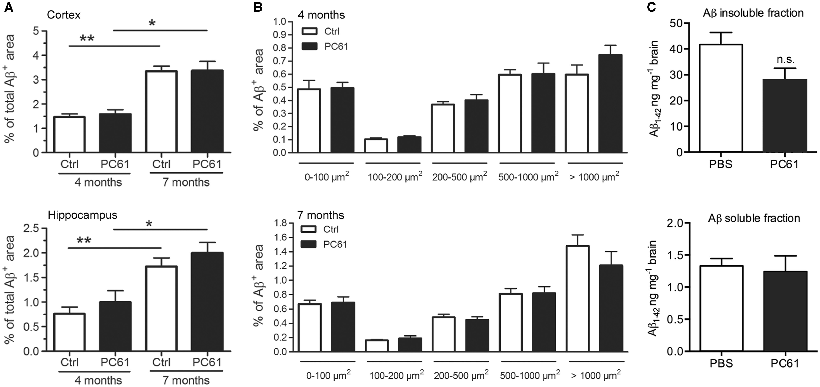
Figure 2 Treg cell depletion does not alter amyloid-β deposition in the brain of APPPS1 mice. ( A and B ) ...
Notes:
Figure 2 Treg cell depletion does not alter amyloid-β deposition in the brain of APPPS1 mice. ( A and B ) Immunohistochemistry analysis of amyloid-β (Aβ) deposition at 4 and 7 months of age in the brain of Treg-depleted or control-treated APPPS1 mice. ( A ) Percentage of area covered by amyloid-β in the cortex and hippocampus. ( B ) Quantification of cortical amyloid-β deposits of different size ranges (0–100; 100–200; 200–500; 500–1000; > 1000 µm 2 ). ( C ) Brain levels of amyloid-β quantified by ELISA in formic acid-treated insoluble and diethylamine-soluble fractions at 4 months of age. Mean ± SEM ( n = 4–6 mice/group). Data representative of two independent experiments. Mann-Whitney test. * P < 0.05, ** P < 0.01. n.s. = not significant.
Unless provided in the caption above, the following copyright applies to the content of this slide: © The Author (2016). Published by Oxford University Press on behalf of the Guarantors of Brain. All rights reserved. For Permissions, please email: journals.permissions@oup.com

Slide 4
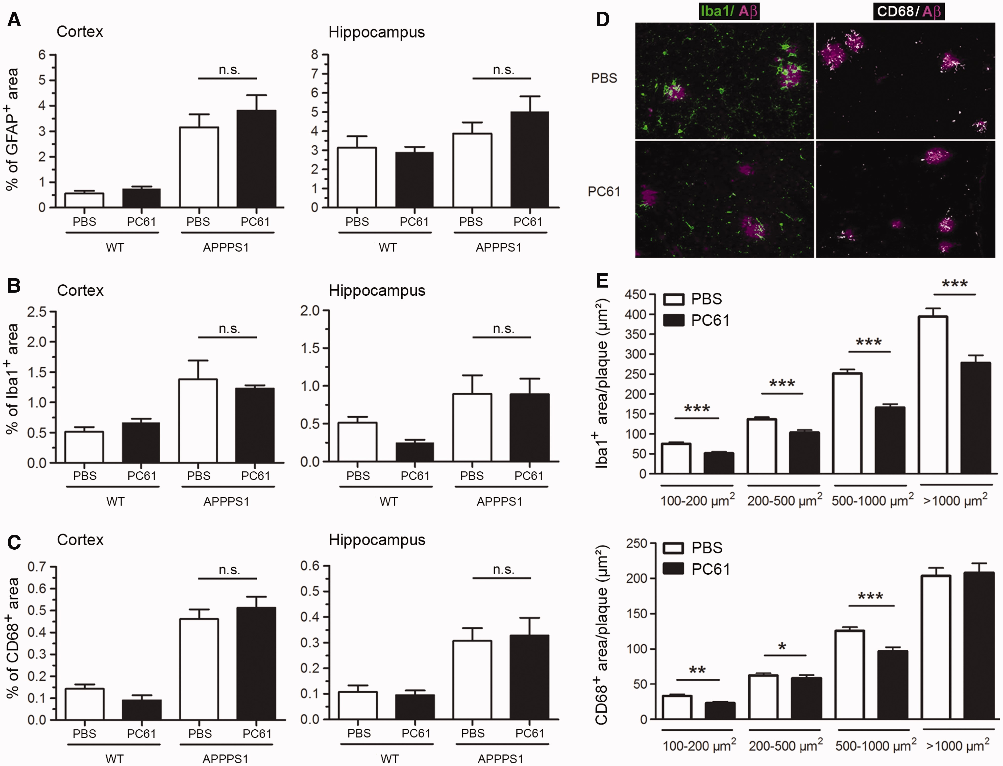
Figure 3 Early depletion of Tregs reduces plaque-associated microglia. ( A – C ) Overall extent of astrocytosis, ...
Notes:
Figure 3 Early depletion of Tregs reduces plaque-associated microglia. ( A – C ) Overall extent of astrocytosis, microgliosis, and microglia activation in the cortex and hippocampus of Treg-depleted or non-depleted APPPS1 and wild-type (WT) mice, measured by immunoreactivity to GFAP ( A ), Iba1 ( B ) and CD68 ( C ) at 4 months of age, respectively. Mean ± SEM ( n = 4–6 mice/group). ( D and E ) Microglia recruitment towards amyloid-β plaques. Representative images ( D ) and quantification ( E ) of Iba1 and CD68 immunoreactivity co-localized with or in close vicinity of cortical amyloid-β (Aβ) deposits of different size ranges. Mean ± SEM ( n > 90 plaques for each size category; from 4–6 mice/group). Data representative of two independent experiments. Mann-Whitney test. n.s. = non-significant; * P < 0.05; ** P < 0.01; *** P < 0.001.
Unless provided in the caption above, the following copyright applies to the content of this slide: © The Author (2016). Published by Oxford University Press on behalf of the Guarantors of Brain. All rights reserved. For Permissions, please email: journals.permissions@oup.com

Slide 5
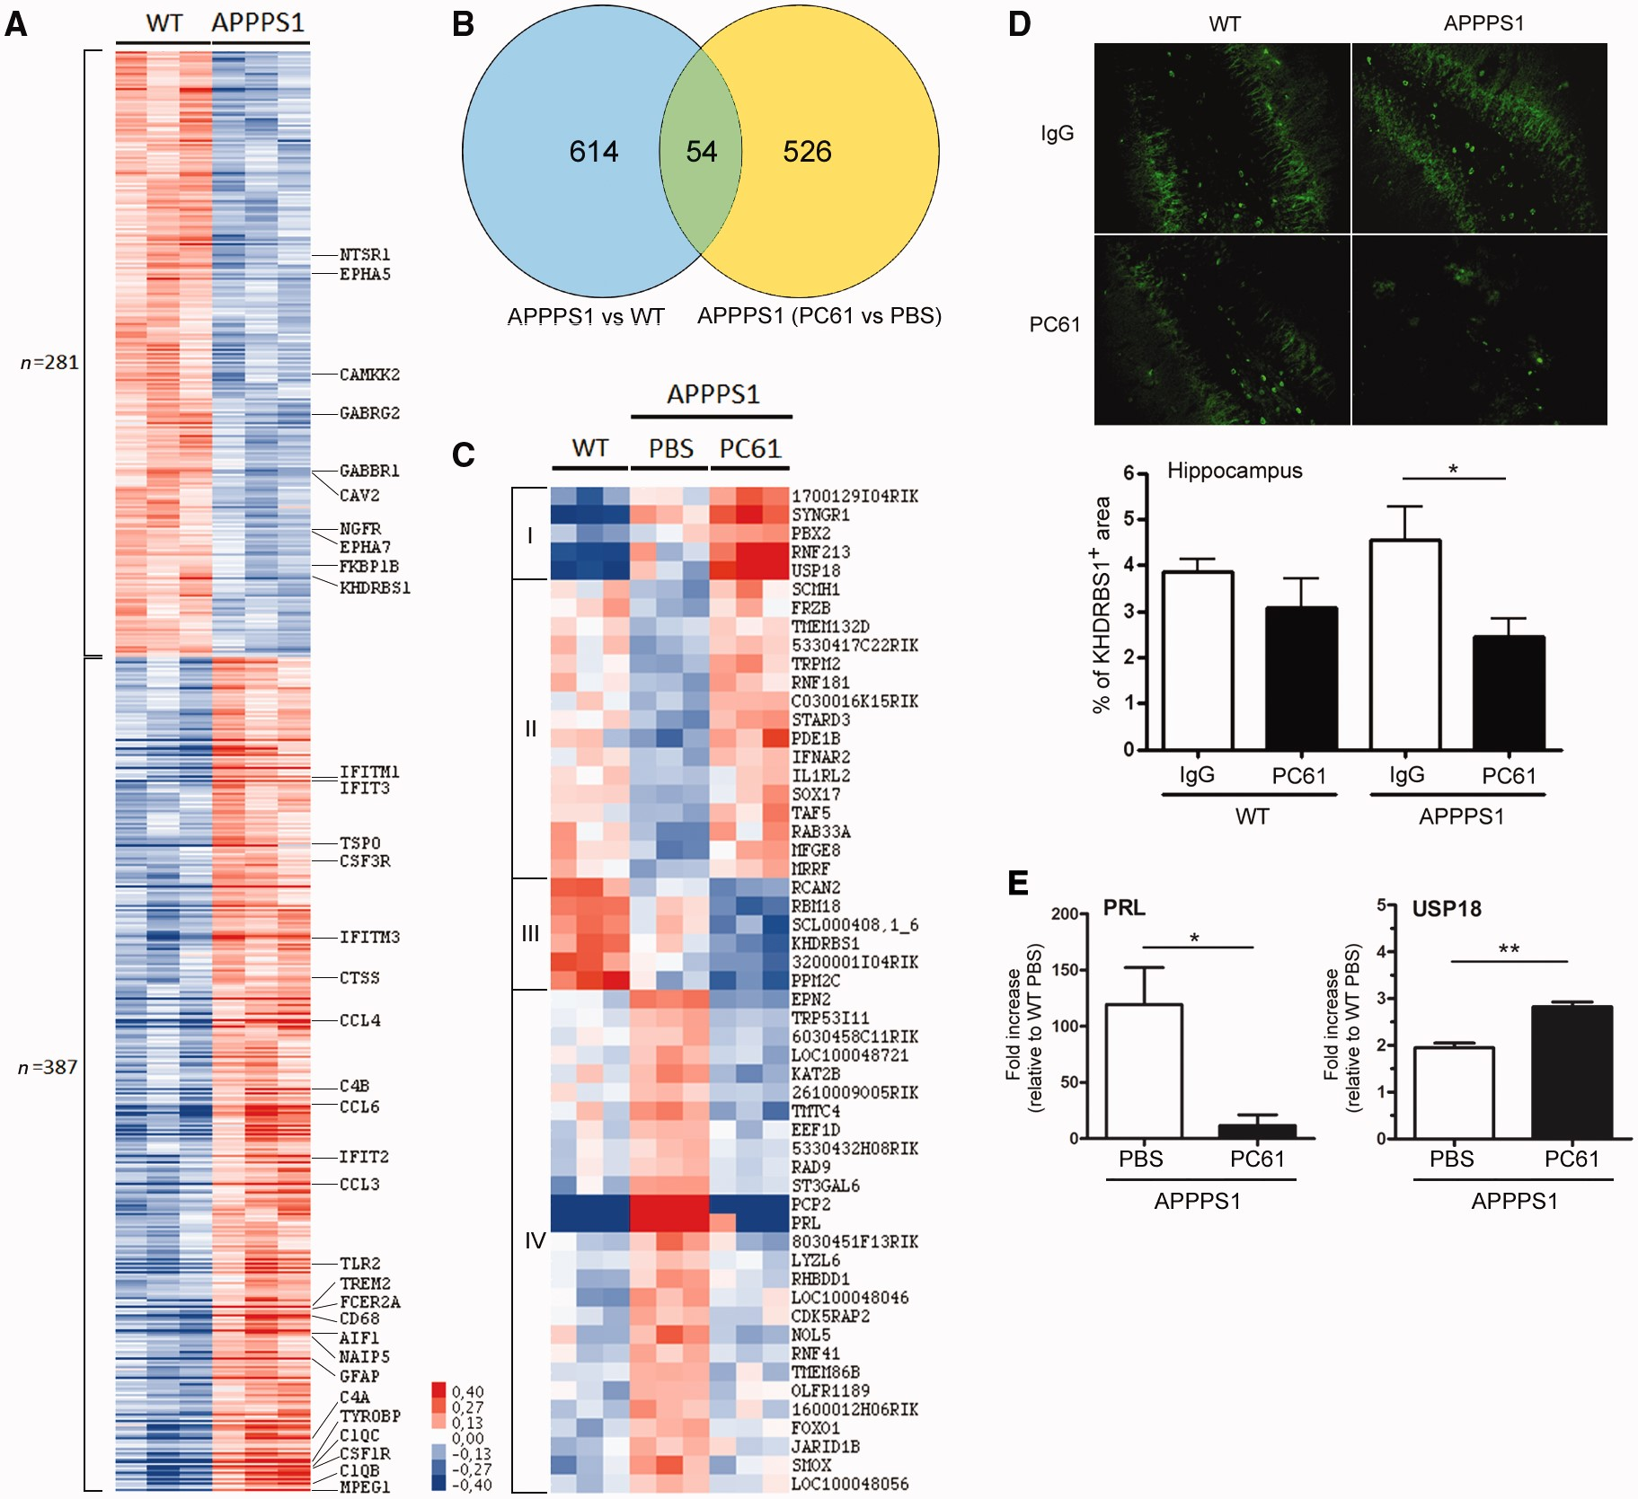
Figure 4 Depletion of Tregs alters disease-related gene expression profile in the brain of APPPS1 mice. ( A ) Heat map ...
Notes:
Figure 4 Depletion of Tregs alters disease-related gene expression profile in the brain of APPPS1 mice. ( A ) Heat map of differentially expressed genes in the brain of PBS-treated APPPS1 as compared to wild-type (WT) mice. Each column represents one mouse and each row an individual probe. Genes representative of upregulated and downregulated functions are indicated. ( B ) Venn diagram identifying disease-related genes differentially modulated upon depletion of Tregs. Blue circle represents 668 disease-related probes (APPPS1 versus wild-type) and yellow circle shows 580 treatment-related probes (PC61- versus PBS-treated APPPS1). Green intersection reveals 54 disease-related genes differentially modulated by PC61 treatment. ( C ) Heat map showing the expression profile of 54 disease-related genes differentially modulated upon Treg cell depletion. Each column represents one mouse and each row corresponds to one gene. For all gene array analyses, only genes with significant P ≤ 0.05 and with modulations significantly different and above the background noise modulations (2xSD) are represented. Relative abundance of transcripts is indicated according to colour scale. ( D ) Representative images and quantification of KHDRBS1/SAM68 immunoreactivity in the hippocampus of Treg-depleted or non-depleted wild-type and APPPS1 mice. Mean ± SEM ( n = 4–6 mice/group). Mann-Whitney test; * P < 0.05. ( E ) Relative quantification by real-time quantitative PCR of Prl and Usp18 mRNA expression in the brain of Treg-depleted and non-depleted APPPS1 mice. Data are expressed as fold increase relative to untreated wild-type mice. Unpaired Student’s t -test; * P < 0.05; ** P < 0.01.
Unless provided in the caption above, the following copyright applies to the content of this slide: © The Author (2016). Published by Oxford University Press on behalf of the Guarantors of Brain. All rights reserved. For Permissions, please email: journals.permissions@oup.com

Slide 6
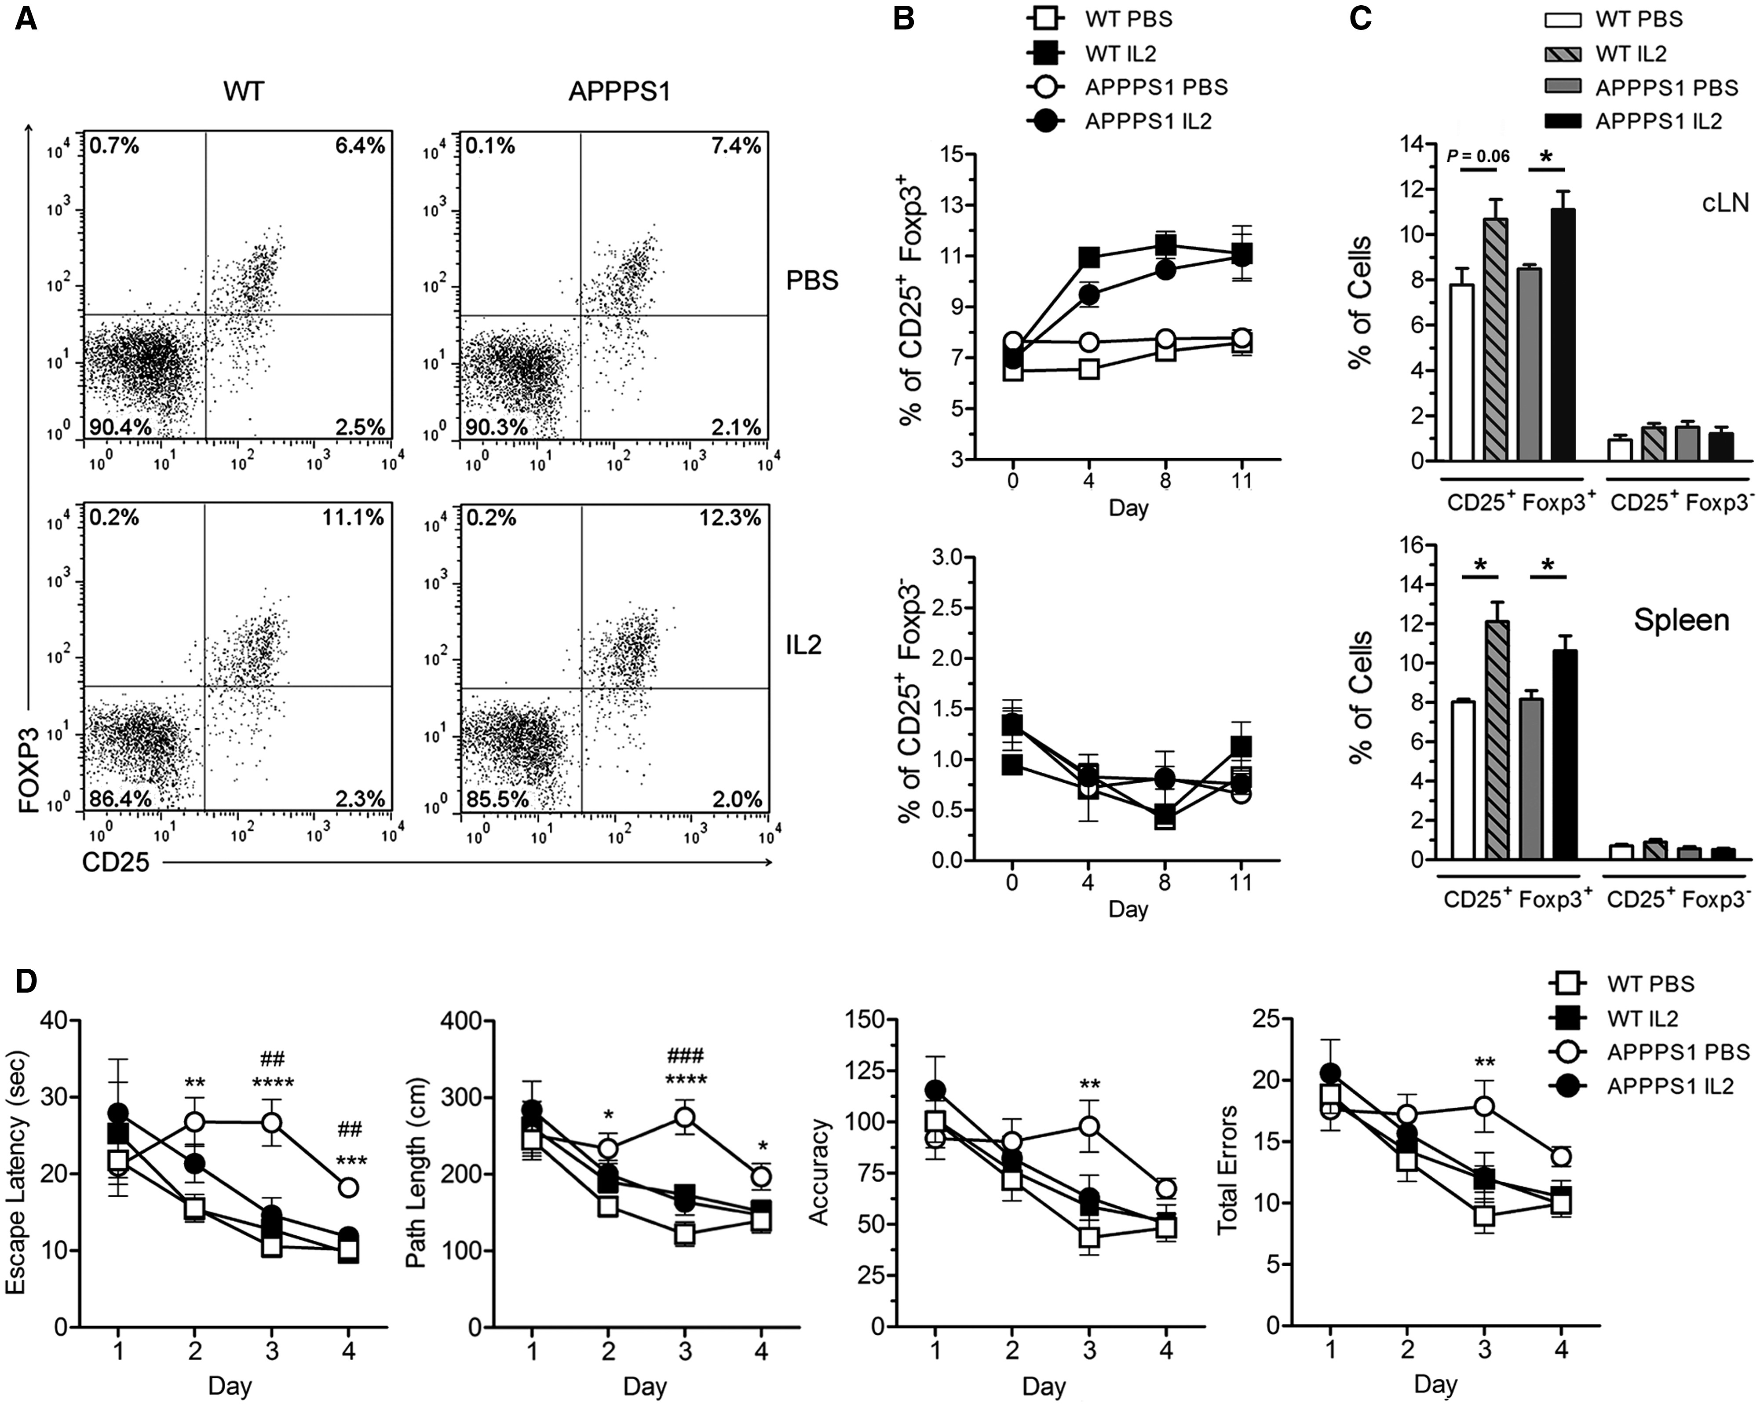
Figure 5 Low-dose IL-2 treatment selectively amplifies Tregs and restores cognitive functions in APPPS1 mice . ...
Notes:
Figure 5 Low-dose IL-2 treatment selectively amplifies Tregs and restores cognitive functions in APPPS1 mice . Six-week-old wild-type (WT) and APPPS1 mice were injected daily intraperitoneally with PBS or 50 000 IU of recombinant human (rh)IL-2 for 10 days. Daily treatments for 5 days were repeated every 3 weeks. ( A–C ) Frequency of CD25 + Foxp3 + Tregs and CD25 + Foxp3 - Teffs among TCRβ + CD4 + cells was analysed by flow cytometry. ( A ) Representative dot plots from blood at Day 11 of IL-2 treatment. ( B ) Quantification of Tregs and Teffs in the blood before and after 4, 8 and 11 days of treatment. ( C ) Quantification in spleen and cervical lymph nodes (Day 11). Mean ± SEM ( n = 3–4 mice/group). Data representative of two independent experiments. Unpaired Student’s t -test. * P < 0.05. ( D ) Impact of IL-2 treatment on spatial learning abilities of 10-month-old wild-type and APPPS1 mice, using the Barnes maze test. Latency, path length, accuracy, and total errors to reach the target hole during the learning phase are shown. Mean ± SEM ( n = 9–12 mice/group). Repeated measures ANOVA. * P < 0.05, ** P < 0.01, *** P < 0.001, **** P < 0.0001 versus wild-type PBS; ##P < 0.01, ###P < 0.001 versus APPPS1 IL-2.
Unless provided in the caption above, the following copyright applies to the content of this slide: © The Author (2016). Published by Oxford University Press on behalf of the Guarantors of Brain. All rights reserved. For Permissions, please email: journals.permissions@oup.com

Slide 7
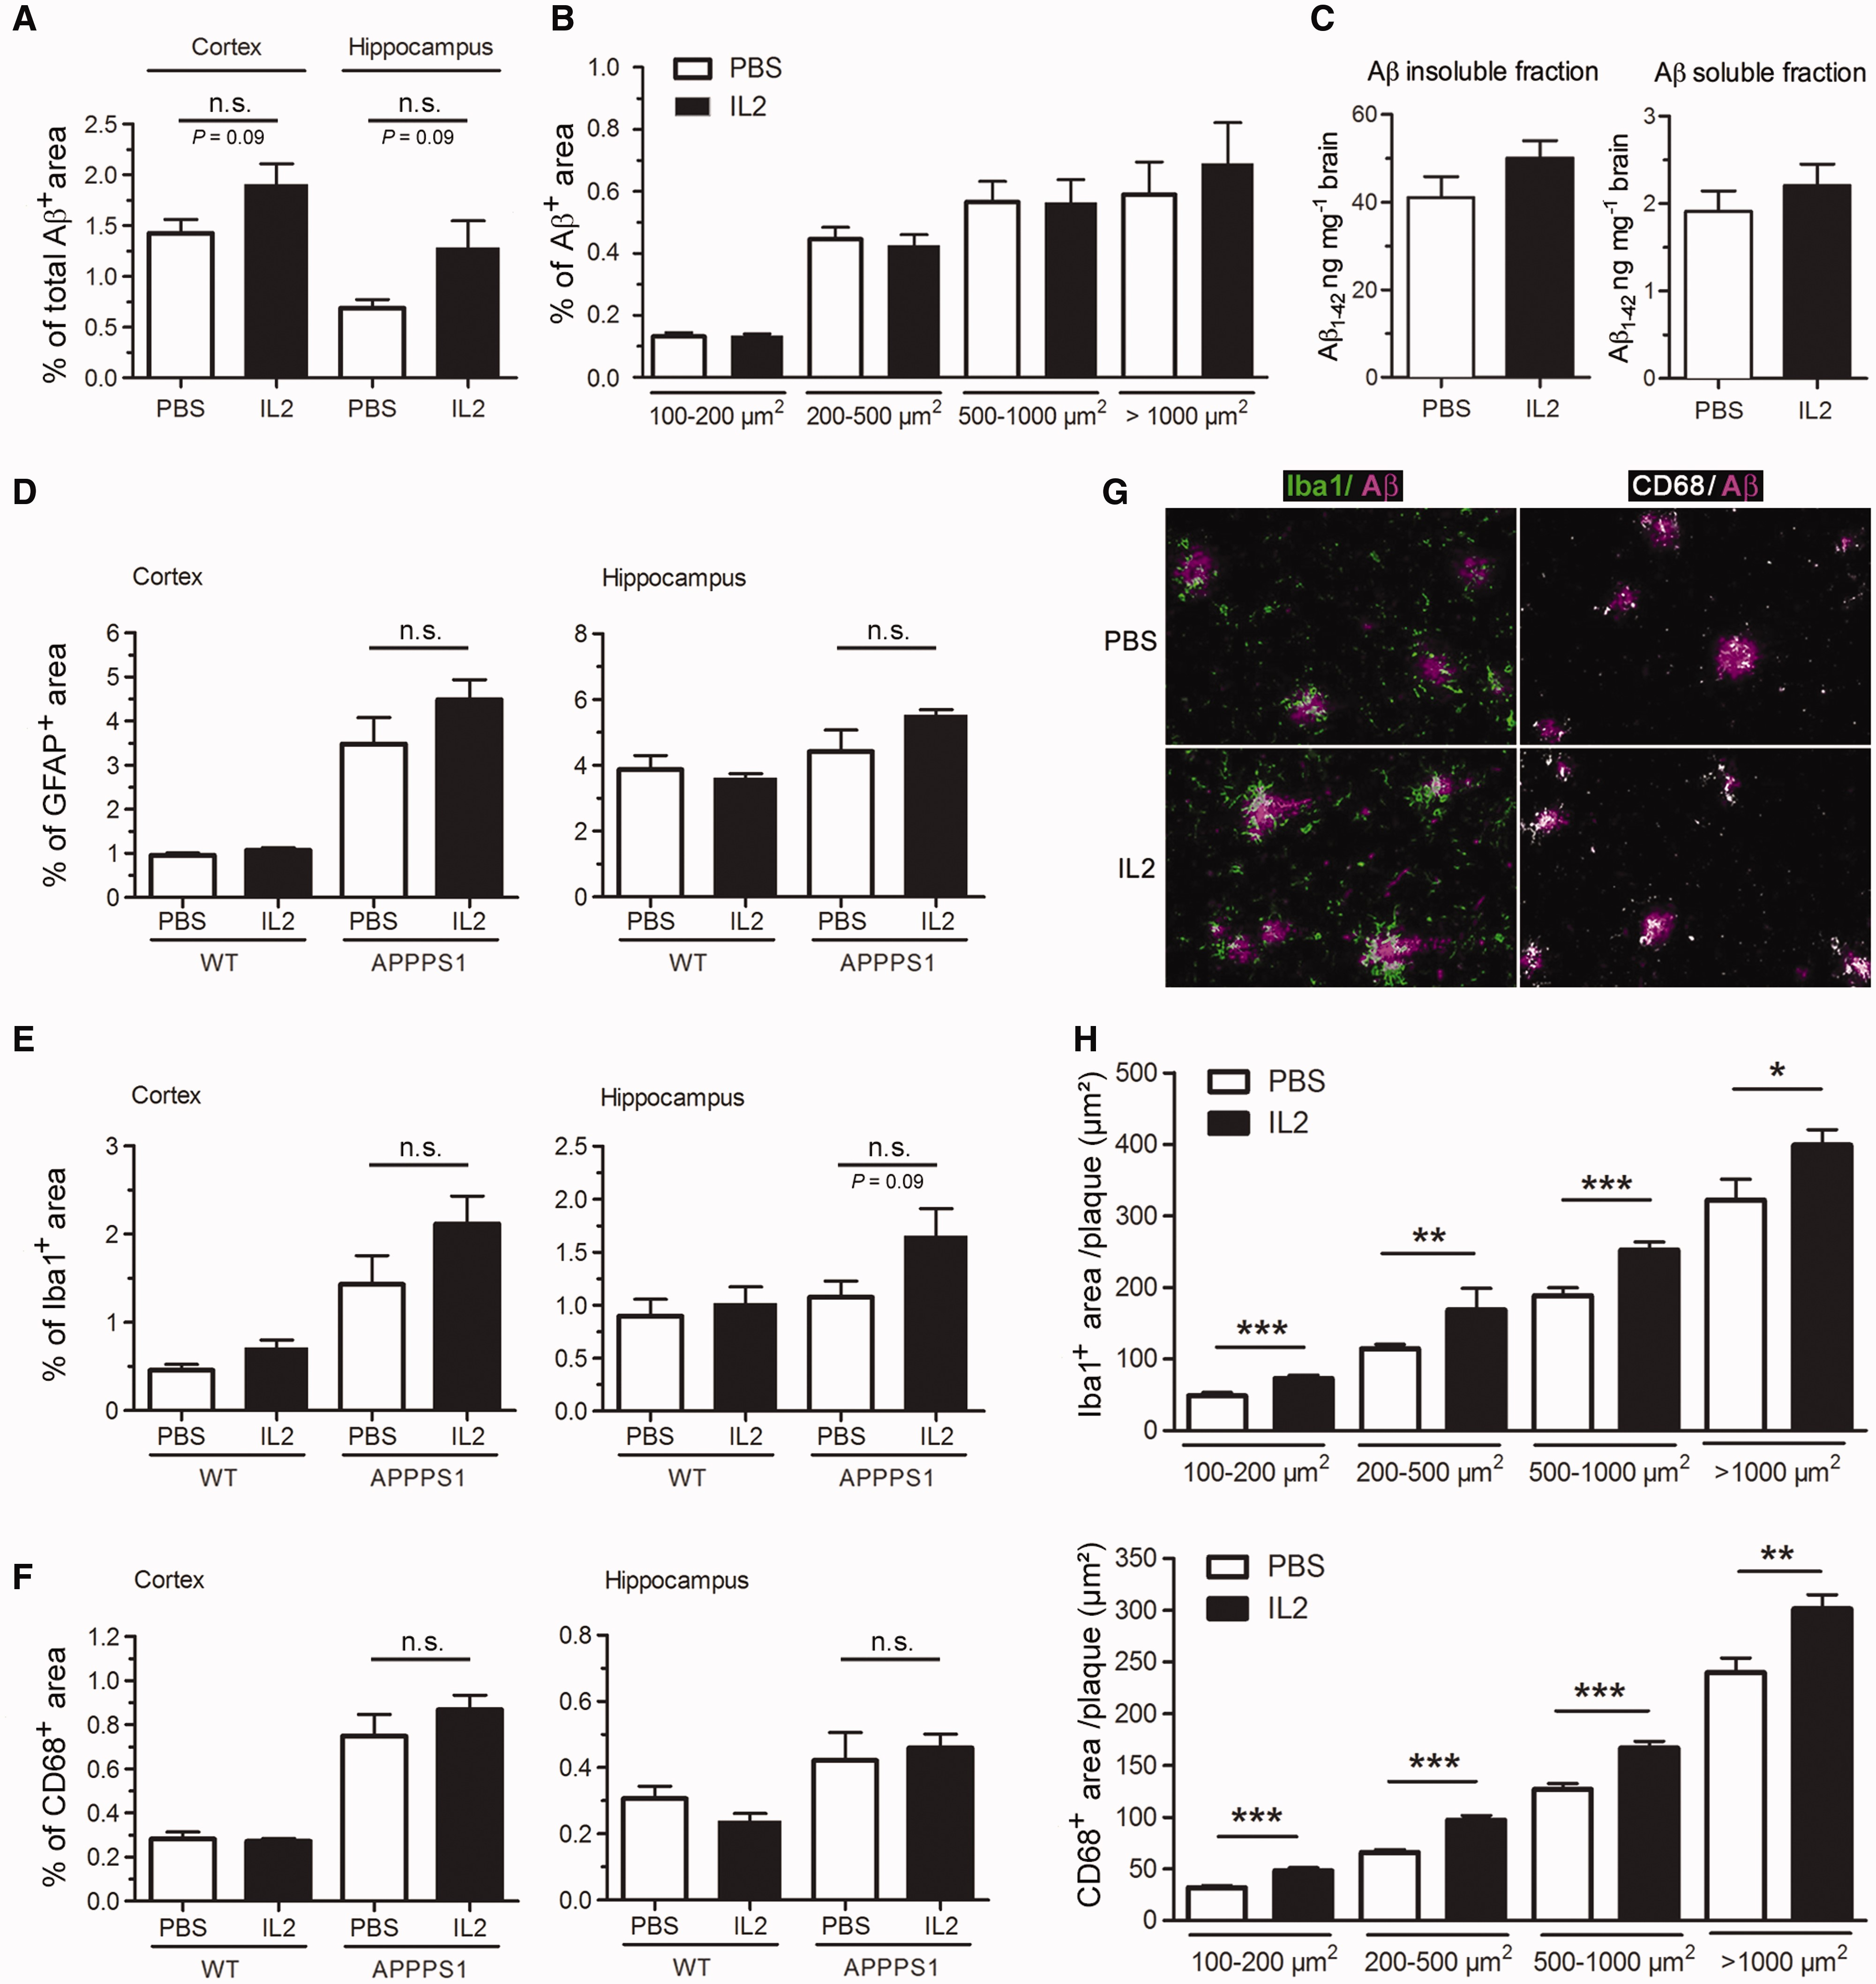
Figure 6 Low-dose IL-2 treatment increases plaque-associated microglia. ( A ) Amyloid-β deposition in the cortex and ...
Notes:
Figure 6 Low-dose IL-2 treatment increases plaque-associated microglia. ( A ) Amyloid-β deposition in the cortex and hippocampus of IL-2- or PBS-treated APPPS1 mice was measured at 4 months of age by immunohistochemistry. ( B ) Quantification of cortical amyloid-β deposits of different size ranges (100–200; 200–500; 500–1000; >1000 µm 2 ). ( C ) Brain levels of amyloid-β were quantified in formic acid-treated insoluble and diethylamine-soluble fractions by ELISA. ( D–F ) Overall extent of astrocytosis, microgliosis, and microglia activation was measured by immunoreactivity to GFAP ( D ), Iba1 ( E ) and CD68 ( F ), respectively. Mean ± SEM ( n = 4–6 mice/group). ( G and H) Microglia recruitment towards amyloid-β plaques. Representative images ( G ) and quantification ( H ) of Iba1 and CD68 immunoreactivity co-localized with or in close vicinity of cortical amyloid-β deposits of different size ranges. Mean ± SEM ( n > 90 plaques for each size category; from 4–6 mice/group). Mann-Whitney test. n.s. = non-significant; * P < 0.05; ** P < 0.01; *** P < 0.001.
Unless provided in the caption above, the following copyright applies to the content of this slide: © The Author (2016). Published by Oxford University Press on behalf of the Guarantors of Brain. All rights reserved. For Permissions, please email: journals.permissions@oup.com

