Slide 1
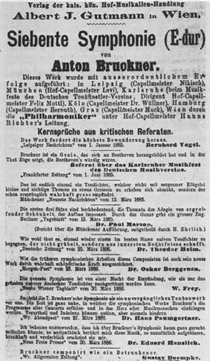
Figure 1. An advertisement for Bruckner's Seventh Symphony published in the Neue Freie Presse, Vienna, 1 April 1886. ...
Notes:
Figure 1. An advertisement for Bruckner's Seventh Symphony published in the Neue Freie Presse, Vienna, 1 April 1886. From Hans-Hubert Schönzeler, Bruckner (New York: Vienna House, n.d. [1970]), 172.
Unless provided in the caption above, the following copyright applies to the content of this slide: © The Author 2010. Published by Oxford University Press. All rights reserved. For permissions, please e-mail: journals.permissions@oup.com

Slide 2
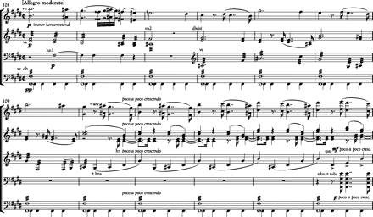
Example 1. Bruckner, Seventh Symphony, first movement, mm. 102–23. From VII. Symphony E-dur, Anton Bruckner, Sämtliche ...
Notes:
Example 1. Bruckner, Seventh Symphony, first movement, mm. 102–23. From VII. Symphony E-dur, Anton Bruckner, Sämtliche Werke, vol. 7, ed. Leopold Nowak (Vienna: Musikwissenschaftlicher Verlag, 1954). Used by permission.
Unless provided in the caption above, the following copyright applies to the content of this slide: © The Author 2010. Published by Oxford University Press. All rights reserved. For permissions, please e-mail: journals.permissions@oup.com

Slide 3
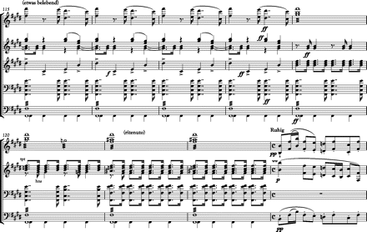
Example 1. Bruckner, Seventh Symphony, first movement, mm. 102–23. From VII. Symphony E-dur, Anton Bruckner, Sämtliche ...
Notes:
Example 1. Bruckner, Seventh Symphony, first movement, mm. 102–23. From VII. Symphony E-dur, Anton Bruckner, Sämtliche Werke, vol. 7, ed. Leopold Nowak (Vienna: Musikwissenschaftlicher Verlag, 1954). Used by permission.
Unless provided in the caption above, the following copyright applies to the content of this slide: © The Author 2010. Published by Oxford University Press. All rights reserved. For permissions, please e-mail: journals.permissions@oup.com

Slide 4
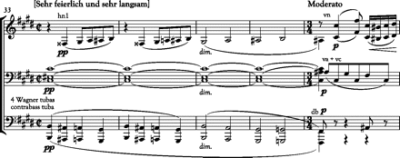
Example 2. Bruckner, Seventh Symphony, second movement, mm. 33–37. From VII. Symphony E-dur, Anton Bruckner, Sämtliche ...
Notes:
Example 2. Bruckner, Seventh Symphony, second movement, mm. 33–37. From VII. Symphony E-dur, Anton Bruckner, Sämtliche Werke, vol. 7, ed. Leopold Nowak (Vienna: Musikwissenschaftlicher Verlag, 1954). Used by permission.
Unless provided in the caption above, the following copyright applies to the content of this slide: © The Author 2010. Published by Oxford University Press. All rights reserved. For permissions, please e-mail: journals.permissions@oup.com

Slide 5
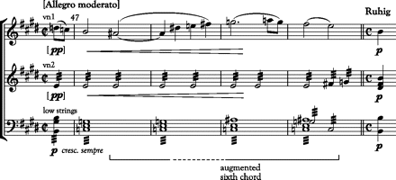
Example 3. Bruckner, Seventh Symphony, first movement, mm. 47–50. From VII. Symphony E-dur, Anton Bruckner, Sämtliche ...
Notes:
Example 3. Bruckner, Seventh Symphony, first movement, mm. 47–50. From VII. Symphony E-dur, Anton Bruckner, Sämtliche Werke, vol. 7, ed. Leopold Nowak (Vienna: Musikwissenschaftlicher Verlag, 1954). Used by permission.
Unless provided in the caption above, the following copyright applies to the content of this slide: © The Author 2010. Published by Oxford University Press. All rights reserved. For permissions, please e-mail: journals.permissions@oup.com

Slide 6
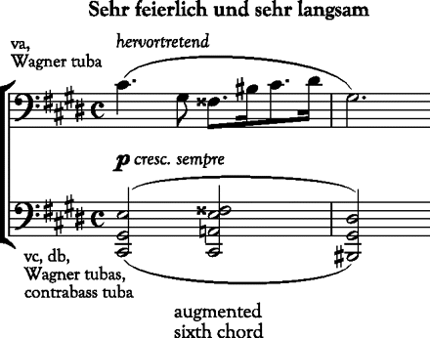
Example 4. Bruckner, Seventh Symphony, second movement, mm. 1–2. From VII. Symphony E-dur, Anton Bruckner, Sämtliche ...
Notes:
Example 4. Bruckner, Seventh Symphony, second movement, mm. 1–2. From VII. Symphony E-dur, Anton Bruckner, Sämtliche Werke, vol. 7, ed. Leopold Nowak (Vienna: Musikwissenschaftlicher Verlag, 1954). Used by permission.
Unless provided in the caption above, the following copyright applies to the content of this slide: © The Author 2010. Published by Oxford University Press. All rights reserved. For permissions, please e-mail: journals.permissions@oup.com

Slide 7
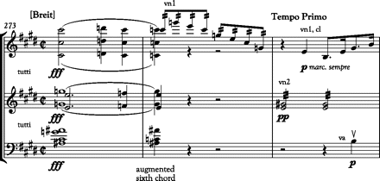
Example 5. Bruckner, Seventh Symphony, fourth movement, mm. 273–75. From VII. Symphony E-dur, Anton Bruckner, Sämtliche ...
Notes:
Example 5. Bruckner, Seventh Symphony, fourth movement, mm. 273–75. From VII. Symphony E-dur, Anton Bruckner, Sämtliche Werke, vol. 7, ed. Leopold Nowak (Vienna: Musikwissenschaftlicher Verlag, 1954). Used by permission.
Unless provided in the caption above, the following copyright applies to the content of this slide: © The Author 2010. Published by Oxford University Press. All rights reserved. For permissions, please e-mail: journals.permissions@oup.com

