Slide 1
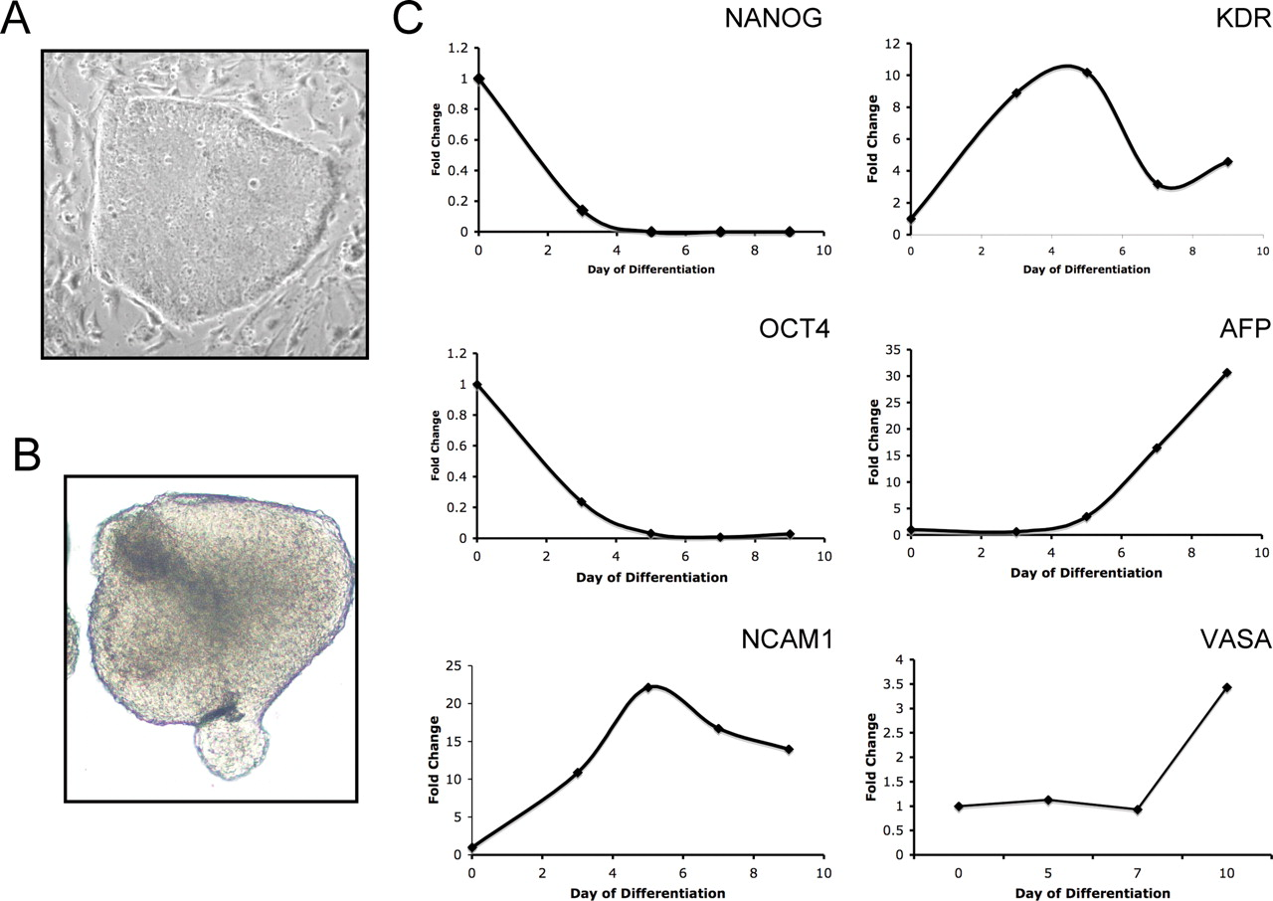
Figure 1. Use of hESCs to study the molecular regulation of pluripotent cells and lineage differentiation. Human ESCs ...
Notes:
Figure 1. Use of hESCs to study the molecular regulation of pluripotent cells and lineage differentiation. Human ESCs are maintained as self-renewing pluripotent cells on feeder cells (shown are MEFs) (A). Differentiation of hESCs is induced by culturing hESCs colonies in suspension in the absence of FGF2 and presence of fetal bovine serum (B). Lineage differentiation is monitored by diagnostic assays; shown is marker analysis at various time points after induction of differentiation (C). In this example, EB differentiation is associated with a reduction in pluripotent gene expression including the canonical pluripotent transcription factors OCT4 and NANOG, whereas markers of embryonic lineage differentiation including ectoderm (NCAM1), mesoderm (KDR), endoderm (AFP) and germ cells (VASA) are increased. Using this simple model, regulators of human embryonic lineage formation can be evaluated.
Unless provided in the caption above, the following copyright applies to the content of this slide: © The Author 2008. Published by Oxford University Press. All rights reserved. For Permissions, please email: journals.permissions@oxfordjournals.org

Slide 2
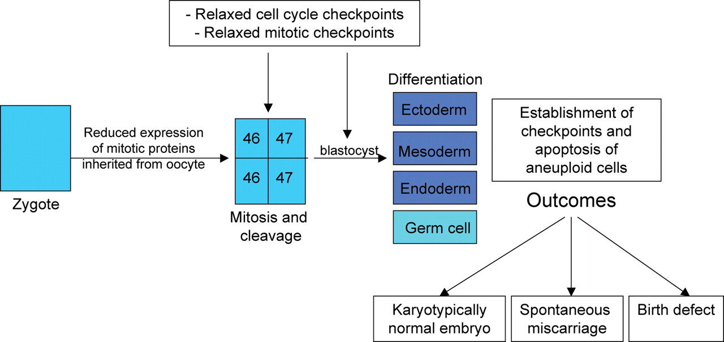
Figure 2. Model for maintaining genomic integrity of human pre-implantation embryos. This model shows a genetic defect ...
Notes:
Figure 2. Model for maintaining genomic integrity of human pre-implantation embryos. This model shows a genetic defect acquired post-zygotically. It is hypothesized that human embryos inherit elevated levels of mitotic and cell cycle proteins from the oocyte to ensure that these factors are not limited during cleavage. If these factors are limited, and cellular aneuploidy occurs, the cell cycle checkpoint machinery is not activated. As a result aneuploid cells (in this example, trisomic cells) accumulate. Upon lineage differentiation, the cell cycle and mitotic checkpoints are re-established and severely aneuploid cells are eliminated. The outcome of this novel mechanism for removing aneuploid cells would be spontaneous miscarriage or birth defects such as trisomy at 16, trisomy 21 or monosomy X. Furthermore, if aneuploid or genetically compromised cells are completely removed upon differentiation then a karyotypically normal embryo may potentially develop.
Unless provided in the caption above, the following copyright applies to the content of this slide: © The Author 2008. Published by Oxford University Press. All rights reserved. For Permissions, please email: journals.permissions@oxfordjournals.org

