Slide 1
Figure 1. Schematic illustration of a baseline session trial in which the participant performed the Face task ...
Notes:
Figure 1. Schematic illustration of a baseline session trial in which the participant performed the Face task incorrectly. Details and examples of specific cue, feedback, and target stimuli are described in Supplementary Figure 1 and the Supplementary Experimental Procedures. Analysis focused on cue and delay period information, indicated here by shading. ITI, intertrial interval.
Unless provided in the caption above, the following copyright applies to the content of this slide: © The Author 2015. Published by Oxford University Press. All rights reserved. For Permissions, please e-mail: journals.permissions@oup.com

Slide 2
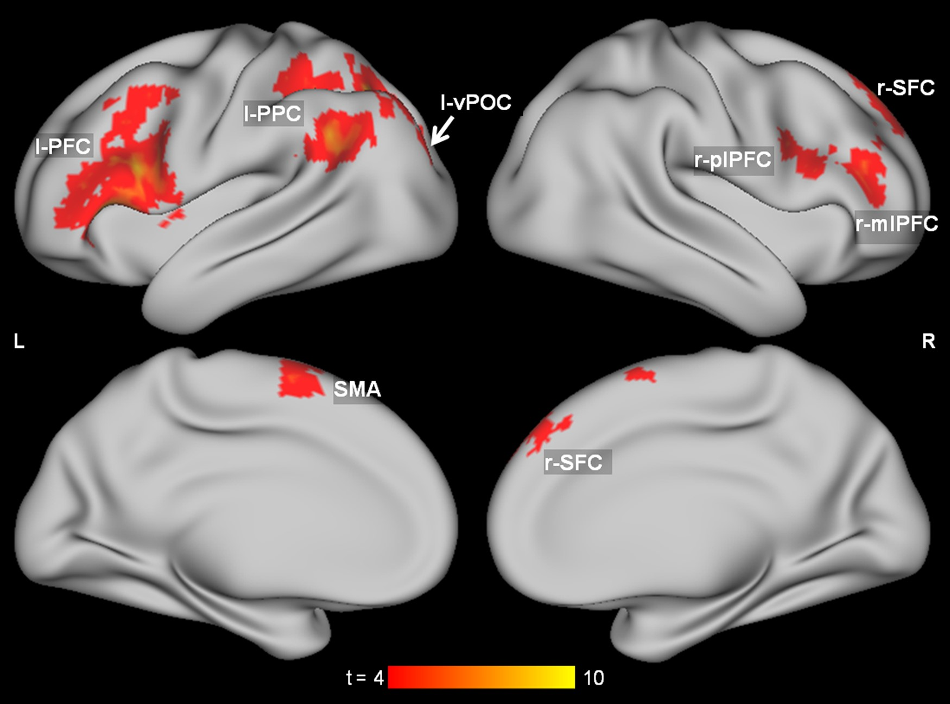
Figure 2. The seven validated ROIs, which together constitute the aggregate ROI. These ROIs significantly classify task ...
Notes:
Figure 2. The seven validated ROIs, which together constitute the aggregate ROI. These ROIs significantly classify task on both the baseline and incentive sessions. Colors give t-values from the group-level searchlight analysis of task in the baseline session. Supplementary Figure 3 shows all candidate ROIs.
Unless provided in the caption above, the following copyright applies to the content of this slide: © The Author 2015. Published by Oxford University Press. All rights reserved. For Permissions, please e-mail: journals.permissions@oup.com

Slide 3
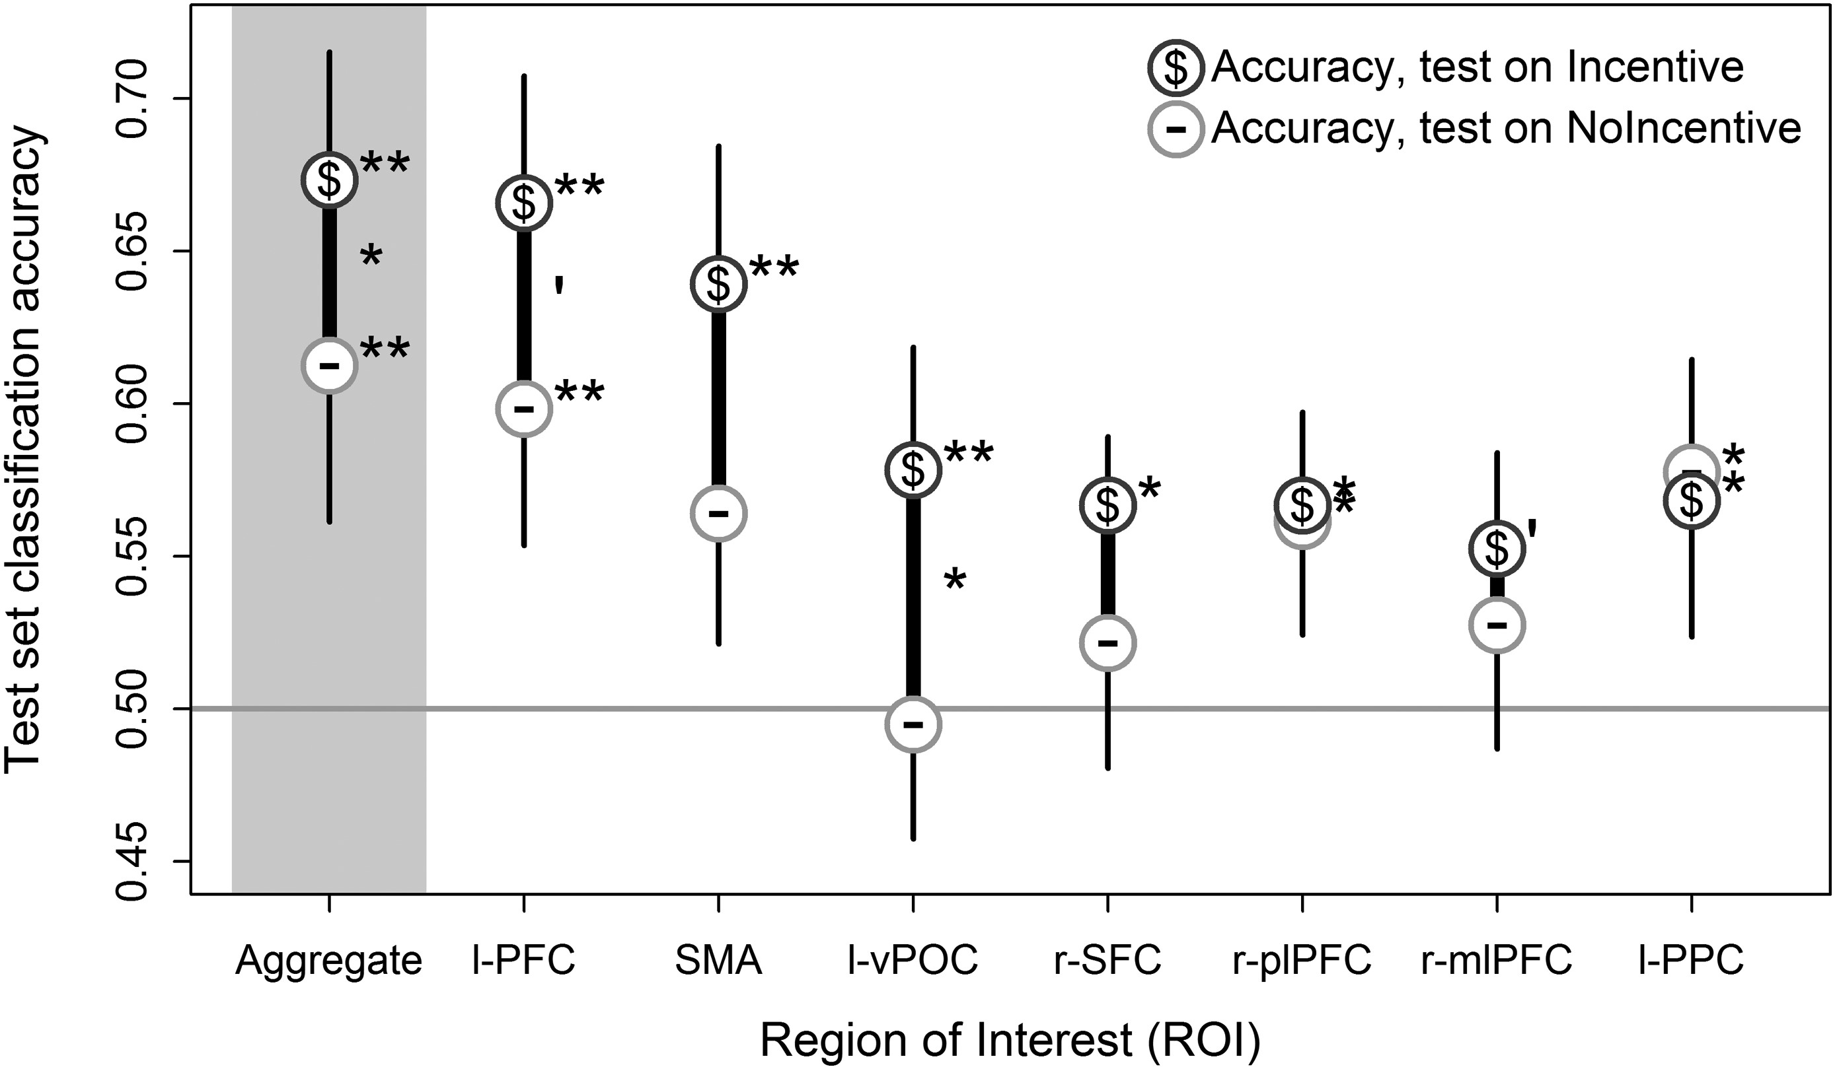
Figure 3. The cross-session task classification results for the validated ROIs and the aggregate ROI, testing on ...
Notes:
Figure 3. The cross-session task classification results for the validated ROIs and the aggregate ROI, testing on Incentive ($) or NoIncentive (-). Narrow lines give the standard error of the mean (SEM) for each accuracy. Significance is given by P-values from the permutation tests, **P < 0.01 *P < 0.05 ‘P < 0.1, as in Table 1. Symbols beside each point indicate if the corresponding accuracy is greater than chance, while symbols between the points indicate if the difference (wide lines) is significant (t-based permutation test).
Unless provided in the caption above, the following copyright applies to the content of this slide: © The Author 2015. Published by Oxford University Press. All rights reserved. For Permissions, please e-mail: journals.permissions@oup.com

Slide 4
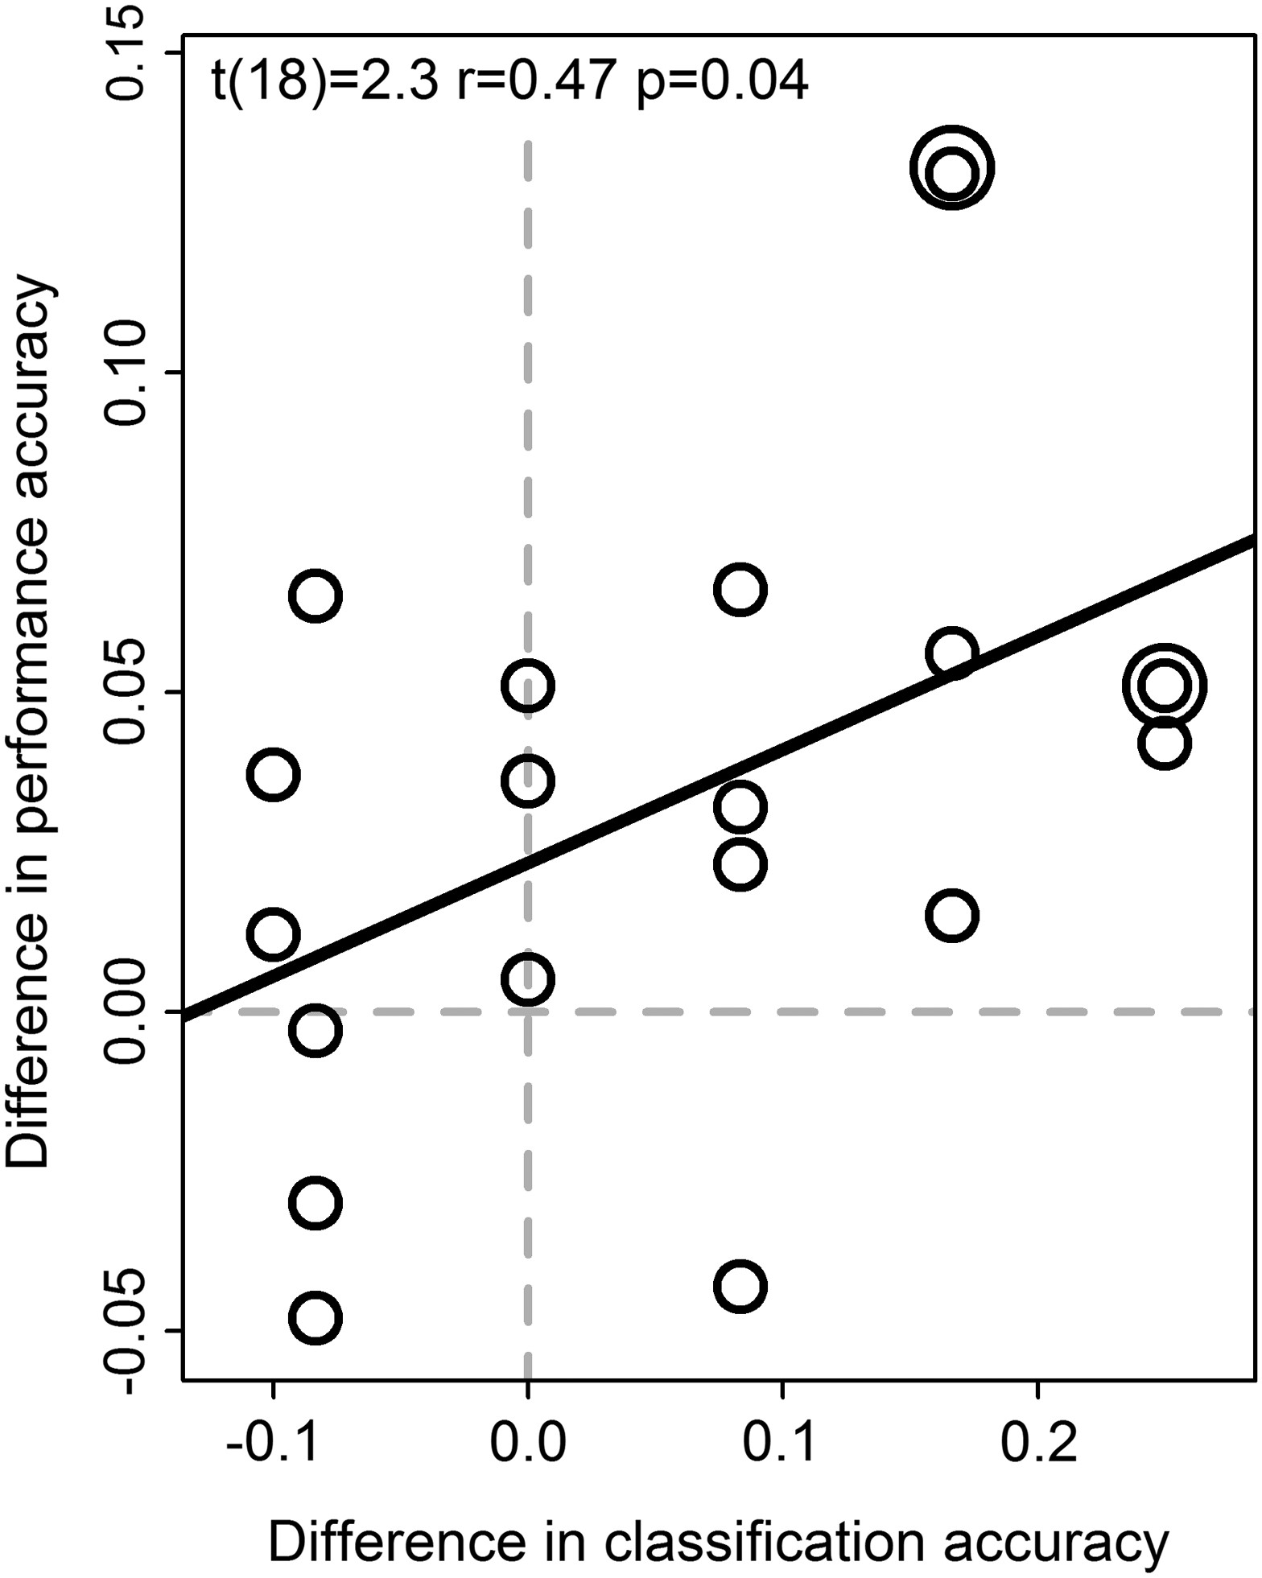
Figure 4. Participants with larger incentive-related increases in MVPA classification accuracy tended to also have a ...
Notes:
Figure 4. Participants with larger incentive-related increases in MVPA classification accuracy tended to also have a larger incentive-related increase in behavioral performance accuracy. Both differences in behavioral performance and classification accuracy were calculated as Incentive – NoIncentive. The scatterplot and regression line indicate the statistical significance of the zero-order correlation on these difference scores. Note that these are illustrated purely for descriptive purposes, and are distinct from the procedures and statistical values used to evaluate the mediation effect. Two pairs of subjects had similar differences, shown here as larger circles to avoid overplotting. See the Mediation Analysis section of the Supplementary Experimental Procedures for further details, and Supplementary Figure 7 for MVPA and behavioral performance correlations plotted separately for Incentive and NoIncentive conditions.
Unless provided in the caption above, the following copyright applies to the content of this slide: © The Author 2015. Published by Oxford University Press. All rights reserved. For Permissions, please e-mail: journals.permissions@oup.com

Slide 5
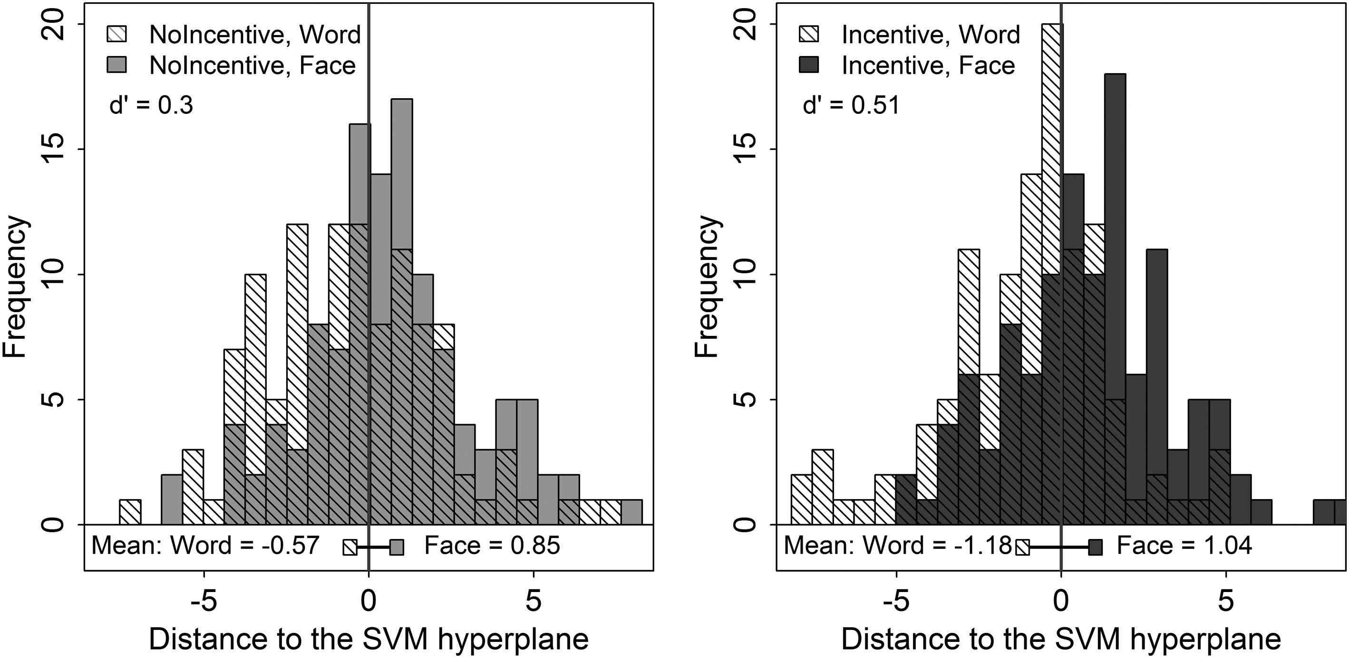
Figure 5. The Word and Face distributions are more distinct with incentive. Each histogram has the distance of each ...
Notes:
Figure 5. The Word and Face distributions are more distinct with incentive. Each histogram has the distance of each example to the SVM hyperplane for the aggregate ROI and all participants.
Unless provided in the caption above, the following copyright applies to the content of this slide: © The Author 2015. Published by Oxford University Press. All rights reserved. For Permissions, please e-mail: journals.permissions@oup.com

Slide 6
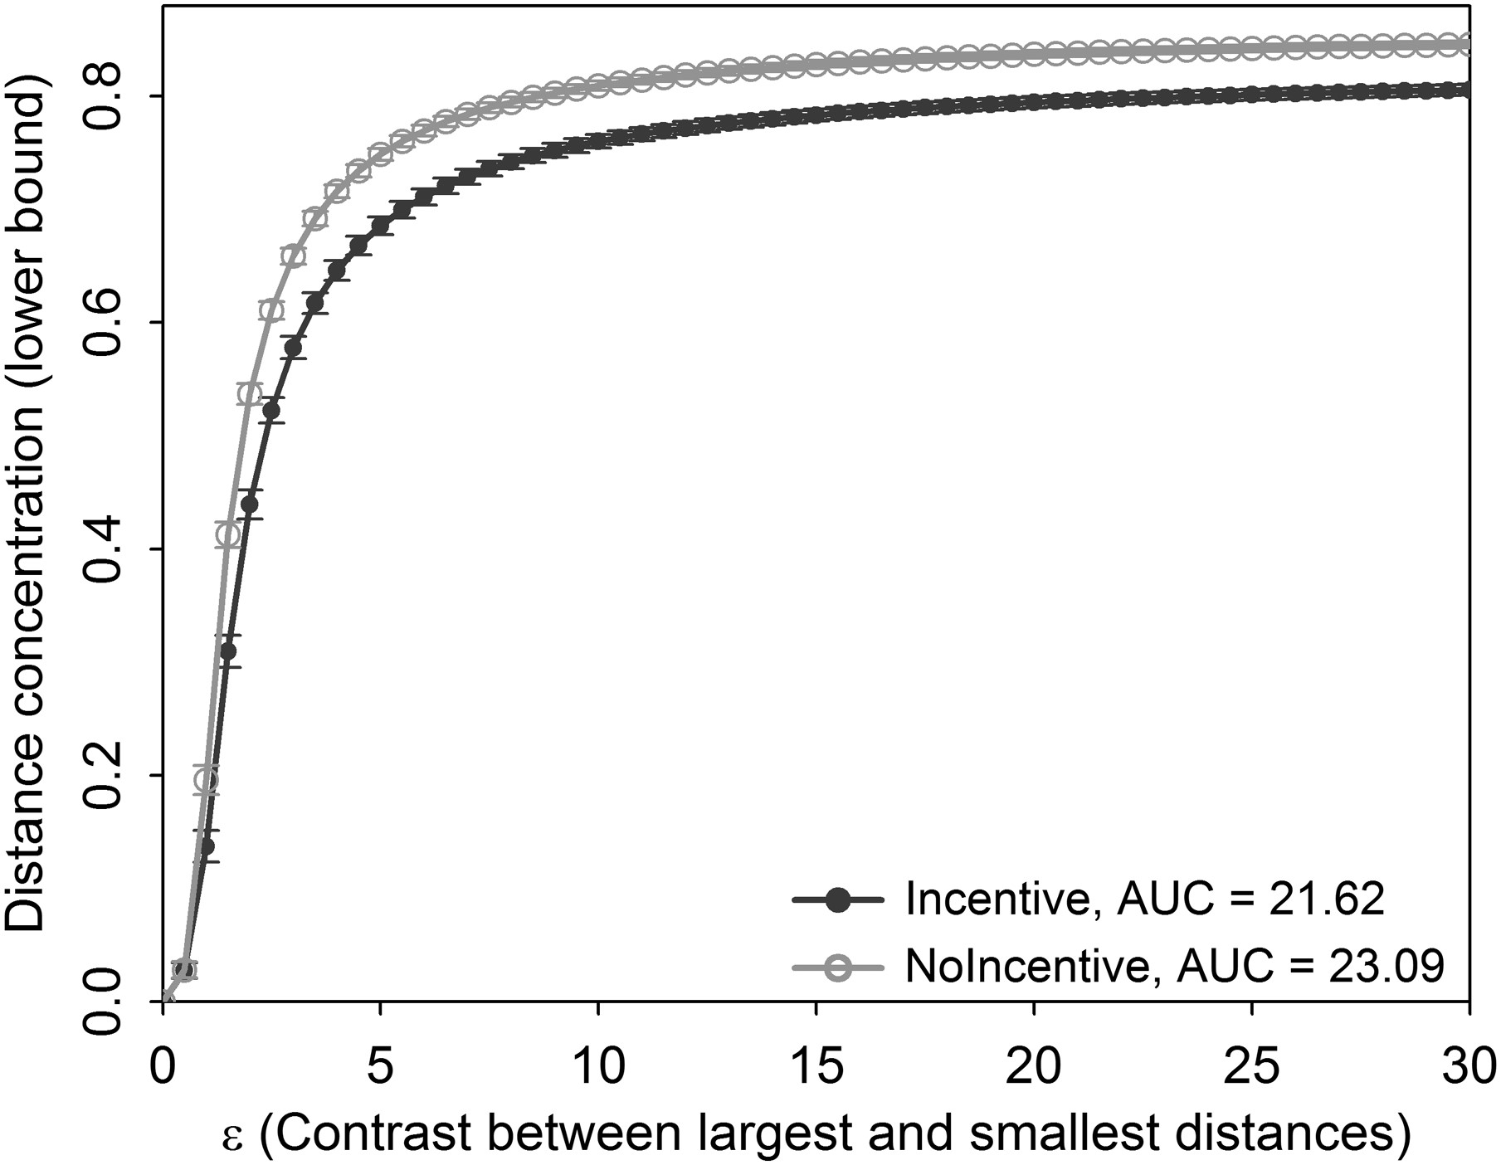
Figure 6. Distance concentration at various epsilons, following Figure 5 (Kabán 2012); larger epsilons correspond to ...
Notes:
Figure 6. Distance concentration at various epsilons, following Figure 5 (Kabán 2012); larger epsilons correspond to more liberal criteria for concluding that distance is concentrated. Calculated with all participants' data combined, and the aggregate ROI.
Unless provided in the caption above, the following copyright applies to the content of this slide: © The Author 2015. Published by Oxford University Press. All rights reserved. For Permissions, please e-mail: journals.permissions@oup.com

