Slide 1
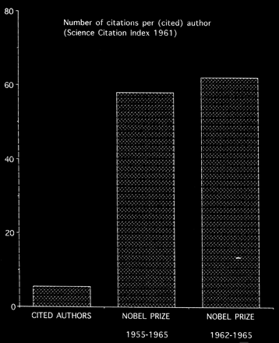
Fig. GR1 Number of citations obtained in 1961 (data from the SCI 1961). Left bar: all cited authors (this is not the ...
Notes:
Fig. GR1 Number of citations obtained in 1961 (data from the SCI 1961). Left bar: all cited authors (this is not the same as all authors; see text for explanation). Middle bar: number of citations obtained by Nobel Prize winners in physics between 1955 and 1965. Right bar: number of citations obtained by Nobel Prize winners in physics between 1962 and 1965 (i.e., after scoring of the citations in 1961). Data taken from [1].
Unless provided in the caption above, the following copyright applies to the content of this slide: Copyright © 1997, European Society of Cardiology

Slide 2
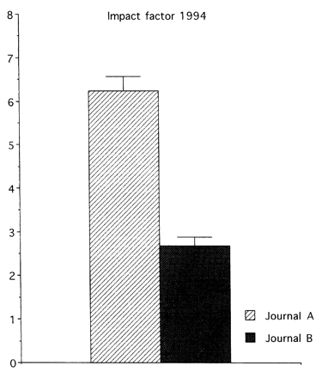
Fig. GR2 Impact factors in 1994 for Journals A and B, both from the cardiovascular category of the SCI. Data are given ...
Notes:
Fig. GR2 Impact factors in 1994 for Journals A and B, both from the cardiovascular category of the SCI. Data are given as mean ± one s.e.m. S.e.m. values could be calculated by comparing the individual author citations for Journals A and B. The impact factors were 6.24 for Journal A and 2.69 for Journal B. The official impact factors were 6.97 and 2.89, respectively (including the ‘errors’ caused by misspellings of the names of the first authors). The distribution of citations over papers was not normal (see also Fig. GR3). For the sake of simplicity the data are given as means ± one s.e.m. Statistical analysis was, however, performed with a non-parametric test (Wilcoxon: Q = 129622; u = 12.65; P < 0.0005).
Unless provided in the caption above, the following copyright applies to the content of this slide: Copyright © 1997, European Society of Cardiology

Slide 3
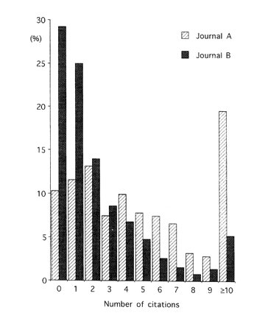
Fig. GR3 Citation of papers from Journals A and B in 1994. Abscissa: Number of citations 0 to 9 and a bin with all ...
Notes:
Fig. GR3 Citation of papers from Journals A and B in 1994. Abscissa: Number of citations 0 to 9 and a bin with all numbers of citations ≥ 10. Ordinate: number of papers in bins divided by total number of papers (560 for Journal A; 484 for Journal B). Impact factors: Journal A, 6.97; Journal B, 2.89. Despite the significant difference between the impact factors of Journal A and B (see legend, Fig. GR2), 35% of the papers in Journal A were less frequently cited than indicated by impact factor of Journal B.
Unless provided in the caption above, the following copyright applies to the content of this slide: Copyright © 1997, European Society of Cardiology

Slide 4
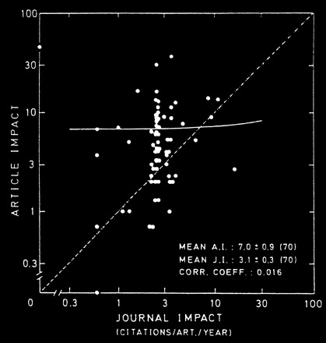
Fig. GR4 Comparison of the impact of the journals in which one author published over 17 years and the impact of the ...
Notes:
Fig. GR4 Comparison of the impact of the journals in which one author published over 17 years and the impact of the individual papers. On average the impact factor of the journal was 3.1, but the averaged article impact was 7.0. Also, there was no relation between the journal impact and the article impact (see the correlation coefficient). Reproduced with permission from the author and Elsevier Science Publishers from [4].
Unless provided in the caption above, the following copyright applies to the content of this slide: Copyright © 1997, European Society of Cardiology

Slide 5
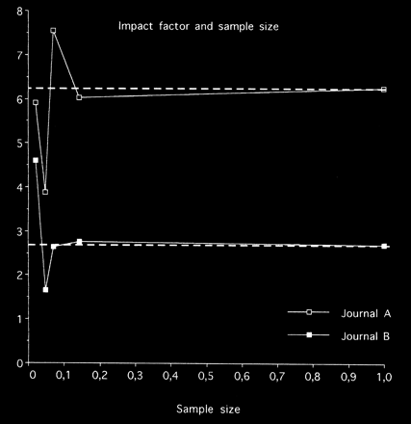
Fig. GR5 The relation between sample size and impact factor of Journals A and B (see also Table 1, Fig. GR2 and Fig. ...
Notes:
Fig. GR5 The relation between sample size and impact factor of Journals A and B (see also Table 1, Fig. GR2 and Fig. GR3). The impact factors of Journals A and B were 6.24 and 2.69 based on scoring of the citation to first authors (see Table 1). A list of contents was made for both journals according to the example in Table 1. By throwing dice (twice, 4 times and 6 times) particular papers were selected from the contents lists of both journals and the number of citations was scored. The same was done for each 50th paper. This procedure yielded the 4 left data points for both journals. One may appreciate that when the random sample is smaller than 15% (about 75 papers) serious discrepancies occur between the impact factor of the sample and the impact factor of the journal. Thus, even with random samples, as many as 100 papers are needed before impact factors assigned as quality label to individual papers can be exchanged without serious mistakes against the results of citation analysis.
Unless provided in the caption above, the following copyright applies to the content of this slide: Copyright © 1997, European Society of Cardiology

Slide 6
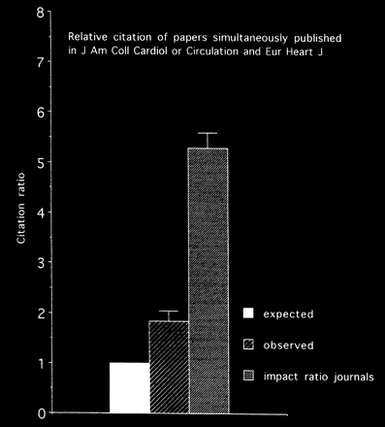
Fig. GR6 Comparison of the citation ratio of [5–7] over 1991–1995. The middle bar shows the number of citations in the ...
Notes:
Fig. GR6 Comparison of the citation ratio of [5–7] over 1991–1995. The middle bar shows the number of citations in the Journal of the American College of Cardiology and/or Circulation divided by the number of citations of the same papers in the European Heart Journal (middle bar). The left bar is the expected ratio of 1.0, if quality would be the sole determinant of citation. The right bar indicates the ratio of the impact factors of the journals at the time of publication.
Unless provided in the caption above, the following copyright applies to the content of this slide: Copyright © 1997, European Society of Cardiology

Slide 7
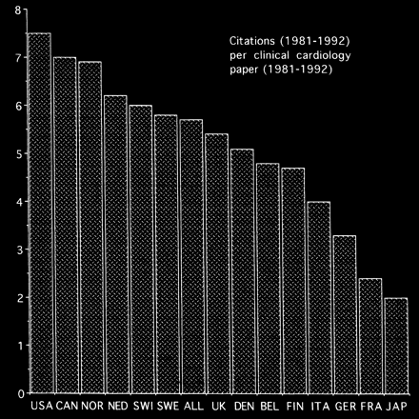
Fig. GR7 Citation of 137019 clinical cardiological papers published between 1981 and 1992. Data are taken from [2]. ...
Notes:
Fig. GR7 Citation of 137019 clinical cardiological papers published between 1981 and 1992. Data are taken from [2]. The citations were scored over the same years (1981 to 1992) and the actual numbers can therefore not be compared with impact factors. A geographical comparison can be made. The average for all countries was just below 6. The USA scored 7.5 citations per paper, Japan 2.0 citations per paper. All countries had large percentages of papers that were not cited at all, ranging from Norway 31% to Japan 69% with 46% for all countries together. USA = United States of America; CAN = Canada; NOR = Norway; NED = Netherlands; SWI = Switzerland; SWE = Sweden; UK = United Kingdom; DEN = Denmark; BEL = Belgium; FIN = Finland; ITA = Italy; GER = Germany; FRA = France; JAP = Japan.
Unless provided in the caption above, the following copyright applies to the content of this slide: Copyright © 1997, European Society of Cardiology

