Slide 1
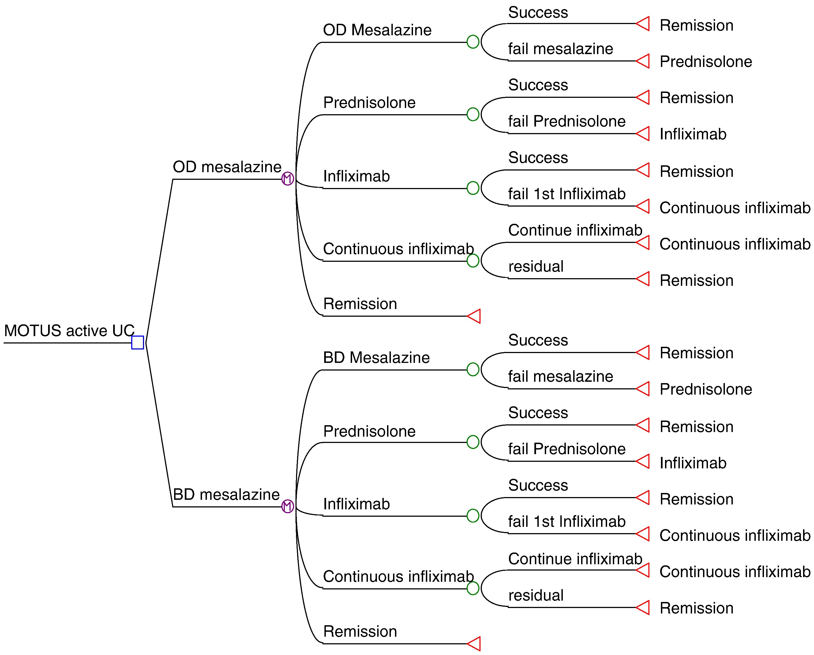
Figure 1 Decision analytic model describing treatments for OD and BD mesalazine.
Notes:
Figure 1 Decision analytic model describing treatments for OD and BD mesalazine.
Unless provided in the caption above, the following copyright applies to the content of this slide: © 2013 European Crohn's and Colitis Organisation

Slide 2
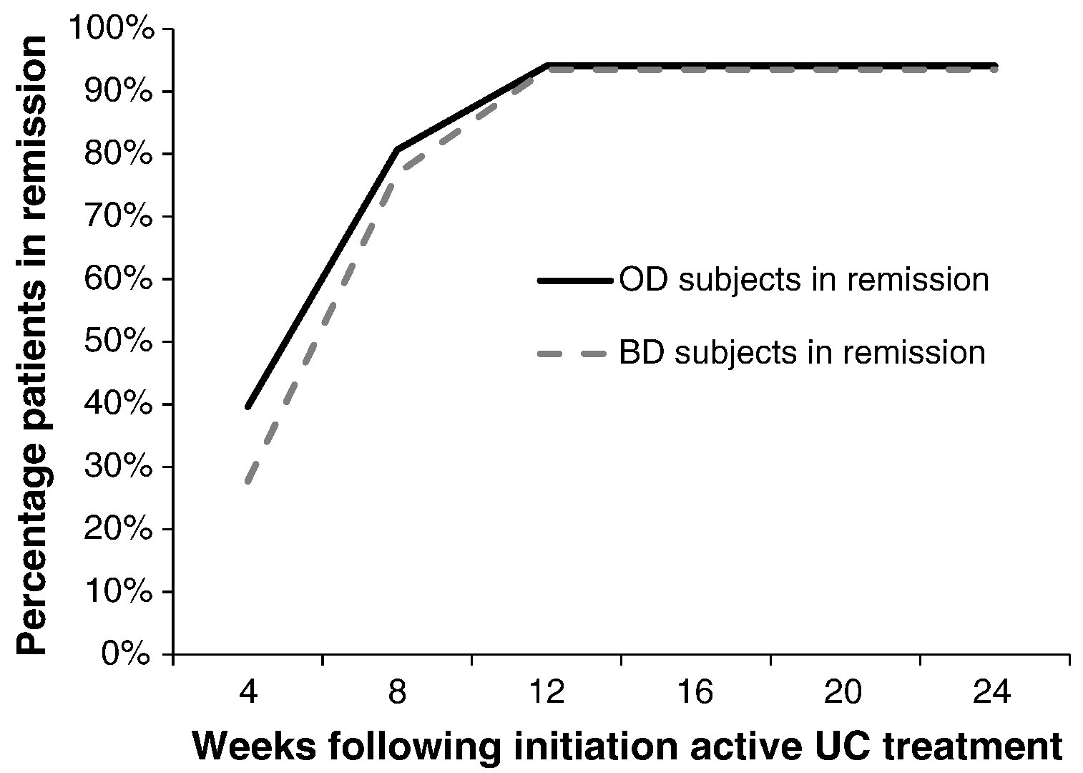
Figure 2 Percentage of patients in remission at different time during treatment (modeled results).
Notes:
Figure 2 Percentage of patients in remission at different time during treatment (modeled results).
Unless provided in the caption above, the following copyright applies to the content of this slide: © 2013 European Crohn's and Colitis Organisation

