Slide 1
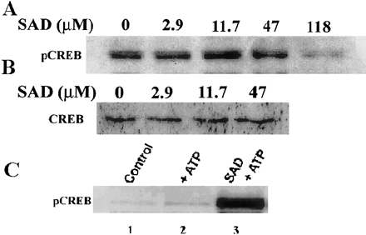
FIG. 1. SAD induces phosphorylation of CREB. Western analysis of phosphoCREB (panel A) and CREB (panel B) in nuclear ...
Notes:
FIG. 1. SAD induces phosphorylation of CREB. Western analysis of phosphoCREB (panel A) and CREB (panel B) in nuclear extracts of palatal mesenchymal cell cultures exposed to 0, 2.9, 11.7, 47, and 188 mM SAD for 48 h. Optimal level of phosphorylated CREB was seen in cells incubated with 11.7 mM SAD. Panel C shows SAD-induced phosphorylation of CREB in vitro. Western analysis of phosphoCREB in GD 12 palatal nuclear extract (15 mg protein) incubated at 37°C for 30 min without (lane 1) and with (lane 2) ATP in the presence of 4.7 mM SAD (lane 3). Peak phosphorylation of CREB was seen in the presence of SAD.
Unless provided in the caption above, the following copyright applies to the content of this slide: © 2002 Society of Toxicology

Slide 2
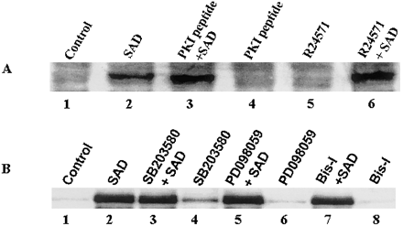
FIG. 2. SAD-induced phosphorylation is not mediated by known CREB kinases. Panels A and B show in vitro ...
Notes:
FIG. 2. SAD-induced phosphorylation is not mediated by known CREB kinases. Panels A and B show in vitro phosphorylation status of CREB in the presence of various inhibitors with and without SAD. Western analysis of phosphoCREB in palatal nuclear extract (15 mg protein) incubated at 37°C for 30 min in the presence of ATP without (lane 1) and with 4.7 mM SAD (lane 2) and with PKI inhibitor peptide (lanes 3, 4) and similarly with calmodulin antagonist R24571 (lane 5) and SAD (lane 6). SAD-induced phosphorylation of CREB is not mediated by PKA or CaMK (panel A). Panel B shows a similar Western analysis of phosphoCREB in palatal nuclear extract (15 mg protein) incubated at 37°C for 30 min in the presence of ATP without (lane 1) and with 4.7 mM SAD (lane 2); with p38MAPK inhibitor SB203580 with (lane 3) and without (lane 4) SAD; with MAP kinase/ERK kinase (MEK) inhibitor PD98059 with SAD (lane 5) and without SAD (lane 6); and with protein kinase C inhibitor bisindolylmaleimide I with (lane 7) and without SAD (lane 8). SAD-induced phosphorylation of CREB is not mediated by p38MAPK, MEK, or PKC.
Unless provided in the caption above, the following copyright applies to the content of this slide: © 2002 Society of Toxicology

Slide 3
FIG. 3. SAD-induced phosphorylation of CREB is not mediated by phosphatase inhibition. Western analysis of ...
Notes:
FIG. 3. SAD-induced phosphorylation of CREB is not mediated by phosphatase inhibition. Western analysis of phosphoCREB in palatal nuclear extract (15 mg protein) incubated at 37°C for 30 min in the presence of ATP and 1, 2, and 4 mM of protein phosphatase 2A inhibitor okadaic acid (OK) without (lanes 1–3) and with 4.7 mM SAD (lanes 4, 5, 6, and 7). Phosphorylation of CREB was induced following addition of SAD and independent of okadaic acid.
Unless provided in the caption above, the following copyright applies to the content of this slide: © 2002 Society of Toxicology

Slide 4
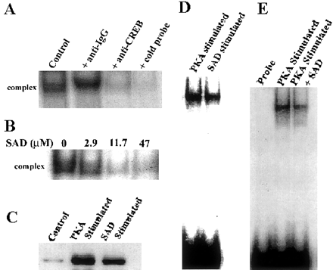
FIG. 4. Presence of SAD reduces TF-CRE complex formation despite increased pCREB. The TF in the complex with CRE ...
Notes:
FIG. 4. Presence of SAD reduces TF-CRE complex formation despite increased pCREB. The TF in the complex with CRE following mobility shift assay of GD12 palatal nuclear extract was confirmed to be CREB by using a CREB antibody that ablated the complex. A nonspecific anti-IgG did not affect the complex, whereas excess cold probe ablated the complex (panel A). A dose-dependent decrease in the TF-CRE complex was observed in nuclear extracts from cells treated with increasing concentrations of SAD (0–47 mM, panel B). Panel C shows phosphorylation of CREB (Western analysis), and panel D shows TF-CRE complex formation (EMSA) in nuclear extract (15 mg protein) stimulated with 1 U PKA-Ca (PKA stimulated) or 4.7 mM SAD (SAD stimulated). Phosphorylation and total complex formation were similar in both the samples. Panel E shows a reduction in TF-CRE complex formation when 4.7 mM SAD was added to the reaction mixture containing the same amount of pCREB (PKA stimulated).
Unless provided in the caption above, the following copyright applies to the content of this slide: © 2002 Society of Toxicology

Slide 5
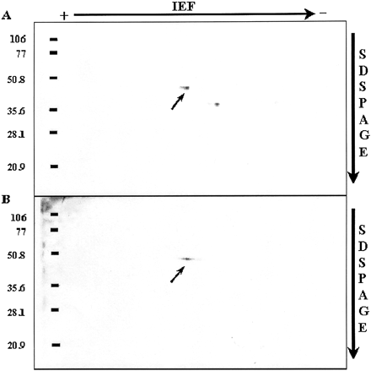
FIG. 5. SAD-induced phosphorylation of CREB does not involve a second site. Western analysis of pCREB following 2D ...
Notes:
FIG. 5. SAD-induced phosphorylation of CREB does not involve a second site. Western analysis of pCREB following 2D electrophoresis of PKA-stimulated (panel A) and SAD-stimulated (panel B) palatal nuclear extracts (100 mg protein). PhosphoCREB (43 kD), indicated by the small arrow in each panel, migrated similarly, appearing as a single spot. The second spot (36 kD) seen in PKA-stimulated sample is pATF-1, which is also recognized by pCREB antibody. The pCREB antibody recognizes only the Ser133-phosphorylated form of CREB and ATF-1. SAD does not phosphorylate ATF-1.
Unless provided in the caption above, the following copyright applies to the content of this slide: © 2002 Society of Toxicology

Slide 6
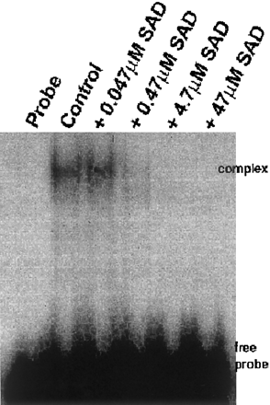
FIG. 6. SAD interferes with TF binding to CRE directly. Mobility shift analysis of PKA-stimulated palatal nuclear ...
Notes:
FIG. 6. SAD interferes with TF binding to CRE directly. Mobility shift analysis of PKA-stimulated palatal nuclear extract with SAD indicated reduced TF-CRE complex formation in the presence of SAD. The reduction in TF-CRE complex was in a SAD dose-dependent manner (0.047–47 mM).
Unless provided in the caption above, the following copyright applies to the content of this slide: © 2002 Society of Toxicology

Slide 7
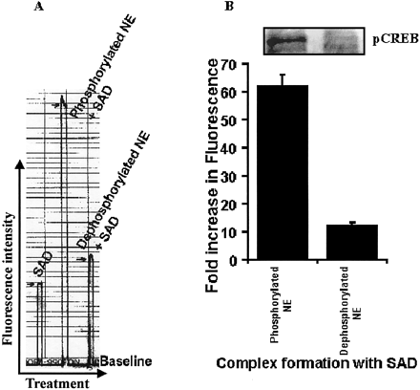
FIG. 7. SAD binds to phosphorylated proteins with a greater affinity. SAD-protein complex, estimated by the fold ...
Notes:
FIG. 7. SAD binds to phosphorylated proteins with a greater affinity. SAD-protein complex, estimated by the fold increase in fluorescence, indicated greater fluorescence of SAD with PKA-Ca–phosphorylated nuclear extract compared with l-phosphatase dephosphorylated nuclear extract (panel A; fluorescence quantitation, panel B). The proportion of phosphorylated CREB in respective samples is shown in the inset.
Unless provided in the caption above, the following copyright applies to the content of this slide: © 2002 Society of Toxicology

Slide 8
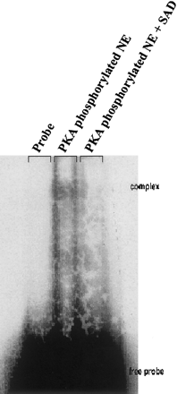
FIG. 8. SAD inhibits TF binding to PCNA-CRE. Mobility shift analysis of PKA stimulated palatal nuclear extract ...
Notes:
FIG. 8. SAD inhibits TF binding to PCNA-CRE. Mobility shift analysis of PKA stimulated palatal nuclear extract without and with 4.7 mM SAD indicated reduced TF binding to mouse PCNA-CRE.
Unless provided in the caption above, the following copyright applies to the content of this slide: © 2002 Society of Toxicology

Slide 9
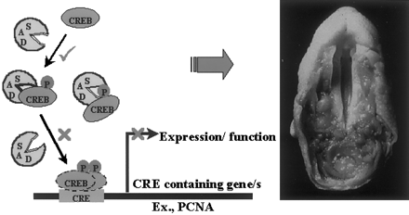
FIG. 9. SAD-induced and CREB-mediated decrease in PCNA expression is relevant to small-size palatal shelves, the ...
Notes:
FIG. 9. SAD-induced and CREB-mediated decrease in PCNA expression is relevant to small-size palatal shelves, the classical SAD phenotype. Although SAD induces phosphorylation of CREB at the same site as that induced by PKA, binding of pCREB to CRE is inhibited by SAD, which preferentially binds the phosphorylated form of CREB. As a result of such an interference, expression of CRE-containing genes such as PCNA, which plays a role in cell proliferation, is possibly affected. Reduced proliferation of palatal mesenchymal cells lead to smaller palatal shelves that fail to elevate and therefore fail to meet each other and fuse, resulting in a persistent cleft, a classical teratological effect of SAD. Positive and negative influences of SAD are represented by ✓ and ×, respectively.
Unless provided in the caption above, the following copyright applies to the content of this slide: © 2002 Society of Toxicology

