Slide 1
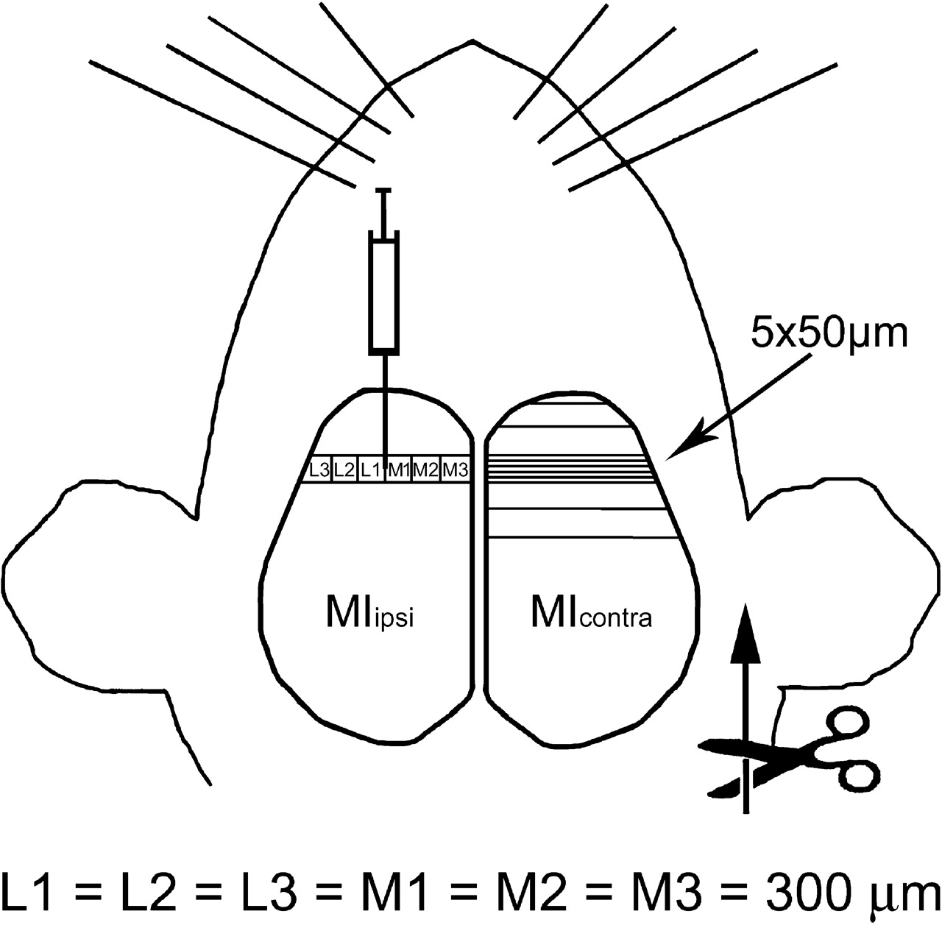
Figure 1. A schematic drawing to explain the experimental paradigm. PRV was injected into the whisker representation ...
Notes:
Figure 1. A schematic drawing to explain the experimental paradigm. PRV was injected into the whisker representation area in the left motor cortex (MIipsi). PRV-immunoreactive (PRV-IR) neurons were counted in five consecutive 50 μm wide coronal sections of both hemispheres (as shown in the right hemisphere: MIcontra). To facilitate the analysis, the photomicrographs of the five coronal sections (forming the 250 μm wide bands of the cortices) were divided in the mediolateral direction into six 300 μm wide areas (on the coronal surface): L1 = L2 = L3 = M1 = M2 = M3 = 300 μm. The numbers of PRV-IR cells obtained in five sham-operated and five n7x animals were quantified according to this cortical division. In one animal each in both the sham-operated and the n7X group, serial sections (50 μm wide) of the rostral part of both hemispheres were made (also as shown in the right hemisphere: MIcontra). The PRV-IR neurons were counted in every sixth section in these two animals. The three-dimensional distributions of the PRV-IR neurons in Figure 5 were constructed on the basis of these studies. Scissors plus arrow denotes the right side facial nerve cut. The divisions (L3–M3 in the left hemisphere, the labeling of the 50 μm wide cortical slides and the mark of every sixth section in the rostral half of the right hemisphere) serve only for demonstration and, of course, are not proportionate in this schematic drawing.
Unless provided in the caption above, the following copyright applies to the content of this slide: Cerebral Cortex V 15 N 4 © Oxford University Press 2004; all rights reserved

Slide 2
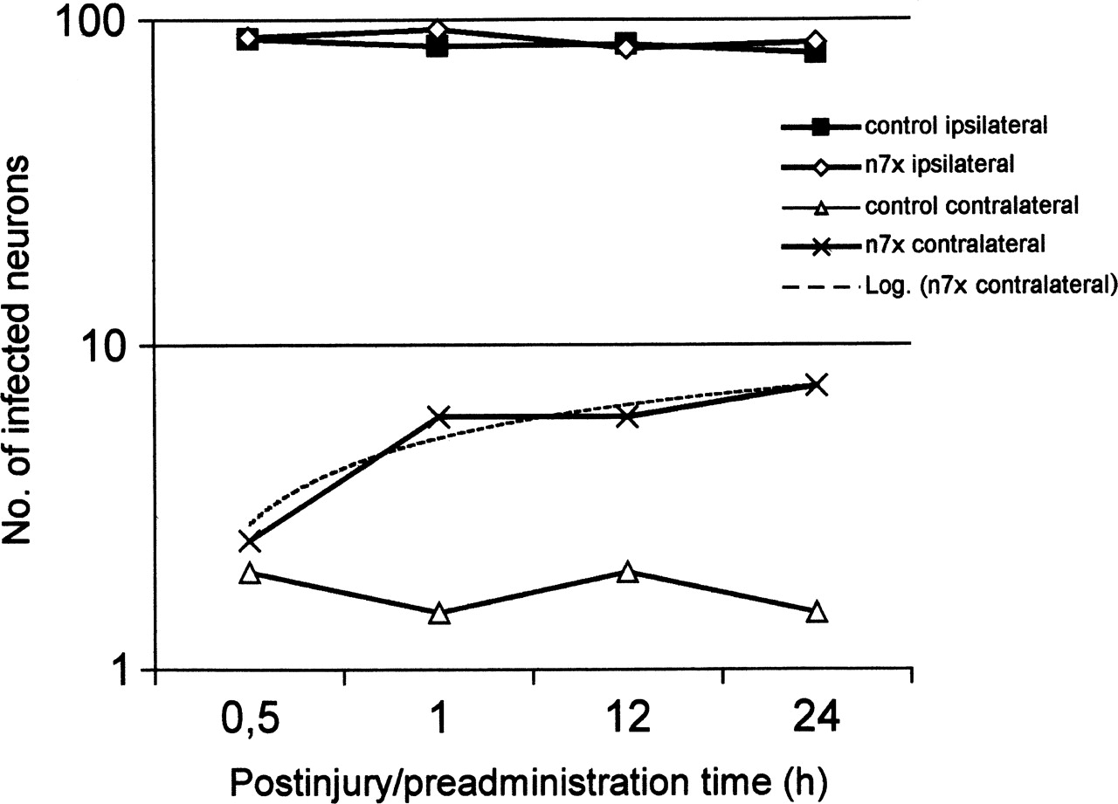
Figure 2. The number of infected neurons increased logarithmically with the postinjury/preadministration time only in ...
Notes:
Figure 2. The number of infected neurons increased logarithmically with the postinjury/preadministration time only in the right hemisphere of the n7x animals (n7x contralateral; its log fit is depicted by a broken line). The other three curves are linear and parallel to the x-axis. The postinjury/preadministration time on the abscissa means that PRV was injected into the animals 0.5 h (n = 2), 1 h (n = 2), 12 h (n = 2) or 24 h (n = 2) after n7x. The study was also made on eight sham-operated animals. The PRV infection was followed in each case by a 72 h survival time.
Unless provided in the caption above, the following copyright applies to the content of this slide: Cerebral Cortex V 15 N 4 © Oxford University Press 2004; all rights reserved

Slide 3
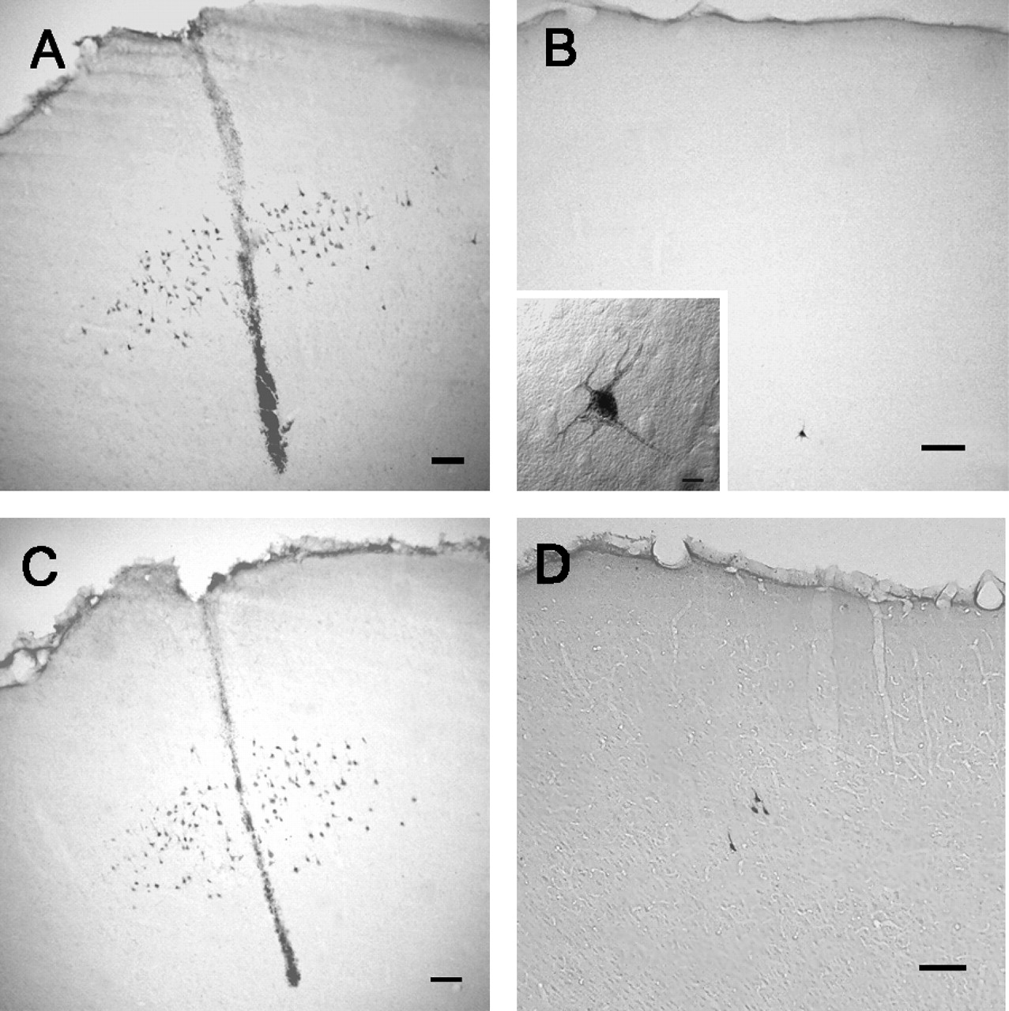
Figure 3. Labeled neurons in the left (A) and right (B) primary motor cortices (MIs) of a control animal, and in the ...
Notes:
Figure 3. Labeled neurons in the left (A) and right (B) primary motor cortices (MIs) of a control animal, and in the left (C) and right (D) primary motor cortices of a rat in which the right facial nerve was transected 1 h before the PRV infection. Several PRV-infected neurons are localized around the injection channels (A, C). We could not usually observe labeling in the contralateral MI of the controls (B), with some exceptions, where a few labeled cells were detected. Inset in B: higher magnification of the one labeled pyramidal neuron found in this control animal. (A and B are corresponding slides.) (D) PRV-IR neurons in the homotopic area of the right hemisphere of an n7x animal, after facial denervation. Calibration: 100 μm in A–D. In the inset in B, the bar is 10 μm.
Unless provided in the caption above, the following copyright applies to the content of this slide: Cerebral Cortex V 15 N 4 © Oxford University Press 2004; all rights reserved

Slide 4
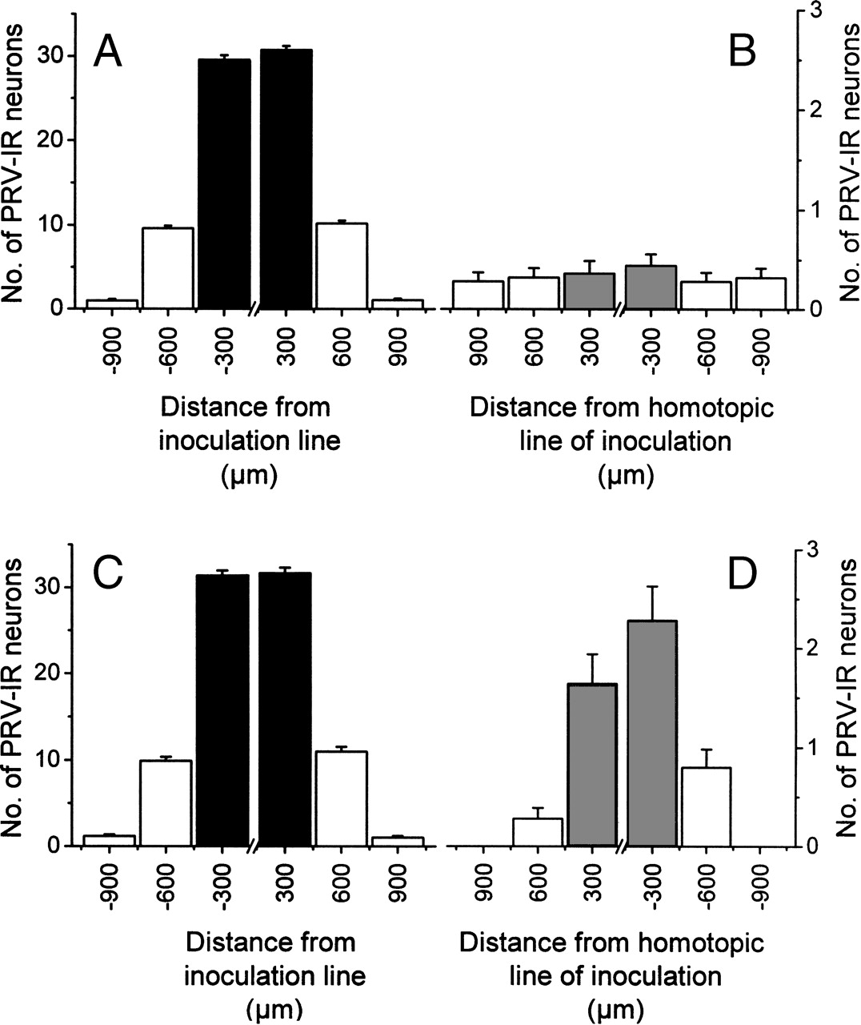
Figure 4. Schematic diagrams of the distribution of labeled cells in two slides of controls (A, B) and in two slides of ...
Notes:
Figure 4. Schematic diagrams of the distribution of labeled cells in two slides of controls (A, B) and in two slides of n7x animals (C, D). The average number of labeled cells per slide is given in these diagrams. The averages of the cell numbers were calculated from the corresponding data on five controls and five n7x animals, i.e. from 5 × 5 slides. The motor cortices are divided into 300 μm wide areas (see also Fig. 1). The black areas denote the 300 μm wide cortical areas in the close medial and lateral environment of the injection channel in the left hemispheres (A, C). The gray areas are homotopic to them in the right hemispheres (B, D). Values are means and SDs for PRV-IR neurons (n = 25) (see also Fig. 1).
Unless provided in the caption above, the following copyright applies to the content of this slide: Cerebral Cortex V 15 N 4 © Oxford University Press 2004; all rights reserved

Slide 5
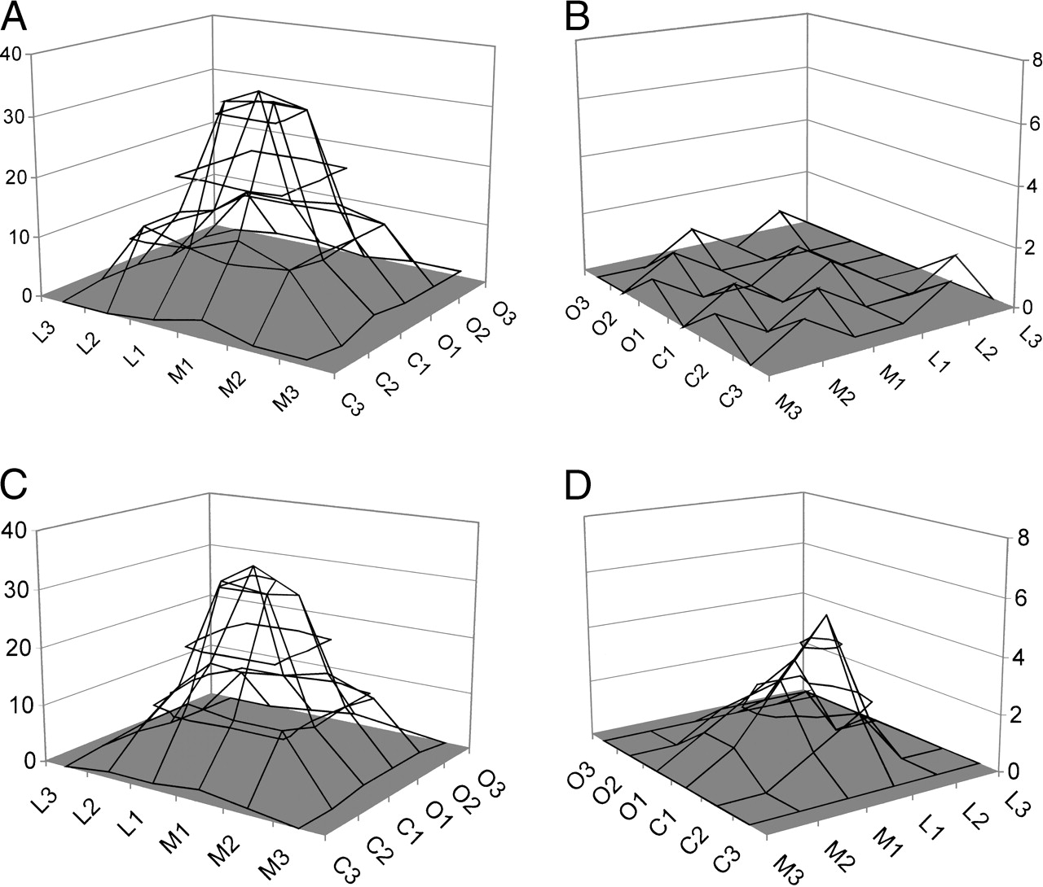
Figure 5. Surface diagrams for a sham-operated (A, B) and n7x animal (C, D). The diagrams exhibit a cone-like shape, ...
Notes:
Figure 5. Surface diagrams for a sham-operated (A, B) and n7x animal (C, D). The diagrams exhibit a cone-like shape, which demonstrates the distribution of PRV-IR neurons on the inoculation side (A, C). In contrast, the diagram of the contralateral cortex is virtually planar (B), while in the right hemisphere of the n7x animal there is an impressive peak in the surface diagram at the homotopic point of the injection channel (D). It should be mentioned that the distance of sampling was in 300 μm in the mediolateral direction, but 50 μm in the rostrocaudal direction in these animals.
Unless provided in the caption above, the following copyright applies to the content of this slide: Cerebral Cortex V 15 N 4 © Oxford University Press 2004; all rights reserved

